Slide 1

Learnathon 4.0 PROJECT PRESENTATION ON HOSPITAL READMISSION RISK PREDICTION
SCHOOL OF ENGINEERING AND TECHNOLOGY
DEPARTMENT OF COMPUTER SCIENCE AND ENGINEERING
Presented By:
Bijayalaxmi Samal (23UG010950)
Abhishek Kumar(23UG010546)
Megha Balabantaray(23UG010847)
Annandita Padhi(23UG010928)
Team_Id:19
Under the Guidance of
Dept. Of CSE,
GIET University , Gunupur

Slide 2
OUTLINES
S.NO. | CONTENTS | PAGE NO.
1 | PROBLEM STATEMENT | 1
2 | INTRODUCTION | 2
3 | TECHNOLOGIES USED | 3
4 | NECESSARY DIAGRAMS | 4
5 | FEATURES | 5
6 | CHALLENGES | 6
7 | LIMITATIONS | 7
8 | SCREENSHOTS | 8-9
9 | CONCLUSION | 10
11 | REFERENCES | 11

Slide 3
Problem Statement
Predict Hospital Readmission Risk for Patients with Chronic Conditions
Background: Hospital readmissions, especially among patients with chronic illnesses (like diabetes, heart disease, or hypertension), are a major challenge for the healthcare system. Early identification of patients at high risk of readmission allows providers to intervene and improve outcomes.

Slide 4
Introduction
Hospital readmissions pose a significant challenge to healthcare systems, often resulting in increased costs, overcrowded facilities, and compromised patient outcomes. Our project tackles this issue using a machine learning–based web solution that predicts the likelihood of a patient being readmitted after discharge. By analyzing key patient information—such as age, medical condition, insurance provider, medication, billing amount, and length of stay—our model provides real-time risk predictions. The system is designed with a user-friendly dashboard that includes prediction results, dynamic risk distribution charts, and visual feature importance analysis to aid clinical decision-making. Hospitals can use these insights to take preventive actions, optimize patient care, and reduce avoidable readmissions. This solution not only streamlines hospital workflows but also supports data-driven health management. Our goal is to empower healthcare providers with predictive intelligence that improves both patient outcomes and operational efficiency.

Slide 5
Technologies Used
Technology | Purpose
Python | Core programming language for model building and backend development
Pandas & NumPy | Data preprocessing, manipulation, and analysis
Scikit-learn | Machine Learning model training and evaluation
Joblib | Saving and loading trained ML model pipeline
Flask | Web framework to serve the ML model and build backend APIs
HTML/CSS | Structure and styling of the web interface
Bootstrap | Responsive and styled frontend design
JavaScript | Used for rendering charts and enhancing interactivity
Chart.js | Visualization of prediction statistics (doughnut chart, bar chart, etc.)
Jinja2 | Templating engine used with Flask to pass data to HTML templates

Slide 6
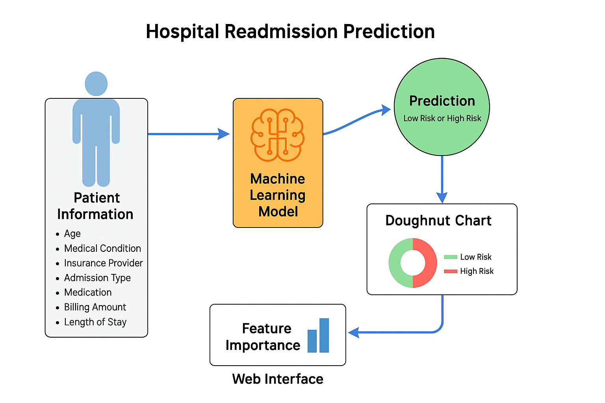
Diagram

Slide 7
Features
Predicts patient readmission risk using machine learning..
Provides real-time prediction based on user-input patient data.
Displays prediction results clearly as "High Risk" or "Low Risk".
Shows feature importance to explain the prediction logic.
Built with a clean, responsive web interface using Flask and Bootstrap.
Supports future expansion with modular and scalable design.
Offers a decision-support tool to assist healthcare professionals.
Aims to reduce hospital readmissions and improve patient care efficiency.

Slide 8
Challenges
Data Quality Issues: The dataset contained missing, inconsistent, or imbalanced values that required thorough preprocessing.
Model Accuracy: Achieving a reliable and accurate prediction model suitable for real-world healthcare use was a key challenge.
Feature Selection: Determining which features most significantly impacted readmission required extensive testing and analysis.
Model Evaluation: Choosing the right evaluation metrics and validating the model's performance took several iterations.
Frontend & Backend Integration: Ensuring seamless interaction between the machine learning model and the web interface was complex.
Dynamic Chart Rendering: Implementing real-time updates for prediction statistics and feature importance charts required advanced scripting.
Data Persistence: Saving prediction data without overwriting or data loss was difficult, especially during concurrent usage.

Slide 9
LIMITATIONS
Limited Dataset Size: The model performance is constrained by the size and diversity of the dataset used. A larger, more comprehensive dataset would improve generalization.
Synthetic Feature Importance: Feature importances were manually defined due to unavailability of actual model-extracted values, which may reduce interpretability.
Model Generalization: The trained model might not perform equally well across different hospitals or regions due to varying patient demographics and clinical practices.
No Real-Time Data Integration: The system does not yet pull live data from hospital databases or EMRs (Electronic Medical Records).
Single Prediction View: The app provides predictions for one patient at a time without support for batch or historical analysis views.

Slide 10
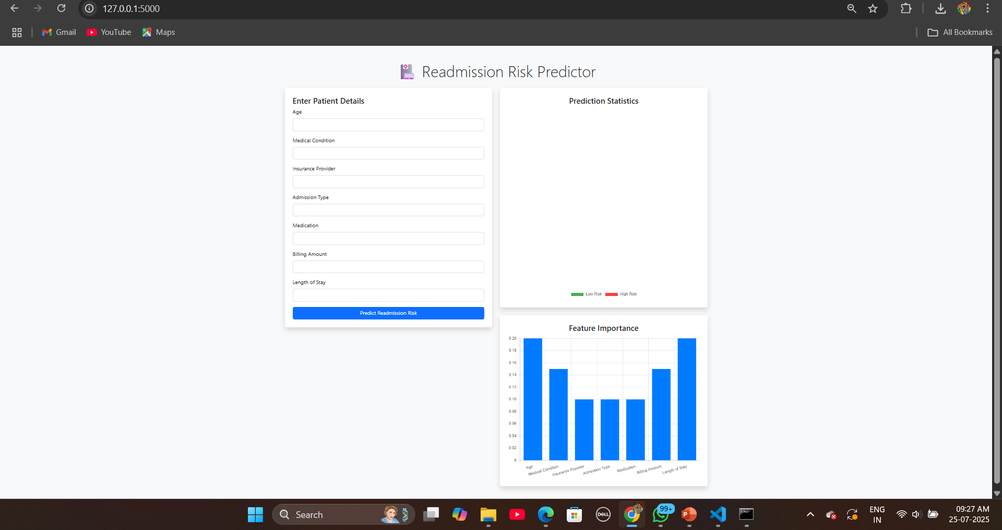
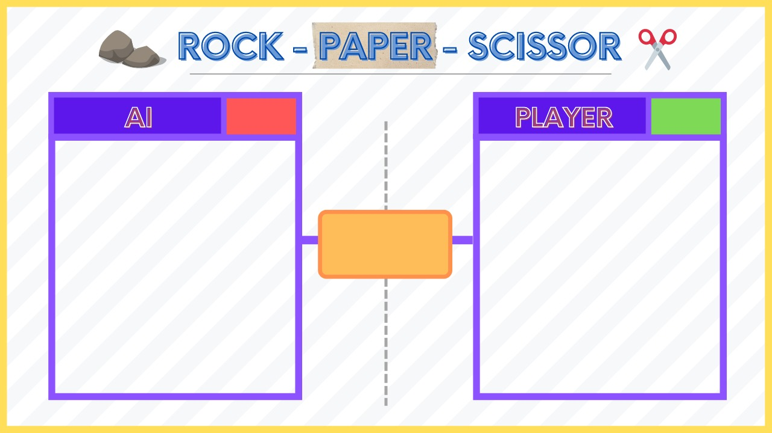
Screenshots
Game UI

Slide 11
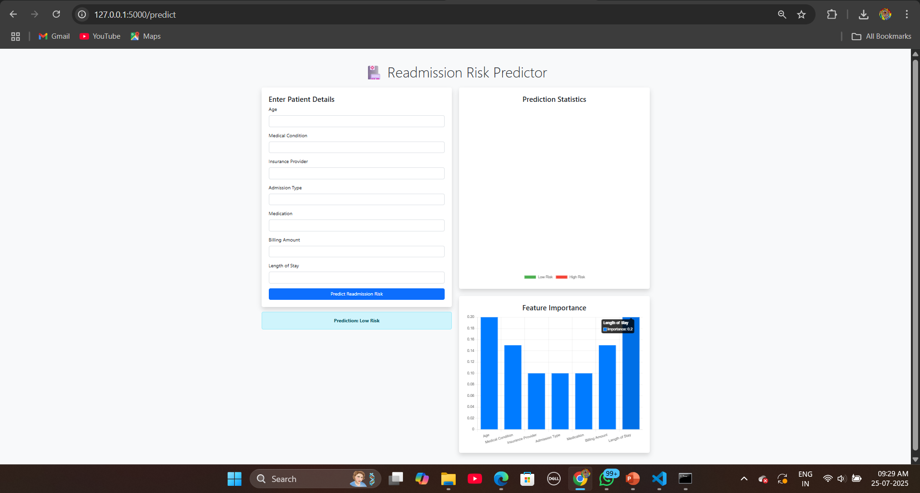
Screenshots

Slide 12
Conclusion
The Hospital Readmission Predictor effectively demonstrates the integration of machine learning with real-world healthcare challenges. By analyzing key patient and admission details, our system predicts the likelihood of a patient being readmitted, enabling hospitals to take proactive measures. This solution not only enhances patient care but also supports better resource management and cost reduction. The project showcases the potential of data-driven decision-making in healthcare, providing a foundation for more advanced and scalable predictive systems in the future.

Slide 13
References
Scikit-learn Documentation https://scikit-learn.org/stable/ (Used for training machine learning models and data preprocessing)
Pandas Documentation https://pandas.pydata.org/docs/ (Used for data manipulation and preparation)
Flask Documentation https://flask.palletsprojects.com/ (Used to build the web application for prediction interface)
Matplotlib & Chart.js https://www.chartjs.org/ (Used for visualizing prediction statistics and feature importance)
Kaggle / UCI Machine Learning Repository (if you used sample data) https://www.kaggle.com/ (For healthcare datasets and model experimentation)
Joblib Documentation https://joblib.readthedocs.io/ (For model serialization and deployment

Slide 14
Thank you all for your attention!

