Slide 1


Tools for Programming, Learning, and Collaboration
Presented by ABHISHEK
ROLL NO. 2501350040
DOMAIN : FULL STACK DEVELOPMENT COURSE
CODE: ETCCP105 , C0URSE NAME :CS
FUNDAMENTAL AND CAREER PATHWAYS
PROGRAMME: B.TECH CSE (FSD)”B”

Slide 2

Tools in Programming
Enhancing Modern Workflows and Collaboration
In today's programming landscape, effective tools are essential for streamlining workflows, improving coding efficiency, and fostering collaboration, significantly impacting productivity and the quality of software development.
2

Slide 3
Enhancing Coding Productivity
01
Code Editors
Code editors provide essential features for development.
02
Debuggers
Debuggers help identify and fix coding errors efficiently.
03
Package Managers
Package managers simplify dependency management in projects.

Slide 4
Development Tools Overview
4

Slide 5

Popular Development Environments
IDEs Revolutionizing Coding Experiences
Integrated Development Environments (IDEs) like VS Code and JetBrains tools streamline the coding process, providing features such as intelligent code completion, debugging support, and customizable interfaces for enhanced productivity.

Slide 6

Supporting Development Tools
  Code editors streamline writing and editing source code
  Debuggers help identify and fix code errors efficiently
  Package managers automate software installation and dependency management

Slide 7
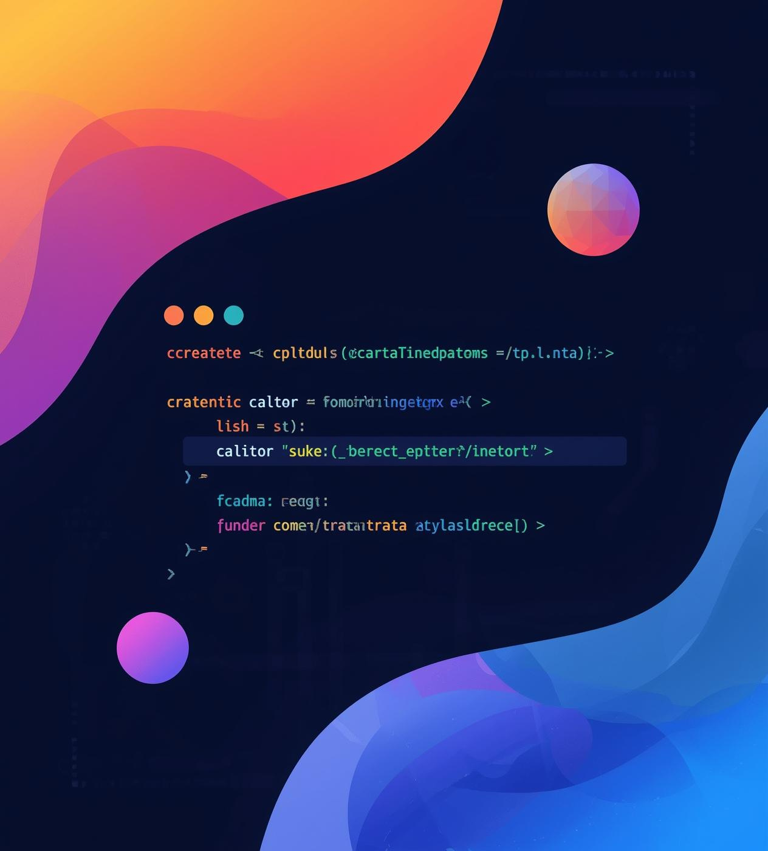
Enhancing Productivity with Development Features
Key features like syntax highlighting, useful extensions, and integrated terminals significantly boost coding efficiency. These tools streamline workflows, making it easier for developers to write, debug, and optimize their code effectively.

Slide 8
Essential GitHub Commands
8

Slide 9

Essential Git Commands
Understanding common Git commands like git clone, git add, git commit, and git push is crucial for effective version control, enabling developers to collaborate seamlessly and track changes in code efficiently.

Slide 10

Essential Git Commands for Version Control
Understanding Branching and Updates
Efficiently manage your project versions.

Slide 11
Documentation and Repository Structure
11

Slide 12


Best Practices for Repository Organization
src
docs
Essential for storing source code files.
Contains documentation and project guidelines.

Slide 13

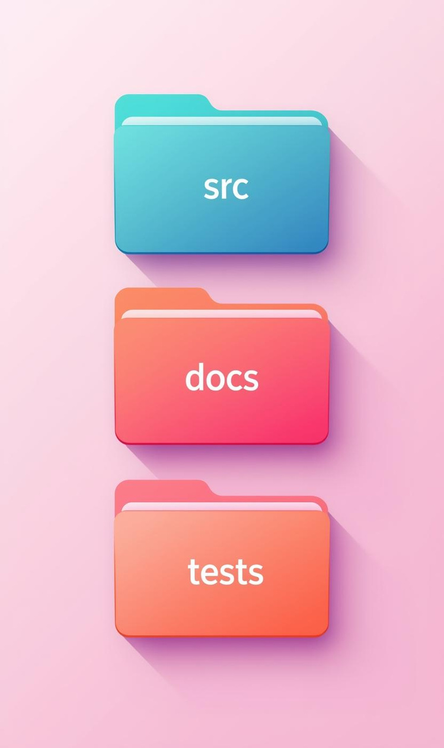
Documentation Formats for Effective Collaboration
Markdown
README
Lightweight markup language for creating formatted text.
Essential project documentation for user guidance.

Slide 14
Conclusion
Recap of tools for programming success
In summary, effective use of development tools, GitHub commands, and well-organized documentation are essential for enhancing productivity and collaboration in programming workflows, leading to successful projects.
14

Slide 15
Reflections on Tool Use
Insights from personal experience and challenges
Navigating programming tools can be daunting, yet overcoming learning curves fosters growth. Collaboration tools significantly enhance teamwork, leading to improved project outcomes and deeper understanding of coding practices.
15

Slide 16


Thank You
BY ABHISHEK AGGARWAL

