Slide 1

Basics of Neural Network Programming
Logistic Regression
deeplearning.ai
Notes:
<number>

Slide 2
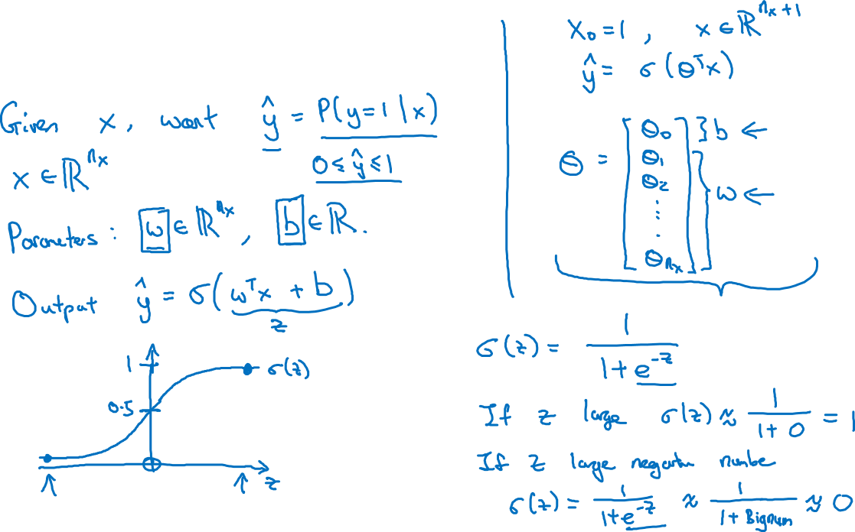
Logistic Regression

Slide 3
Basics of Neural Network Programming
Logistic Regression
cost function
deeplearning.ai
Notes:
<number>

Slide 4
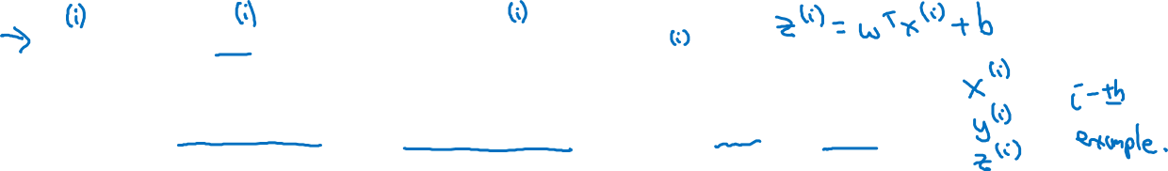
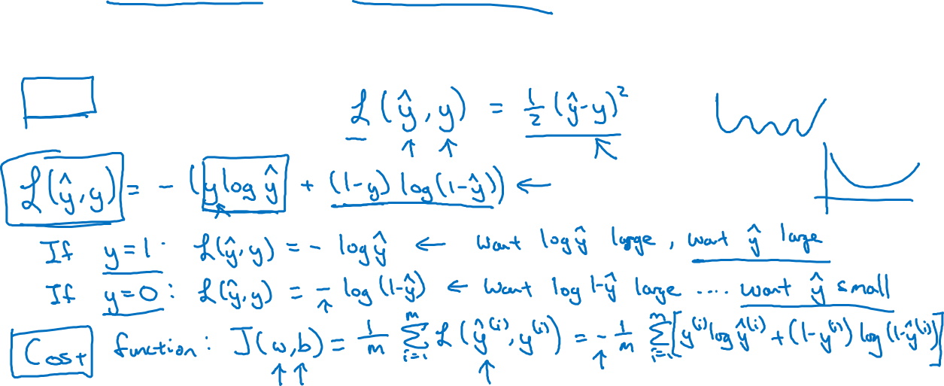
Logistic Regression cost function
, where
Given want .
Loss (error) function:

