Slide 1
CSE 403
Reliability Testing
These lecture slides are copyright (C) Marty Stepp, 2007. They may not be rehosted, sold, or modified without expressed permission from the author. All rights reserved.

Slide 2
Big questions
What kinds of testing can be done to see whether my web app is reliable?
What are the metrics for reliability?
Can I

Slide 3
Load testing
load testing: Measuring system's behavior and performance when subjected to particular heavy tasks.
  often tested at ~1.5x the expected SWL (safe working load)
  examples:
    testing a word processor by loading large documents
    testing a printer by sending it many large print jobs
    testing a web app by having several users connect at once
Differences between performance and load testing
  performance testing looks for code bottlenecks
  (which are often the same at any level of load) and fixes them
  in load testing, level of load remains fixed
  load testing measures performance at a given level of activity so that you can make decisions about allocating resources

Slide 4
Goals of load tests
Expose bugs that don't show up during normal usage
  memory leaks / memory management problems
  buffer overflows
  concurrency problems / race conditions
Ensure that system meets performance requirements
  load tests can be done repeatedly as regression tests to make sure system retains required performance

Slide 5
Stress testing
stress testing: An extreme load test where the system is subjected to much higher than usual load.
  often an error (timeout, etc.) is the expected result
Goals of stress testing
  see how gracefully the system handles unreasonable conditions
  discover any data loss or corruption problems when under load
  test recoverability and recovery time
Difference between load and stress testing
  stress testing often runs at a level of load far beyond load tests
  stress tests are meant to break things
  there's no clear boundary between a load test and stress test

Slide 6
System reliability
reliability testing: Measuring how well the system can remain available and functional over time.
Common goals:
  "two nines": 99% uptime (down 3.65 days/year)
  "four nines": 99.99% uptime (down 52 minutes/year)
  "five nines": 99.999% uptime (down 5 minutes/year)
Why does a system become unavailable?
  software failures
  hardware failures
  network failures

Slide 7
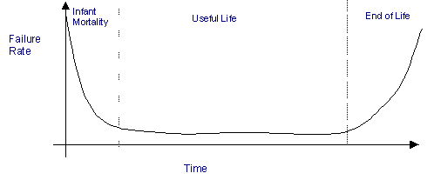
Estimating failures
Most hardware dies either very early or very late
  components have a mean time between failures (MTBF) rating
  FITS: failures per billion hours (1,000,000,000)
Software failure depends on many factors
  quality of design and engineering process
  complexity and size of the system
  experience level of the development team
  percentage of reused code
  depth of testing performed
  Software failures are often measured per 1000 lines of code.

Slide 8

Improving reliability
Replicate crucial system components
  example: two web servers, two database servers
Benefits of replication
  system is only considered unavailable if BOTH are down
  2 replicas * 99% reliability => 99.99% reliability

Slide 9
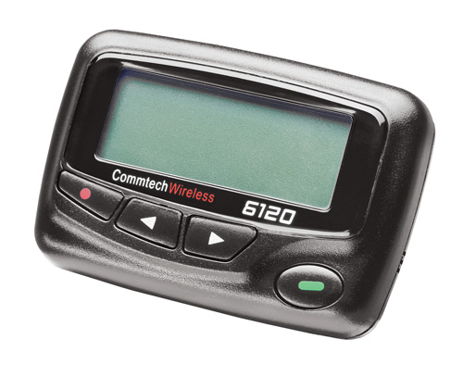
Repairing failures
Some failure recovery can be automated
  roll back transaction / fall back to another database
  redirect to another site
  reboot (Windows!)
Most failure recovery requires a human component
  on-site support staff
  on-call developers or QA engineers
    (Google pagers)
Estimating failure recovery time
  MTTR (mean time to repair)
    < 10 minutes if problem/fix are known
    1 hour to 2 weeks if not
    availability = MTBF / (MTBF + MTTR)

Slide 10
Logging
logging: Writing state information to files or databases as your application runs.
Reasons to do logging:
  logging is the println-debugging of web apps
  notice patterns of repeated errors
  a minimal guarantee on errors: the error will be logged
Why not just output error messages to the page?
  the wrong person sees the message (user, not developer)
  user shouldn't be told detailed information about the system or about the causes of errors
  message is not permanent (shows on page, but then is lost)

Slide 11
Log file contents
Web server software has its own request/error logs
  A typical Apache log file /var/log/apache2/error.log :
  [Tue Nov 20 12:07:37 2007] [notice] Apache/2.2.6 (Win32) mod_ssl/2.2.6 OpenSSL/0.9.8e PHP/5.2.5 configured -- resuming normal operations
  [Tue Nov 20 12:07:37 2007] [notice] Server built: Sep 5 2007 08:58:56
  [Tue Nov 20 12:07:37 2007] [notice] Parent: Created child process 8872
  PHP Notice: Constant XML_ELEMENT_NODE already defined in Unknown on line 0
  [Sun Nov 04 18:29:19 2007] [error] [client 24.17.240.98] File does not exist: D:/www/gradeit/courses/142/07au/a5/files/BL/BEIROUTY_0726779/output_3_2.png, referer: http://pascal.cs.washington.edu:8080/gradeit/testcases_view.php?course=142&quarter=07au&assignment=a5&section=BL&student=BEIROUTY_0726779&small=1
  [Sun Nov 04 18:29:19 2007] [error] [client 24.17.240.98] File does not exist: D:/www/gradeit/courses/142/07au/a5/files/BL/BEIROUTY_0726779/output_3_3.png, referer: http://pascal.cs.washington.edu:8080/gradeit/testcases_view.php?course=142&quarter=07au&assignment=a5&section=BL&student=BEIROUTY_0726779&small=1
  [Tue Oct 30 17:22:06 2007] [error] [client 128.95.141.49] PHP Warning: Invalid argument supplied for foreach() in D:\\www\\gradeit\\Section.php on line 43, referer: http://pascal.cs.washington.edu:8080/gradeit/assignment_view.php?course=142&quarter=07au&assignment=a5
  [Tue Oct 30 17:22:06 2007] [error] [client 128.95.141.49] PHP Warning: Invalid argument supplied for foreach() in D:\\www\\gradeit\\Section.php on line 43, referer: http://pascal.cs.washington.edu:8080/gradeit/assignment_view.php?course=142&quarter=07au&assignment=a5

Slide 12
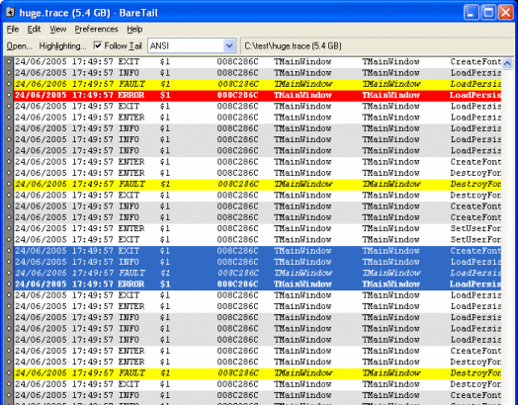
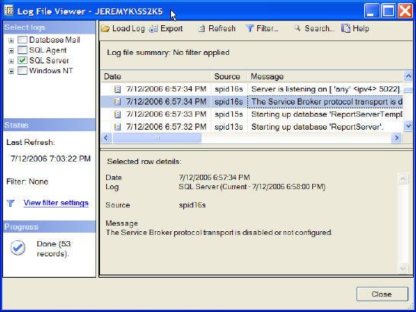
Log file viewers
some logging frameworks provide log viewers
can sort, search, color-code various types of messages

Slide 13
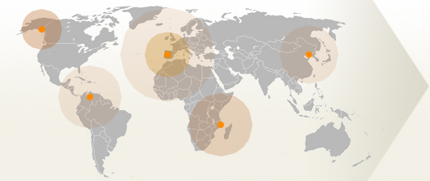
Web site monitoring
web site monitoring: a third-party machine "pings" your machine periodically to make sure it is live
  downloadable scripts (ZABBIX, Spong, CheckWebSite)
    some can be scripted to gather more detailed data, create reports
  paid services (ExternalTest, SiteUpTime, Internet Vista)

