Slide 1
CSE 403
Performance Testing, Profiling, Optimization
Reading:
McConnell, Code Complete, Ch. 25-26
These lecture slides are copyright (C) Marty Stepp, 2007. They may not be rehosted, sold, or modified without expressed permission from the author. All rights reserved.

Slide 2
Big questions
What are the measures of an app's performance?
How do you know when your app's performance is bad?
How can you figure out why your app is so slow?
What are some ways to speed up a slow app?
When should you optimize?

Slide 3
Code performance questions
Performance is important during system design:
  Did you choose the right data structure?
  Are you using the right algorithm?
  Is your recursive method TOO recursive?
  Are you recomputing a value many times that you've already computed before?
  Are you accessing an expensive resource (database, disk, network) too much?
  Are you creating too many objects unnecessarily or otherwise wasting memory?

Slide 4
What's wrong with this code?
  public class BuildBigString {
  public final static int REPS = 8000;
  public static String makeString() {
  String str = "";
  for (int n = 0; n < REPS; n++) {
  str += "more";
  }
  return str;
  }
  // Builds a big, important string.
  public static void main(String[] args) {
  System.out.println(makeString());
  }
  }

Slide 5
What's wrong with this code?
  public class Fibonacci {
  public static void main(String[] args) {
  // print the first 10000 Fibonacci numbers
  for (int i = 1; i <= 10000; i++) {
  System.out.println("fib(" + i + ") is " + fib(i));
  }
  }
  // pre: n >= 1
  public static long fib(int n) {
  if (n <= 2) {
  return 1;
  } else {
  return fib(n - 2) + fib(n - 1);
  }
  }
  }

Slide 6
What's wrong with this code?
  import java.util.*;
  // A set of words in our game.
  public class WordDictionary {
  private List<String> words = new ArrayList<String>();
  public void add(String word) {
  words.add(word.toLowerCase());
  }
  public boolean contains(String searchWord) {
  for (String word : words) {
  if (word.toLowerCase().equals(searchWord)) {
  return true;
  }
  }
  return false;
  }
  }

Slide 7
The correct answers
Who gives a shit?
Who gives a shit?
Who gives a shit?
"We should forget about small efficiencies, say about 97% of the time: premature optimization is the root of all evil." -- Knuth, Donald
"We follow two rules in the matter of optimization:
  1. Don't do it.
  2. (for experts only) Don't do it yet."
  -- M. A. Jackson

Slide 8
Thinking about performance
The app is only too slow if it doesn't meet your performance requirements.
  If it meets them, DON'T optimize it!
Which is more important, fast code or correct code?
What are reasonable performance requirements?
  What are the user's expectations? How slow is "acceptable" for this portion of the application?
  How long do users wait for a web page to load?
  Some tasks (admin updates database) can take longer

Slide 9
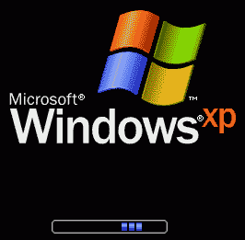
Perceived performance
Okay, my app is too slow. Now what?
  possibly optimize it
  And/or, improve the app's perceived performance
perceived performance:
User's perception of your app's responsiveness.
  loading screens
  multi-threaded UIs (GUI doesn't stall while something is happening in the background)
Examples:
  Grade-It
  Catalyst

Slide 10
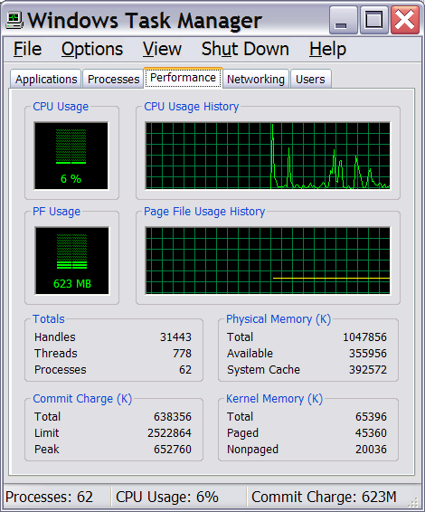
Optimization metrics
runtime / CPU usage:
  what lines of code the program is spending the most time in
  what call/invocation paths were used to get to these lines
    naturally represented as tree structures
memory usage:
  what kinds of objects are on the heap
  where were they allocated
  who is pointing to them now
  "memory leaks" (does Java have these?)
web page load times,
requests/minute, etc.

Slide 11
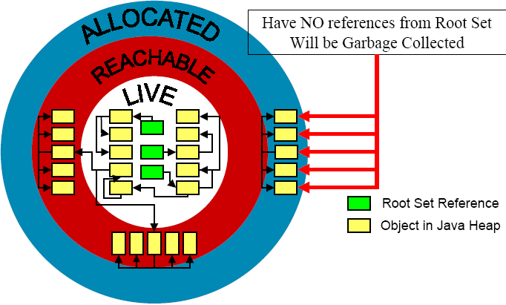
Garbage collection
garbage collector: A memory manager that reclaims objects that are not reachable from a root-set
root set: all objects with an immediate reference
  all reference variables in each frame of every thread's stack
  all static reference fields in all loaded classes

Slide 12
Heap and garbage collection
Size
Heap Size
GC
GC
GC
GC
GC
Max Occupancy
Total size of reachable objects
Total size of allocated objects
Time

Slide 13
Profiling
profiling: Measuring relative system statistics.
  Where is the most time being spent? ("classical" profiling)
    Which method takes the most time?
    Which method is called the most?
  How is memory being used?
    What kind of objects are being created?
    This in especially applicable in OO, GCed environments.
  Profiling is not the same as benchmarking or optimizing.
benchmarking: Measuring the absolute performance of your app on a particular platform.
optimization: Applying refactoring and enhancements to speed up code.

Slide 14
Profiling motivation
Why use a profiler?
  your intuition about what's slow is often wrong
  performance is a major aspect of program acceptance by users
Profiler advantages:
  accuracy
  completeness
  solid, statistical information
  platform- and machine-independence

Slide 15
Types of profilers
there are a variety of types of profilers
  insertion
  sampling
  instrumenting
there is usually a trade-off in terms of:
  accuracy
  speed
  granularity of information
  intrusiveness

Slide 16
Types of profiling
insertion: placing special profiling code into your program (manually or automatically)
  pros: can be used across a variety of platforms; accurate
  cons: requires recompilation; profiling code may affect performance
sampling: monitoring CPU or VM at regular intervals and saving a snapshot of CPU and/or memory state
  pros: no modification of app is necessary
  cons: less accurate; varying sample interval leads to a time/accuracy trade-off; small methods may be missed;
  cannot easily monitor memory usage

Slide 17
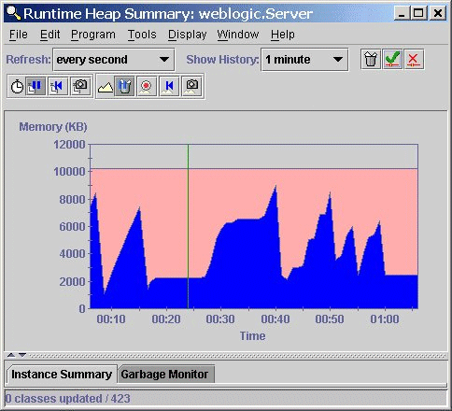
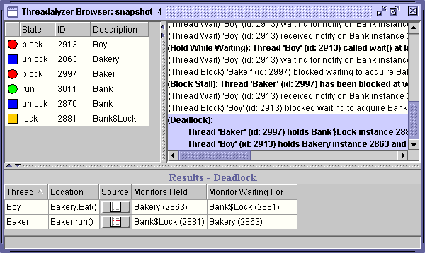
Java profiling tools
Many free Java profiling/optimization tools available:
  TPTP profiler extension for Eclipse
  Extensible Java Profiler (EJP) - open source, CPU tracing only
  Eclipse Profiler plugin
  Java Memory Profiler (JMP)
  Mike's Java Profiler (MJP)
  JProbe Profiler - uses an instrumented VM
hprof (java -Xrunhprof)
  comes with JDK from Sun, free
  good enough for anything I've ever needed

Slide 18
Using hprof
  usage: java -Xrunhprof:[help]|[<option>=<value>, ...]
  Option Name and Value Description Default
  --------------------- ----------- -------
  heap=dump|sites|all heap profiling all
  cpu=samples|times|old CPU usage off
  monitor=y|n monitor contention n
  format=a|b text(txt) or binary output a
  file=<file> write data to file off
  depth=<size> stack trace depth 4
  interval=<ms> sample interval in ms 10
  cutoff=<value> output cutoff point 0.0001
  lineno=y|n line number in traces? Y
  thread=y|n thread in traces? N
  doe=y|n dump on exit? Y
  msa=y|n Solaris micro state accounting n
  force=y|n force output to <file> y
  verbose=y|n print messages about dumps y

Slide 19
Sample hprof usage
To measure CPU usage:
  java -Xrunhprof:cpu=samples,depth=6,heap=sites
  or
  java -Xrunhprof:cpu=old,thread=y,depth=10,cutoff=0,format=a ClassName
  Takes samples of CPU execution
  Record call traces that include the last 6/10 levels on the stack
  Only record "sites" used on heap (to keep output file small)
To measure memory usage:
  java -Xrunhprof ClassName
After execution, open the text file java.hprof.txt in the current directory with a text editor

Slide 20
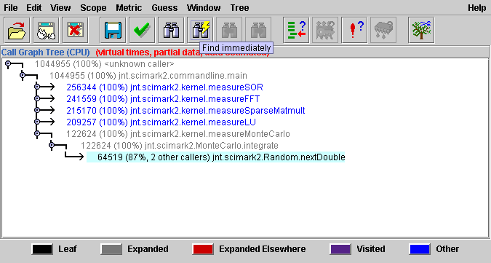
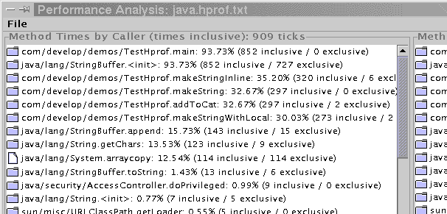
Visualization tools
CPU samples
  critical to see traces to modify code
  hard to read - far from the traces in the file
  HP's HPjmeter analyzes java.hprof.txt visually
    http://www.hp.com/products1/unix/java/hpjmeter/
  another good tool called PerfAnal builds
  and navigates the invocation tree
  download PerfAnal.jar, and...
  java -jar PerfAnal.jar ./java.hprof.txt
Heap dump
  critical to see what objects are there, and who points to them
  Tools: HPjmeter or HAT navigate heap objects
    https://hat.dev.java.net/

Slide 21
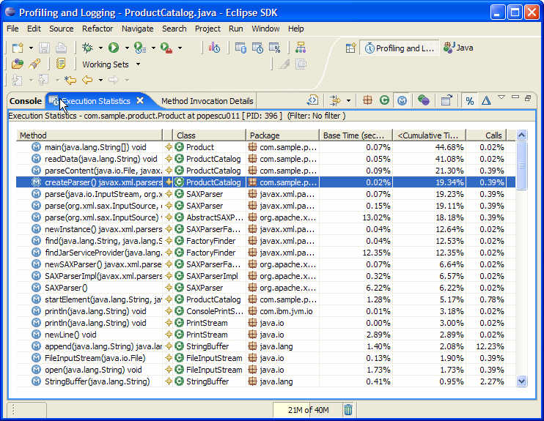
TPTP
a free extension to Eclipse for profiling
  difficult to install, but very powerful

Slide 22
Profiler results
What do do with profiler results:
  observe which methods are being called the most
    These may not necessarily be the "slowest" methods!
  observe which methods are taking most time relative to others
Warnings
  CPU profiling slows down your code (a lot)
    design your profiling tests to be very short
    CPU Samples is better than CPU Time
  CPU samples don't measure everything
    doesn't record object creation and garbage collection time
  Output files are very large, esp. if there is a heap dump

Slide 23
Profiling Web languages
Javascript
  Firebug: http://getfirebug.com/
  Venkman: http://www.mozilla.org/projects/venkman/
Ruby on Rails
  ruby-prof: http://ruby-prof.rubyforge.org/
JSP
  x.Link: http://sourceforge.net/projects/xlink/

Slide 24
Optimization tips
Pareto Principle / "80-20 Rule"
  80% of a program's execution occurs within 20% of its code.
  You can get 80% results with 20% of the work.
"The best is the enemy of the good."
  You don't need to optimize all your app's code.
  Find the worst bottlenecks and fix them. Leave the rest.

Slide 25
Optimization myths
A program with fewer lines of code is faster.
Certain operations are inherently faster than others.
  Example: x << 1 is faster to compute than x * 2 .
  This depends on many factors, such as language used.
  Don't write ugly code on the assumption that it will be faster.
You should optimize your code as you write it.
  Premature optimization is the root of all evil.
  Optimize only as needed.
Having a fast program is as important as a correct one.
  If it doesn't work, it doesn't matter how fast it's running!

Slide 26
Common places to optimize
I/O routines
  accessing the console (print statements)
  files
  network access
  database queries
  exec() / system calls
Lazy evaluation saves you from computing/loading
  don't read / compute things until you need them
Hashing, caching save you from reloading resources
  combine multiple database queries into one query
  save I/O / query results in memory for later

Slide 27
Optimizing memory access
Non-contiguous memory access (bad):
  for (int col = 0; col < NUM_COLS; col++) {
  for (int row = 0; row < NUM_ROWS; row++) {
  table[row][column] = bulkyMethodCall();
  }
  }
Contiguous memory access (good):
  for (int row = 0; row < NUM_ROWS; row++) {
  for (int col = 0; col < NUM_COLS; col++) {
  table[row][column] = bulkyMethodCall();
  }
  }
  switches rows NUM_ROWS times, not NUM_ROWS * NUM_COLS

Slide 28
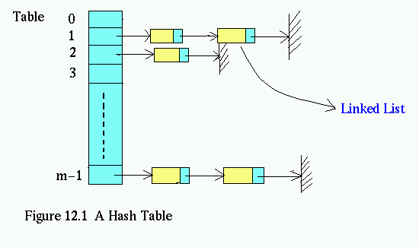
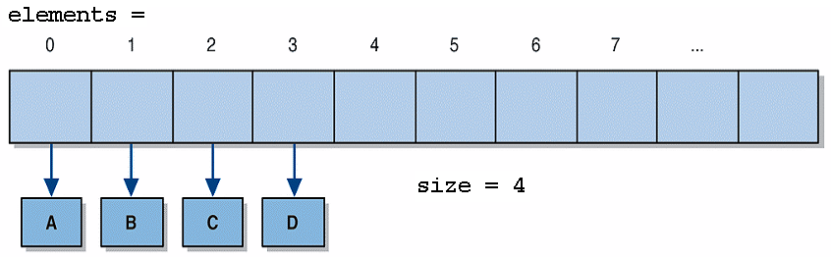
Optimizing data structures
Many new programmers don't fully take advantage of hash-based Maps and Sets
  searching an ArrayList (contains, indexOf) is O(N)
  searching a HashMap/HashSet is O(1)
Getting around limitations of hash data structures
  need to keep elements in sorted order? Use TreeMap/TreeSet
  need to keep elements in insertion order?
  Store two copies of the data: an ArrayList and a HashMap

Slide 29
Optimization is deceptive
Original code (to sum elements of a 2D matrix):
  int sum = 0;
  for (int row = 0; row < NUM_ROWS; row++) {
  for (int col = 0; col < NUM_COLS; col++) {
  sum += matrix[row][column];
  }
  }
Optimized code:
  int sum = 0;
  Cell* p = matrix;
  Cell* end = &matrix[NUM_ROWS - 1][NUM_COLS - 1];
  while (p != end) {
  sum += *p++;
  }
Speed-up observed: NONE.
  Compiler was already optimizing the original into the second!

Slide 30
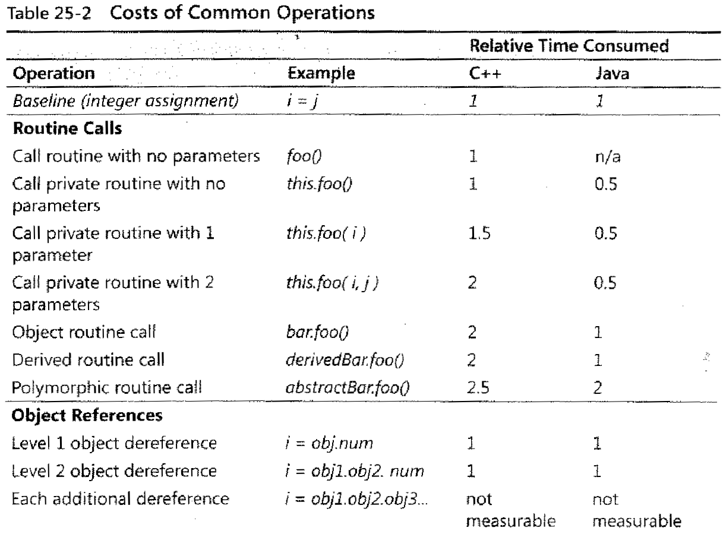
Rough cost of operations

Slide 31
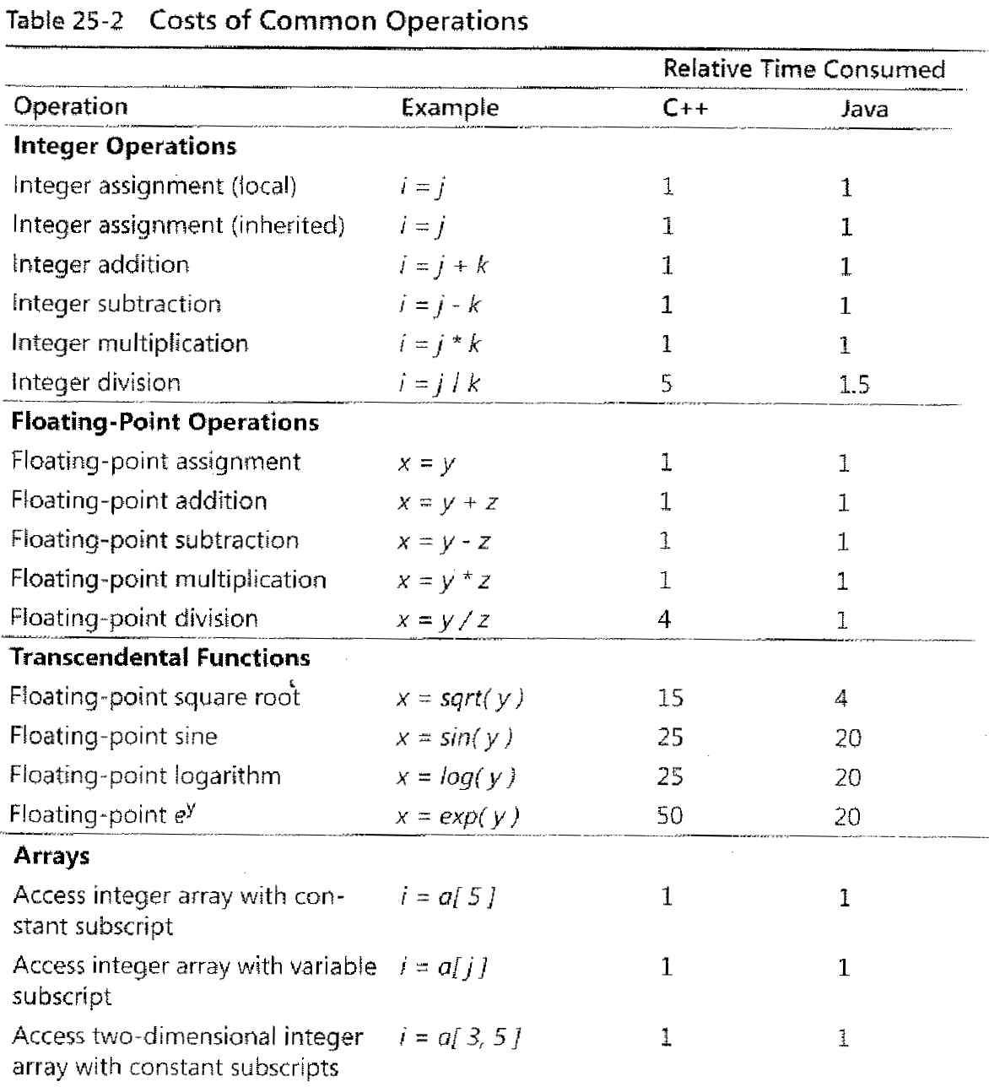
Rough cost of operations 2

Slide 32
Avoiding computations
Stop computing when you know the answer:
  found = false;
  for (i = 0; i < reallyBigNumber; i++) {
  if (inputs[i].isTheOneIWant()) {
  found = true;
  break;
  }
  }
Hoist expensive loop-invariant code outside the loop:
  double taxThreshold = reallySlowTaxFunction();
  for (i = 0; i < reallyBigNumber; i++) {
  accounts[i].applyTax(taxThreshold);
  }

Slide 33
Lookup tables
Figuring out the number of days in a month:
  if (month == 9 || month == 4 || month == 6 || month == 11) {
  return 30;
  } else if (month == 2) {
  return 28;
  } else {
  return 31;
  }
Days in a month, using a lookup table:
  DAYS_PER_MONTH = {-1, 31, 28, 31, 30, 31, 30, ..., 31};
  ...
  return DAYS_PER_MONTH[month];
  Probably not worth the speedup with this particular example...

Slide 34
Dynamic programming
Computing whether a number is prime:
  public static boolean isPrime(int n) {
  double sqrt = Math.sqrt(n);
  for (int i = 2; i <= sqrt; i++)
  if (n % i == 0) { return false; }
  return true;
  }
Caching previous results (dynamic programming):
  private static Map<Integer, Boolean> PRIME = ...;
  public static boolean isPrime2(int n) {
  if (!PRIME.containsKey(n))
  PRIME.put(n, isPrime(n));
  return PRIME.get(n);
  }

Slide 35
JavaScript optimization
JavaScript is ~1000x slower than C code.
Modifying a page using the DOM is expensive.
  Code that modifies DOM objects while they are visible:
  var ul = document.getElementById("myUL");
  for (var i = 0; i < 2000; i++) {
  ul.appendChild(document.createElement("li"));
  }
  Faster code that modifies DOM objects "offline":
  var ul = document.getElementById("myUL");
  var li = document.createElement("li");
  var parent = ul.parentNode;
  parent.removeChild(ul);
  for (var i = 0; i < 2000; i++) {
  ul.appendChild(li.cloneNode(true));
  }
  parent.appendChild(ul);

