Slide 1
CSE 403
Testing
Reading:
Code Complete, Ch. 22 (McConnell)
Object-Oriented Software Engineering, Ch. 9 (B. Bruegge, A. Dutoit)
These lecture slides are copyright (C) Marty Stepp, 2007. They may not be rehosted, sold, or modified without expressed permission from the author. All rights reserved.

Slide 2
Big questions
What are the major goals of testing? Why test?
What are some of the major types of testing?
Who should do the testing?
  How much time should they spend on it?
When should a team test its product?
What makes a good test case? How many do I need?
  How do we measure/decide whether we have tested enough?
  If we don't plan to test our entire product, which parts should we test / not test, and why?

Slide 3
More big questions
What is the difference between a "black box" and "white box" test?
  When is each one more appropriate?
What is a regression test?

Slide 4
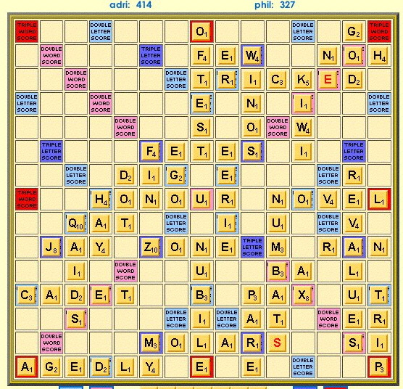
Example: Scrabble moves
Think about code to validate Scrabble board moves:
  Where can we
  start a move?
  Where can tiles
  be in relation to
  the starting tile?
  How do we com-
  pute scores for a
  move?
  How do we do
  word challenges?

Slide 5
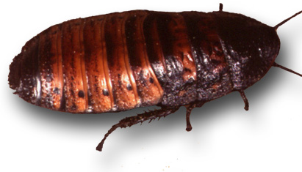
Bug and testing
software reliability: probability that a software system will not cause failure under specified conditions
  measured by uptime, MTTF (mean time till failure), crash data
bugs are inevitable in any complex software system
  a bug can be visible or can hide in your code until much later
  some estimates: ? bugs per 100 lines of code
testing: a systematic attempt to reveal errors
  failed test: an error was demonstrated
  passed test: no error was found (for this particular situation)

Slide 6
Difficulties of testing
perception by some developers and managers
  seen as a beginner's job
  assigned to the least experienced team members
  done as an afterthought (if at all)
limitations of what testing can show you
  it is impossible to completely test a system
    example: Space Shuttle Columbia launch, 1981
    50ms delay was set to 80ms; led to 1/67 chance of launch failure
  does not show absence of errors in software
  does not directly reveal the actual bugs in the code

Slide 7

Faults and errors
error: incorrect software behavior
  example: message box text said, "Welcome null."
fault: mechanical or algorithmic cause of error
  example: account name field is not set properly.
  a fault is not an error, but it can lead to them
  need requirements to specify desired behavior, and need to see system deviate from that behavior, to have a failure
  algorithmic faults
    design produces a poor algorithm
    fail to implement the software to match the spec
    subsystems don't communicate properly
  mechanical faults
    power outage; virtual machine failure (why is this "mechanical"?)

Slide 8
Quality control techniques
fault avoidance: prevent errors by finding faults before the system is released
fault detection: find existing faults without recovering from the errors
fault tolerance: when system can recover from failure by itself

Slide 9
Fault avoidance
fault avoidance: prevent errors by finding faults before the system is released
development methodologies: use requirements and design to minimize introduction of faults
  get clear requirements
  minimize coupling
configuration management: don't allow changes to subsystem interfaces
review: manual inspection of system
walkthrough: dev presents code to team
inspection: team looks at code without dev's guidance

Slide 10
Fault detection
fault detection: find existing faults without recovering from the errors
debugging: move through steps to reach error states
testing: tries to expose errors in planned way
  a good test model has test cases and data that identify errors
  ideally, every possible input to a system should be tested
  this is prohibitively time-consuming

Slide 11
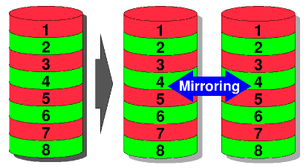
Fault tolerance
fault tolerance: recovery from failure by system
  example: database transaction rollbacks
modular redundancy: assumes failures usually occur at subsystem level, and assigns more than one component for same task
  example: a RAID-1 hard disk array
  uses more than one hard
  disk to store the same
  data, so that in case one
  disk breaks down,
  the rest still contain
  the important data

Slide 12
Kinds of testing
unit testing: looks for errors in objects or subsystems
integration testing: find errors with connecting subsystems together
  system structure testing: integration testing all parts of system together
system testing: test entire system behavior as a whole, with respect to scenarios and requirements
  functional testing: test whether system meets requirements
  performance testing: nonfunctional requirements, design goals
  acceptance / installation testing: done by client

Slide 13
Test cases
test case: set of inputs and outputs to cause failures
  name: descriptive name of what is being tested
  location: full path/URL to test
  input: arguments, commands, input files to use
    entered by tester or test driver
  oracle: expected output
  log: actual output produced
Notes:
(test case example: Microsoft Web Excel)

Slide 14
Black and white box testing
black-box test: focuses on input/output of each component
white-box test: focuses on internal states of objects
  requires internal knowledge of the component to craft input
  example: knowing that the internal data structure for a spreadsheet program uses 256 rows and columns, choose a test case that tests 255 or 257 to test near that boundary
Notes:
(test case example: Microsoft Web Excel)

Slide 15
Regression testing
regression testing: re-executing all prior tests after a code change
  often done by scripts, automated testing
  used to ensure that old fixed bugs are still fixed
    a new feature or a fix for one bug can cause a new bug or reintroduce an old bug
  especially important in evolving object-oriented systems

Slide 16
Unit testing
unit testing looks for errors in individual objects or subsystems in isolation
benefits of isolating one object/component:
  1. reduces number of things to test
  2. easier to find faults when errors occur
  3. can test all components in parallel
in principle, test all objects; because of time, test important ones involved in use cases

Slide 17
Equivalence testing
equivalence testing:
  a black-box test that minimizes # of test cases
  steps in equivalence testing:
  identify classes of inputs with same behavior
  test on one member of each equivalence class
  assume behavior will be same for all members of class
  criteria for selecting equivalence classes:
  coverage: every input is in one class
  disjointedness: no input in more than one class
  representation: if error occurs with one member of class, it will occur with all

Slide 18
Boundary testing
boundary testing: testing conditions on bounds between equivalence classes
  a black-box test
  Imagine we are testing a Date class with a getDaysInMonth(month, year) method. What are some important conditions and good boundary tests for this method?
    some ideas:
    check for leap years (every 4th yr, no 100s, yes 400s)
    try years such as: even 100s, 101s, 4s, 5s
    try months such as: june, july, feb, invalid values

Slide 19
Path testing
path testing: an attempt to use test input that will pass once over each path in the code
  path testing is white box
  What would be path testing for daysInMonth(month, year)?
    some ideas:
    error input: year < 1, month < 1, month > 12
    one month from [1, 3, 5, 7, 10, 12]
    one month from [4, 6, 9, 11]
    month 2
      in a leap year, not in a leap year

Slide 20
Types of integration testing
big bang: no stubs; do unit testing, then throw all parts together
bottom-up: integrate upward into double, triple, quadruple test
top-down: test top layer (UI) first, then add layers to replace underlying stubs
  What are some pros and cons of each?
big bang: + faster - can be costly, error-prone
bottom-up: + fewer stubs needed - tests UI last; UI is important!
top-down: + focuses on user experience - needs many stubs

Slide 21

The sandwich!!!
sandwich integration testing:
  bread (UI)
  meat (major subsystems)
  bread (ground layer)
  perform top-down and bottom-up testing at same time
  might miss bugs in middle "target" layer
modified sandwich: test each layer individually, then do the sandwich

Slide 22
Types of system testing
functional [/requirements] testing:
  black-box run through each use case (hit ones most likely to fail)
performance testing:
  verify non-functional performance requirements
  stress testing: tests response to many simultaneous requests
  volume testing: tests response to lots of input data
  security testing
pilot testing:
  install and use system by set of users
  usability testing: observe user behavior to learn about product design
  alpha: features are still in development
  beta: feature-complete, trying to find bugs
acceptance / installation testing:
  benchmarks
  competitor testing: test against another product/system
  shadow testing: test against older legacy systems

Slide 23
Testing exercise 1
Recall the list of tests we discussed to determine whether a Scrabble move is legal:
  Are all tiles in a straight line?
  Are the tiles contiguous or separated only by existing old tiles?
  Are the tiles touching an existing old tile?
  On each of the words made:
    What is the score of this word?
    Is this word in the dictionary?
Question: What is/are some suitable Scrabble test board configuration(s) and moves that check each of these conditions?
  Make both passing and failing tests.

Slide 24
Testing exercise 2
Imagine that we have a Date class with working methods called isLeapYear(year) and daysInMonth(month, year).
  Question: What is the pseudo-code for the algorithm for an addDays(days) method that moves the current Date object forward in time by the given number of days. A negative value moves the Date backward in time.
  Question: Come up with a set of test values for your addDays method to test its correctness.

