Slide 1
CSE 403
Software Lifecycle Models
Reading:
Rapid Development Ch. 7, 25
(further reading: Ch. 21, 35, 36, 20)
These lecture slides are copyright (C) Marty Stepp, 2007, with significant content taken from slides written by Valentin Razmov. They may not be rehosted, sold, or modified without expressed permission from the author. All rights reserved.

Slide 2
Lecture outline
The software lifecycle
  evaluating models
Lifecycle models
  code-and-fix
  waterfall
  spiral
  evolutionary prototyping
  staged delivery
  design-to-schedule

Slide 3
Big questions
What is a software lifecycle model? When and why should we use such models?
How do we decide which model is the best one to use?
Briefly describe each of these models:
  code-and-fix, waterfall, spiral, evolutionary prototyping, staged delivery, design-to-schedule
What are some benefits and drawbacks of each model?

Slide 4
Ad-hoc development
ad-hoc development: no formal process
  Sounds great! No learning required.
drawbacks?
  some important actions (design, testing) may go ignored
  not clear when to start or stop doing each task
  does not scale well to multiple people
  not easy to review or evaluate one's work
  code didn't match user's needs (no requirements!)
  code was not planned for modification, not flexible
Key observation: The later a problem is found, the more expensive it is to fix.

Slide 5
Lifecycle phases
software lifecycle: series of steps / phases
  Requirements Analysis & Specification
  High-level (Architectural) Design
  Detailed (Object-oriented) Design
  Implementation, Integration, Debugging
  Testing, Profiling, Quality Assurance
  Operation and Maintenance
  other possibilities: Risk Assessment, Prototyping
  in each phase:
  mark out a clear set of steps to perform
  produce a tangible document or item
  allow for review of work
  specify actions to perform in the next phase

Slide 6
Some software models
code-and-fix: write some code, debug it, repeat (i.e., ad-hoc)
waterfall: standard phases (req., design, code, test) in sequence
spiral: assess risks at each step; do most critical action first
evolutionary prototyping: build an initial requirement spec, code it, then "evolve" the spec and code as needed
staged delivery: build initial requirement specs for several releases, then design-and-code each in sequence
benefits of models
  decomposing workflow, understanding/managing the process
limitations of models
  can lead to compromises and artificial constraints
  risk of overemphasizing the process (process is not the end in itself)
ways of evaluating models
  risk management, quality/cost control, predictability, visibility of progress, customer involvement/feedback

Slide 7
Waterfall
req. change
benefits
  formal, standard; specific phases with clear goals
  good feedback loops between adjacent phases
drawbacks?
requirements
verify
design
verify
implement
test
operations
retirement
  assumes requirements will be clear and well-understood
  requires a lot of planning up front (not always easy)
  rigid, linear; not adaptable to change in the product
  costly to "swim upstream" back to a previous phase
  nothing to show until almost done ("we're 90% done I swear!")

Slide 8
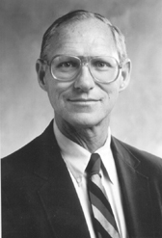
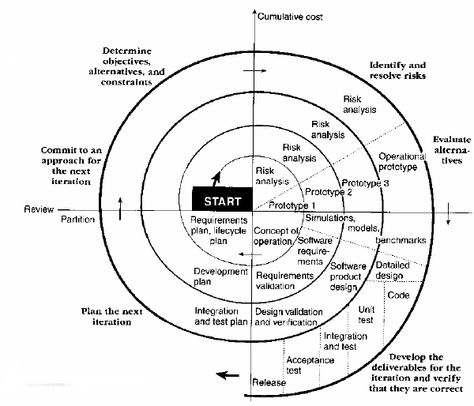
Spiral
Barry Boehm, USC
steps taken at each loop:
  determine objectives, constraints
  identify risks
  evaluate options to resolve the risks
  develop and verify any deliverable items
benefits
  provides early indication of unforeseen problems
  always addresses the biggest risk first
  accommodates changes, growth
  eliminates errors and unattractive choices early
drawbacks?
  relies on developers to have risk-assessment expertise
  complex; works poorly when bound to an inflexible contract

Slide 9
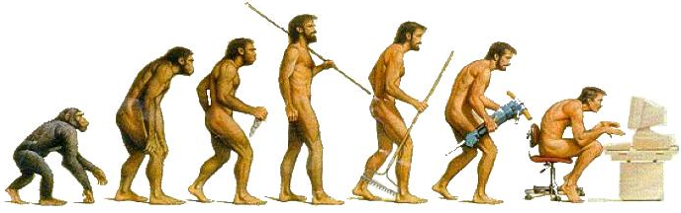
Evolutionary
requirements
arch. design
for each build:
detailed design,
implement,
test, deliver
build initial requirements, code it, "evolve" as needed
  produces steady signs of progress, builds customer confidence
  useful when requirements are not well known or change rapidly
  customer involvement ("What do you think of this version?")
drawbacks?
operations
verify
verify
retirement
  assumes user's initial spec will be flexible
  fails for separate pieces that must then be integrated
  temporary fixes become permanent constraints
  bridging; new software trying to gradually replace old
  unclear how many iterations will be needed to finish

Slide 10
Staged delivery
staged delivery
  waterfall-like beginnings, then develop in short stages
  tight coordination with docs, management, marketing
  can ship at any time during implementation
  from the outside (to customers) it looks like a successful delivery even if it is not the final goal the team aimed for
How does staged delivery differ from evolutionary prototyping?
  In staged delivery, requirements are better known ahead of time rather than discovered through customer feedback after each release.

Slide 11
Design-to-schedule
design-to-schedule
  useful when you absolutely need to ship by a certain date
  similar to the staged delivery model
    but less flexible because of the fixed shipping date
  requires careful prioritization of features and risks to address
design-to-tools
  a model where the project only incorporates features that are easy to implement by using or combining existing components
  reduces development time at cost of losing control of project

Slide 12
Model category matrix
Rate each model 1-5 in each of the categories shown:
 | Risk mgmt. | Quality/ cost ctrl. | Predict- ability | Visibility of progress | Customer involvement
code-and-fix
waterfall
spiral
evolutionary prototyping
staged delivery
design-to-schedule
 | Risk mgmt. | Quality/ cost ctrl. | Predict- ability | Visibility of progress | Customer involvement
code-and-fix | 1 | 1 | 1 | 3 | 2
waterfall | 2 | 4 | 3 | 1 | 2
spiral | 5 | 5 | 3 | 3 | 3
evolutionary prototyping | 3 | 3 | 2 | 5 | 5
staged delivery | 3 | 5 | 3 | 3 | 4
design-to-schedule | 4 | 3 | 5 | 3 | 2

