Slide 1
CSE 403
Integration
Reading:
McConnell, Code Complete, Ch. 29
These lecture slides are copyright (C) Marty Stepp, 2007. They may not be rehosted, sold, or modified without expressed permission from the author. All rights reserved.

Slide 2
Big questions
How does one integrate separately developed system components to ensure they work properly together?
When should integration be performed? By whom?
Can integration be tested? If so, how?
What are the benefits of daily builds?
What is a "smoke test", and what are its benefits?

Slide 3
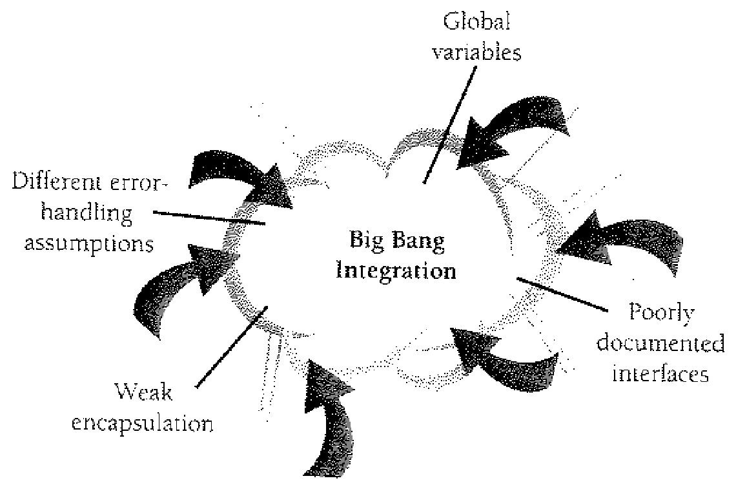
Phased integration
phased ("big-bang") integration:
  design, code, test, debug each class separately
  combine them all
  pray

Slide 4
Drawbacks of phased
Benefits:
Don't have to bother with "software engineering" stuff
Drawbacks:
New problems will inevitably surface
  many systems now together that have never been before
All problems present themselves at once
  hard to diagnose, debug, fix
Cascade of interdependencies
  cannot find and solve problems one-at-a-time

Slide 5
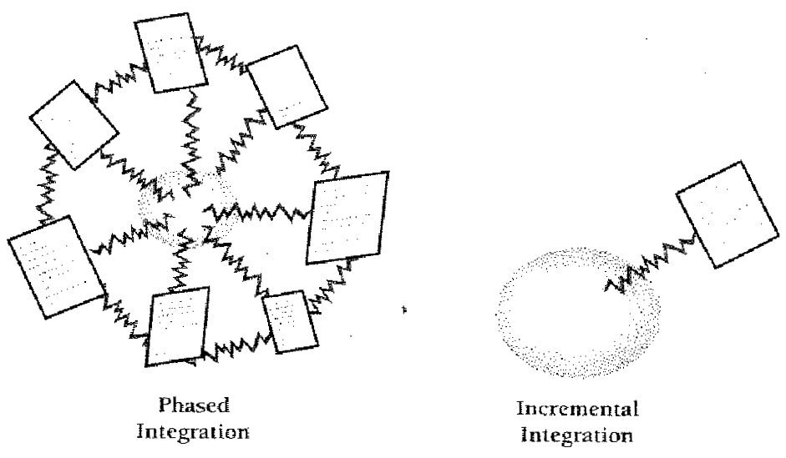
Incremental integration
incremental integration:
  develop a functional "skeleton" system (i.e. ZFR)
  design, code, test, debug a small new piece
  integrate this piece with the skeleton
    test/debug it before adding any other pieces

Slide 6
Benefits of incremental
Benefits:
Errors easier to isolate, find, fix
  reduces developer bug-fixing load
System is always in a (relatively) working state
  good for customer relations, developer morale
Drawbacks:
May need to create "stub" versions of some features that have not yet been integrated

Slide 7
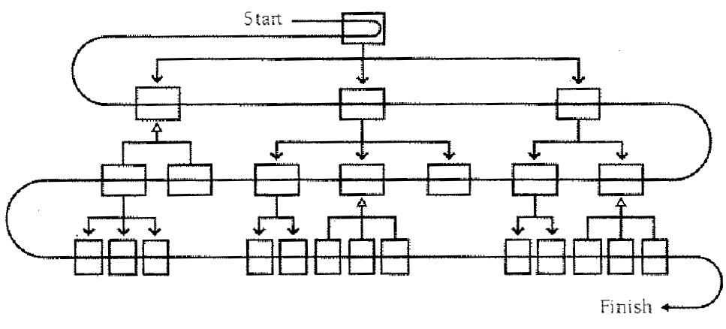
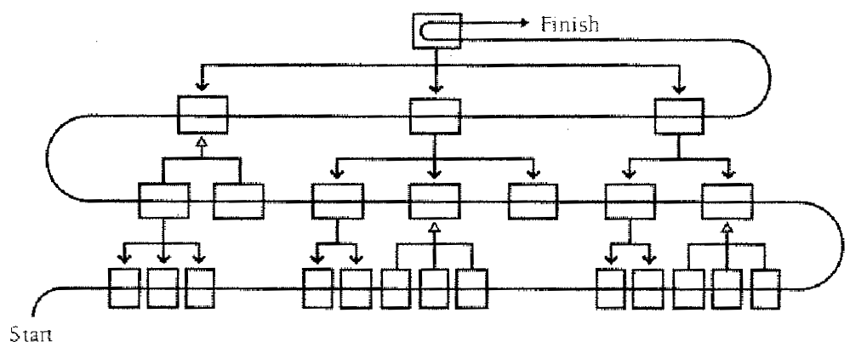
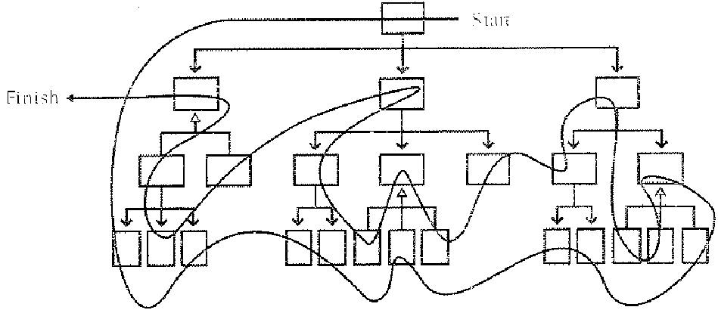
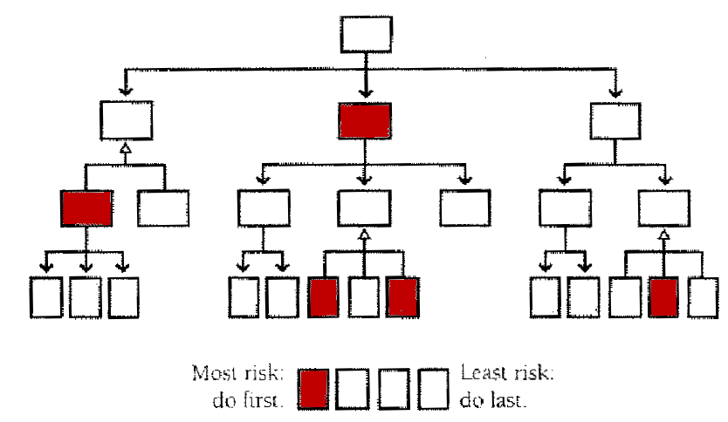
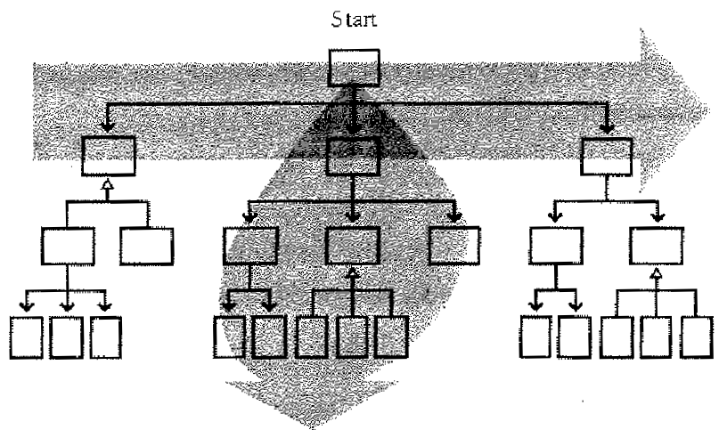
Types of incremental
top-down
bottom-up
sandwich
risk-oriented
feature-oriented
T-shaped

Slide 8
Top-down integration
top-down integration:
Start with outer UI layers and work inward
  must write (lots of) stub lower layers for UI to interact with
  allows postponing tough design/debugging decisions (bad?)

Slide 9
Bottom-up integration
bottom-up integration:
Start with low-level data/logic layers and work outward
  must write test drivers to run these layers
  won't discover high-level / UI design flaws until late

Slide 10
"Sandwich" integration
"sandwich" integration:
Connect top-level UI with crucial bottom-level classes
  add middle layers later as needed
  more practical than top-down or bottom-up?

Slide 11
Other incremental styles
risk-oriented: integrate
most "risky" features first
feature-oriented: integrate
all code related to each given
feature before moving on
T-shaped: integrate one
slice/feature deeply, then
do the rest in a breadth-
first order

Slide 12
Daily builds
daily build: A process where every file is compiled and built into a working executable on a daily basis.
  allows you to test the quality of your integration so far
  helps morale; product "works every day"; visible progress
smoke test: A quick set of tests run on daily build to make sure that it generally runs correctly.
  see whether the code "smokes" as it runs (bad)
  used (along with compilation) to make sure daily build runs
  should NOT be exhaustive

Slide 13
Advice about daily builds
The daily aspect is crucial! Update the build EVERY day.
Automate your daily build and smoke test.
Put someone in charge of maintaining the daily build.
Make whomever causes a broken build fix it.
  Punish them! Make them stop other work, wear dunce cap, etc.
Encourage / force developers to place small "smoke" unit tests on all code before checking it in.
  decreases the chance of build breaks

