Slide 1


NEXT GEN EMPLOYABILITY PROGRAM
CREATING A FUTURE-READY WORKFORCE
Student Name :
ABHISHEK M U
Student ID :
STU67b036d770e2b1739601623
College Name :
VIVEKANANDA INSTITUTE OF TECHNOLOGY BENGALURU -560074

Slide 2
CAPSTONE PROJECT SHOWCASE
Project Title
Custom E-commerce Platform with MERN Technology​
Abstract | Problem Statement | Project Overview | Proposed Solution | Technology Used | Modelling & Results | Conclusion | Q&A

Slide 3
Abstract
1
This MERN stack e-commerce application is a full-featured online shopping platform built using MongoDB, Express.js, React, and Node.js. It offers user authentication, product browsing, cart management, secure checkout, and order tracking.
2
The backend efficiently handles product data, user sessions, and payment integration, while the frontend delivers a responsive and intuitive user experience.
3
It features seamless user registration/login, product filtering, cart and Wishlist management, and integrated payment gateways.
4
Built with modular architecture, the app is easily extendable for admin dashboards, inventory management, and analytics.

Slide 4


Problem Statement
In today’s digital era, many small to medium-sized businesses lack an affordable, scalable, and customizable online platform to showcase their products and manage sales efficiently.
Existing solutions are often either too complex, too generic, or come with high subscription costs. There is a growing need for a full-stack web application that enables businesses to easily list products, manage customer interactions, and securely process transactions — all while offering a seamless and responsive user experience.
This project aims to solve this problem by developing an e-commerce application using the MERN stack (MongoDB, Express.js, React, Node.js) that is cost-effective, scalable, and user-friendly for both store owners and customers.

Slide 5

Project Overview
This project is a full-stack e-commerce web application built using the MERN stack — MongoDB, Express.js, React, and Node.js.
It allows users to browse products, add items to the cart, manage Wishlists, and complete secure online payments. The frontend is built with React for a responsive and intuitive shopping experience.
The platform is designed to be fully responsive, user-friendly, and easy to expand with new features.
The backend uses Node.js and Express.js to handle API requests, authentication, and business logic. Product and user data are stored in MongoDB, ensuring fast and scalable database operations. Admins can manage product listings, track orders, and oversee customer activity.

Slide 6
Proposed Solution
To address the need for a flexible, modern, and scalable e-commerce platform, this project proposes the development of a web-based application using the MERN stack (MongoDB, Express.js, React, Node.js).
The application will offer a user-friendly interface where customers can browse products, manage their shopping cart, and complete secure transactions with integrated payment gateways.
On the backend, a API will manage product data, user authentication, and order processing, while MongoDB will serve as a robust NoSQL database to store and retrieve information efficiently.
The admin panel will allow business owners to add, update, or remove products, monitor sales, and manage customer orders in real-time. The React-based frontend will ensure smooth navigation, responsiveness, and fast interactions, enhancing the overall user experience.

Slide 7
Technology used
Frontend : MERN , Javascript, TailwindCSS
Backend : MongoDB, Cloudinary, Node.js, Express.js
Integrations : Razorpay and Stripe payment gateway

Slide 8
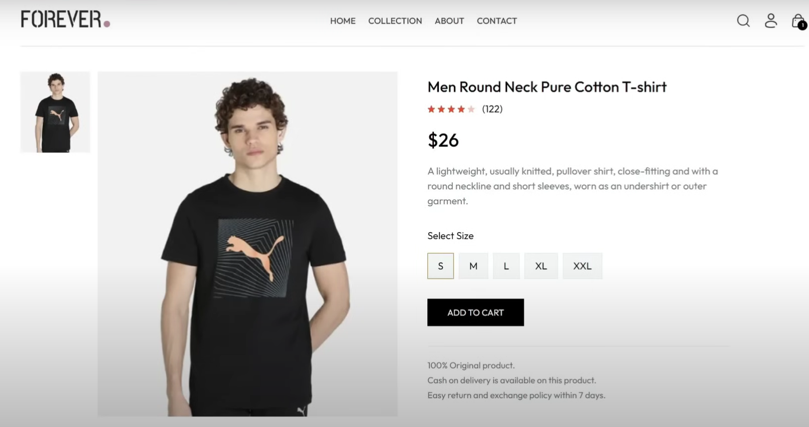
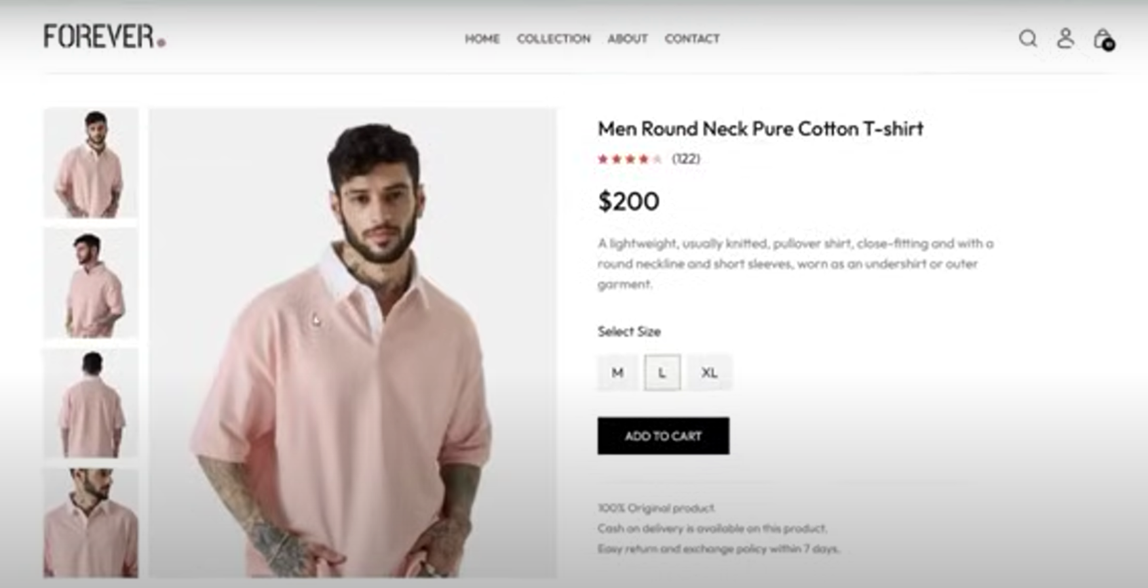
Modelling & Result

Slide 9
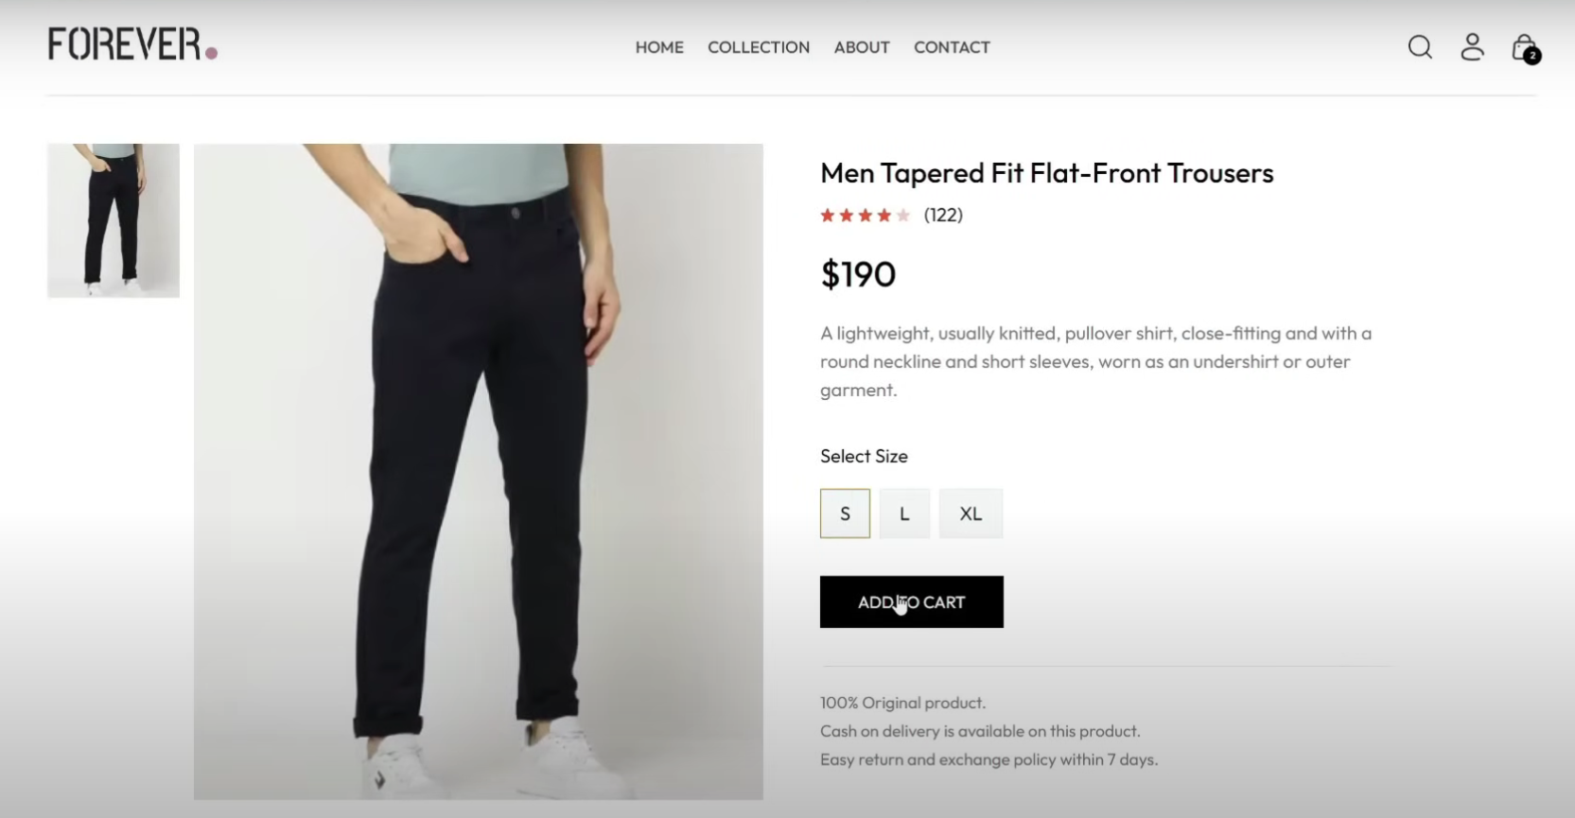
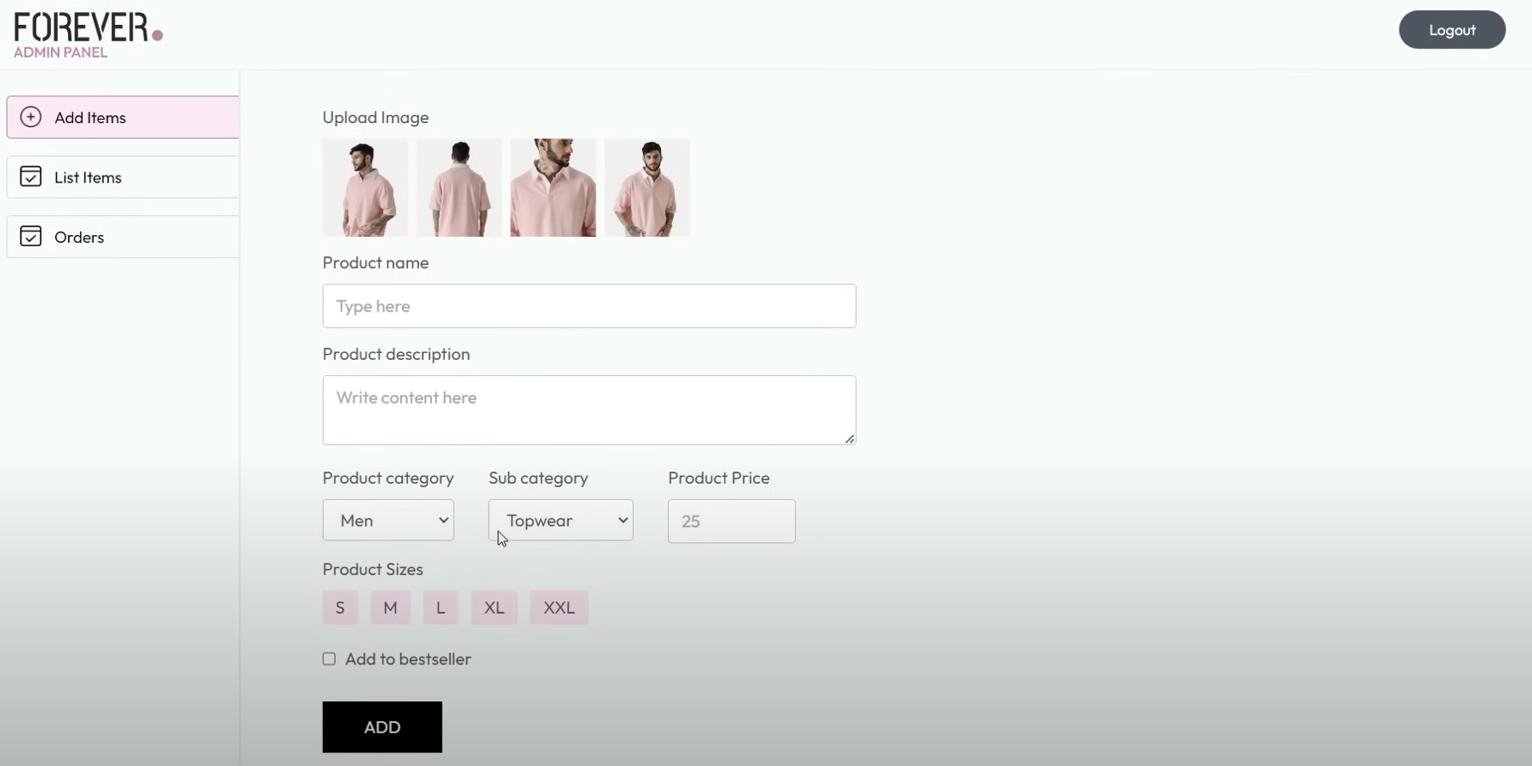
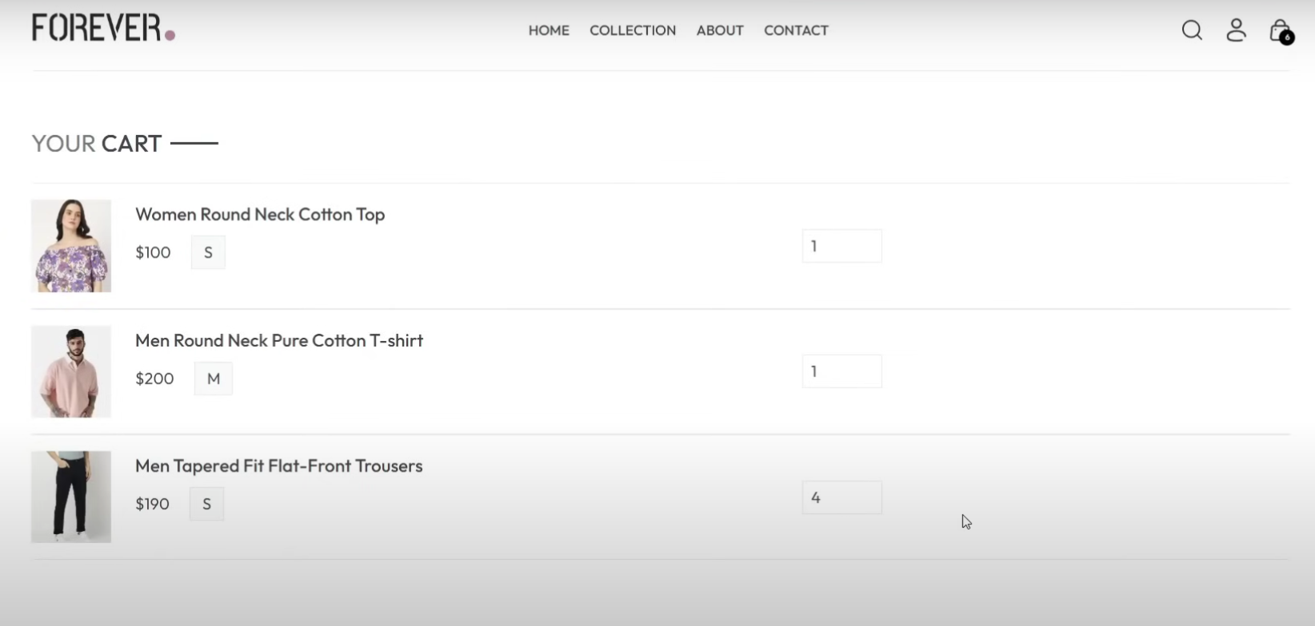
Modelling & Result

Slide 10
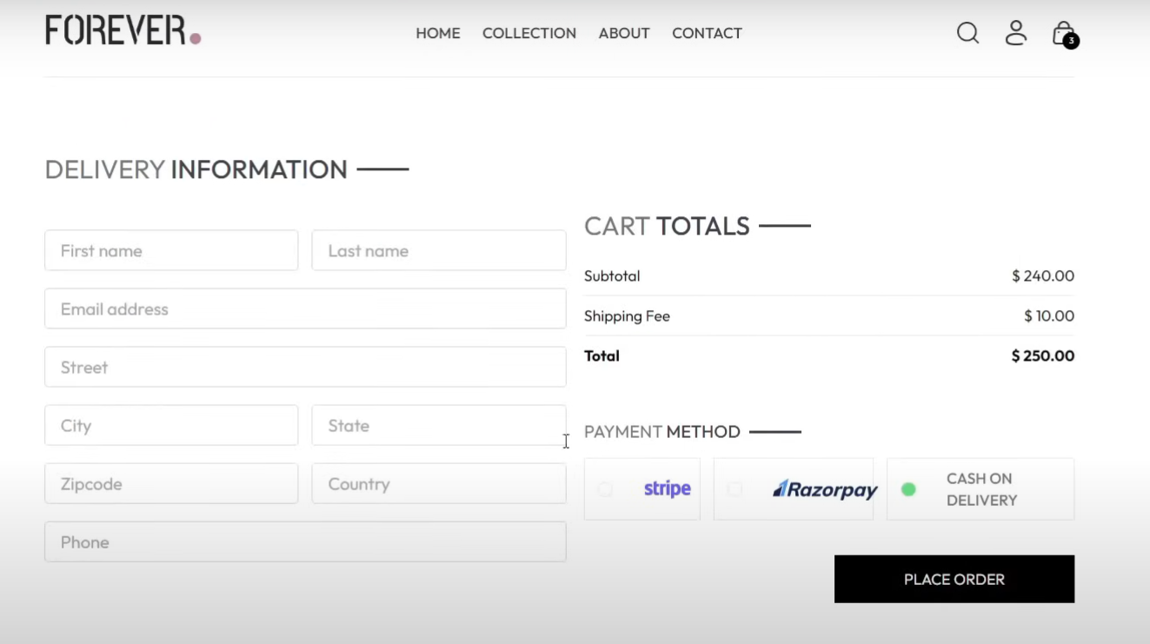
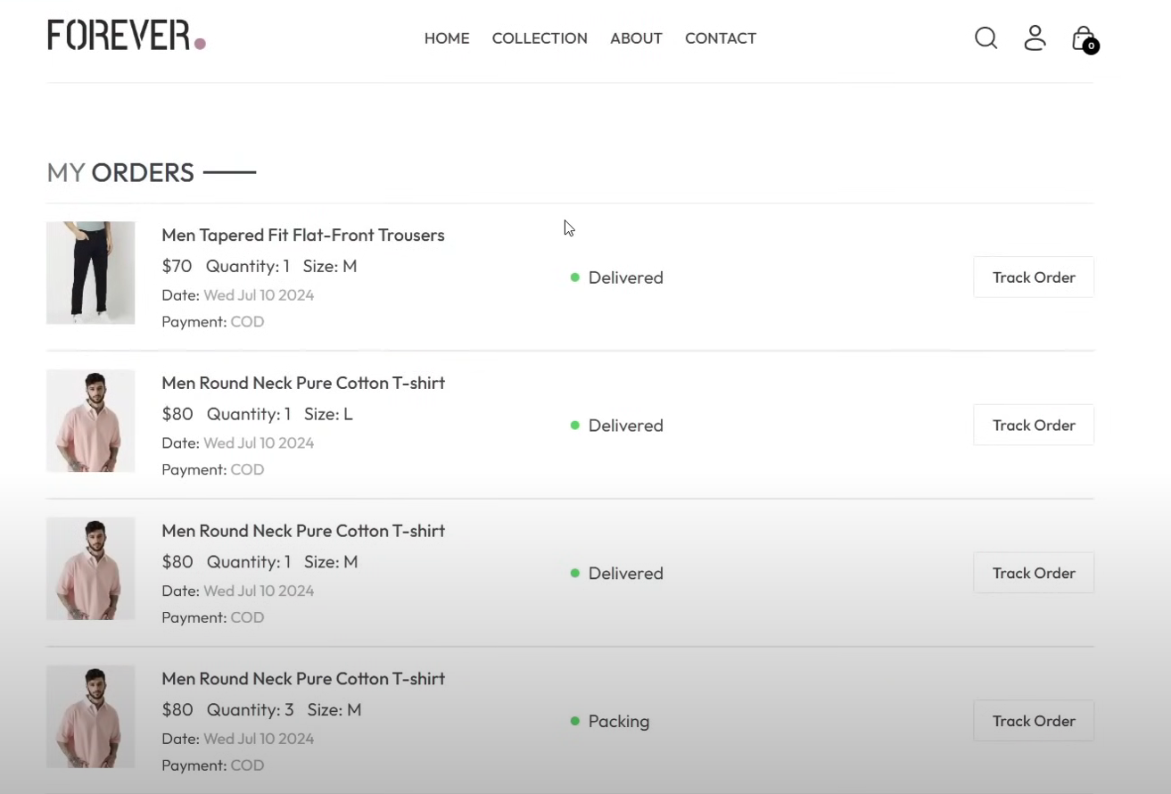
Modelling & Result

Slide 11

Conclusion
The development of this MERN stack e-commerce application successfully demonstrates the power and flexibility of modern web technologies in creating a scalable, user-friendly, and feature-rich online shopping platform. By integrating MongoDB, Express.js, React, and Node.js, the project offers a complete solution for both customers and administrators — from seamless product browsing and secure checkout to efficient backend management.
The application is designed with performance, usability, and future scalability in mind, making it suitable for small and medium-sized businesses seeking a customized e-commerce solution. Overall, this project not only meets the core requirements of an online store but also lays a strong foundation for future enhancements like analytics, reviews, and mobile app integration.

Slide 12


Notes:
Thank You !!

