Slide 1
Malignant Comments Classifier
By Abhishek Pai

Slide 2
Problem Statement
There has been a remarkable increase in the cases of cyberbullying and trolls on various social media platforms. Many celebrities and influences are facing backlashes from people and have to come across hateful and offensive comments. This can take a toll on anyone and affect them mentally leading to depression, mental illness, self-hatred and suicidal thoughts.
Internet comments are bastions of hatred and vitriol. While online anonymity has provided a new outlet for aggression and hate speech, machine learning can be used to fight it.

Slide 3
Business Goal
Goal is to build a prototype of online hate and abuse comment classifier which can used to classify hate and offensive comments so that it can be controlled and restricted from spreading hatred and cyberbullying.

Slide 4

Data Set Description
The data set contains the training set, which has approximately 1,59,000 samples and the test set which contains nearly 1,53,000 samples. All the data samples contain 8 fields which includes ‘Id’, ‘Comments’, ‘Malignant’, ‘Highly malignant’, ‘Rude’, ‘Threat’, ‘Abuse’ and ‘Loathe’.
The label can be either 0 or 1, where 0 denotes a NO while 1 denotes a YES. There are various comments which have multiple labels. The first attribute is a unique ID associated with each comment.

Slide 5
Data Set
Malignant: It is the Label column, which includes values 0 and 1, denoting if the comment is malignant or not.
Highly Malignant: It denotes comments that are highly malignant and hurtful.
Rude: It denotes comments that are very rude and offensive.
Threat: It contains indication of the comments that are giving any threat to someone.
Abuse: It is for comments that are abusive in nature.
Loathe: It describes the comments which are hateful and loathing in nature.
ID: It includes unique Ids associated with each comment text given.
Comment text: This column contains the comments extracted from various social media platforms.

Slide 6

Steps
Loading data set
EDA
Data cleaning
Model building
Performing prediction
Saving results

Slide 7
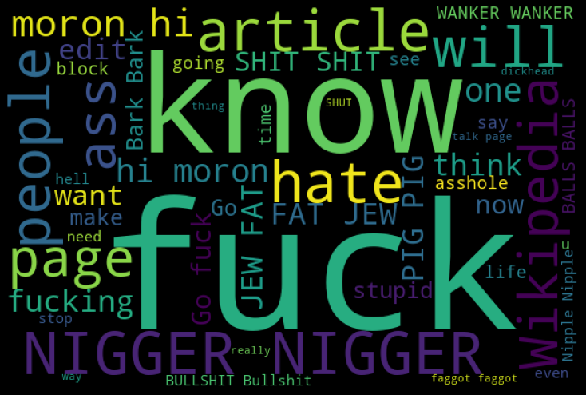
Cloud of loud words which are offensive

Slide 8
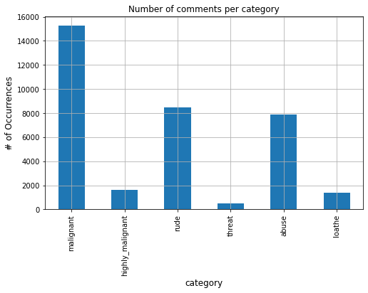
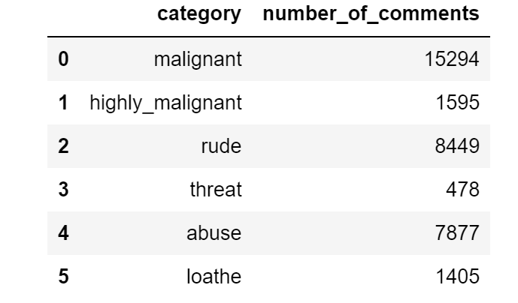
Separating data for measuring count categories

Slide 9
Model used
Keras with Bidirectional long-short term memory(bi-lstm) was used
(97 % accuracy was been achieved)

Slide 10
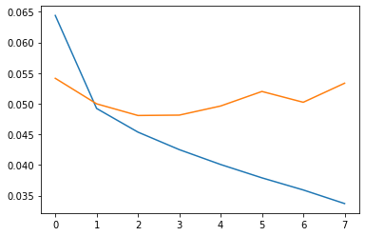
Plot of loss and Val-loss
Blue | loss
Yellow | Val-loss

Slide 11
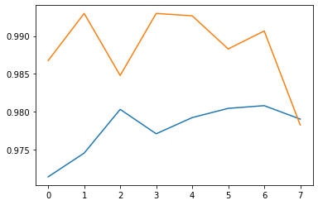
Plot of accuracy and Val-accuracy
Blue | accuracy
Yellow | Val-accuracy

Slide 12
Conclusion
The model performed great and the output obtained had much reasonable accuracy
This model can be helpful for understanding real-world situations for the comments which are in English language

Slide 13
Thanks!

