Slide 1
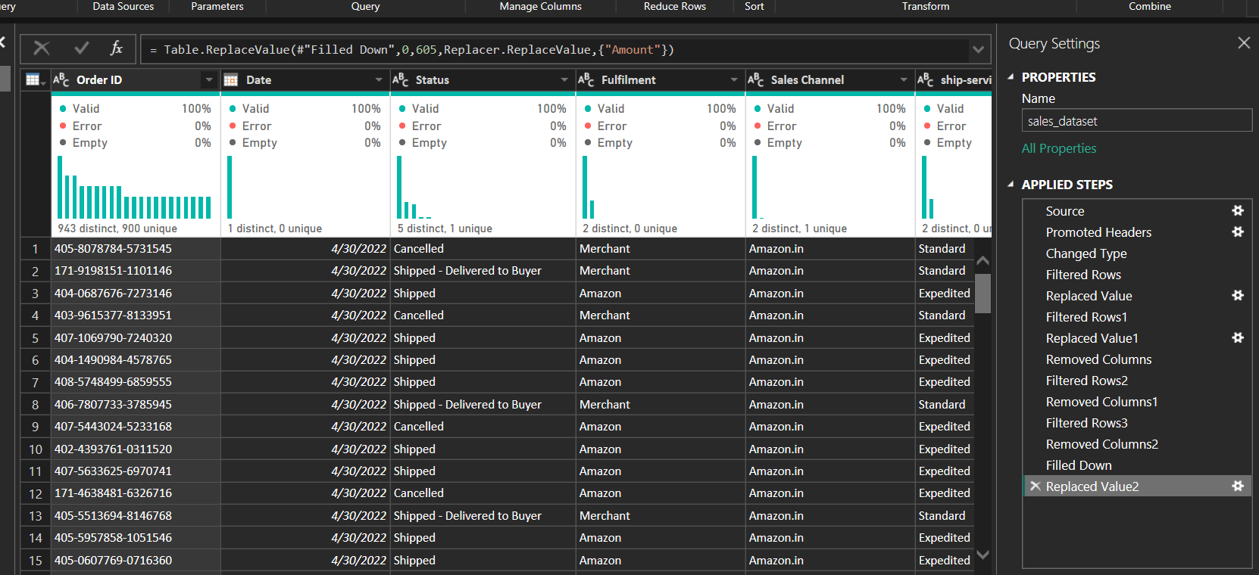
STEP 1 DATA CLEANING
Data cleaning is the first and most important step of analysis.
In this stage, we handled missing values, corrected data types, and ensured data consistency across key fields such as Order ID, Status, Fulfilment, and Sales Channel.
Null values in the Amount column were replaced with the median value to avoid skewing revenue insights.
This ensures that every record contributes accurately to the final analysis.

Slide 2
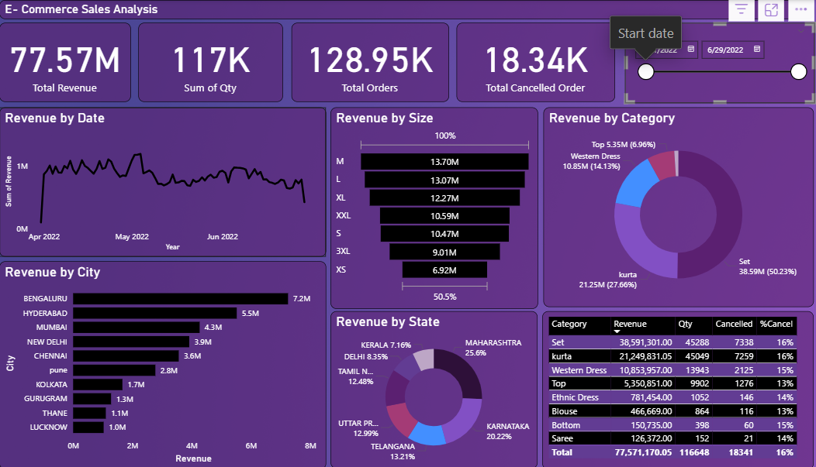
STEP 2 Dashboard Explanation
This dashboard presents a complete view of sales performance from April to June 2022.
It highlights key business metrics such as Total Revenue (77.57M), Total Orders (128.95K), Total Quantity (117K), and Cancelled Orders (18.34K), allowing quick evaluation of overall business health.

Slide 3
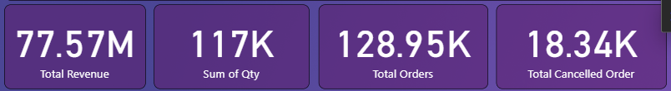
STEP 3 KPI Summary
These key performance indicators provide a quick snapshot of the overall business health and sales performance within the selected period.
Overall revenue generated during the selected period: 77.57M.
total quantity sold across all products: 117K units.
Total number of orders placed: 128.95K.
Total number of cancelled orders: 18.34K, giving insight into order issues.

Slide 4
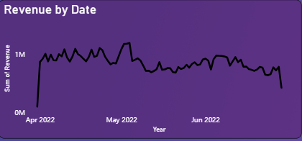
STEP 4 Revenue by Date
This line chart shows the daily revenue pattern from April to June 2022.
The revenue remains consistently above the 1M mark, indicating stable and reliable sales performance throughout the period.
The overall trend stays relatively stable, with normal fluctuations indicating regular customer activity.

Slide 5
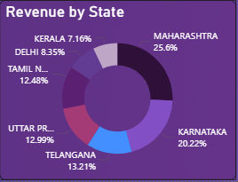
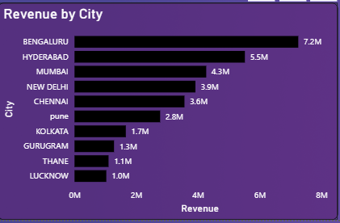
STEP 5 Revenue Distribution by State and City
State-wise Revenue Contribution
The donut chart highlights how different states contribute to overall revenue.
Two states dominate the sales performance: Maharashtra – 25.6% (highest contributor) Karnataka – 20.22% (second highest)
City-wise Revenue Breakdown
The bar chart displays revenue at the city level.
Top-performing cities include: Bengaluru – 7.2M (highest revenue-generating city) Hyderabad – 5.5M Mumbai – 4.3M

Slide 6
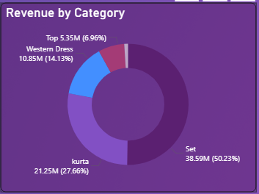
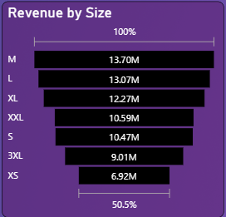
STEP 6 Revenue by Category & Product Size
Donut chart showing revenue distribution across product categories. Set contributes ~50%, kurta ~28%.
Revenue by Category
The donut chart illustrates the contribution of each product category to the total revenue.
The distribution is dominated by: Set – 38.59M (50.23%) , Kurta – 21.25M (27.66%)
Revenue by Size
The horizontal bar chart shows revenue distribution based on product size.
Top performing sizes include: M – 13.70M (highest revenue) , L – 13.07M

Slide 7
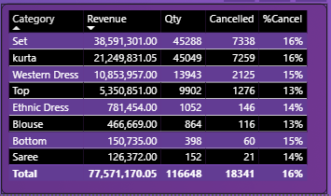
STEP 7 Category Performance Summary Table
This table provides a detailed breakdown of revenue, quantity sold, cancellations, and cancellation percentage across all product categories.
It helps identify top-performing categories as well as those requiring operational or inventory improvements.

