Slide 1
Java Programming

Slide 2
Introduction to Java
Java is a language developed by Sun Microsystems
Java was developed initially for consumer devices
Now it is a popular platform to develop web based enterprise applications

Slide 3
Salient Features of Java
Object Oriented
Simpler language
  Compared to earlier OO languages like C++, it is simple
  Designed considering the pitfalls of earlier languages
Architecture Neutral/Portable
  Example: Java code compiled on Windows can be run on Unix without recompilation
  Write Once, Run Anywhere
Secure
  Built -in security features like absence of pointers
Notes:
Java is a strict Object Oriented Programming language. It is not possible to write programs that contains global data and functions. Any function that is written in Java should be inside a class and is known as a method. Similarly any data that is declared in a Java program should also be inside a class.
Java is simpler than languages like C++. For example, Java eliminates pointers
Java language is portable across platforms and operating systems, both at the source and at the binary level, which means that the same Java program can run on any machine.

Slide 4
Platform Independence
Java is platform independent.
A Java program that is written and compiled in one platform can run on any other platform without any recompilation or modification
  Write Once Run Anywhere

Slide 5
Java Compiler
The source code of Java will be stored in a text file with extension .java
The Java compiler compiles a .java file into byte code
  Byte code will be in a file with extension .class
  Languages like C compiles the program into the machine language format of the hardware platform on which it is running
  Byte Code is NOT in the machine language format of the hardware platform on which the code is compiled
  The hardware processor cannot understand the byte code

Slide 6
JVM (1/2)
The byte code is in the machine language format of a machine known as the Java Virtual Machine or the JVM
  Needs a JVM to execute the byte code
  JVM is not a real machine, it is just a virtual machine; implemented in software

Slide 7
JVM (2/2)
JVM is platform dependant; that is there is one JVM for Windows, another one for UNIX, yet another one for Mainframe etc
All JVMs accept the same input, the byte code
Each JVM interprets the byte code into the machine language format of the platform on which it is running
The same byte code can be run on any platform, if the JVM for that platform is available
  The JVMs for all platforms are available free (http://java.sun.com/) and hence we say that the byte code runs in all platforms
Notes:
The JVM is an interpreter. It executes the byte code line by line.

Slide 8
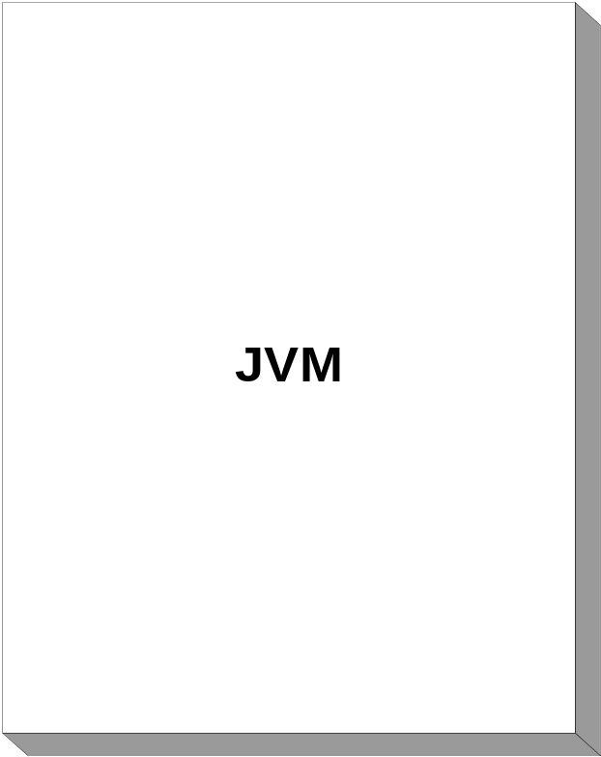
Java Architecture
Source File (HelloWorld.java)
Compiler (javac)
Machine Code or Byte code
(HelloWorld.class)
Operating System
Hardware

Slide 9
A Sample Java Application
The following program can be created using any text editor
public class HelloWorld{
public static void main(String [] args){
System.out.println(“Hello World!”);
}
}
Save the file as HelloWorld.java
Take care; case of file name matters
Notes:
A Java program file is an ordinary text file with “. java” extension. Java source files are created in a plain text editor like Notepad.
Any code in Java is to be written inside a class. Just like the C language, the program execution starts with the main method. In C, the function main is a global function. But in Java, even the main method should be inside a class. The signature of the main method in Java is different from that of function main in C. The main method of Java should have the signature of public static void main(String [])

Slide 10
To Compile
Open a command prompt
Go to the directory in which the source file is saved
Type the following command
javac HelloWorld.java
The Java compiler will convert the source code into the byte code
  HelloWorld.class
Notes:
Compiling a Program
Use the following command to compile the HelloWorld program
C:\Work\MyJavaPrograms>javac HelloWorld.java
This command creates a file called HelloWorld.class. This .class file is nothing but the byte code for the program. This byte code can be interpreted by the JVM. Thus, the output of the Java compiler is not the code that can be directly executed by the processor

Slide 11
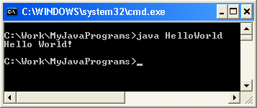
To execute
Use the following command to execute the bytecode
java HelloWorld
Notes:
Executing a Program
Use the following command to run the HelloWorld program
C:\Work\MyJavaPrograms>java HelloWorld
When the program is run, the following output is displayed:
Hello World!

Slide 12
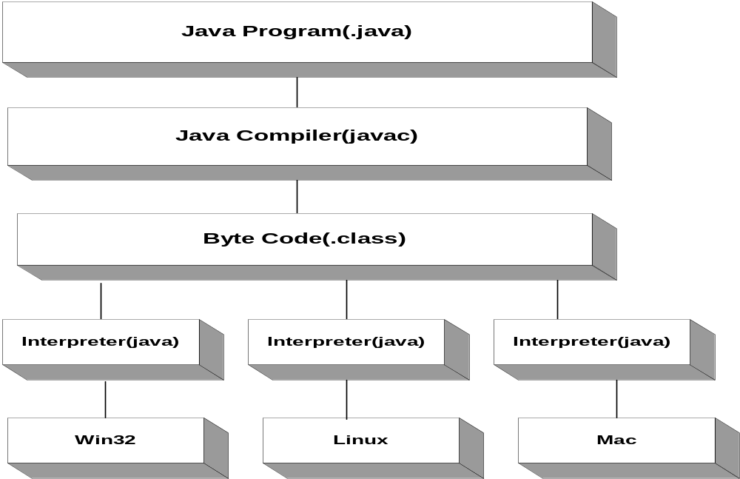
Compilation & Execution

Slide 13
Primitive Data Types in Java
Integer Types
  byte (1 byte)
  short (2 bytes)
  int (4 bytes)
  long (8 bytes)
Floating Type
  float (4 bytes)
  double (8 bytes
All numeric data types are signed
The size of data types remain the same on all platforms

Slide 14
Primitive Data Types in Java
Textual
  char (2 bytes)
Logical
  boolean (1 byte) (true/false)
The char data type in Java is 2 bytes because it uses UNICODE character set to support internationalization
UNICODE is a character set which covers all known scripts and language in the world

Slide 15
Comments in Java
A single line comment in Java will start with //
// This is a single line comment in Java
A multi line comment starts with a /* and ends with a */
/* This is a multi line
comment
in Java */

Slide 16
Variables in Java (1/2)
Declaring and using primitive data types is Java similar to that of C
int count;
int max=100;

Slide 17
Variables in Java (2/2)
Unlike C, in Java variables can be declared anywhere in the program
int i = 10;
System.out.println(“Program starts here”);
int j = 20;
for (int count=0; count < max; count++) {
int z = count * 10;
}
BEST PRACTICE: Declare a variable in program only when required. Do not declare variables upfront like in C.

Slide 18
Local Variables
In Java, if a local variable is used without initializing it, the compiler will show an error
class Sample{
public static void main (String [] args){
int count;
System.out.println(count);//Error
}
}

Slide 19
Typecasting of primitive data types
Variable of smaller capacity can be assigned to another variable of bigger capacity without any explicit typecasting
Whenever a larger type is converted to a smaller type, the typecast operator has to be explicitly specified
int i = 10;
double d;
d = i;
Type cast operator
double d = 10;
int i;
i = (int) d;
Notes:
Whenever a larger type is converted to a smaller type, the typecast operator has to be explicitly specified. This prevents accidental corruption of data.

Slide 20
Operators
Operators in Java are very similar to operators in C
  Assignment Operators
  Arithmetic Operators
  Relational Operators
  Logical Operators

Slide 21
Control Statements
The syntax of the control statements in Java are very similar to that of C language
  if
  if-else
  for
  while
  do-while
  switch
  break
  continue

Slide 22
Methods in Java
The syntax of writing methods in Java is similar to that of functions in C
Unlike C
  All methods in Java should be written inside a class
  There is no default return type for a Java method
Notes:
In C language, a function whose return type is not specified is assumed to return an int. In Java there is no default return type for a method. Specifying the return type of a method is mandatory in Java.

Slide 23
Arrays in Java
In Java, all arrays are created dynamically
The operator new is used for dynamic memory allocation
The following statement creates an array of 5 integers
new int[5]
The above statement returns a reference to the newly created array
  References in Java are very similar to pointers in C

Slide 24
Reference variables in Java (1/4)
Reference variables are used in Java to store the references of the objects created by the operator new
Any one of the following syntax can be used to create a reference to an int array
The reference x can be used for referring to any int array
int x[];
int [] x;
//Declare a reference to an int array
int [] x;
//Create a new int array and make x refer to it
x = new int[5];

Slide 25
Reference variables in Java (2/4)
The following statement also creates a new int array and assigns its reference to x
In simple terms, reference can be seen as the name of the array
int [] x = new int[5];
Notes:
Arrays can be created only using dynamic memory allocation in Java. The memory is allocated dynamically using the keyword new.

Slide 26
Reference variables in Java (3/4)
Even though we can think of Java references as C pointers, their usages are different
Pointers | References
Printing a pointer will print the address stored in it | Printing a reference will NOT print the address of the object referred by it
Pointer arithmetic like incrementing a pointer is valid in the case of a pointer | We cannot use arithmetic operators on references
A pointer has to be de-referenced using the * operator to get the value pointed by it | A reference is automatically de-referenced to give the data referred by it and no special operator is required for this

Slide 27
Reference Types in Java (4/4)
A reference type can be assigned ‘null’ to show that it is not referring to any object
  ‘null’ is a keyword in Java
int [] x = null;

Slide 28
Initializing an array in Java
An array can be initialized while it is created as follows
int [] x = {1, 2, 3, 4};
char [] c = {‘a’, ‘b’, ‘c’};

Slide 29
The length of an array
Unlike C, Java checks the boundary of an array while accessing an element in it
  Java will not allow the programmer to exceed its boundary
If x is a reference to an array, x.length will give you the length of the array
  The for loops can be set up as follows
for(int i = 0; i < x.length; ++i){
x[i] = 5;
}

Slide 30
Multidimensional Arrays
Multidimensional arrays are arrays of arrays.
To declare a multidimensional array variable, specify each additional index using another set of square brackets.
int [][] x;
//x is a reference to an array of int arrays
x = new int[3][4];
/*Create 3 new int arrays, each having 4 elements
x[0] refers to the first int array, x[1] to the second etc
x[0][0] is the first element of the first array
x.length will be 3
x[0].length, x[1].length and x[2].length will be 4 */

Slide 31
Can you answer these questions?
How is Java made platform neutral?
What is a reference variable in Java?

Slide 32
Summary:
Review of Object Oriented Concepts
Java architecture
The basic constructs in Java
Arrays in Java

