Slide 1

AIONOS Introduction
Shell x AIONOS: AI-led operations transformation

Slide 2

SECTION 01
About AIONOS
Who we are, what we have built, and how we deliver applied AI at enterprise scale

Slide 3
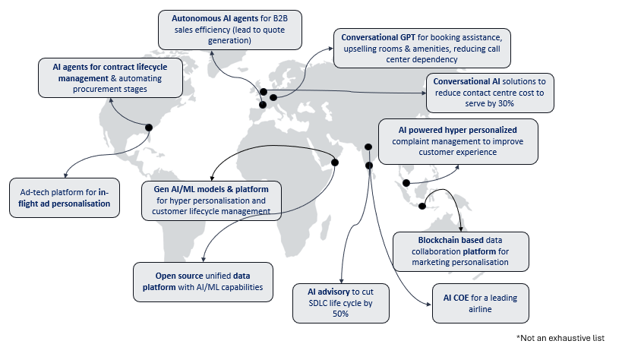
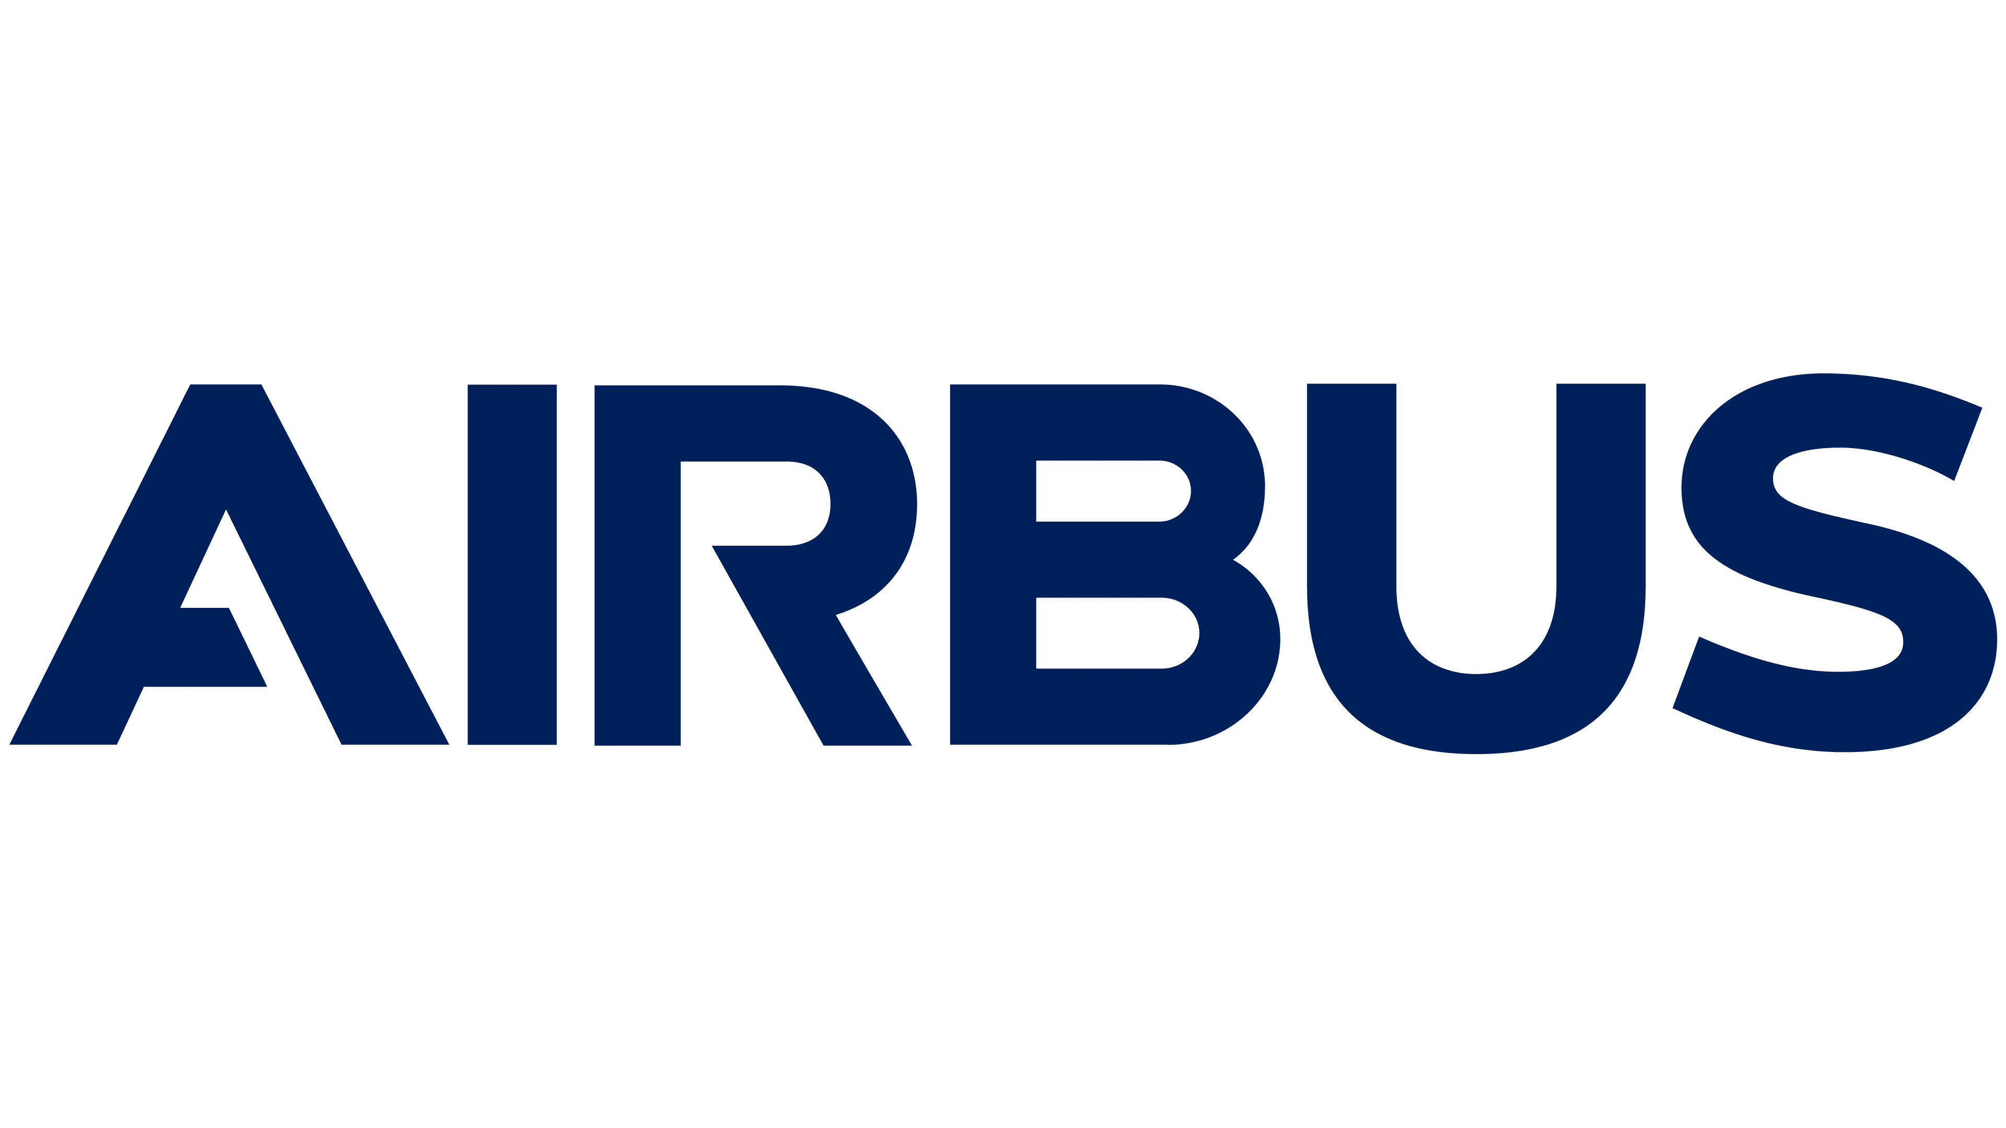
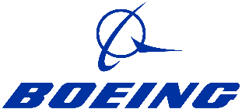


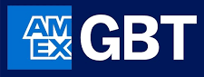

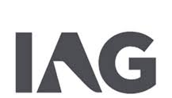














AIONOS: An Applied AI Company
TTLH DNA
Applied AI leader
6+ Countries and counting, giving us a truly global presence​
35+ Years of aviation & travel tech excellence ​as part of the InterGlobe Group
2000+ Domain led technical experts driving impact &
innovation
Trusted by Leading Global Enterprises
Our Ecosystem Partnerships
& many more

Slide 4
Integrated Products, Expert Services and AI Foundry
From fragmented pilots to scaled enterprise AI
AI Products & Platforms
Enterprise Transformation Services
Four integrated platforms spanning AI operations, CX, data and security
AI Strategy and Consulting
1
UniStack
UniWeave
Enterprise AI Operations Platform
Multi-Modal Customer Experience Platform
2
Salesforce AI and Automation
Unified Agentic AI observability
DataOps orchestration and self-healing
Hybrid cloud orchestration with guardrails
AI impact dashboards for leadership
Omnichannel Conversation AI
Real-time sentiment analysis
Proactive and personalised CX
AI-powered agent assist and decision support
3
SAP Transformation
4
ServiceNow Capabilities
UniScale
UniProtect
Microsoft Ecosystem
Agentic AI Marketplace for B2B Data Monetization
Security and Business Resilience Platform
5
Data asset discovery
Data packaging and productization
SEO and AEO intelligence
Campaign and revenue orchestration
Intelligent threat detection and response
Business continuity
Disaster recovery
Compliance automation
Data and AI Engineering
6
AIONOS AI Foundry
Our proprietary engine industrializing AI adoption: the operating model to scale enterprise AI
01
02
03
04
05
STARTING POINT
BUILD
OPERATE
SCALE
LEAD
Slow GenAI Adoption
Domain AI Squads
Strong Engineering Foundations
Reusable AI Accelerators
Rapid Enterprise AI Scaling
2

Slide 5
AIONOS Core AI Capabilities
CAPABILITY
PROVEN METRIC
1
Computer Vision
>90% classification accuracy
3D scanning, dent detection, assembly conformance, cabin installation QA
2
Knowledge Extraction & RAG
86%+ retrieval accuracy
Multi-agent retrieval from legacy manuals, mainframes, and engineering drawings
3
Agentic AI Orchestration
Deployed across multiple enterprise engagements
Multi-agent pipelines with human-in-the-loop governance for regulatory decisions
4
Anomaly Detection
Applied in Dent AI and IntelliFleet
Real-time surface and operational anomaly detection, predictive supply stress engine
5
Intelligent Automation
75% faster process turnaround
Source-to-contract workflow automation across procurement and compliance pipelines
6
Model Traceability
Compliance-grade audit trail
Full data lineage from engineering data to model to agent to decision
3

Slide 6
SECTION 02
The Shell Opportunity
Two high-impact control towers for Shell India: dangerous goods logistics and source-to-pay operations

Slide 7
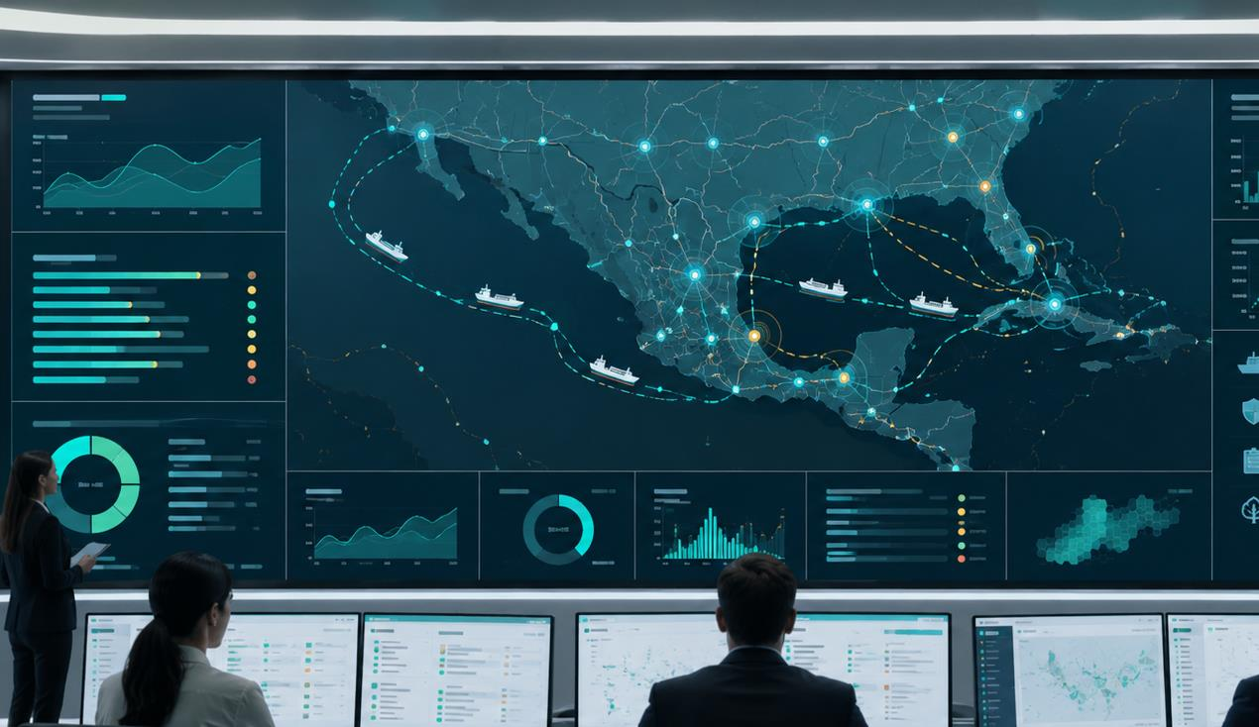
Shell x AIONOS: AI use-cases to create business-outcome transformation
Two high-impact control towers for Shell: Dangerous goods (DG) logistics and Source-to-pay operations
AIONOS can embed governed AI into Shell's daily operating fabric
The opportunity is not another GenAI chatbot. It is a business command layer that orchestrates risk, work and evidence around business outcomes.
INTRA-CITY FUEL LOGISTICS
PROCUREMENT + AP CO-PILOT
ENTERPRISE AI OPERATING MODEL
AI journey control for dangerous-goods movement: dispatch, route risk and live exceptions.
Vendor experience, payment predictability and audit trails across source-to-pay.
UniStack and AI Foundry industrialise data, agents, guardrails, HITL approvals and measurable ROI.
Business command layer
Senses risk, recommends action, automates controls, proves decisions. Point-tracking tools tell you where a shipment is. AIONOS tells you what to do about it and proves you did it right. This is a governed decision layer, not a visibility dashboard.
Starting point: Shell India. Both control towers are designed to prove the model in one geography, then extend as a global operating layer across Shell's road transport and source-to-pay footprint.
Safer movements
Fewer stockout miles
Faster dispute closure
Stronger payment trust
Compliance evidence
4

Slide 8
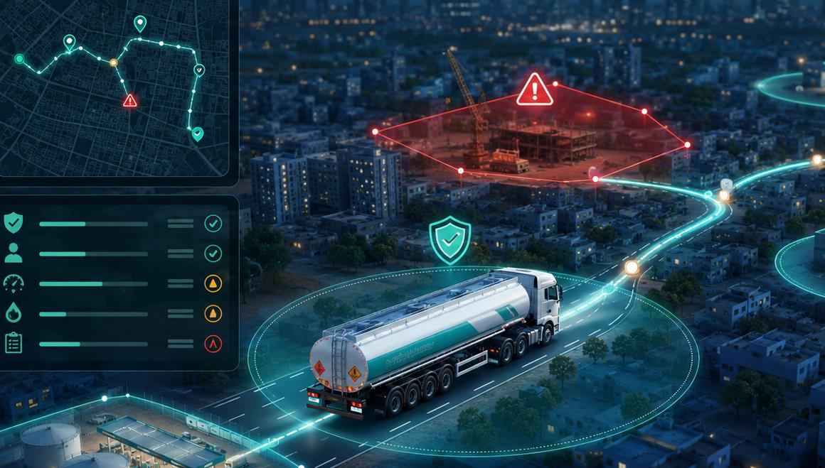
Intra-City Fuel Logistics: build a dangerous-goods movement nerve centre
PILLAR 1 OF 2: DG LOGISTICS
From depot gate-out to retail-site delivery, every litre, vehicle, driver and route has an AI-assisted safety and service plan
Depot / Terminal
Dispatch Plan
City Route
Retail / B2B Site
Settlement
Load readiness, permit validation
AI trip plan, time-window fit
Risk scoring, geofence monitor
ePOD, dips, stock, exception capture
Quantity, invoice and audit evidence
Sense
Decide
Act
Learn
Beyond Visibility
TMS
GPS/telematics
Depot systems
ePOD
Weather and road restrictions
Dynamic risk score
Trip feasibility
Load/route exceptions
Driver fitness
ETA confidence
Dispatch hold/release
Alternate route
Escalation
Site reschedule
Evidence capture
Near-miss patterns
Recurring bottlenecks
Vendor/driver performance
Control tuning
Visibility platforms flag exceptions; AIONOS closes the loop; each trigger is a governed, audited decision built for regulated, safety-critical movement
This is an Order-to-Delivery control tower. Every stage - dispatch, route, delivery, settlement - maps to OtD performance: on-time delivery rate, dispatch cycle time, exception-to-resolution time, order fulfilment accuracy.
24x7
HITL
Every trip
Every site
Movement watch
DG hold/release
Decision trail
ETA confidence
5

Slide 9
Outcome scorecard for Shell intra-city fuel logistics
PILLAR 1 OF 2: DG LOGISTICS
Proposed measurable outcomes for a 90-day pilot. Baselines to be validated with Shell operational data.
Safety
Service
Cost
Fewer preventable exceptions
Higher on-time delivery
Fewer avoidable miles
Route/deviation alerts, fatigue risk detection, unsafe-stop detection, DG classification and ADR/hazmat compliance checks, near-miss pattern surfacing for HSSE review
ETA confidence and station replenishment priority
Route optimization, dispatch sequencing, asset utilization
Compliance
Working capital
Customer experience
100% trip dossier
Lower dispute ageing
Higher station confidence
Permit, SOP, ePOD, incident and audit evidence chain
Quantity reconciliation and faster claim closure
Proactive ETA, issue escalation, delivery transparency
AIONOS changes the management conversation from “what happened?” to “what should we prevent, accelerate and prove next?”
Built to plug into existing HSSE incident reporting and near-miss review cycles — not a parallel safety system.
6

Slide 10
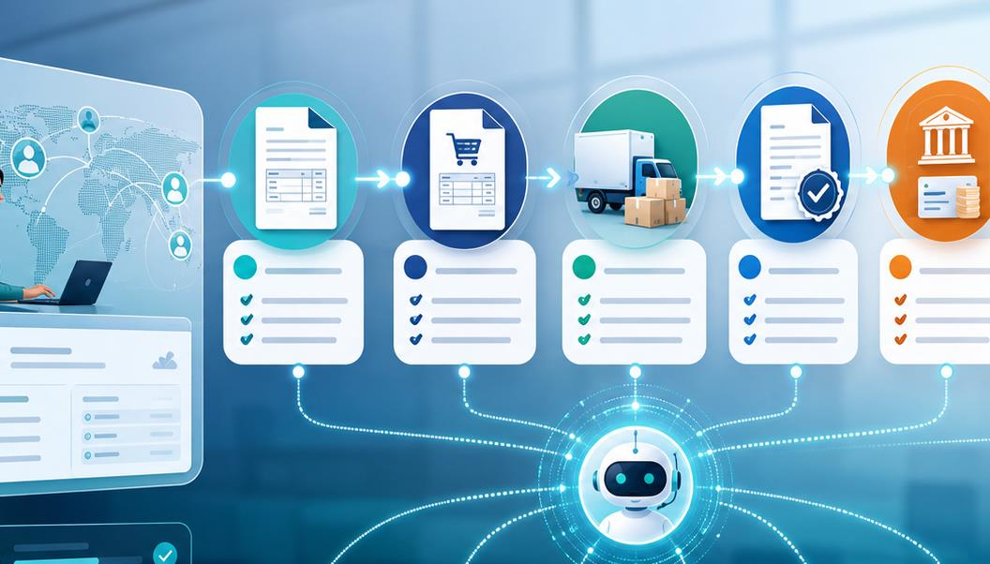
Procurement + Accounts Payable Co-Pilot for Shell
PILLAR 2 OF 2: S2P CO-PILOT
A unified agentic layer to improve vendor experience, payment reliability and auditability across source-to-pay
Request
Source
Contract
PO
Receive
Invoice
Pay
Audit
PR / demand
RFQ, vendor
Terms, obligations
Approval, budgets
GRN / service entry
3-way match, tax
Approval, remittance
Evidence pack
How this connects to Order-to-Delivery performance Dispatch cycle time → Route risk scoring → On-time delivery rate → Exception dwell time → OtD dossier completeness
Every metric on the DG logistics scorecard (slide 9) rolls up into the same OtD performance metrics Shell already tracks globally.
Co-Pilot Capabilities
Vendor experience
Payment intelligence
Self-service status, dispute triage, SLA promises
Cash-flow visibility, blocked invoice reasoning, payment run simulation
Controls automation
Auditability
Policy checks, SoD, duplicate invoice and tax/TDS validations
Document lineage, approval trail, exception resolution, evidence pack
Designed as an overlay on existing ERP and procurement platforms, not a disruptive rip-and-replace. Your S2P platform runs the transaction. AIONOS runs the judgment layer on top; the vendor experience, exception reasoning and audit trail your platform's native AI roadmap won't reach for another 2-3 release cycles.
7

Slide 11
Outcome scorecard for Shell source-to-pay operations
PILLAR 2 OF 2: S2P CO-PILOT
Proposed measurable outcomes for a 90-day pilot. Baselines to be validated with Shell operational data.
Vendor experience
Payment predictability
Working capital
Higher vendor satisfaction
Higher on-time payment rate
Lower DPO leakage
Self-service status, faster dispute triage, clear SLA promises
Cash-flow visibility and payment run simulation
Early-payment capture and reduced manual reconciliation
Controls and compliance
Audit readiness
Cycle time
Fewer policy exceptions
100% audit evidence pack
Faster invoice-to-pay cycle
SoD, duplicate invoice and tax/TDS validation catch rate
Document lineage and approval trail on every transaction
3-way match automation and exception triage
The commercial model is the point: AI is rewarded for real operational impact, not licences or model minutes.
This mirrors the discipline Shell is already applying internally — prioritising the parts of the portfolio that are genuinely profitable and funding what proves impact, not what consumes licences or model minutes.
Account Payables Copilot
8

Slide 12
This is not a first-of-a-kind bet for Shell
AIONOS has delivered comparable AI-led control towers across complex, regulated, safety-critical operations elsewhere
AEROSPACE & DEFENCE
AEROSPACE MANUFACTURING
AVIATION
ENERGY & RESOURCES
Governed contract intelligence in an export-controlled, in-situ environment
Engineering document intelligence for the world's largest aircraft manufacturer
Network and disruption control tower for a large Saudi carrier
Contract and licence compliance cockpit across thermal power and mining
95%+ extraction accuracy
40% faster time-to-market
70% faster recovery decisions
70% faster licence diligence
Also launching AI led Healthcare automation for UPS India (Movin)
Full proof points and detail follow. Case studies available in Appendix.
9

Slide 13
SECTION 03
Proven at Scale
Demonstrated outcomes across complex enterprise environments

Slide 14
AIONOS Proof Points & Reference Value
Demonstrated outcomes across complex enterprise environments
AEROSPACE & DEFENCE
AEROSPACE MANUFACTURING
AVIATION
ENERGY & RESOURCES
Contract Intelligence & Authoring
Engineering Document Intelligence
Airline Network Management
Thermal Power & Mining Contract Intelligence
European aerospace and defence major needed governed contract analysis and creation in an export-controlled, fully in-situ environment.
World's largest aircraft manufacturer with decades of specifications and drawings locked in unstructured documents.
Large Saudi full-service carrier managing disruption and capacity decisions manually across a peak-heavy hub network.
Large thermal power and captive-mining ecosystem with PPAs, leases and permits spread across plants, mines and vendors.
Key Results:
Key Results:
Key Results:
Key Results:
95%+ extraction accuracy across clause-heavy contracts
40% faster time-to-market
+6 pts on-time performance
12K+ clauses and licence conditions indexed
60% faster contract review and drafting
60% fewer defects before prototype stage
70% faster recovery decisioning
95%+ extraction accuracy target
8+ document types unified
3x faster decision cycles
30% fewer downline misconnections
70% faster licence diligence
100% in-situ, export-control compliant
50% lower development effort
24x7 network watch
24x7 expiry and penalty alerts
Platform: UniStack + AI Foundry
Platform: UniStack + AI Foundry
Platform: UniScale + UniStack
Platform: UniStack + AI Foundry
10

Slide 15
Proposed Path Forward with Shell
A staged, low-risk path — funded by outcomes, not commitments — built for a moment when every initiative has to earn its place in the portfolio.
01 Discovery & Alignment
→
02 60-Day Pilot
→
03 Scale & Operating Model
2 to 3 weeks
One control tower per pillar
Post-pilot
Validate baselines for both pillars
Confirm data access and system owners
Agree success metrics and pilot scope
DG Logistics: dispatch, route risk, exception management
S2P: invoice matching, vendor self-service, controls
Weekly outcome tracking against scorecards
Extend to full network and full source-to-pay scope
Embed UniStack + AI Foundry as the operating layer
Transition to outcome-based commercial model
What we need from Shell to start
A staged, low-risk path designed to prove value fast, before committing to a larger transformation programme
A named pilot sponsor for each pillar
Read access to TMS/telematics data and ERP/procurement data for baselining
3 to 5 stakeholder interviews across OCC, logistics and procurement teams
Agreement on the 60-day success scorecard
11

Slide 16
SECTION 04
Appendix
Detailed proof point case studies

Slide 17
Case Study 1: Aerospace & Defence Contract Intelligence
Business Context
Our Solution
A European aerospace & defence major needed a governed AI platform to analyse and author complex programme contracts: RFX packs, offers, procurement manuals and infopacks, all inside a highly secure, export-controlled environment.
Discovery & Due Diligence
Built a contract-document taxonomy (RFX, Offer/Contract, Infopack, Procurement Manual) with automated classification
Unified ingestion across all enterprise formats with single sign-on
Implementation Approach
Hybrid OCR + layout-aware VLM parsing of text, clauses, tables, flowcharts and images
Containerised deployment fully on client infrastructure
Operating Intelligence
Contract analysis and authoring workflows with clause-level extraction
Automated compliance checks against procurement rules
Continuous Improvement
SME validation loops and a KPI framework aligned to the client's AI development standards
Key Challenges
Contract knowledge locked in clause-heavy, multi-format documents (Office, PDF, scans) with dense tables and flowcharts
Manual review and drafting of RFX and offer documents was slow and error-prone, constraining bid turnaround
Stringent security posture: all work in-situ on client infrastructure, zero data egress, export-control classification of every deliverable
Impact
8+
95%+
60%
100%
Document types unified
Extraction accuracy
Faster contract review and drafting
In-situ, export-control compliant

Slide 18
Case Study 2: Engineering Document Intelligence
Business Context
Our Solution
One of the world's largest aircraft manufacturers held decades of specifications, drawings and tribal engineering knowledge locked in unstructured documents, slowing every engineering decision and handoff across the product lifecycle.
Discovery & Due Diligence
Mapped the engineering document estate across specifications, drawings and lifecycle artefacts
Prioritised high-value knowledge domains for onboarding
Implementation Approach
RAG over specifications and drawings with layout-aware extraction
Governed digital thread with MBSE integration
Operating Intelligence
Predictive AI/ML that surfaces engineering risk before prototypes are built
Instant retrieval across decades of technical knowledge
Continuous Improvement
SME-validated confidence scoring and expanding domain coverage
Key Challenges
Legacy scans, complex drawings and dense technical specifications spread across programmes and repositories
Tribal knowledge concentrated in senior engineers, not searchable or transferable
Slow decision cycles and handoffs across the engineering lifecycle; risk discovered late, at prototype stage
Impact
40%
60%
3x
50%
Faster time-to-market
Fewer pre-prototype defects
Faster decision cycles
Lower development effort

Slide 19
Case Study 3: Airline Network Management
Business Context
Our Solution
A large Saudi full-service carrier operating a dense hub network with extreme seasonal peaks needed AI-led network intelligence: disruptions, schedule changes and capacity decisions were being managed manually across siloed planning and OCC teams.
Discovery & Due Diligence
Mapped the network decision chain across planning, scheduling and the OCC
Built a disruption-event taxonomy and downstream cost model
Implementation Approach
AI agents for IROPS detection and ranked recovery options with full downstream cost visibility
Tail-assignment and schedule-integrity optimisation as an overlay on existing PSS/OCC systems
Operating Intelligence
Network control cockpit with live disruption alerts
What-if simulation for seasonal capacity scenarios
Continuous Improvement
OCC-controller feedback refining recovery playbooks and cost models
Key Challenges
Disruption recovery decisions (swap, delay, cancel, reprotect) made manually across OCC, crew and passenger silos
Schedule changes rippled unpredictably across fleet, crew pairings and slot commitments
Seasonal peaks stress-tested capacity planning with no fast what-if simulation capability
Impact
+6 pts
70%
30%
24x7
On-time performance
Faster recovery decisioning
Fewer downline misconnections
Network watch across the schedule horizon

Slide 20
Case Study 4: Thermal Power & Mining Contract Intelligence
Business Context
Our Solution
One of the largest thermal power and captive-mining ecosystems needed a governed way to read PPAs, EPC/O&M contracts, fuel-supply agreements, mining leases, environmental clearances and statutory permits across plants, mines and vendors.
Discovery & Due Diligence
Mapped PPAs, EPC/O&M, fuel-supply contracts, leases, ECs and permits
Created plant-mine-vendor-regulator obligation taxonomy
Prioritised expiry, royalty, dispatch, HSE and penalty-risk clauses
Implementation Approach
Layout-aware OCR/VLM for scans, annexures, tables, maps and approvals
Extracted renewals, quantities, safety/environment conditions and penalties
Built graph: licence clause to asset/site to owner to deadline to evidence
Operating Intelligence
Compliance cockpit with risk heatmaps, audit packs and 24x7 alerts
What-if diligence for expiring licences, coal shortfall and LD exposure
Continuous Improvement
SME validations refine taxonomy, confidence scores and renewal playbooks
Key Challenges
Legacy scans and clause-heavy PDFs across contracts, licences and permits
Obligations spread across renewals, royalties, dispatch, penalties, safety and environmental conditions
Expiry, compliance and liability risks were tracked manually across legal, mining, procurement and operations teams
Impact
12K+
95%+
70%
24x7
Clauses and licence conditions indexed
Extraction accuracy target
Faster licence diligence
Expiry and penalty alerts

Slide 21
Thank You

Slide 22

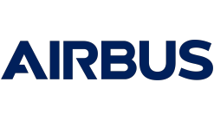
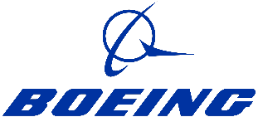




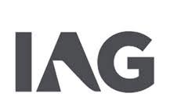













AIONOS: An Applied AI Company
TTLH DNA
Applied AI Leader
6+
35+
Countries and counting, giving us a truly global presence
Years of aviation and travel tech excellence as part of the InterGlobe Group
2000+
Domain led technical experts driving impact and innovation
Trusted by Leading Global Enterprises
Our Ecosystem Partnerships
1

