Slide 1

ACROPOLIS INSTITUTE OF TECHNOLOGY AND RESEARCH
SESSION 2018-2019
TOPIC : ONLINE EXAMINTION SYSTEM
BY:
Aditi Bais 07
Abhishek Raikwar 06
Aishwarya Borgaonkar 09
Amisha Mishra 14
Divya Kothari 32
Submitted to:
Prof.Gaurav Mandloi

Slide 2
THE PROBLEM WITH PAPER EXAMINATIONS
Not feasible for remote candidates
Inability to create, modify and delete the test papers and its particular questions.
Low accuracy comparatively
Delayed results
Need of manual insertion of marks as a record
No Realtime evaluation of the tests.
Course material and doubt solving

Slide 3
SOLUTION
Immediate results and solutions
Past records repository
Study material, Doubt solution, and interaction with faculties
Feasible for remote candidates
Ability to make changes in the existing paper

Slide 4







6 Reasons Why We Must Use Online Examination System
Result Displaying Screen
Availability of document
No need of delays in manual checking
Provide course material ,answer key ,sample question paper
Easy to store and retrieve information
Because
Doubt clearing
Rather to save the information on a papers or in separate sheets. There are a data base management to store and retrieve the information needed by the administrator or Faculty member or student according a report generated by the system.
Direct interaction between user and admin
Remote Users
Inefficient paper system
Feasible for different candidates at different locations
The problems of traditional methods have lead to increasing problems with students and teachers.

Slide 5
FLOW
Administrator: Access to master forms for the purpose of creating and modifying results, access user data and upload documents
Can create/delete an account.
Can change the password.
Can hide any kind of features from the both of users.
Insert/delete/edit the information of available on OES.
Can access all the accounts of the faculty members/students.
FACULTY
Can view the different categories of Test available in their account.
Can change password.
Can view their marks.
Can view the various reading material.
Can view and modify its profile but can modify it to a limited range.
STUDENT

Slide 6
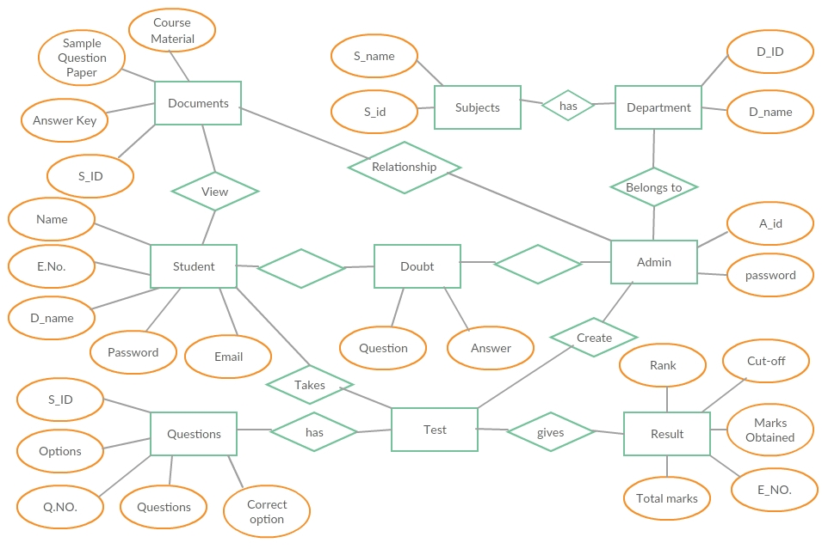
E-R DIAGRAMS

Slide 7
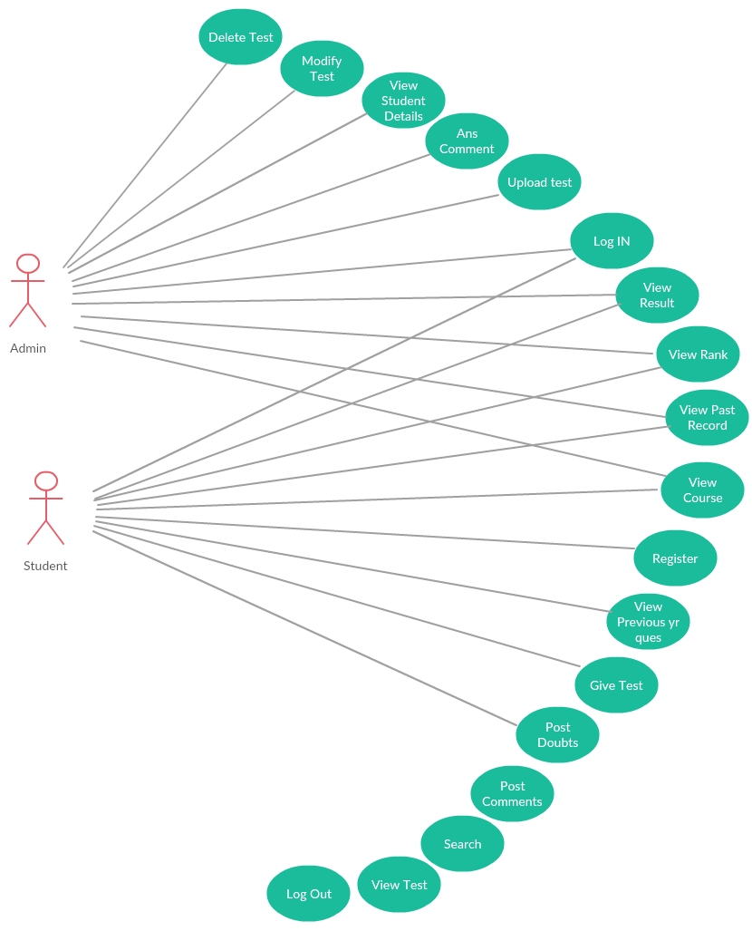
USE CASE

Slide 8
LIMITATIONS
Does not support PDF format
Question paper can be conducted only in given format
Slow Internet connection hinders ease
Questions are generally objective type so either it is correct or wrong, no marks for any unnecessary writing
If user has lack of knowledge of computer
Server Problems
Need or required no of computers

Slide 9
SCOPE
Several categories of test
course material& sample question papers
Hold all operation and generate reports to user and administrator.
Support
multiple
choices, images
Online Examination System
subjective
Answer key, Ranking, Doubt solving
Verify a security, authority and safety
Hold all operation and generate reports to student, teachers and administrator.
The on-line exam system design for educational institutes.
Feedback of test

Slide 10
Conclusion
The key concept of online examination system is to minimize the amount of paper and convert all forms of documentation and convert it to digital form. It can also be observed that the information required can be obtained with ease and accuracy in the computerized system. The user with minimum knowledge about computer can be able operate the system easily. The system also produces brief result required by the management. The doubt solving feature will help in the discussion of doubts. Thus, this system will be a complete exam builder for any institute as the admin can create the test, upload the documents and the user can attempt the test as well as view the test material with an addition of the doubt discussion feature.
.

Slide 11
THANK-YOU

