Slide 1
Car Price Prediction PredX
Project Report by Pranav Choudhary & Abhishek Saha

Slide 2
Table of contents
01
02
03
04
Introduction
Explanation
Screenshots
Conclusion
Insights
Output
Future Scope
Blockages

Slide 3
Objectives
Machine learning model development for prediction of car price highlight features which will help customer predicting the value of their car in terms of :
Company
Model
Year of Purchase
Owners of car
Type of fuel
Transmission

Slide 4
01
Introduction

Slide 5
Motivation
When you’re thinking about selling a used car is its resale value. You must understand that the resale value depends on many factors, some of which you have control over. Demand and supply are important factors in calculating a used car’s price. A survey is a great way to learn what your car’s customers think. If you do your research, it will become clear that the best time to sell a car is when demand is high.
In this project we made a car price predictor using Linear Regression. We will also convert it into a full-fledged website using the flask framework.

Slide 6
Information Gathering
You tube, Books and online courses
Engagement
Learning how to perform EDA and attach a ML model to the data was the base. We finished many prediction models with random databases at first.
Glancing back at the time we had anticipated and the time we took, we made progress at a steady pace and have completed the goals we set for the time period.

Slide 7
Tools Used
65%
25%
10%
Python
HTML
CSS
For Making Model
For Frontend
For Designing

Slide 8
02
Explanation

Slide 9

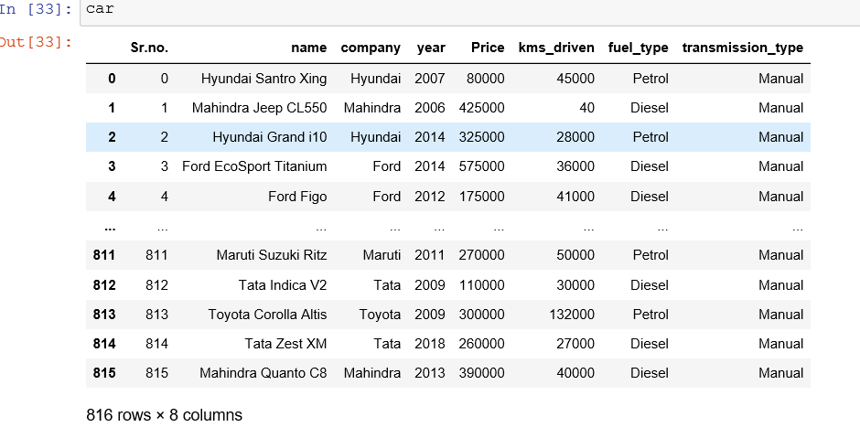
Implementation

Slide 10
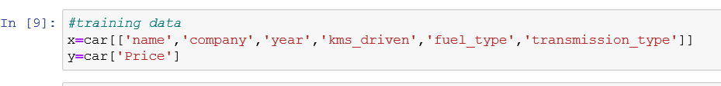
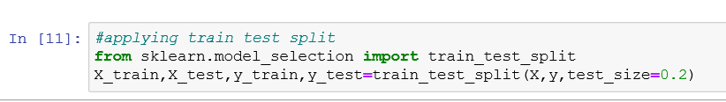
Implementation

Slide 11
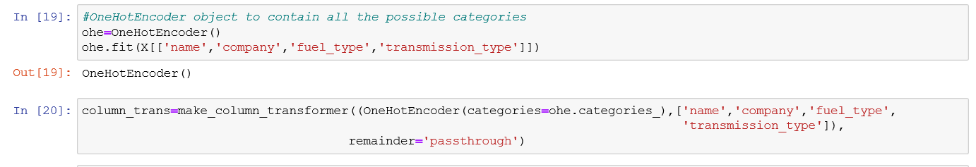
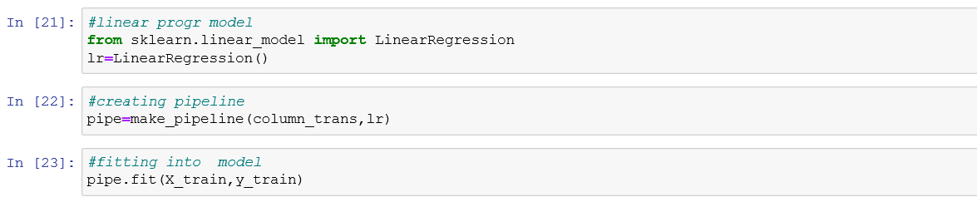
Implementation

Slide 12
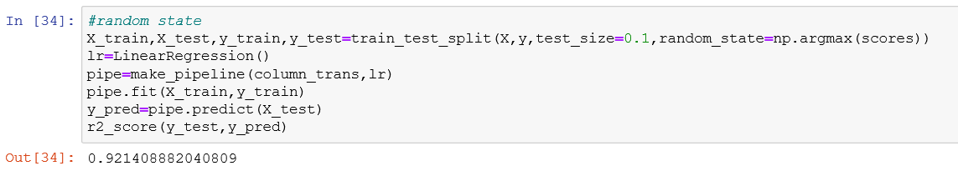
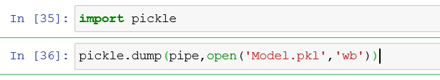
Implementation

Slide 13
03
Screenshots

Slide 14

Testing

Slide 15
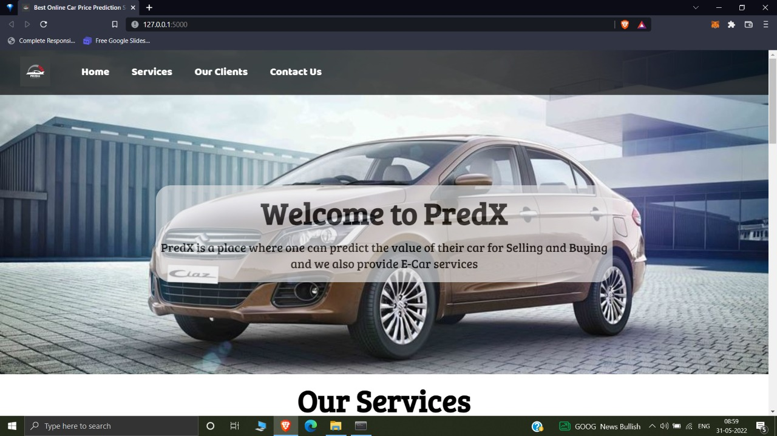

Slide 16
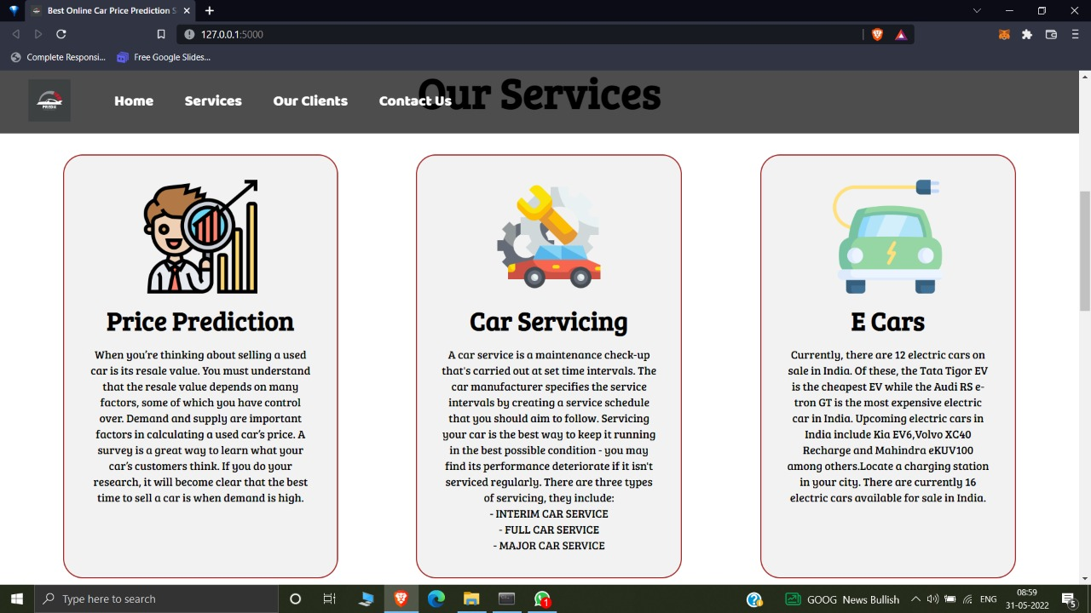

Slide 17
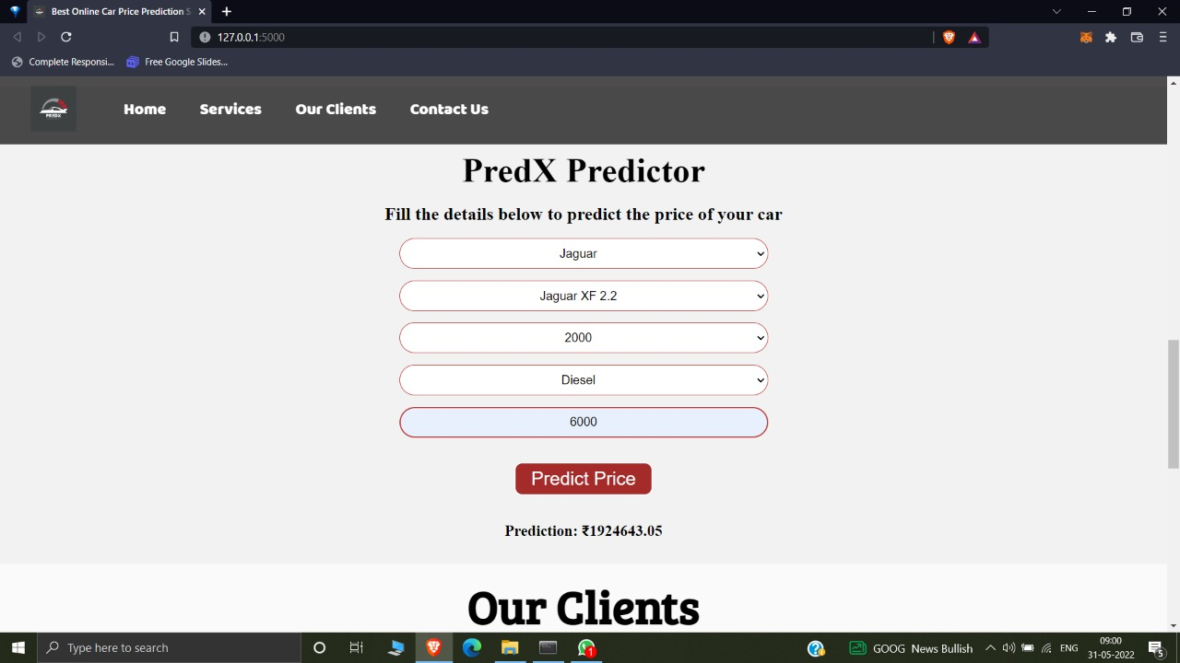

Slide 18
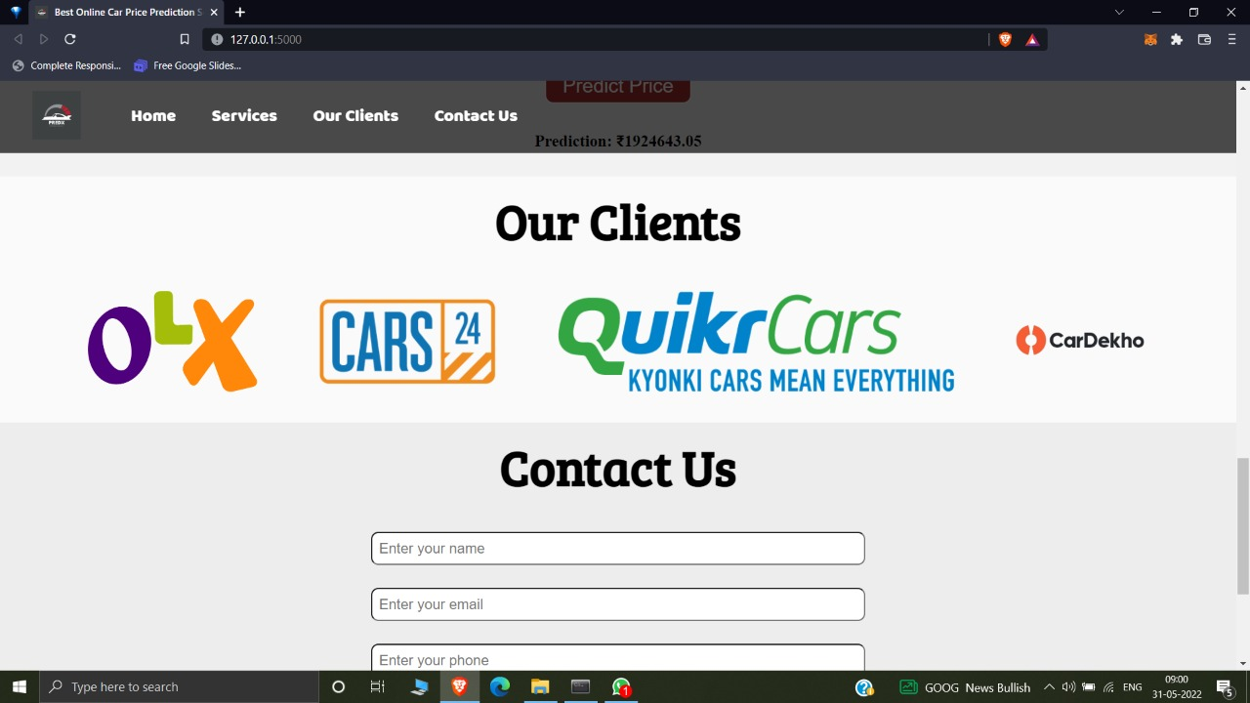

Slide 19
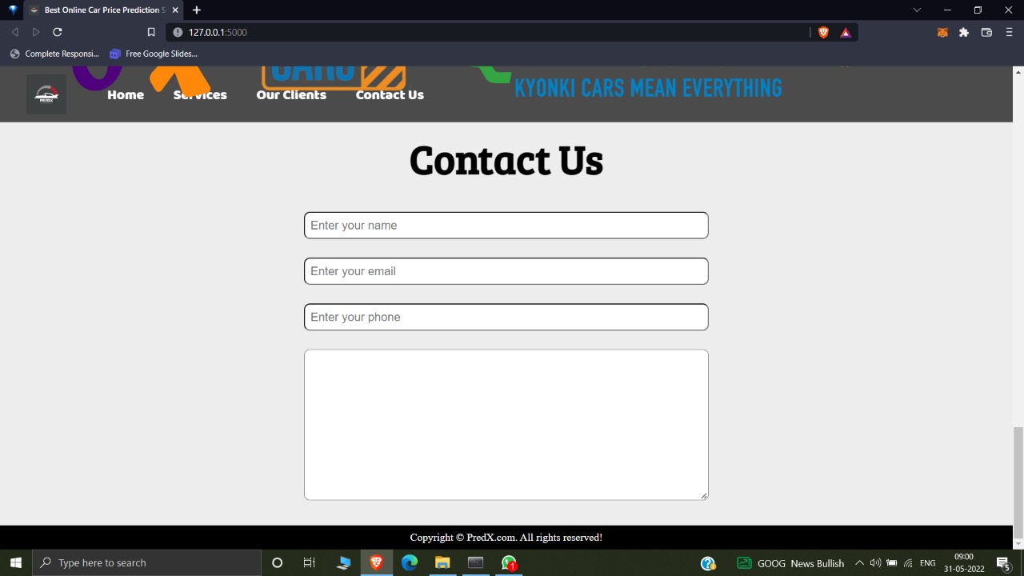

Slide 20
Future Scope
Chatbot
E-Car Prediction
One on One Consultancy

Slide 21
References
Sites
Apps
https://codewithharry.com/
https://docs.python.org/3/
https://www.kaggle.com/datasets/hellbuoy/car-price-prediction
Youtube
Spyder
Udemy

Slide 22
Thank You!

