Slide 1
Case study title
Abhishek sharma

Slide 2
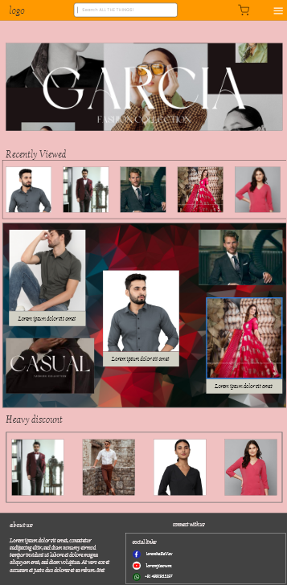
Project overview
The product:
This project is focused on providing good shopping experience.
Project duration:
It took 1week to design the website.

Slide 3
Project overview
The problem:
Availability of wearable shopping app .
The goal:
Provide hastle free shopping.
Provide simple and user friendly app.

Slide 4
Project overview
My role:
Ux designer
Responsibilities:
Wireframing , prototyping, product

Slide 5
User research
Pain point
Personas
Understanding
the user

Slide 6
User research: summary
I conducted interviews and created empathy maps to understand the users I’m designing for and their needs. A primary user group identified through research was working adults who don’t have time to clean their garden
Unmoderated research study is conduced and assumed that user can navigate between different tabs easily.

Slide 7
User research: pain points
1
2
3
Pain point
Pain point
Pain point
Difficulty in finding confirmation option.
Finding location facility.
Navigation to Home screen.

Slide 8
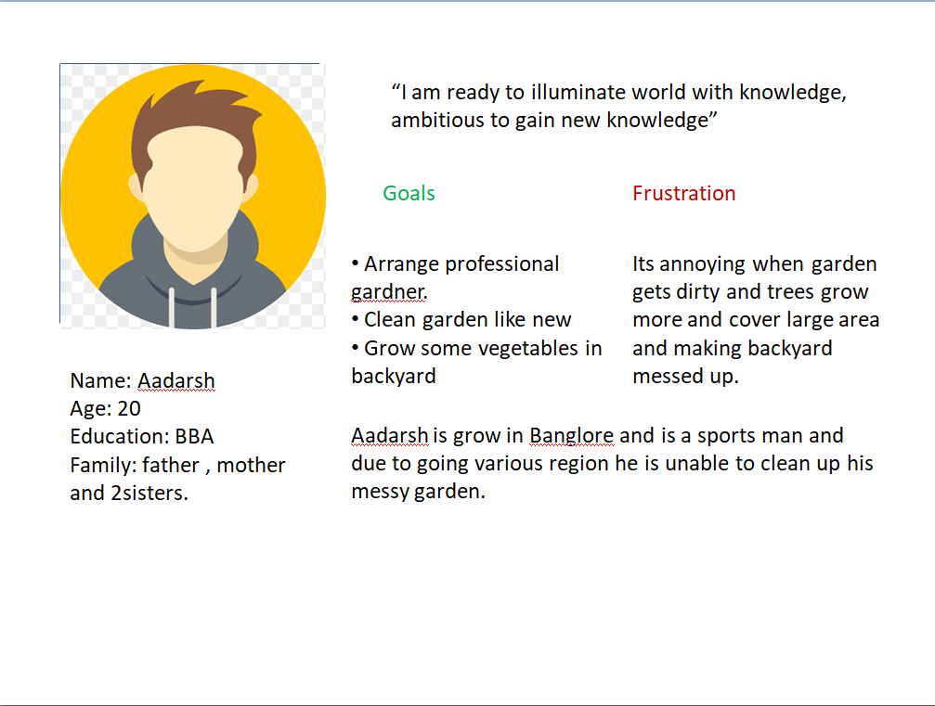
Persona: Lakshit
Problem statement:
Aadarsh is a sports man
who Shopping app for buying cloths. Because he is out of own frequently and is unable to go to shop .

Slide 9
Paper wireframes
Digital wireframes
Low-fidelity prototype
Starting
the design

Slide 10
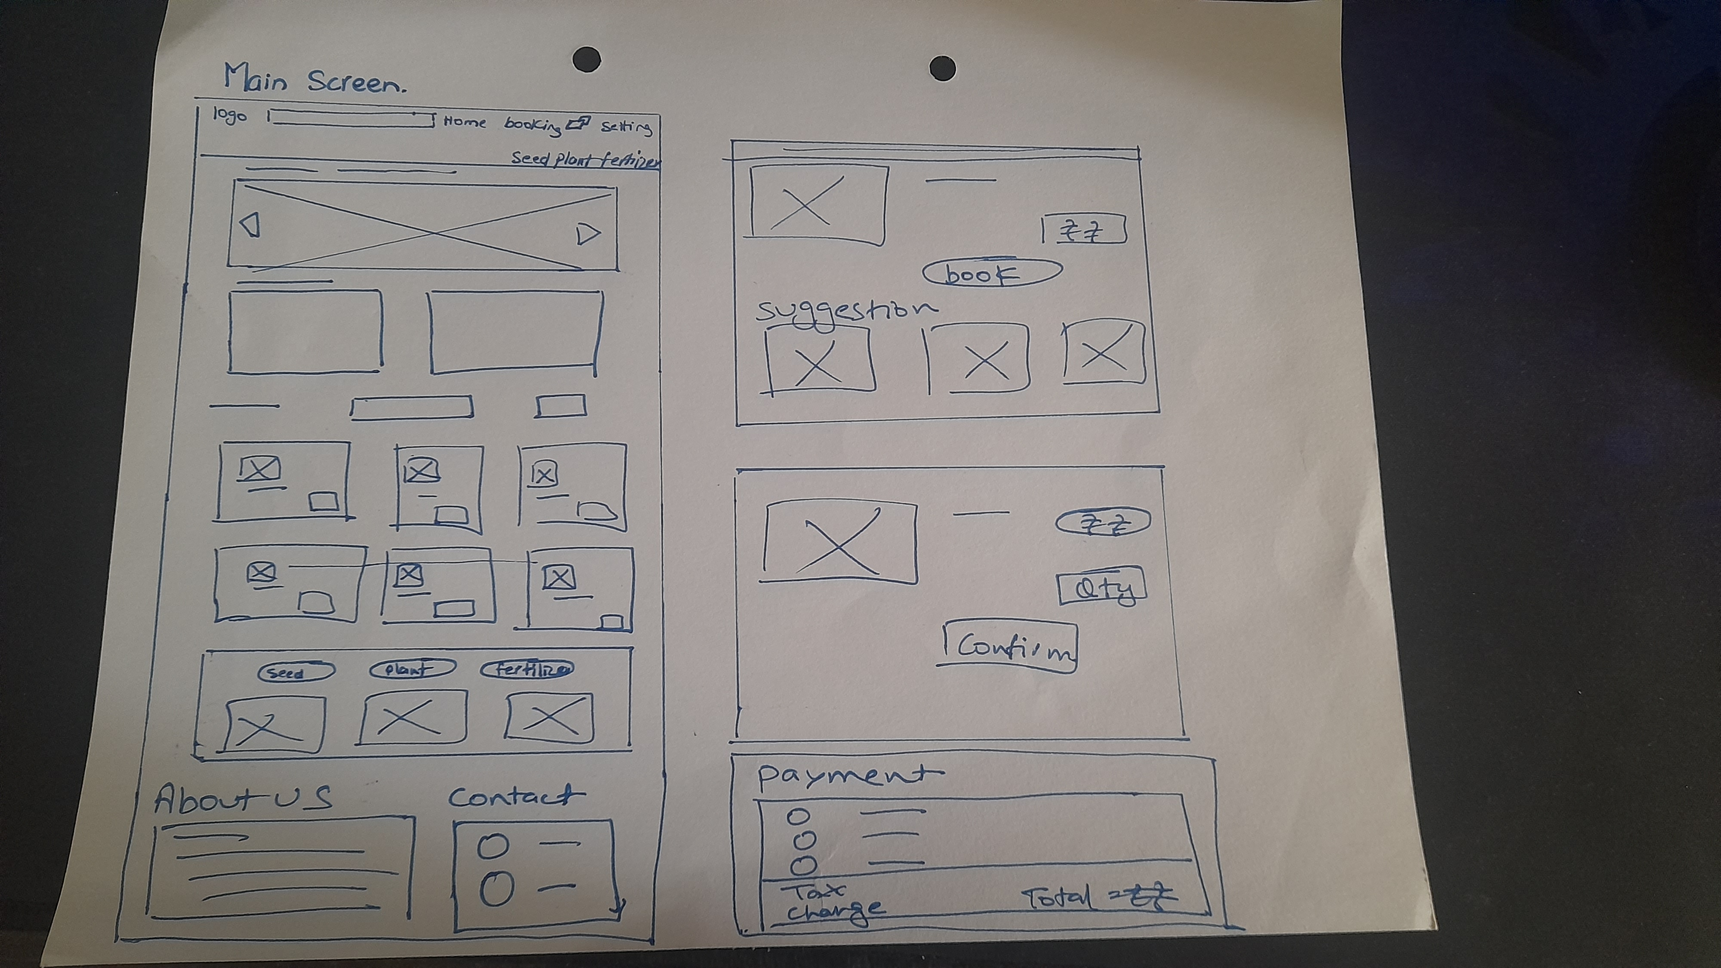
Paper wireframes

Slide 11
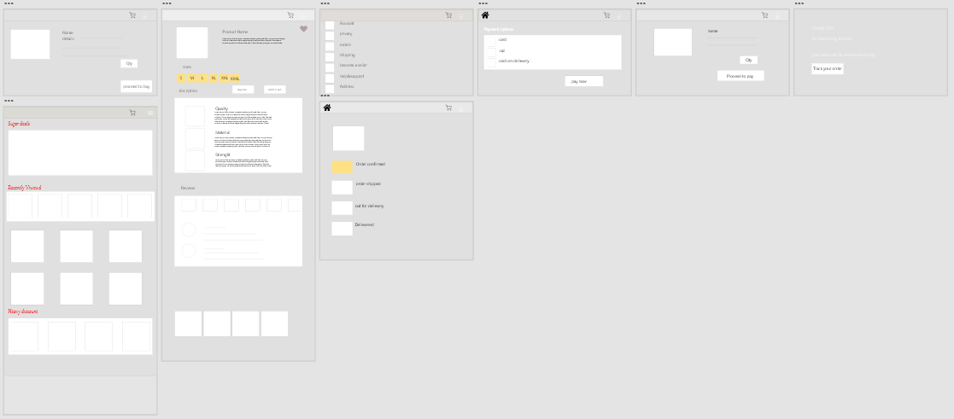
Digital wireframes

Slide 12
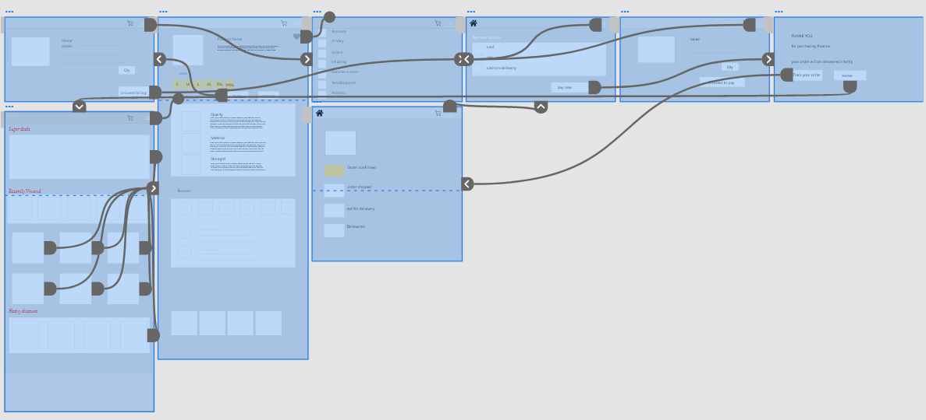
Low-fidelity prototype

Slide 13
Refining
the design
Mockups
High-fidelity prototype
Accessibility

Slide 14
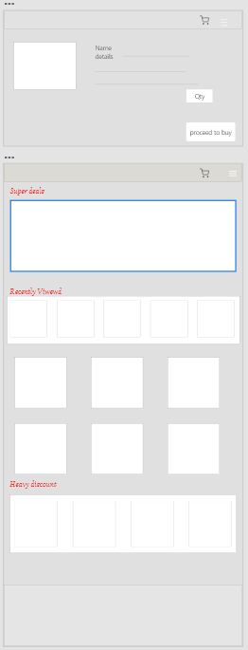
Before usability study
After usability study
Mockups

Slide 15
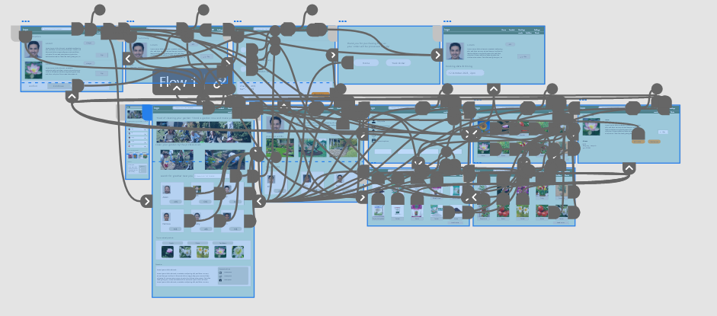
High-fidelity prototype
Screenshot of prototype with connections or prototype GIF

Slide 16
Accessibility considerations
1
2
3
Provided access to users who are vision impaired through adding alt text to images for screen readers.
Used icons to help make navigation easier.
Used image of worker to identify the worker.

Slide 17
Going forward
Takeaways

Slide 18
Takeaways
Impact:
Helps the people to buy cloths for them self at every season.
While designing the Estore , I learned that the first ideas for the app are only the beginning of the process. Usability studies and peer feedback influenced each iteration of the app’s designs.

Slide 19
Let’s connect!
Thank you for your time reviewing my work on the Estore! If you’d like to see more or get in touch, my contact information is provided below.
Email: abhisheksh0012@gmail.com

Slide 20
Thank you!

