Slide 1
Parish Directory
A walk-through of every page
St.Peter’s Parish
Sign in as peterparish@gmail.com / 12345678 — families sign in with their own email address and Churchmembers@2026

Slide 2
The pages
Fifteen screens, from the first-run setup to a family completing its own entry.
1
First run
9
User accounts
Name the parish, create the administrator.
Administrators, editors, viewers.
2
Sign in
10
My account
Every other page needs a session.
Your own name and password.
3
Dashboard
11
Print directory
Counts, and birthdays in the next 30 days.
The printed book, in the browser.
4
Families
12
Page not found
The whole list, searchable.
The error page.
5
Add a family
13
Inviting families
Family details, photo, members.
One login each, and every address to write to.
6
Family record
14
What a family sees
Everything held about one family.
Their own entry — and only theirs.
7
Edit family
15
Their shorter form
The same form, filled in.
What a household may change itself.
8
Parish settings
Name, layout, relation codes, colours.
2

Slide 3
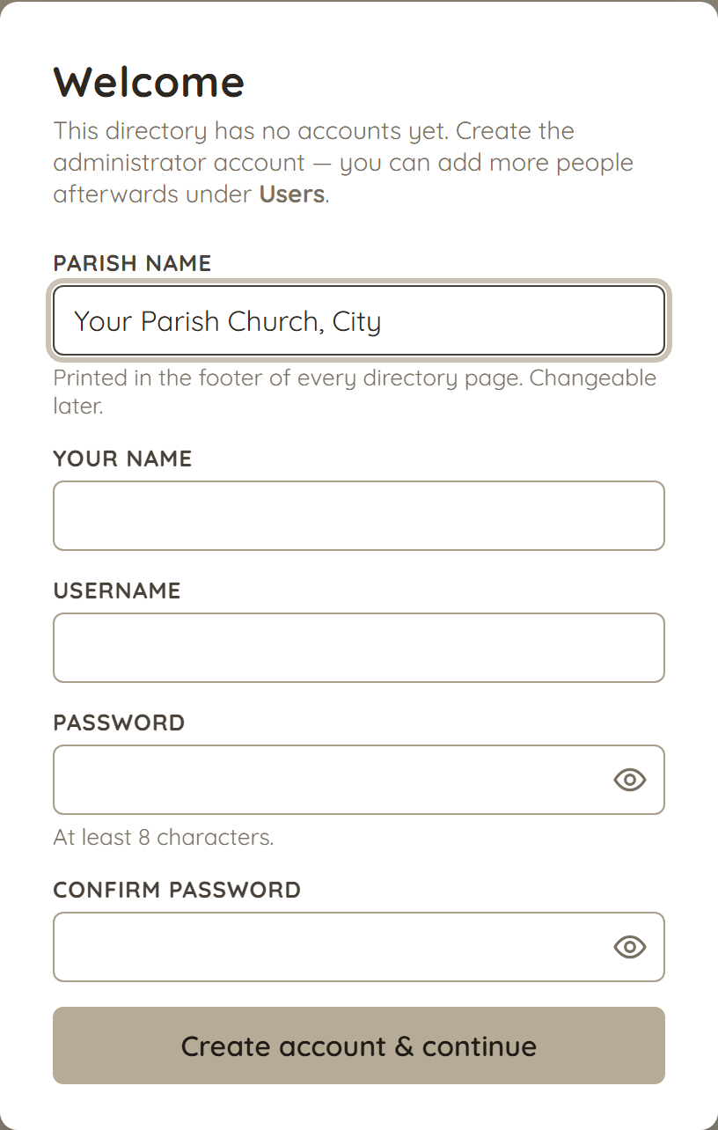
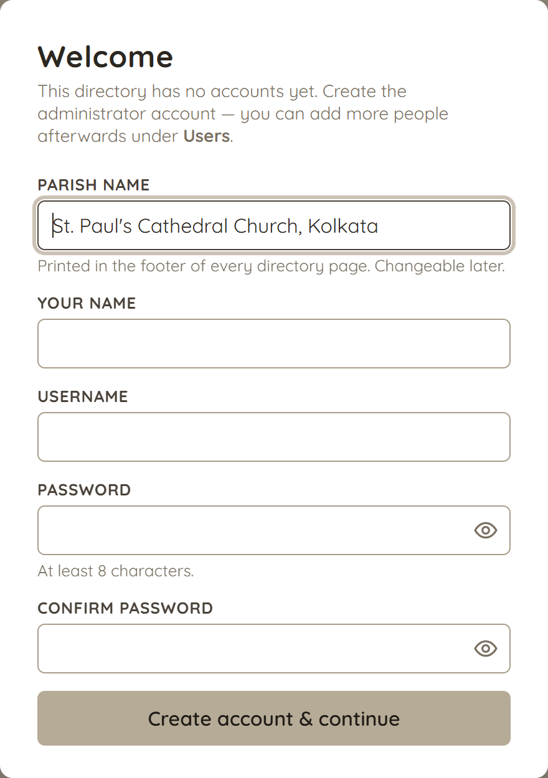
First run
/setup
Shown once, while the directory has no accounts: name the parish and create the administrator. There is no default password to change afterwards.
3

Slide 4
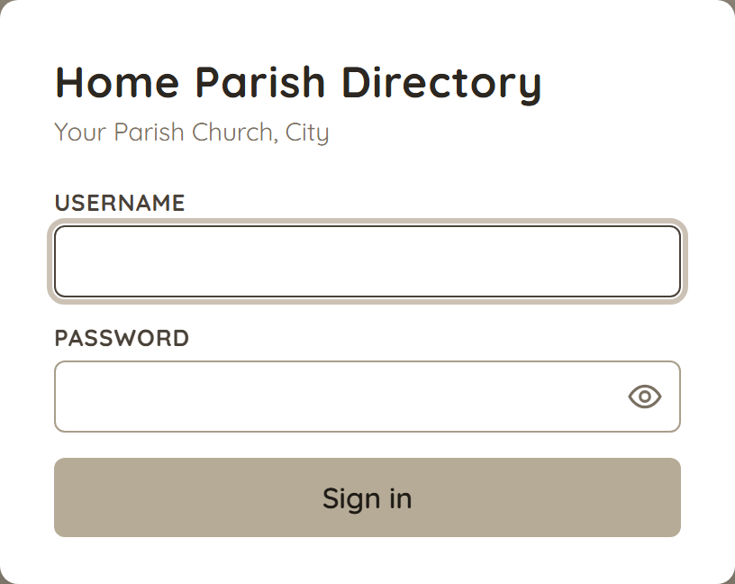
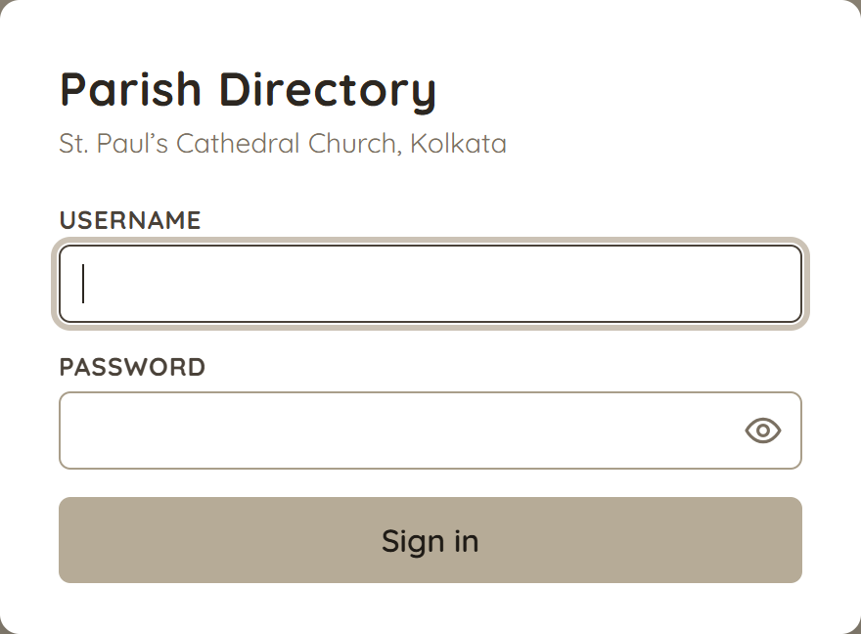
Sign in
/login
The only page that does not need a session. Failed attempts are throttled per IP and username; the parish name and title come from Settings.
4

Slide 5
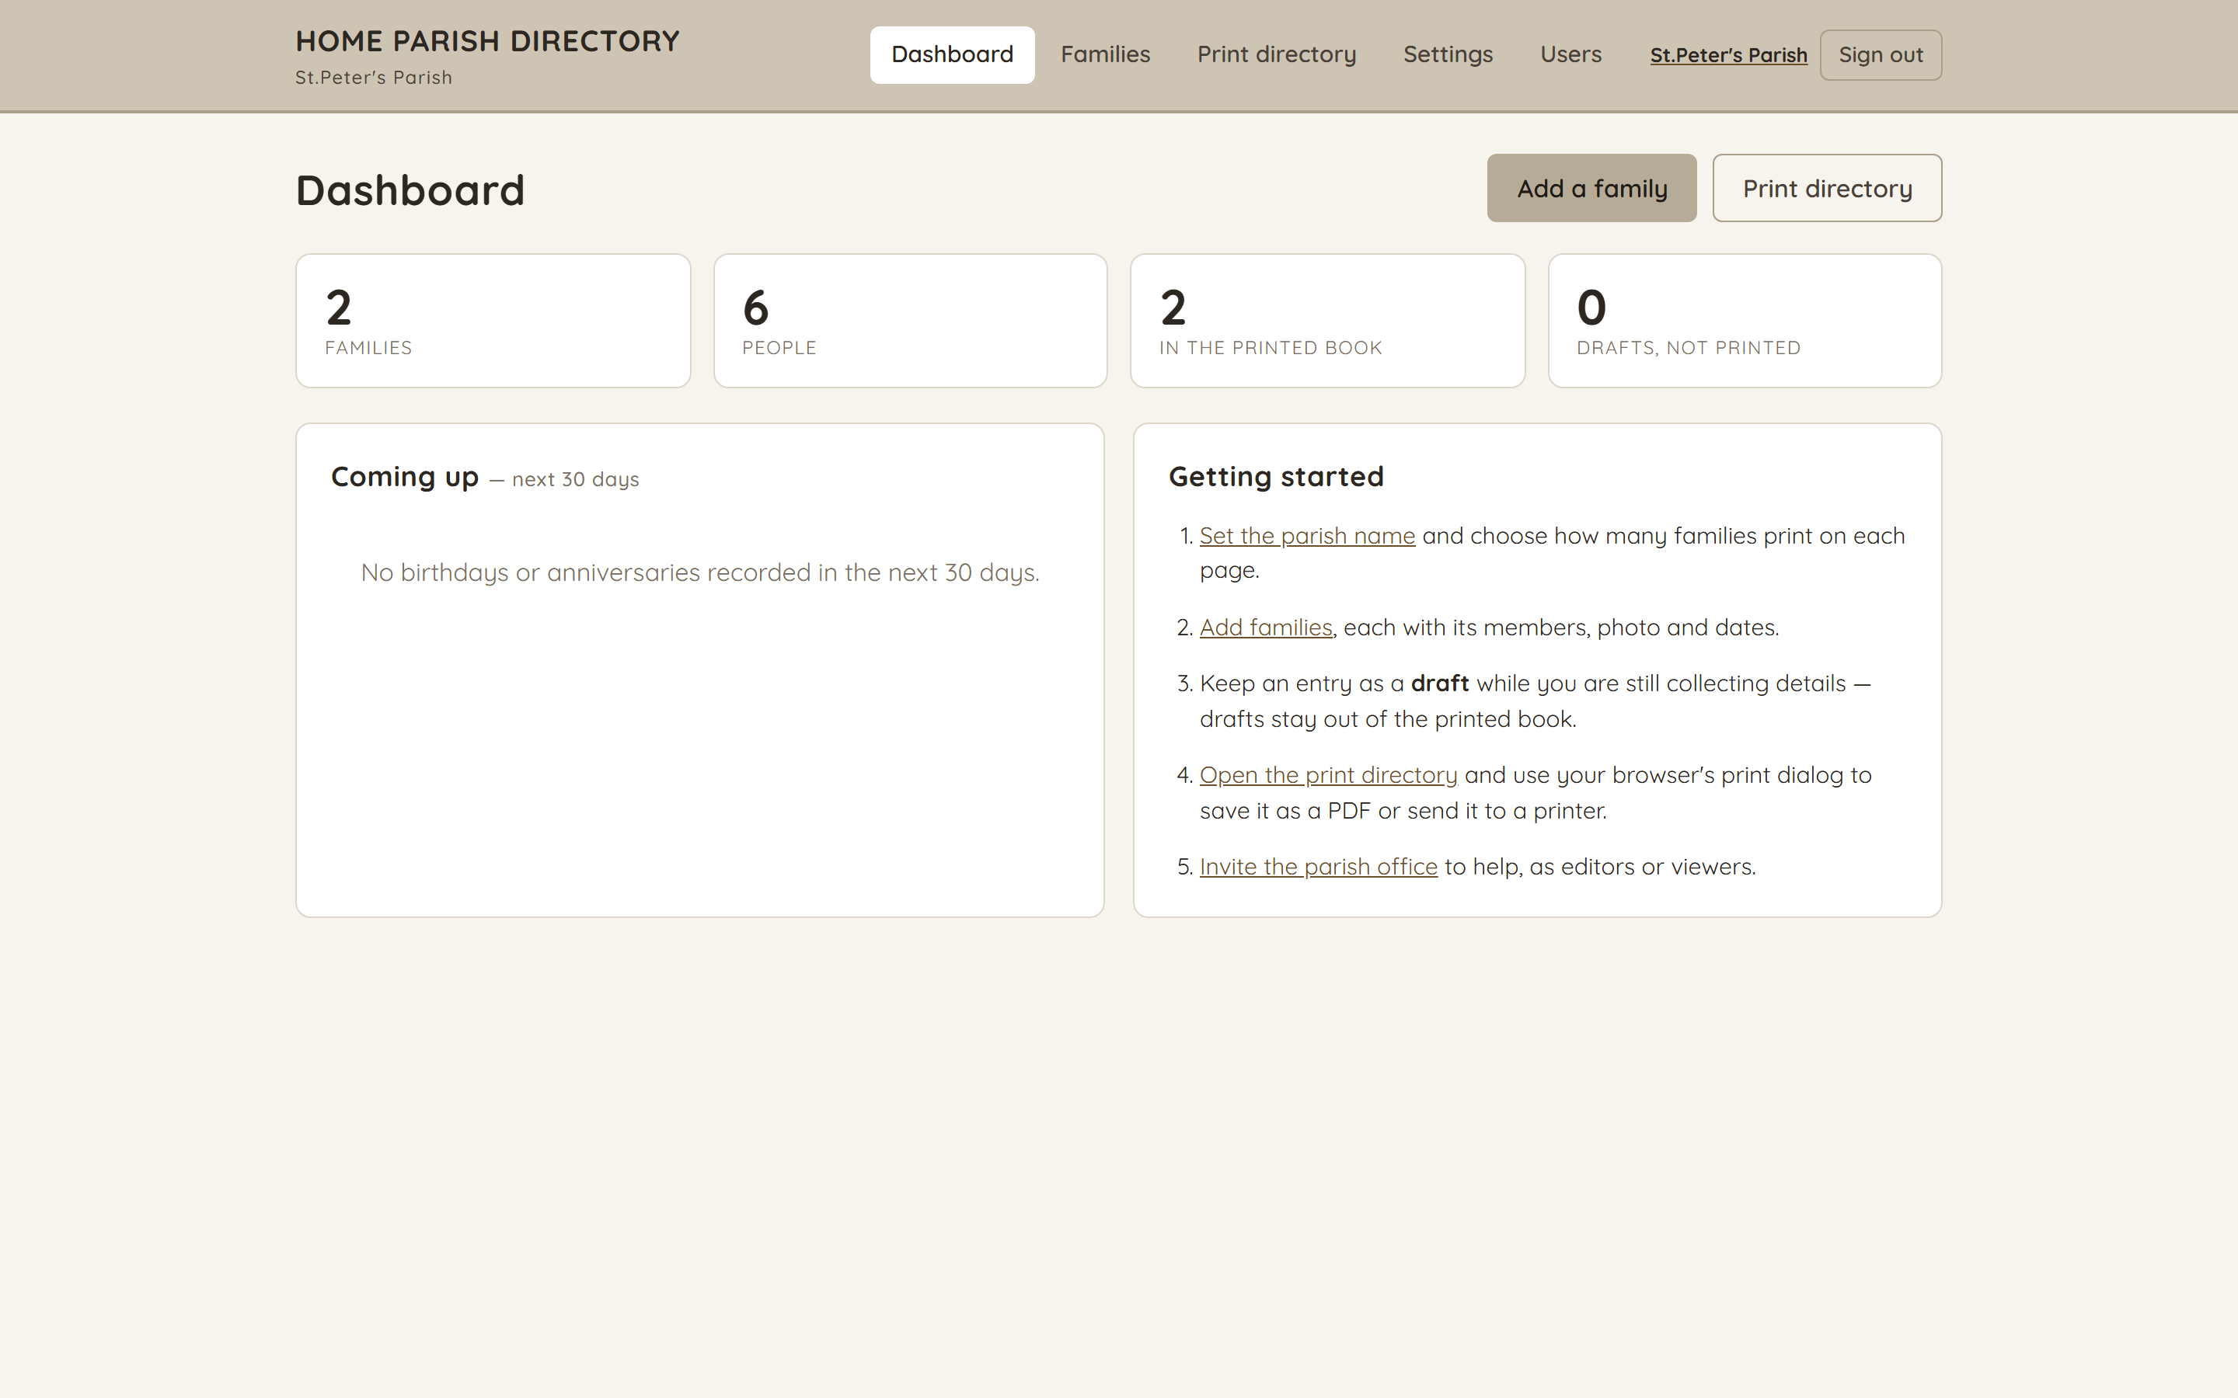
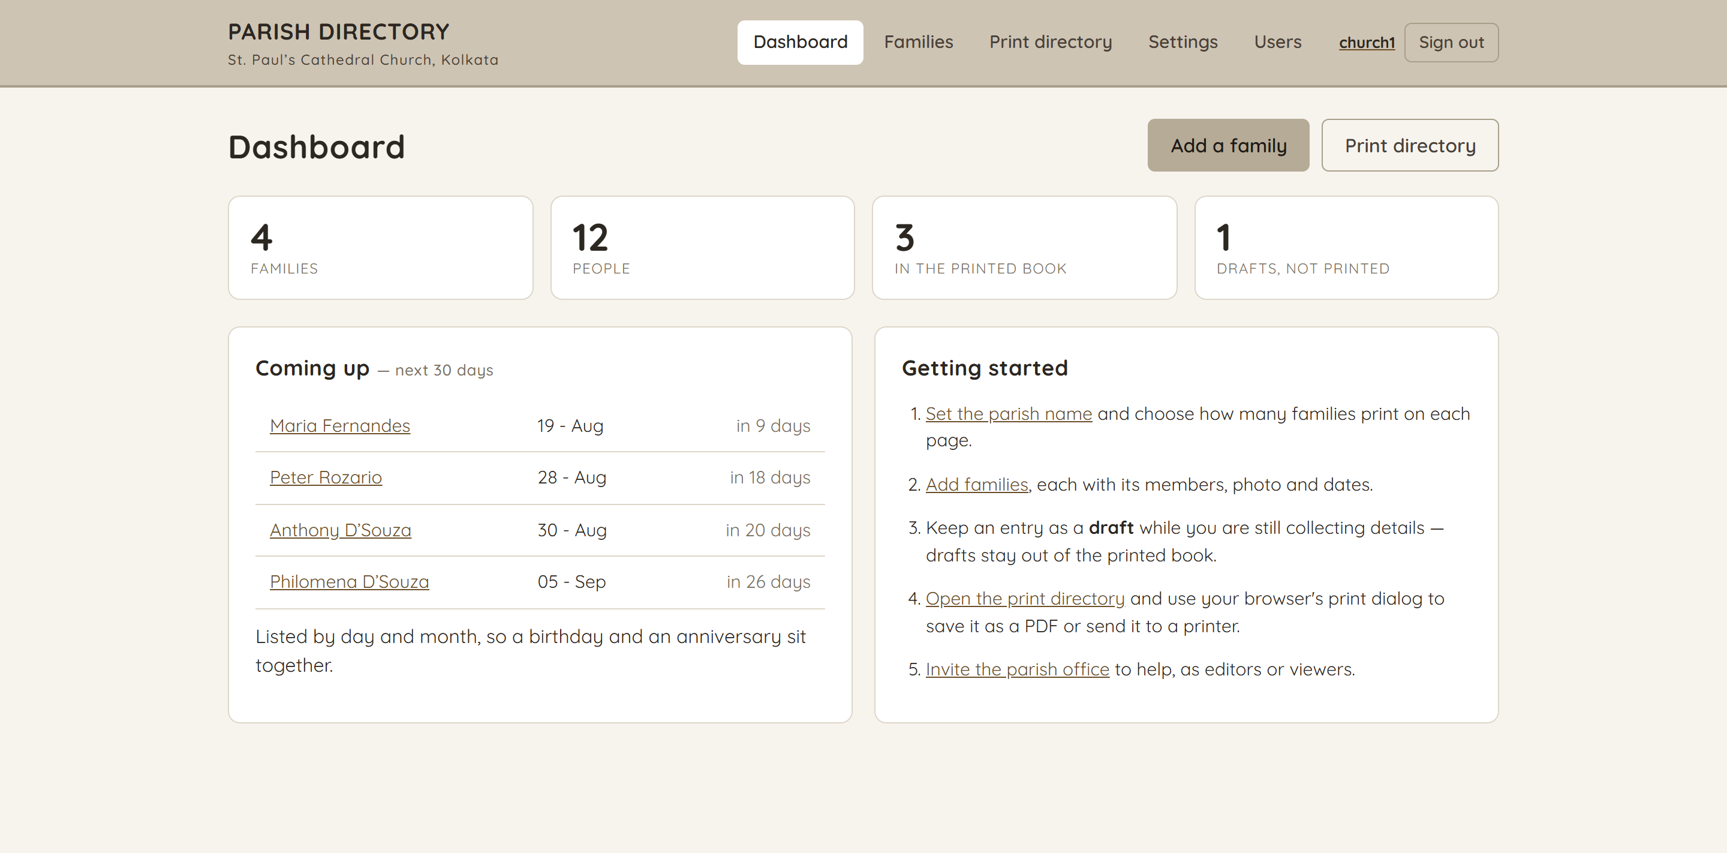
Dashboard
/
Families, people, how many are in the printed book and how many are still drafts — with birthdays and anniversaries falling in the next 30 days.
5

Slide 6
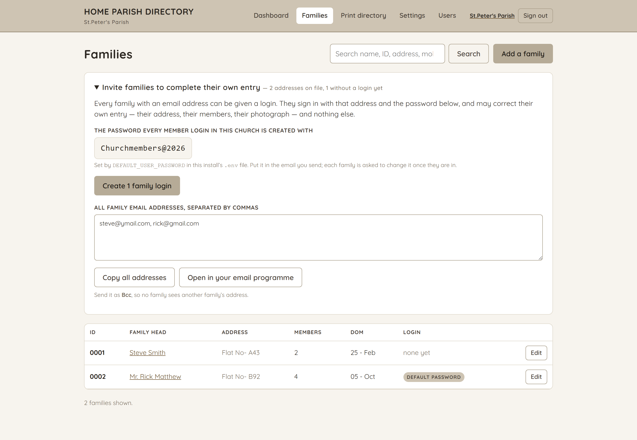
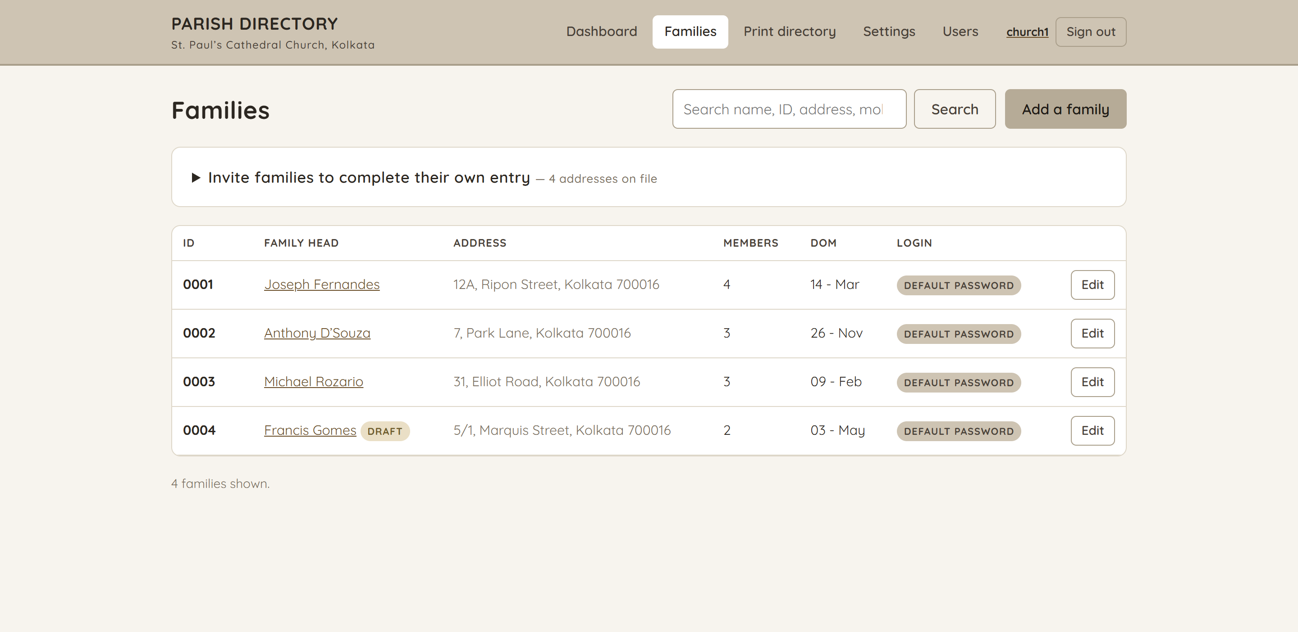
Families
/families
The whole list, searchable by name, family ID, address, hometown or mobile. Drafts stay out of the printed book; the Login column shows which households can sign in and who is still on the password they were given.
6

Slide 7
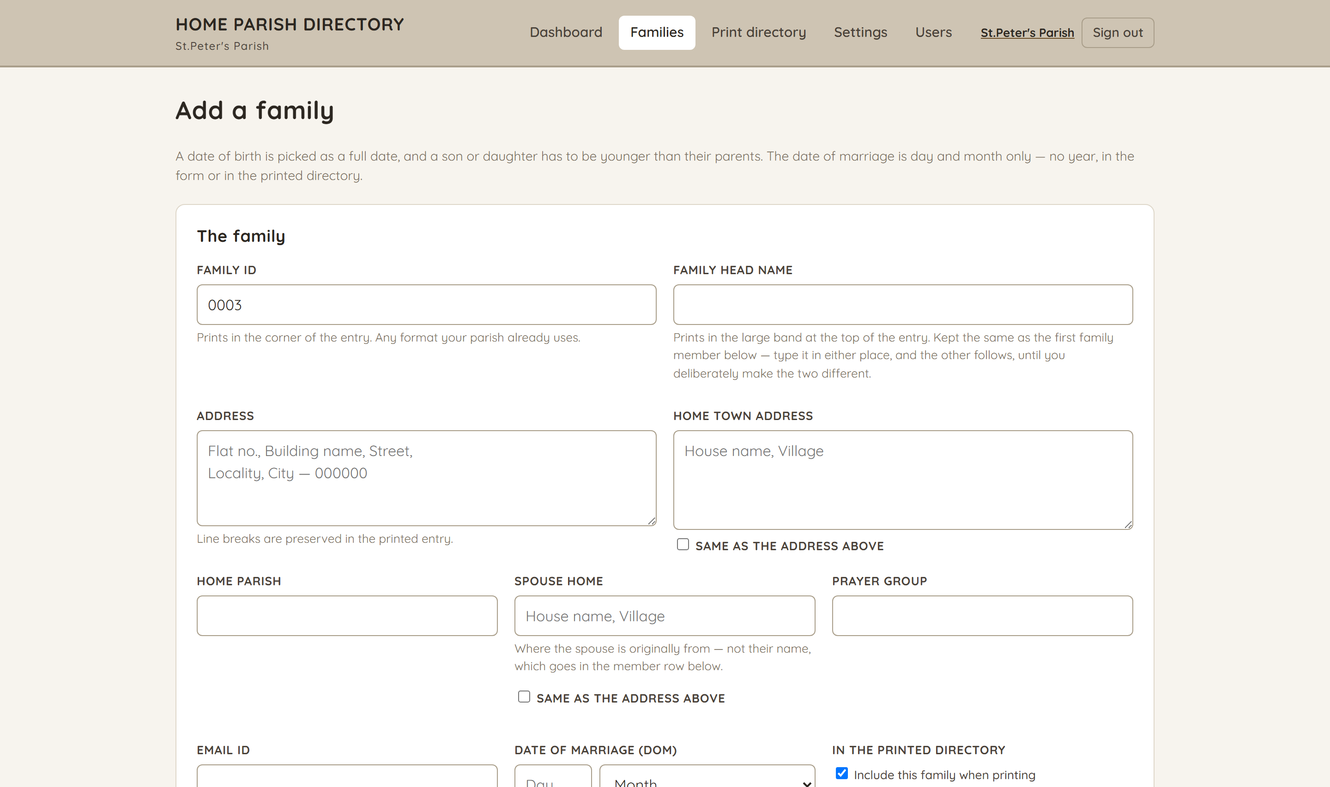
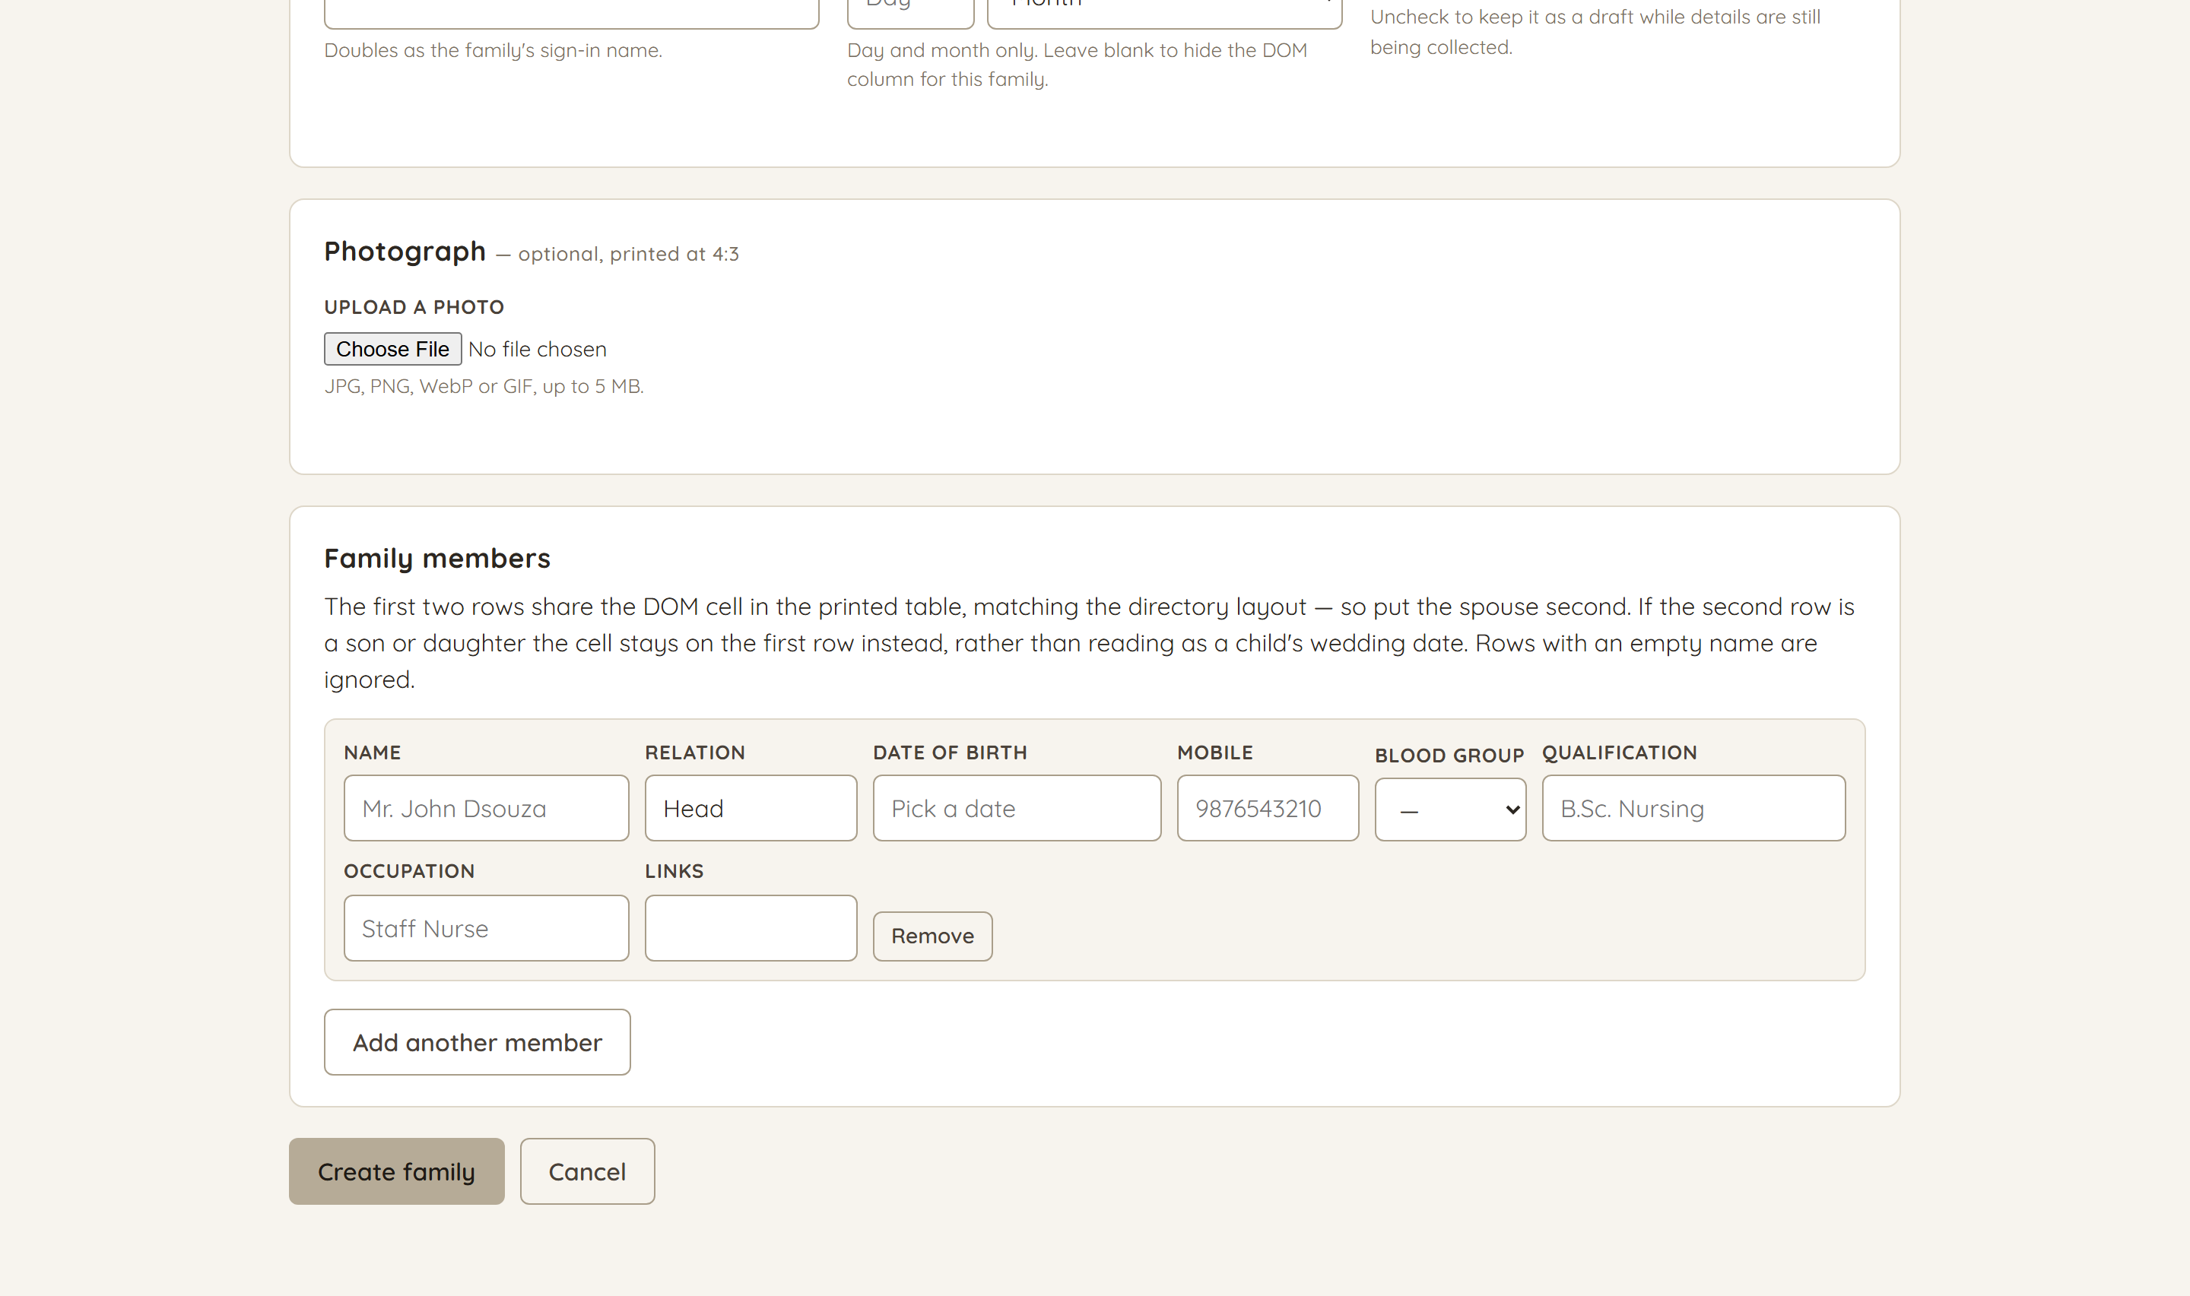
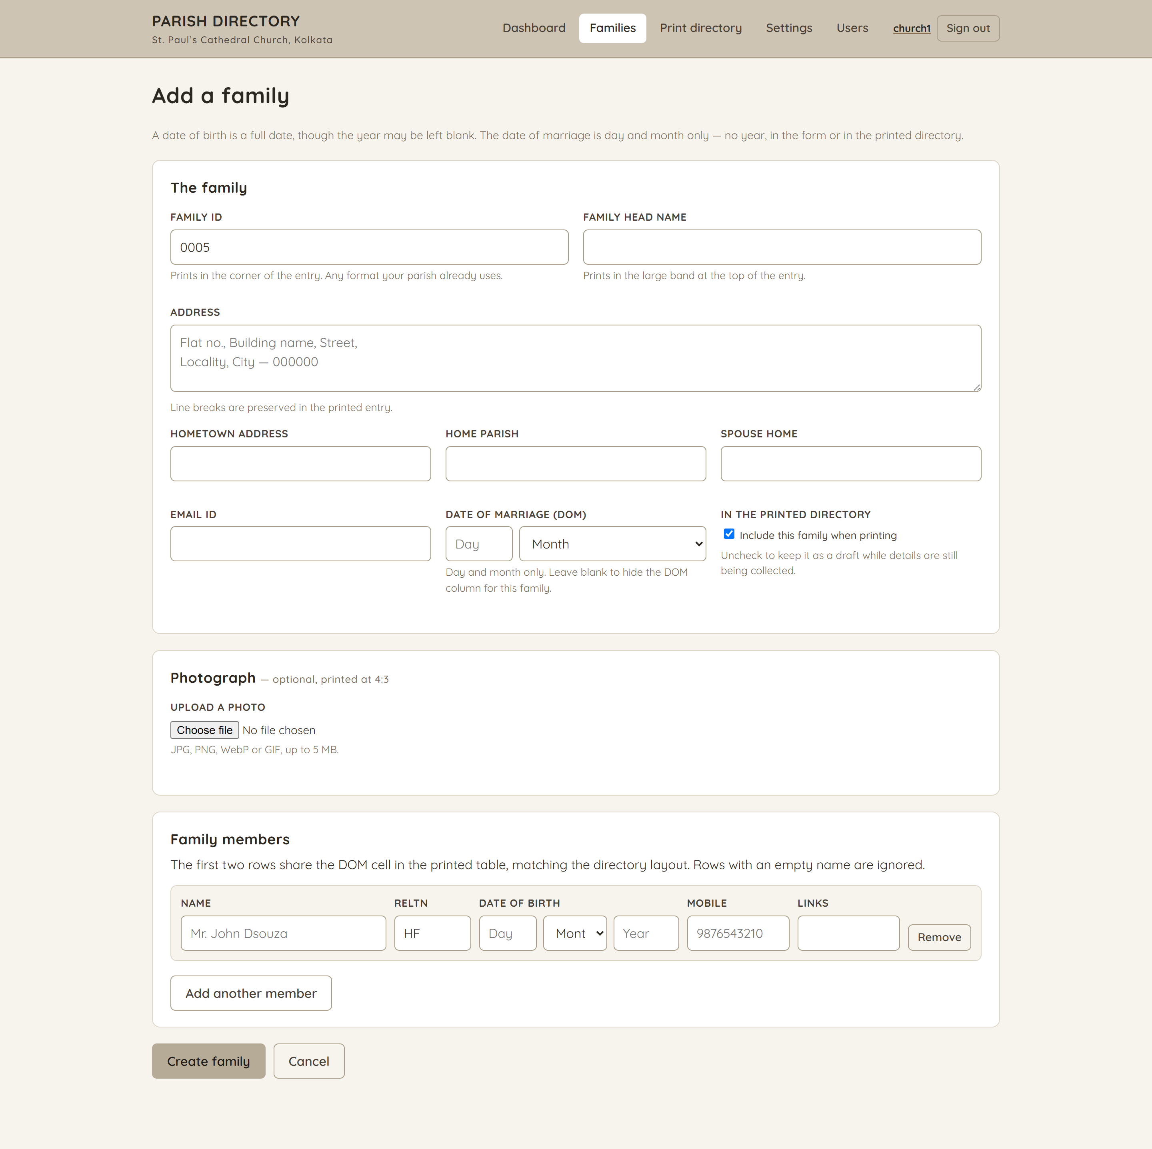
Add a family
/families/new
Family details — including a prayer group — an optional 4:3 photograph, and the members, each with a blood group, qualification and occupation alongside the usual name, relation, date of birth and mobile. Rows are added, reordered and removed in place. A date of birth is a full date, though the year may be left blank; the date of marriage is day and month only. Editors and administrators only.
The page continues on the right — one long form, shown in two halves.
7

Slide 8
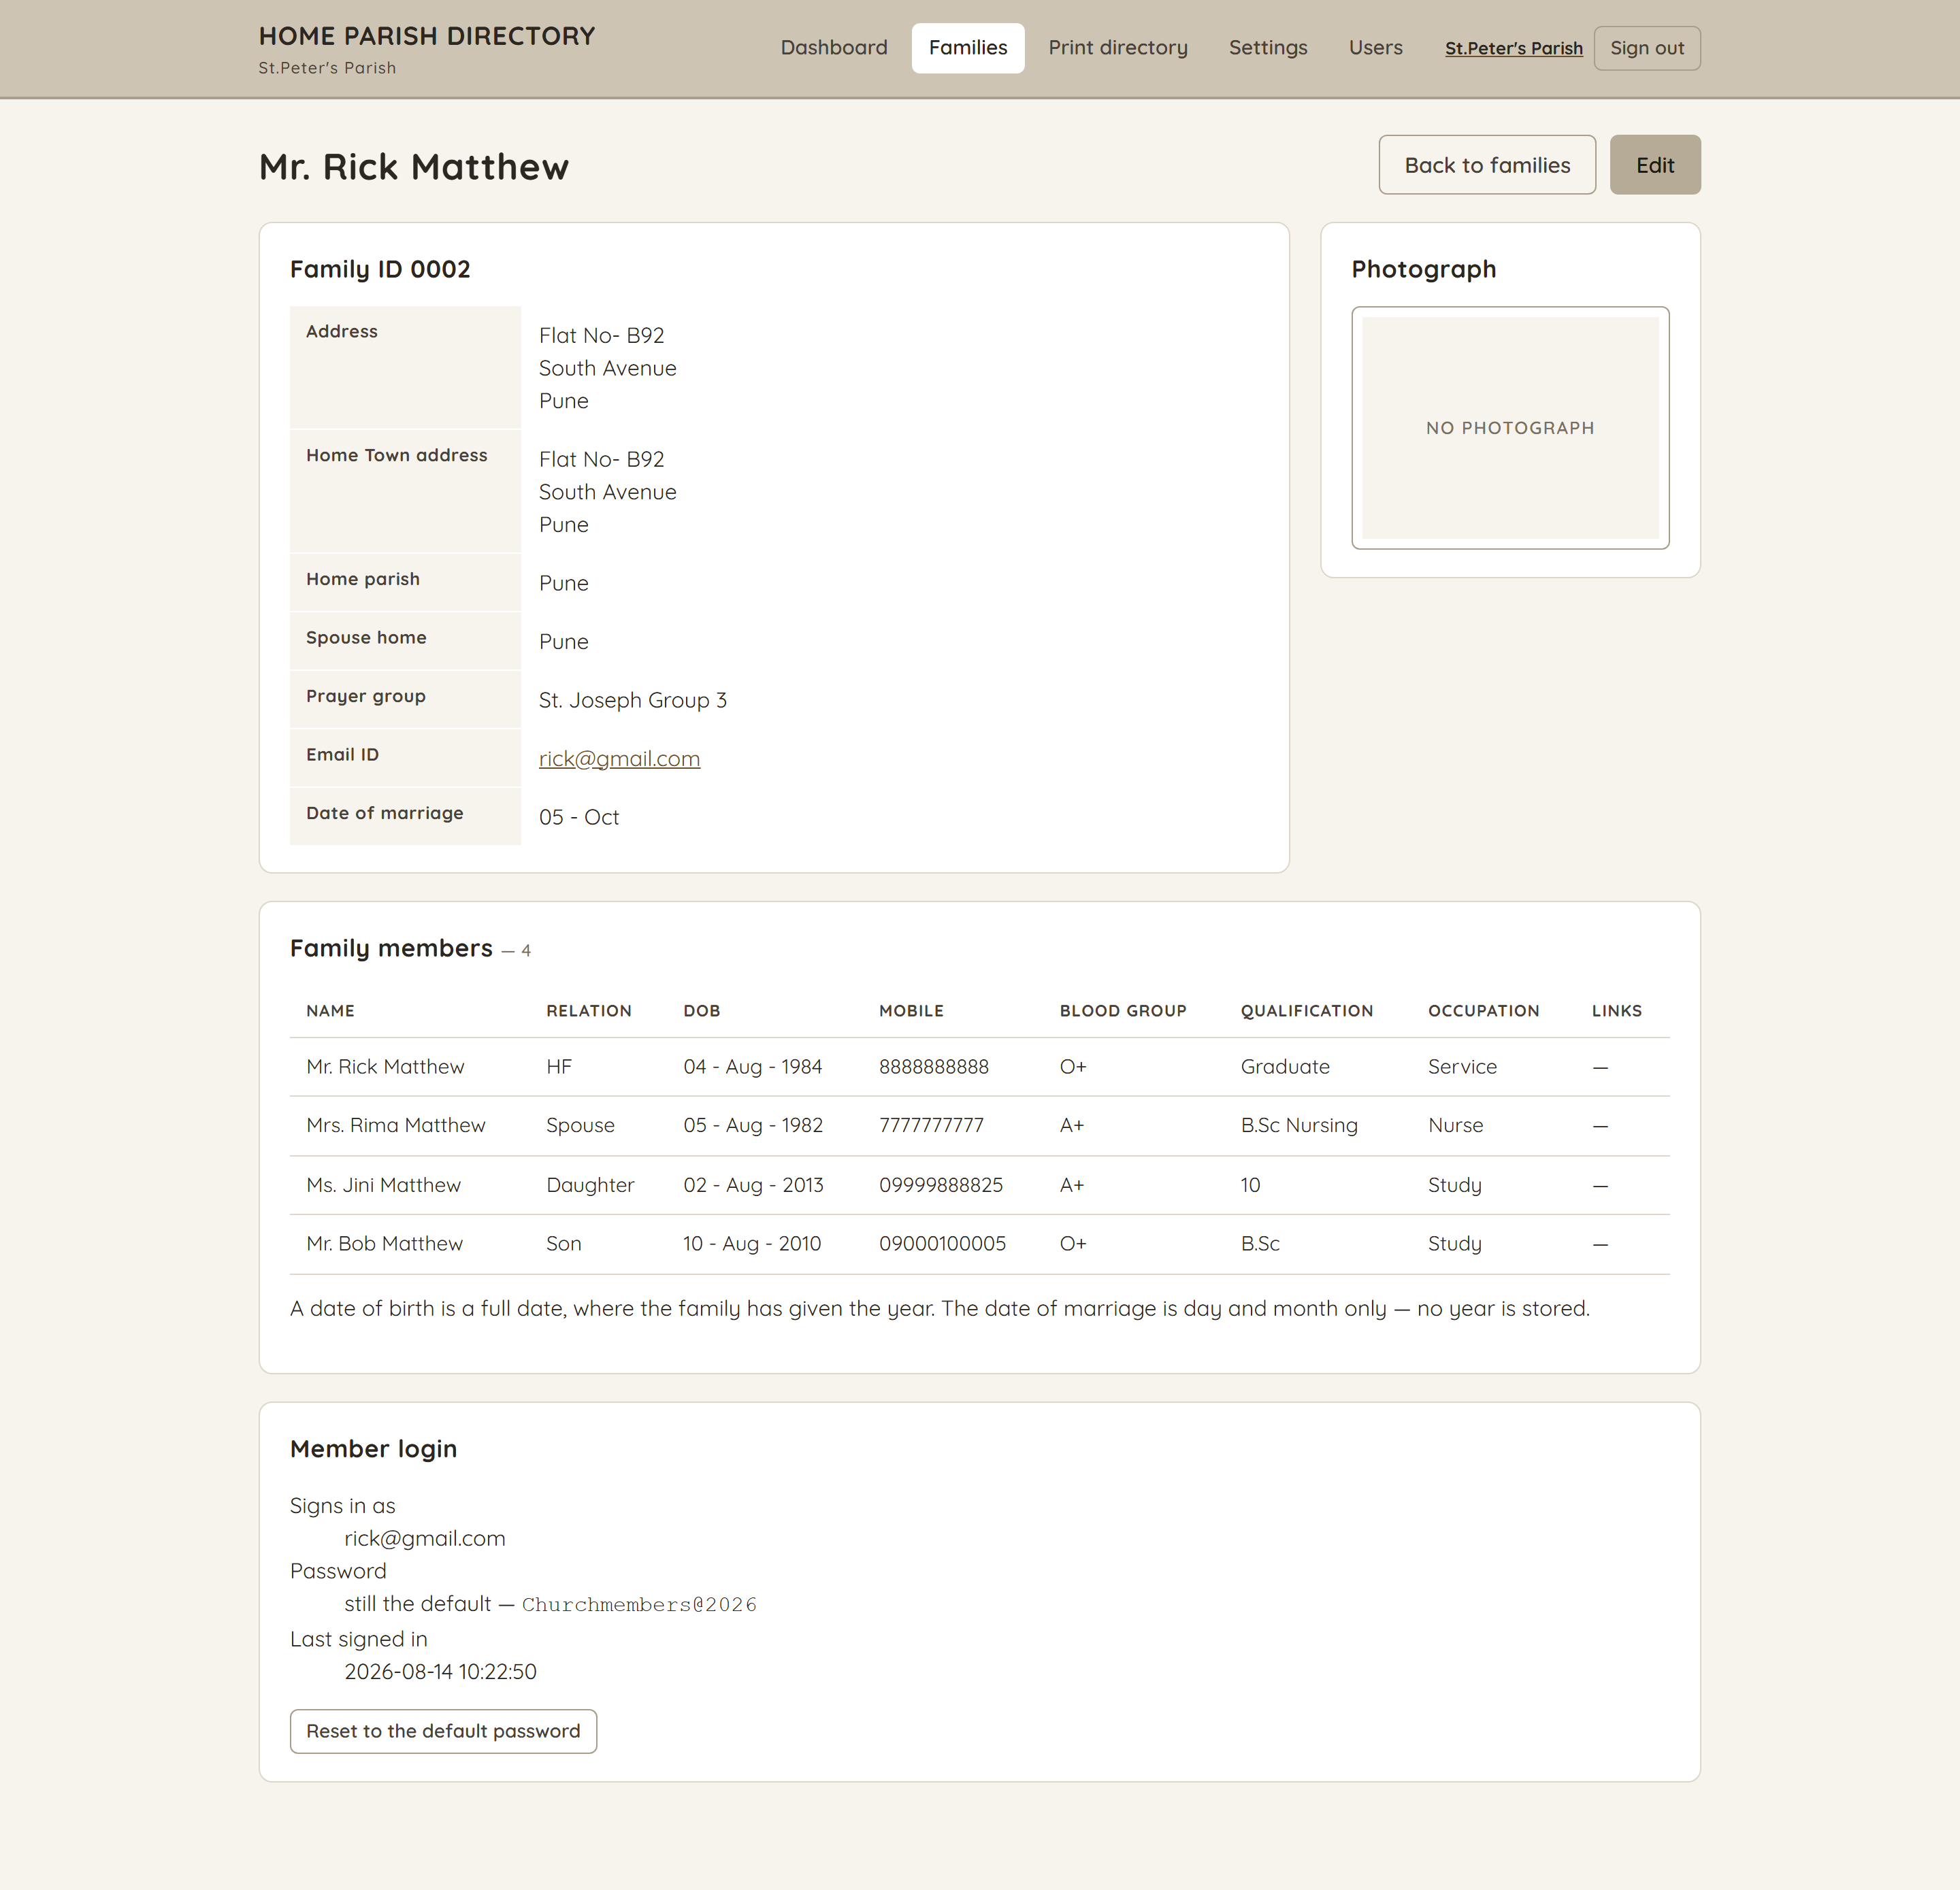
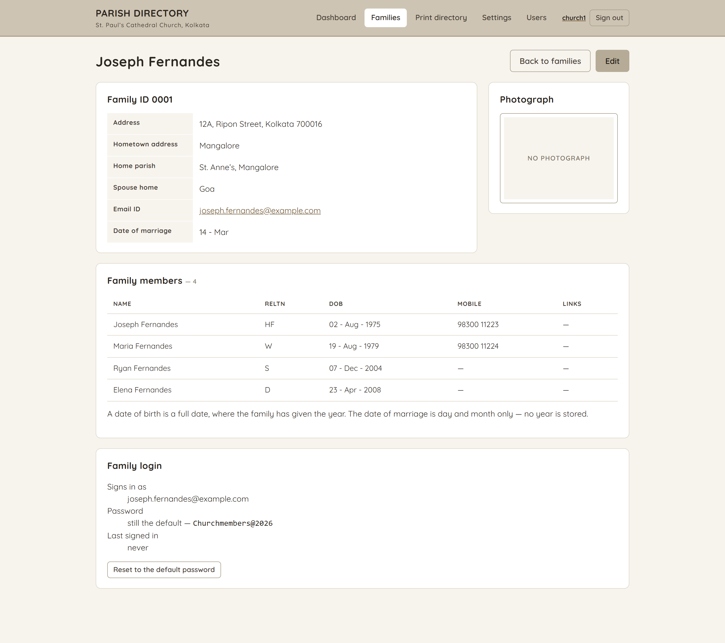
Family record
/families/:id
Everything held about one family, including the members table exactly as it will print. An administrator also sees the household’s login here, and can create it or put it back to the default password.
8

Slide 9
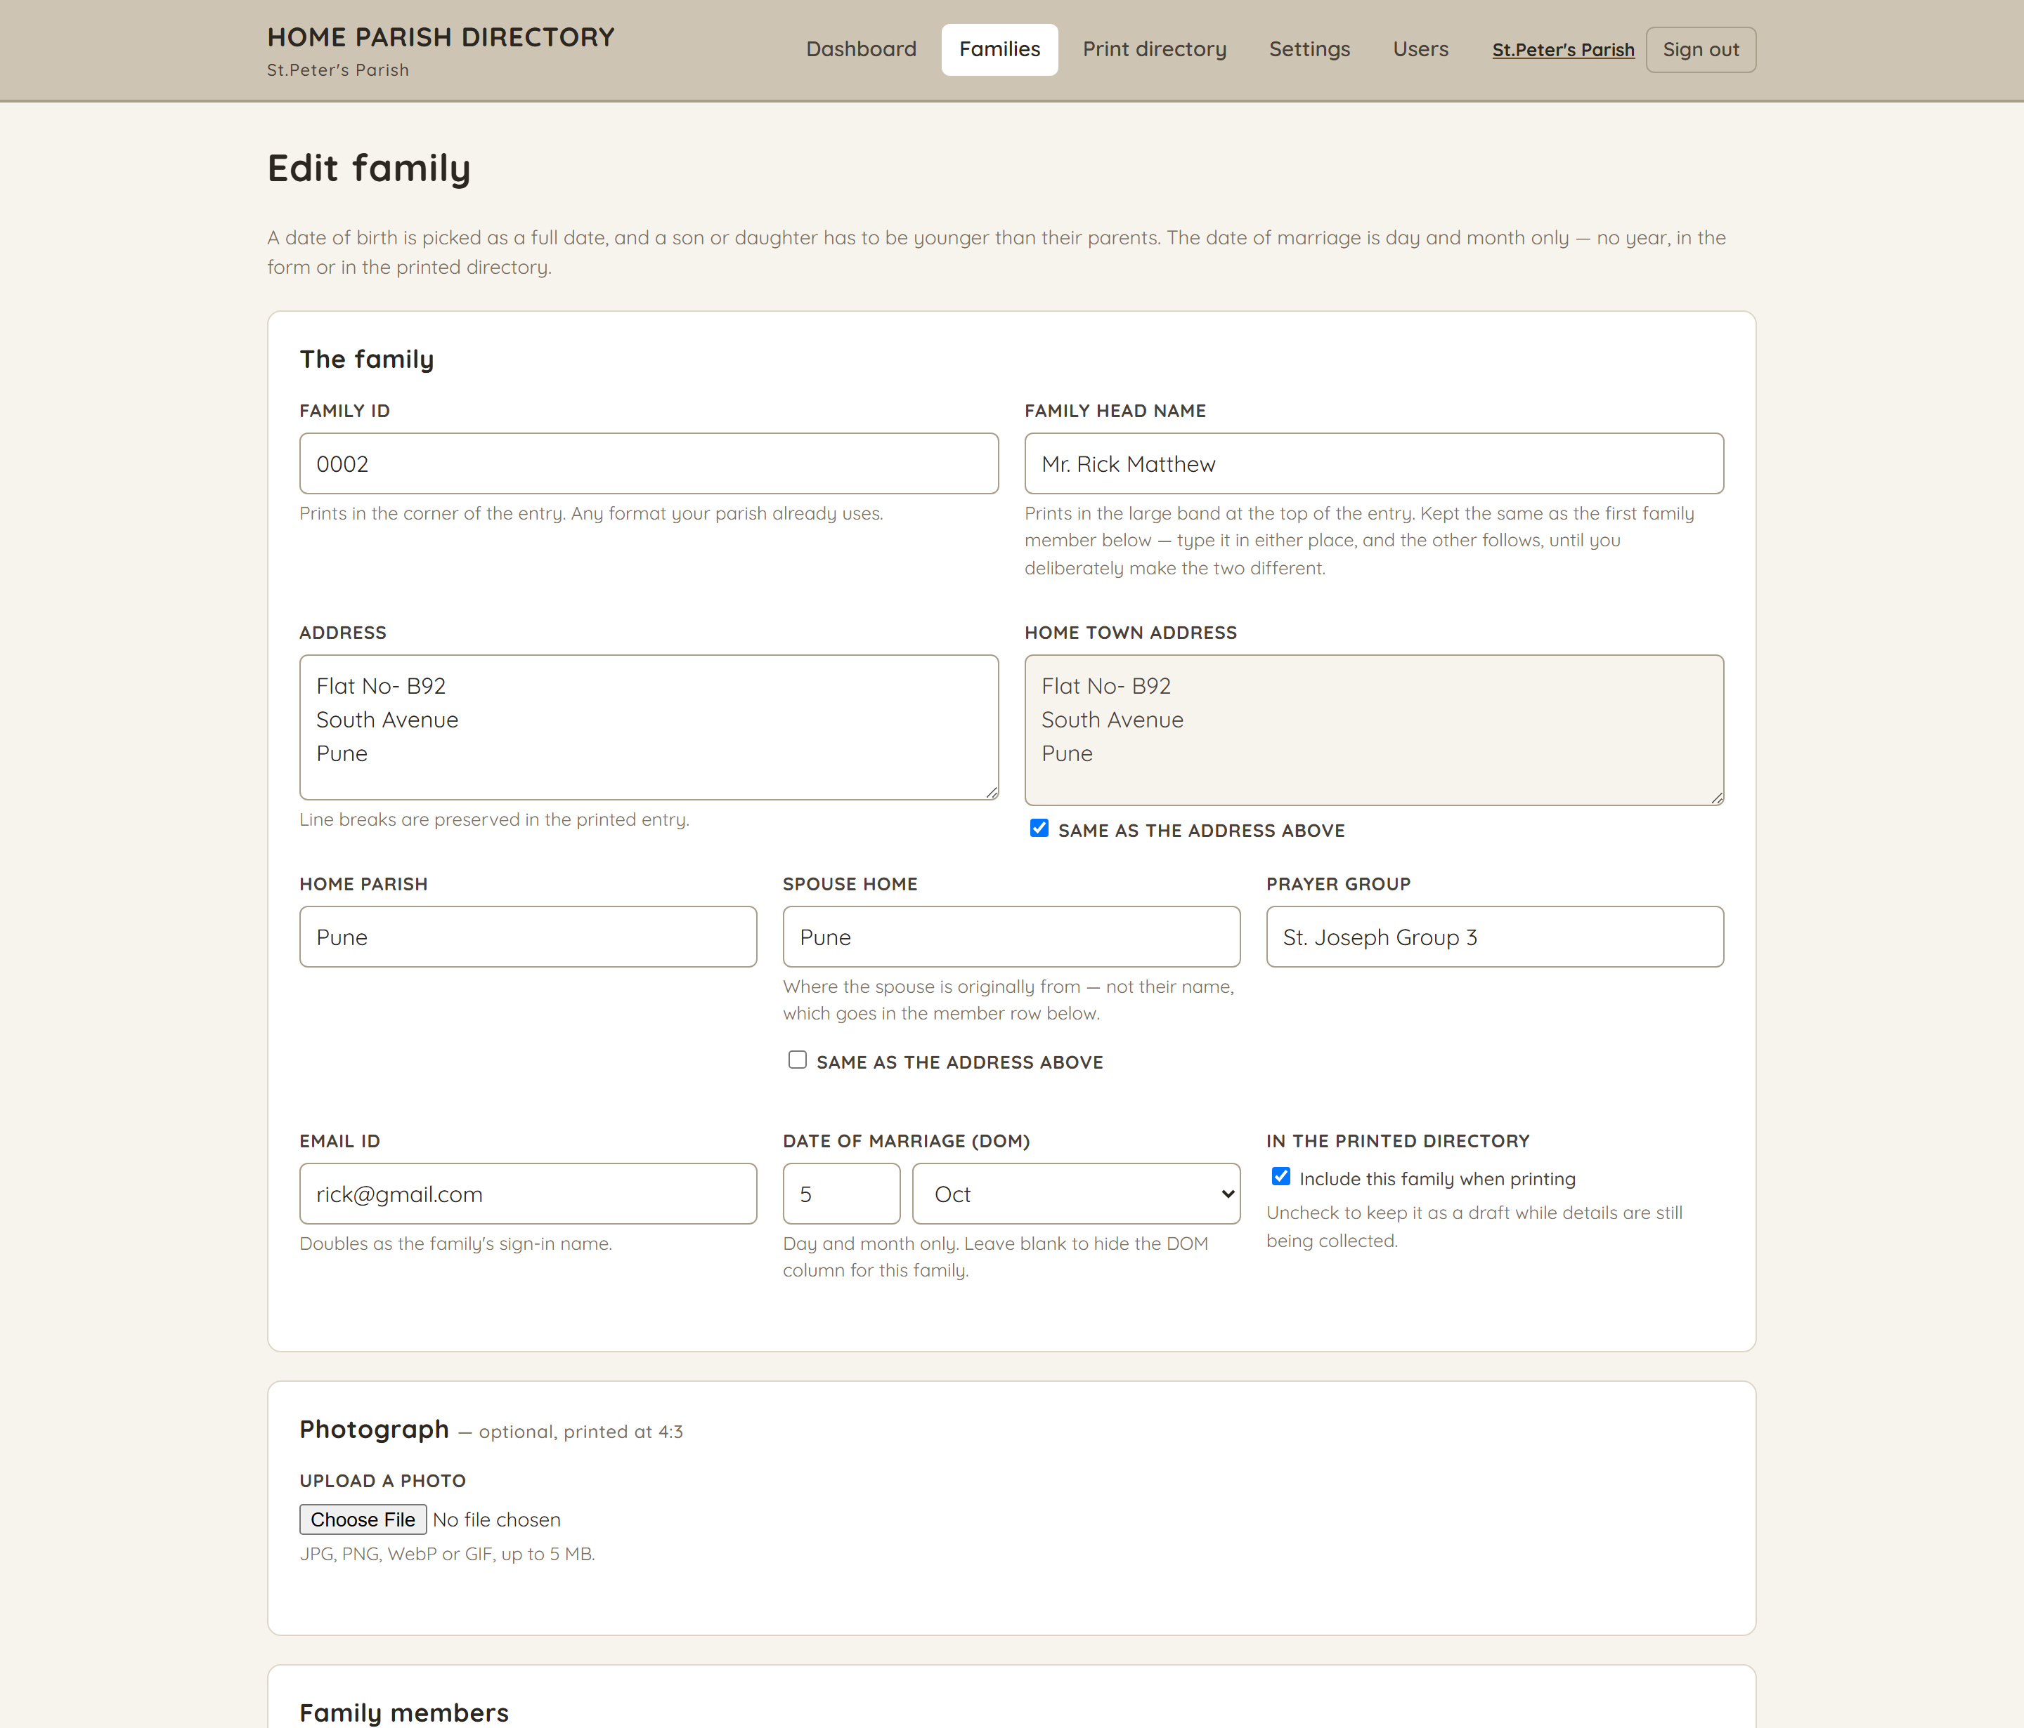
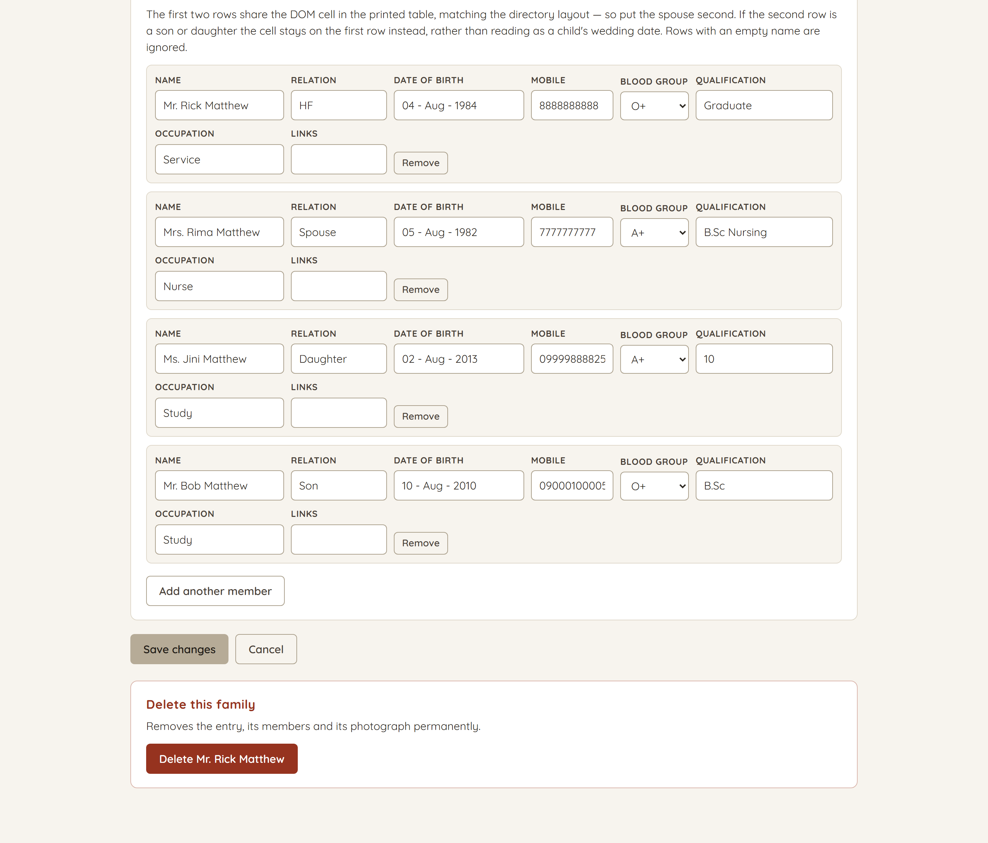
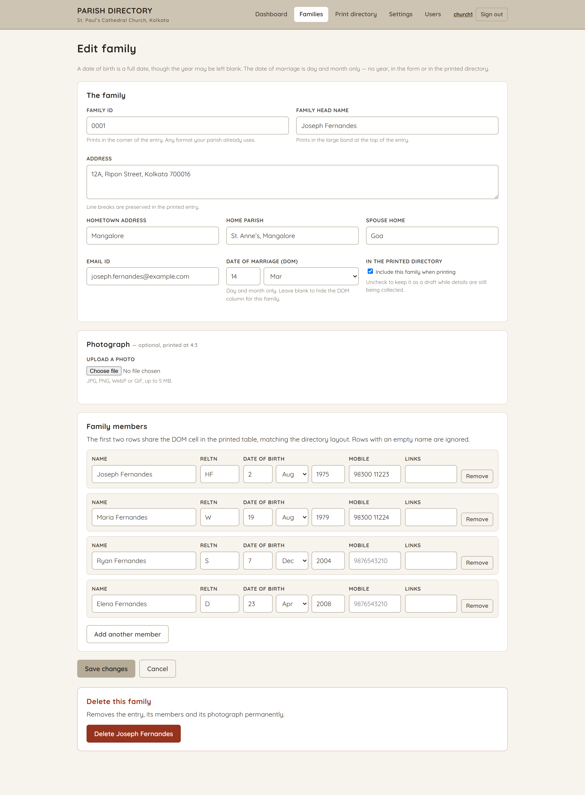
Edit family
/families/:id/edit
The same form as Add, filled in, with the delete action at the foot.
The page continues on the right — one long form, shown in two halves.
9

Slide 10
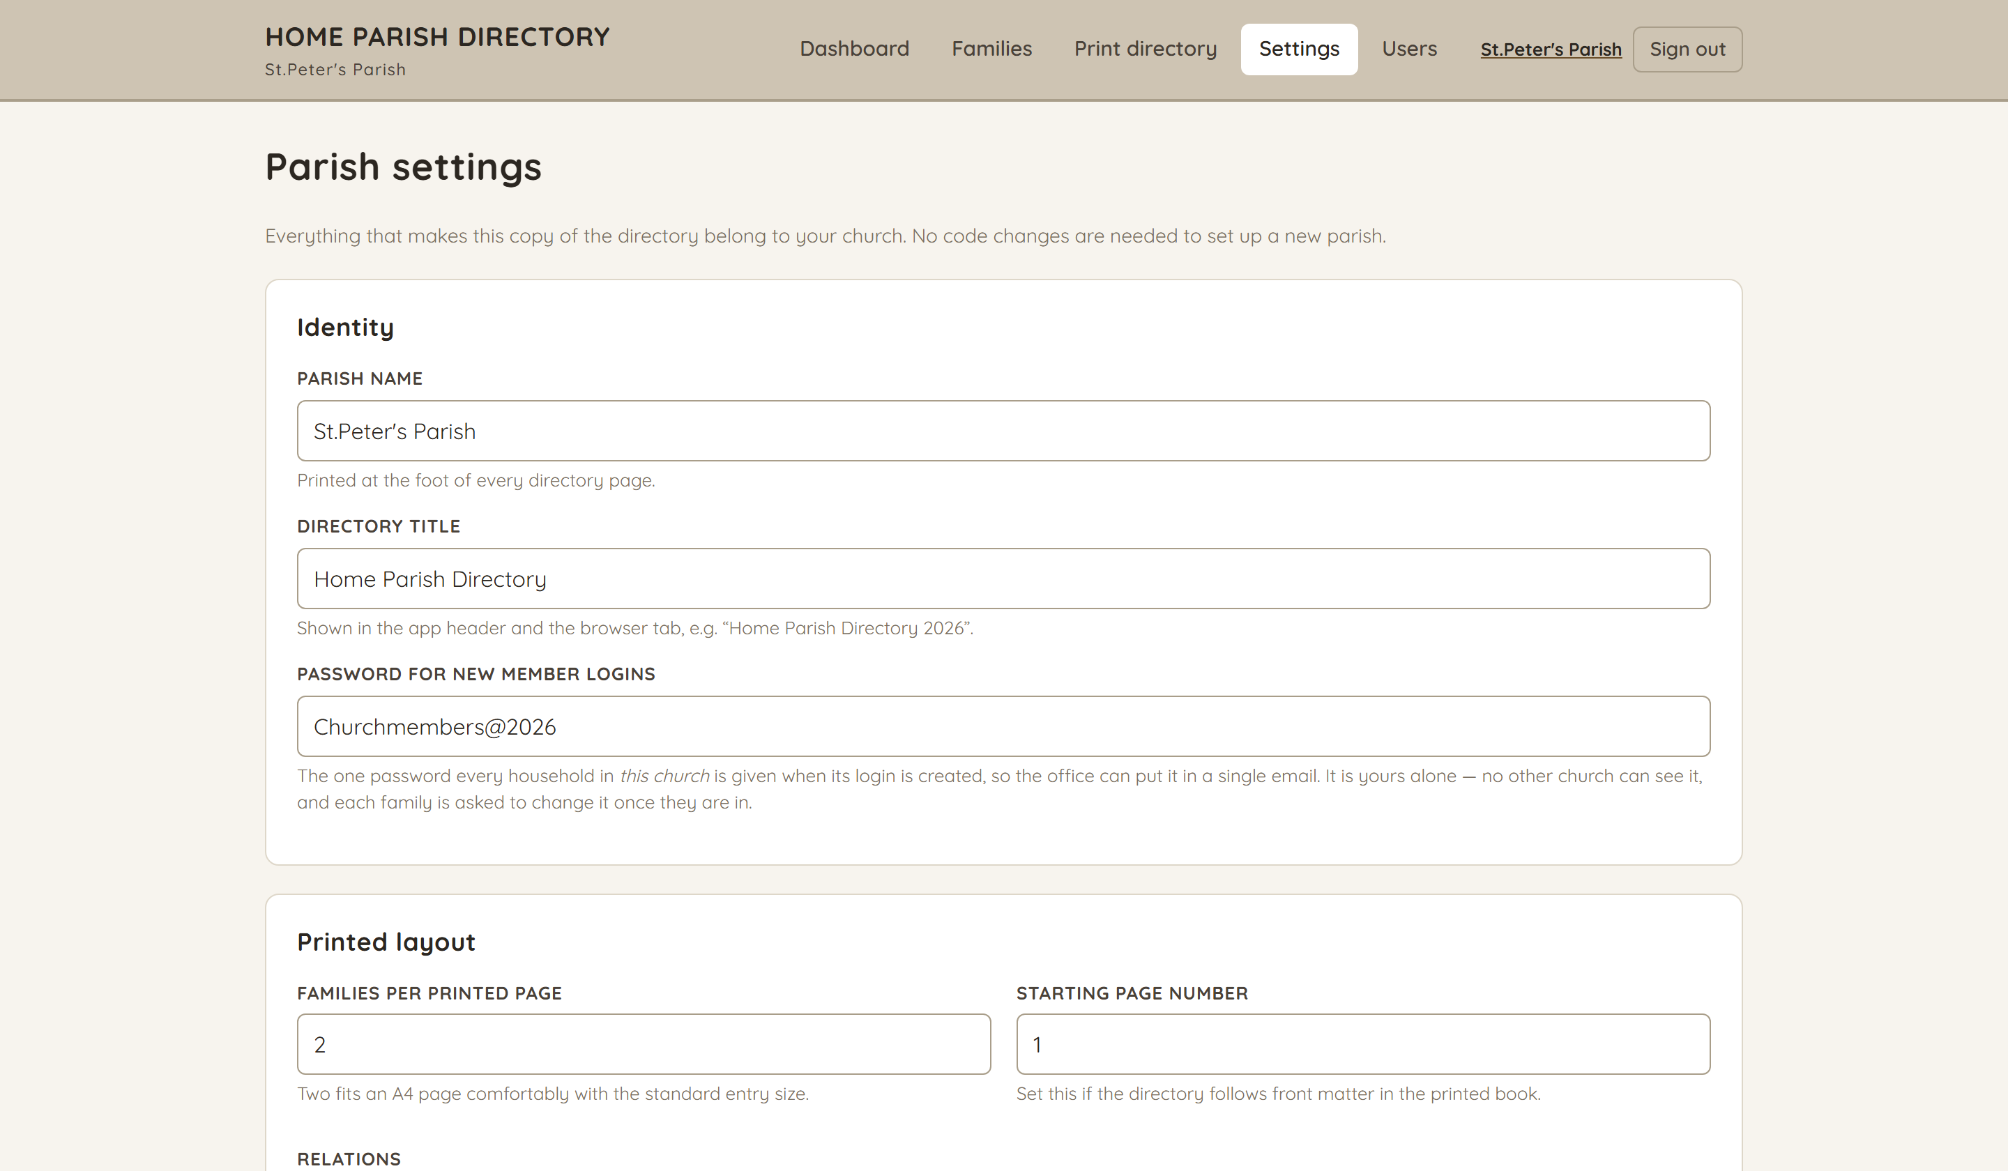
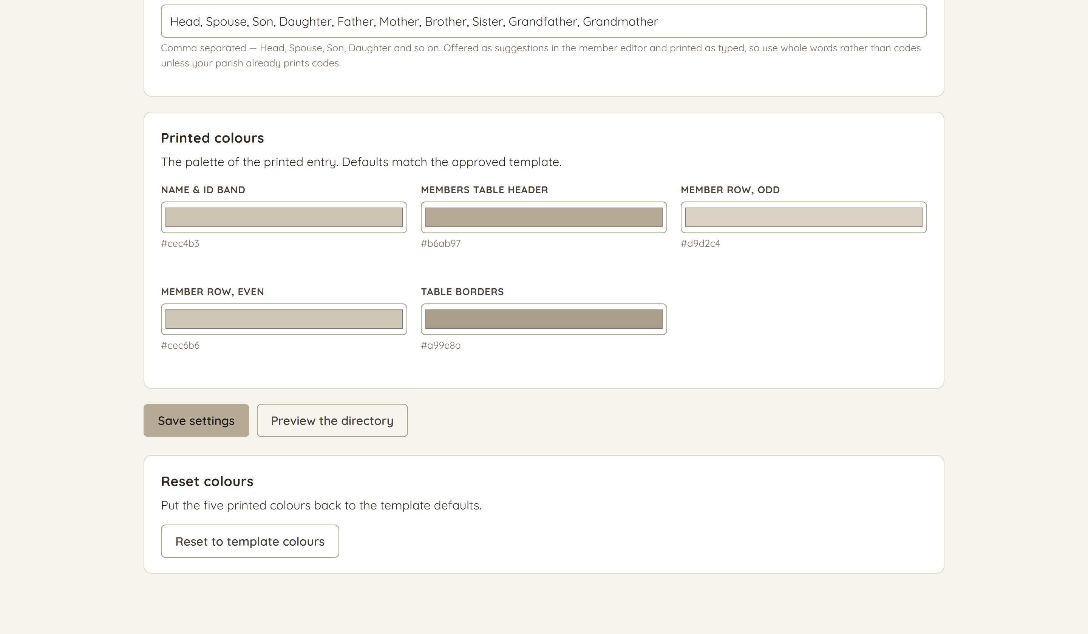
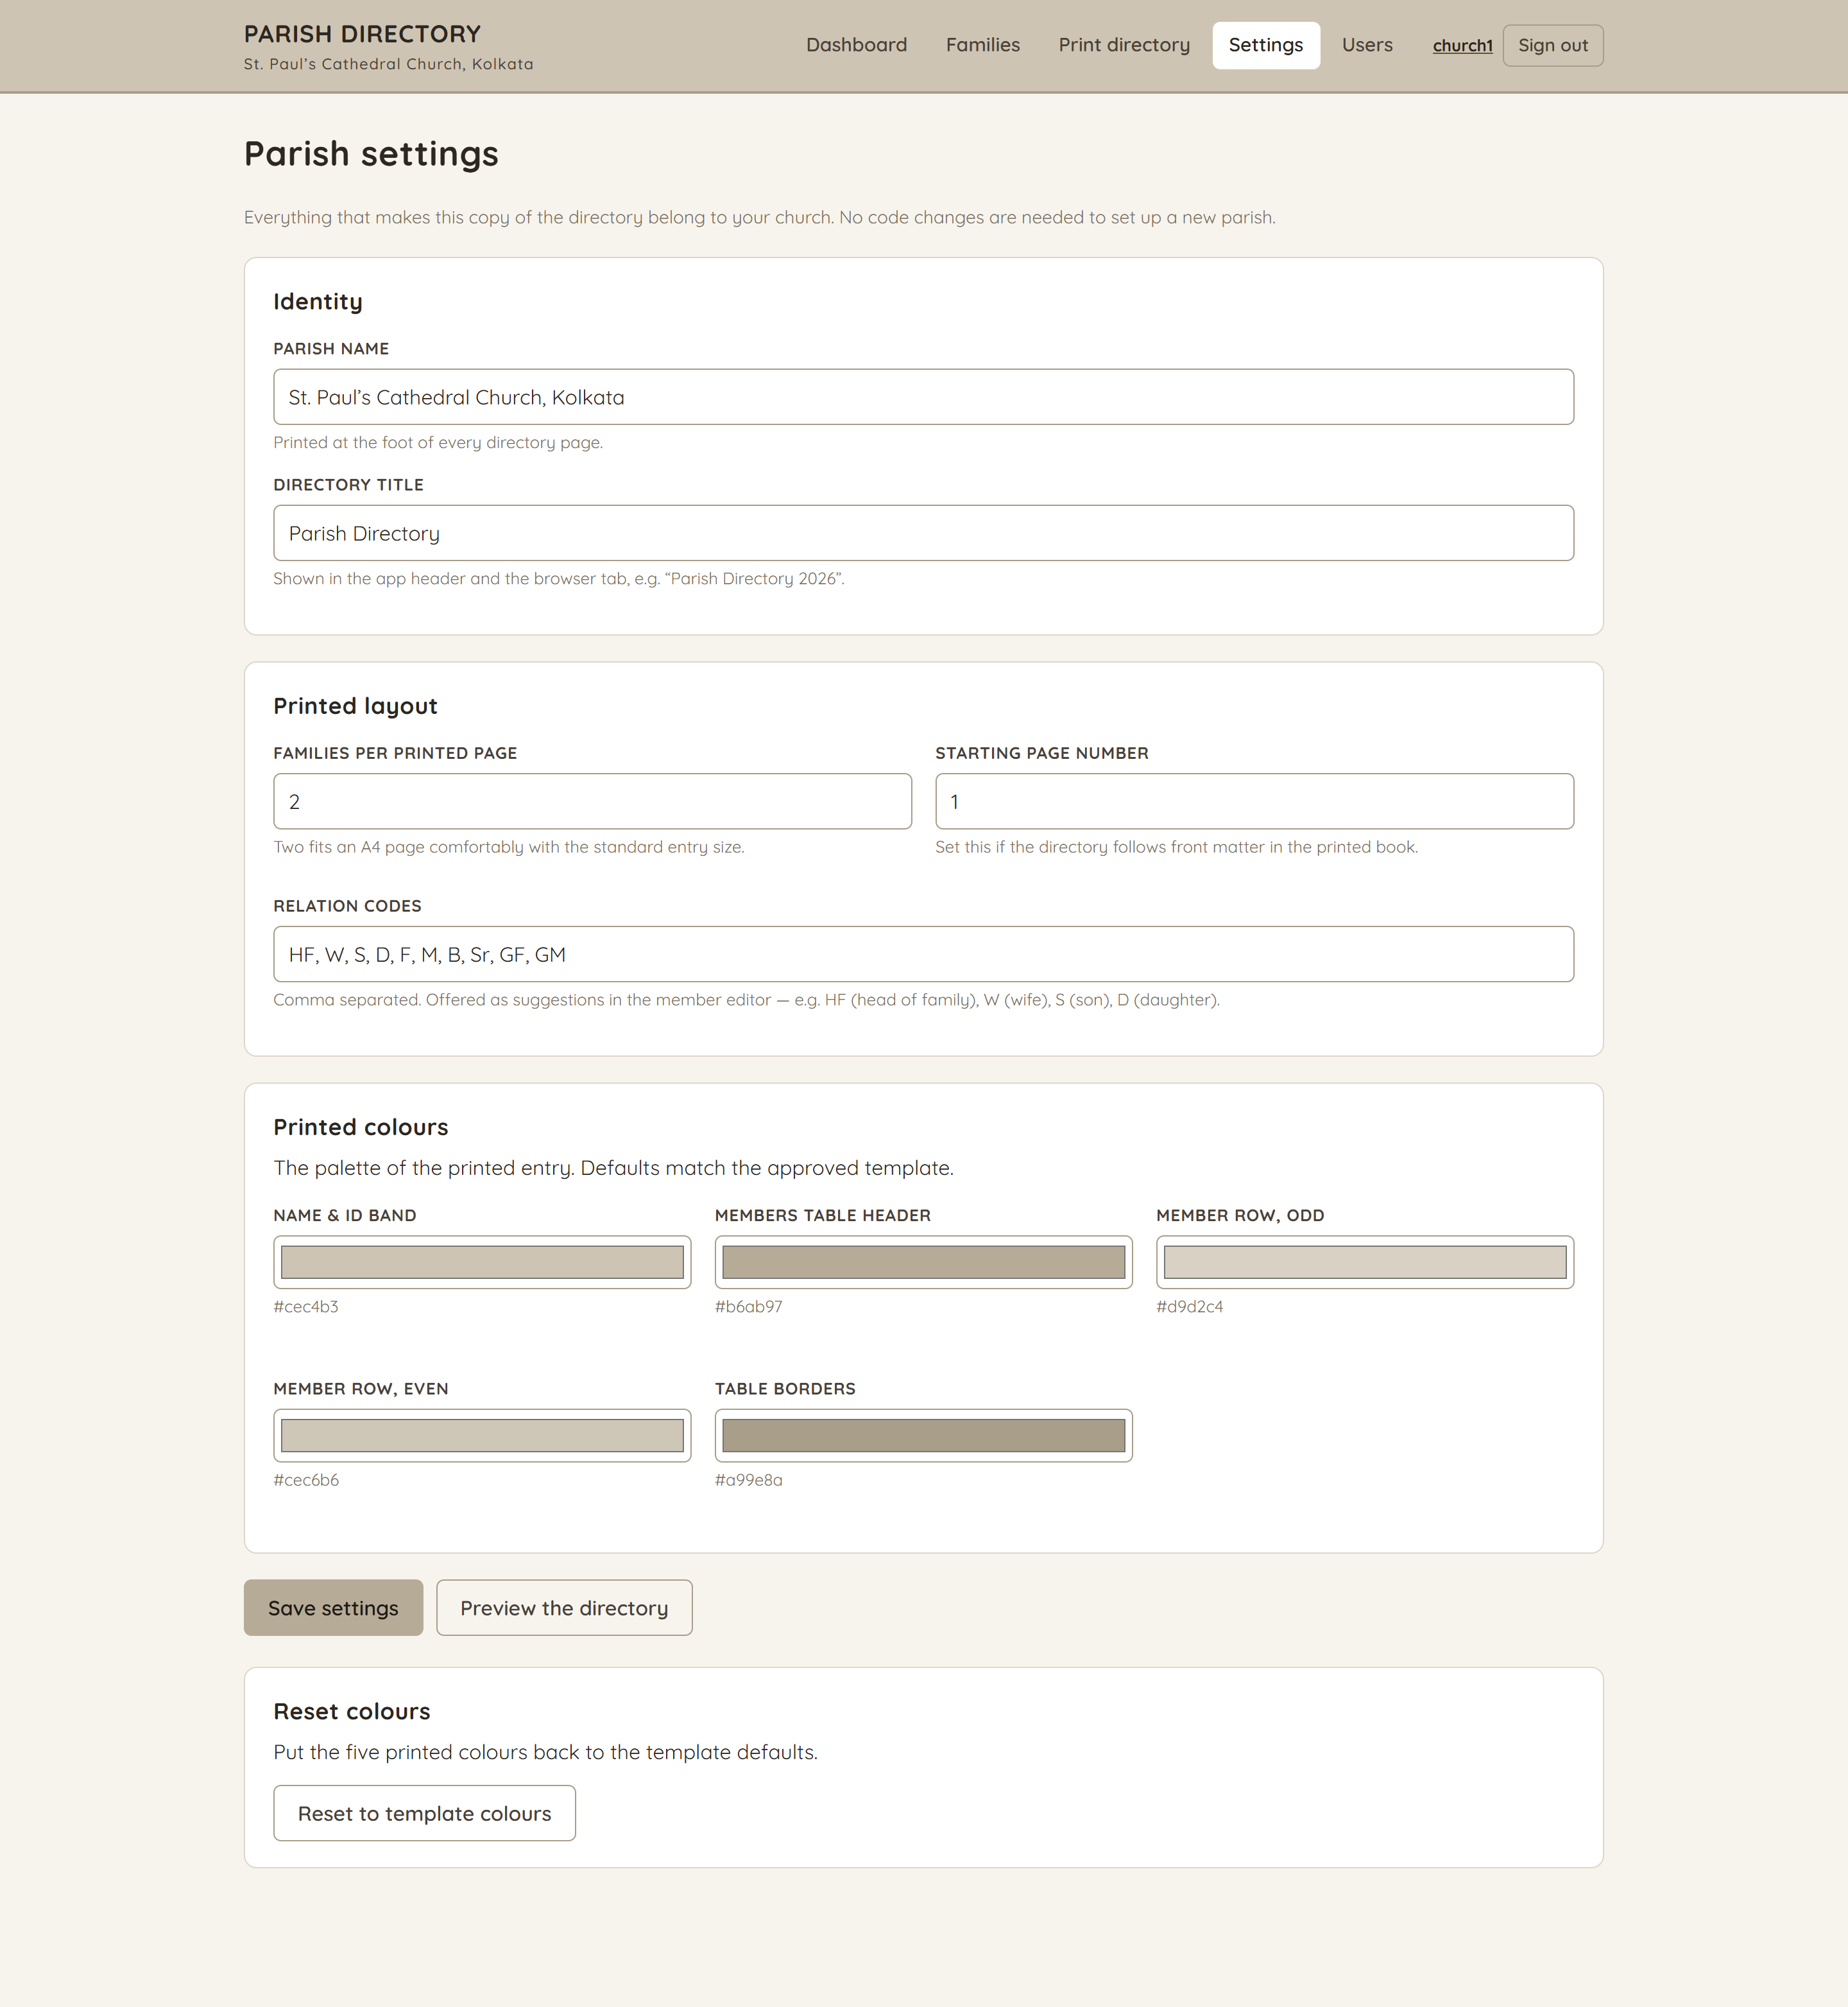
Parish settings
/admin/settings
What makes this copy belong to your church: name and title, families per printed page, the starting page number, your relation codes and the five printed colours. Administrators only.
The page continues on the right — one long form, shown in two halves.
10

Slide 11
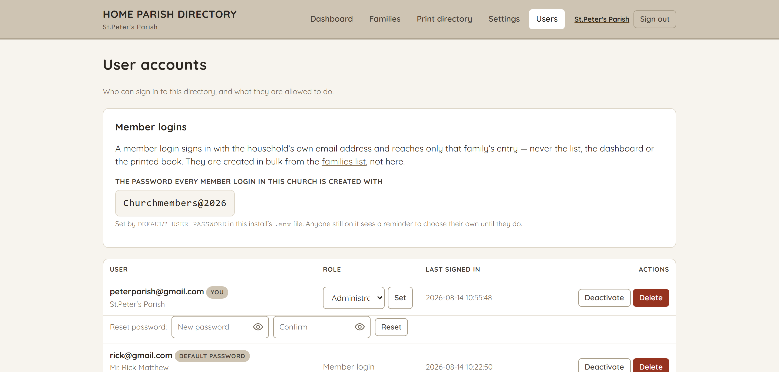
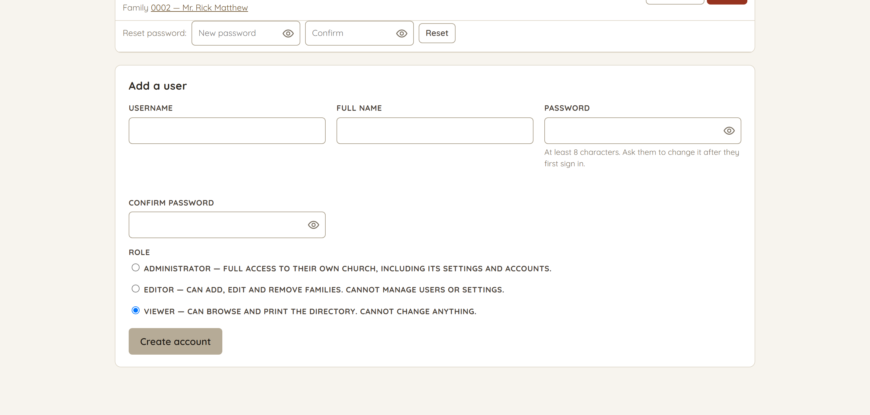
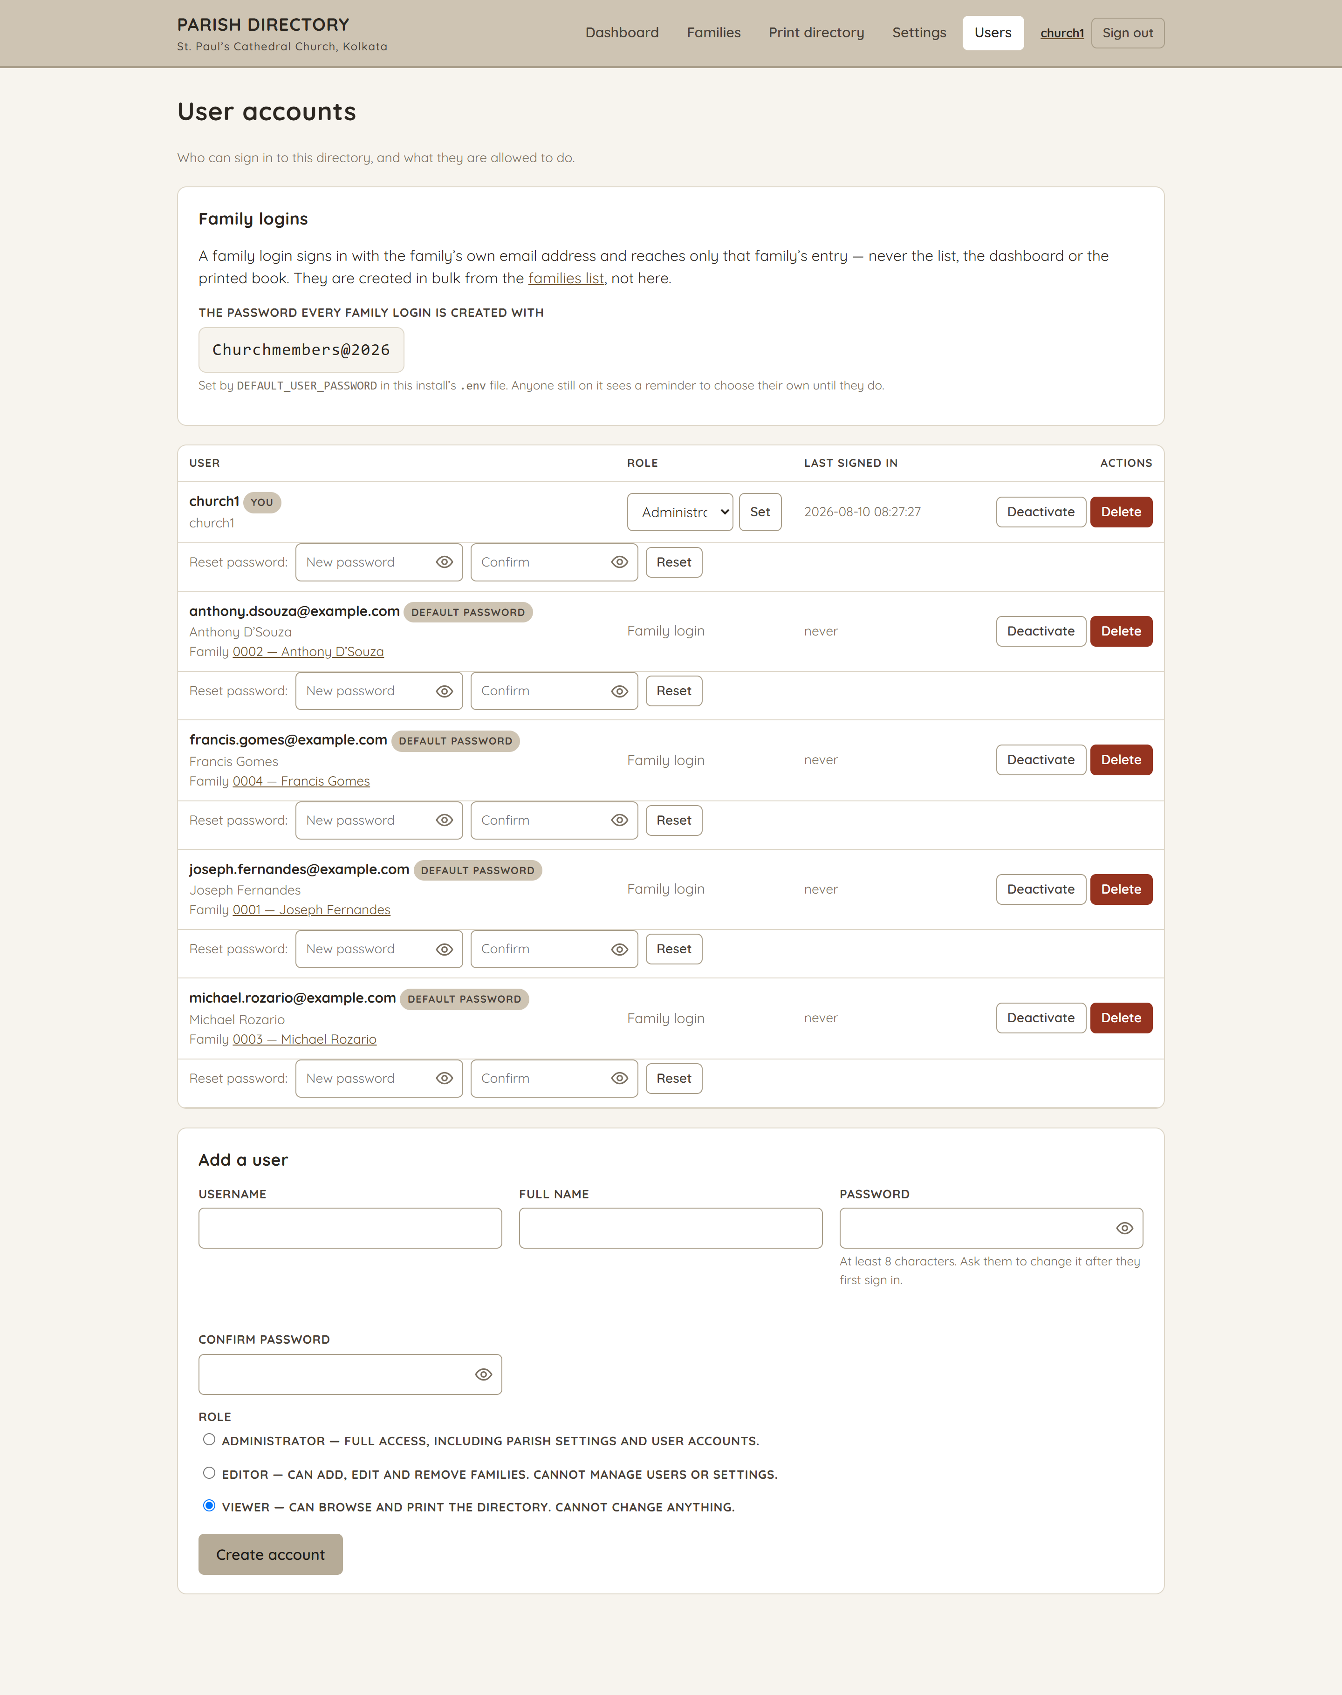
User accounts
/admin/users
Administrator, editor or viewer — and the family logins, listed with the family each belongs to. Passwords are hashed with bcrypt; deactivating or deleting someone signs them out everywhere immediately. Administrators only.
The page continues on the right — one long form, shown in two halves.
11

Slide 12
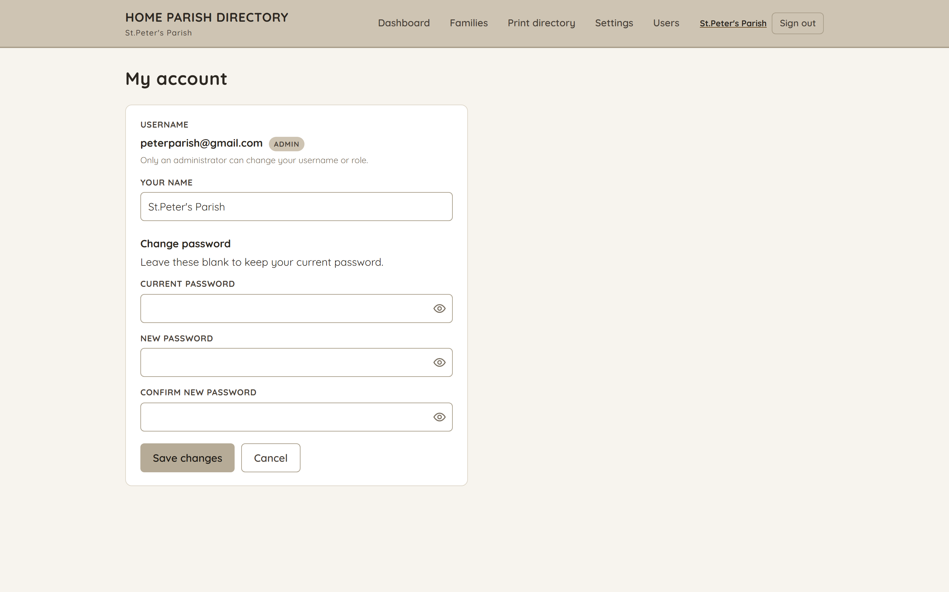
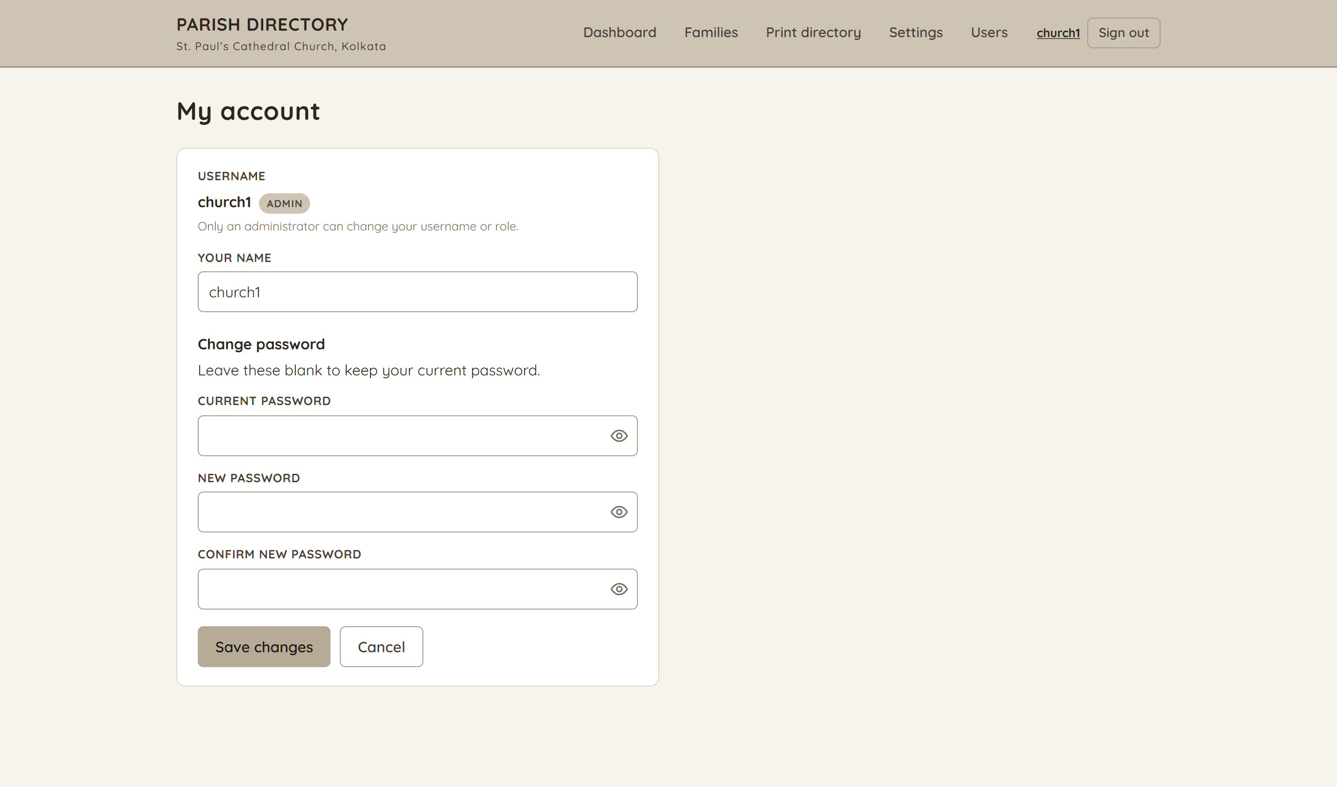
My account
/account
Your own display name and password — the one page every role can reach.
12

Slide 13
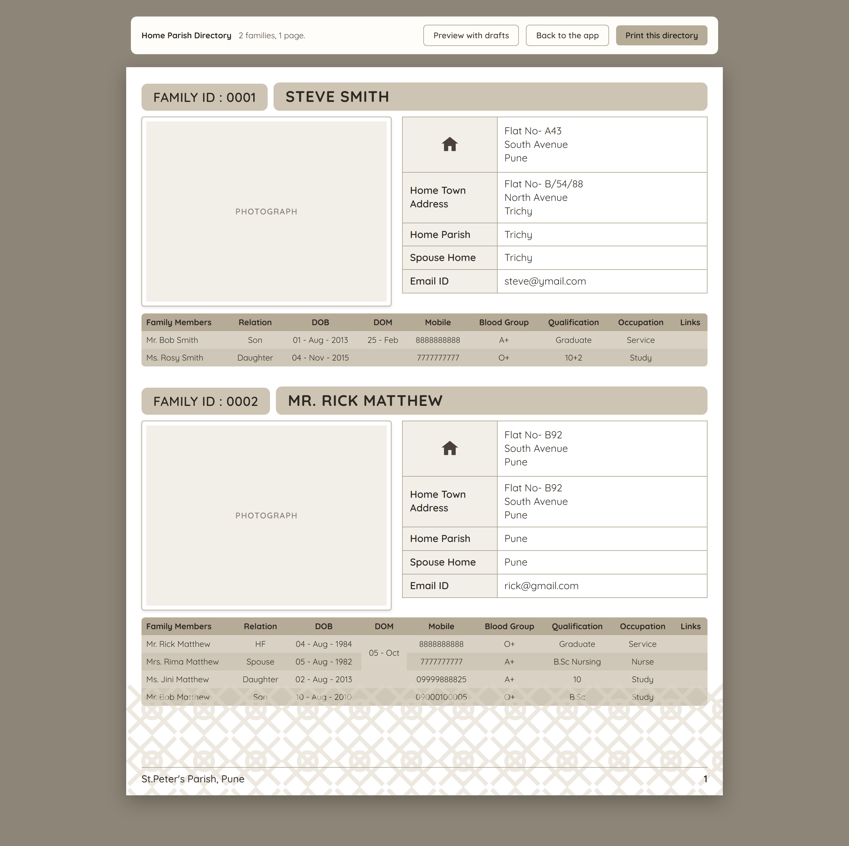
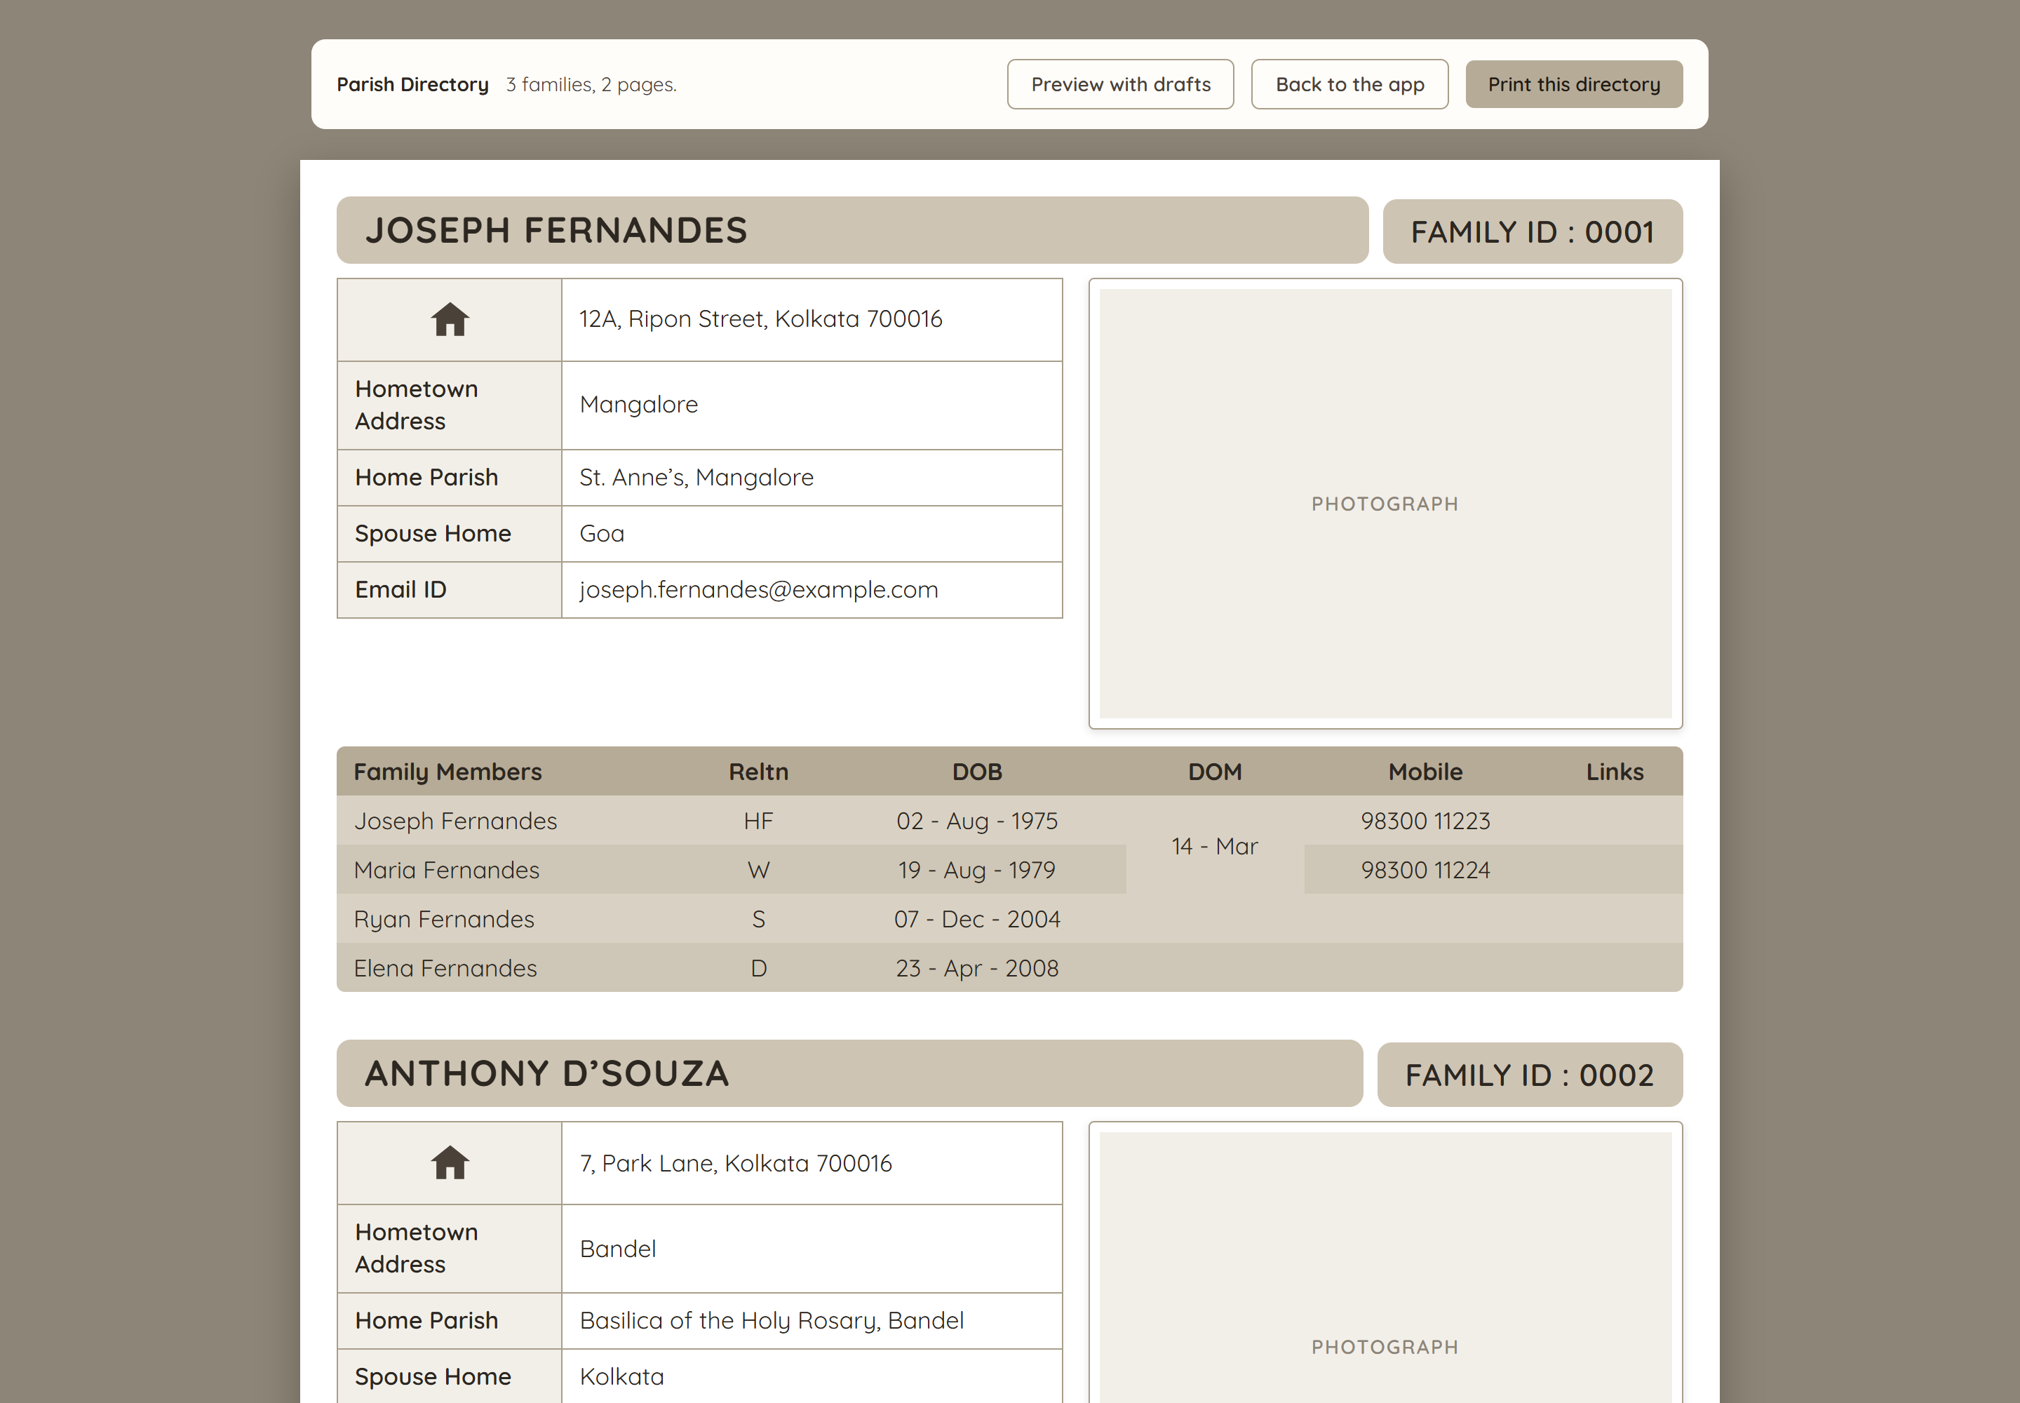
Print directory
/directory
The printed book rendered in the browser, page by page, from the same data. Drafts can be previewed; the browser’s print dialog sends it to a printer or saves a PDF.
13

Slide 14
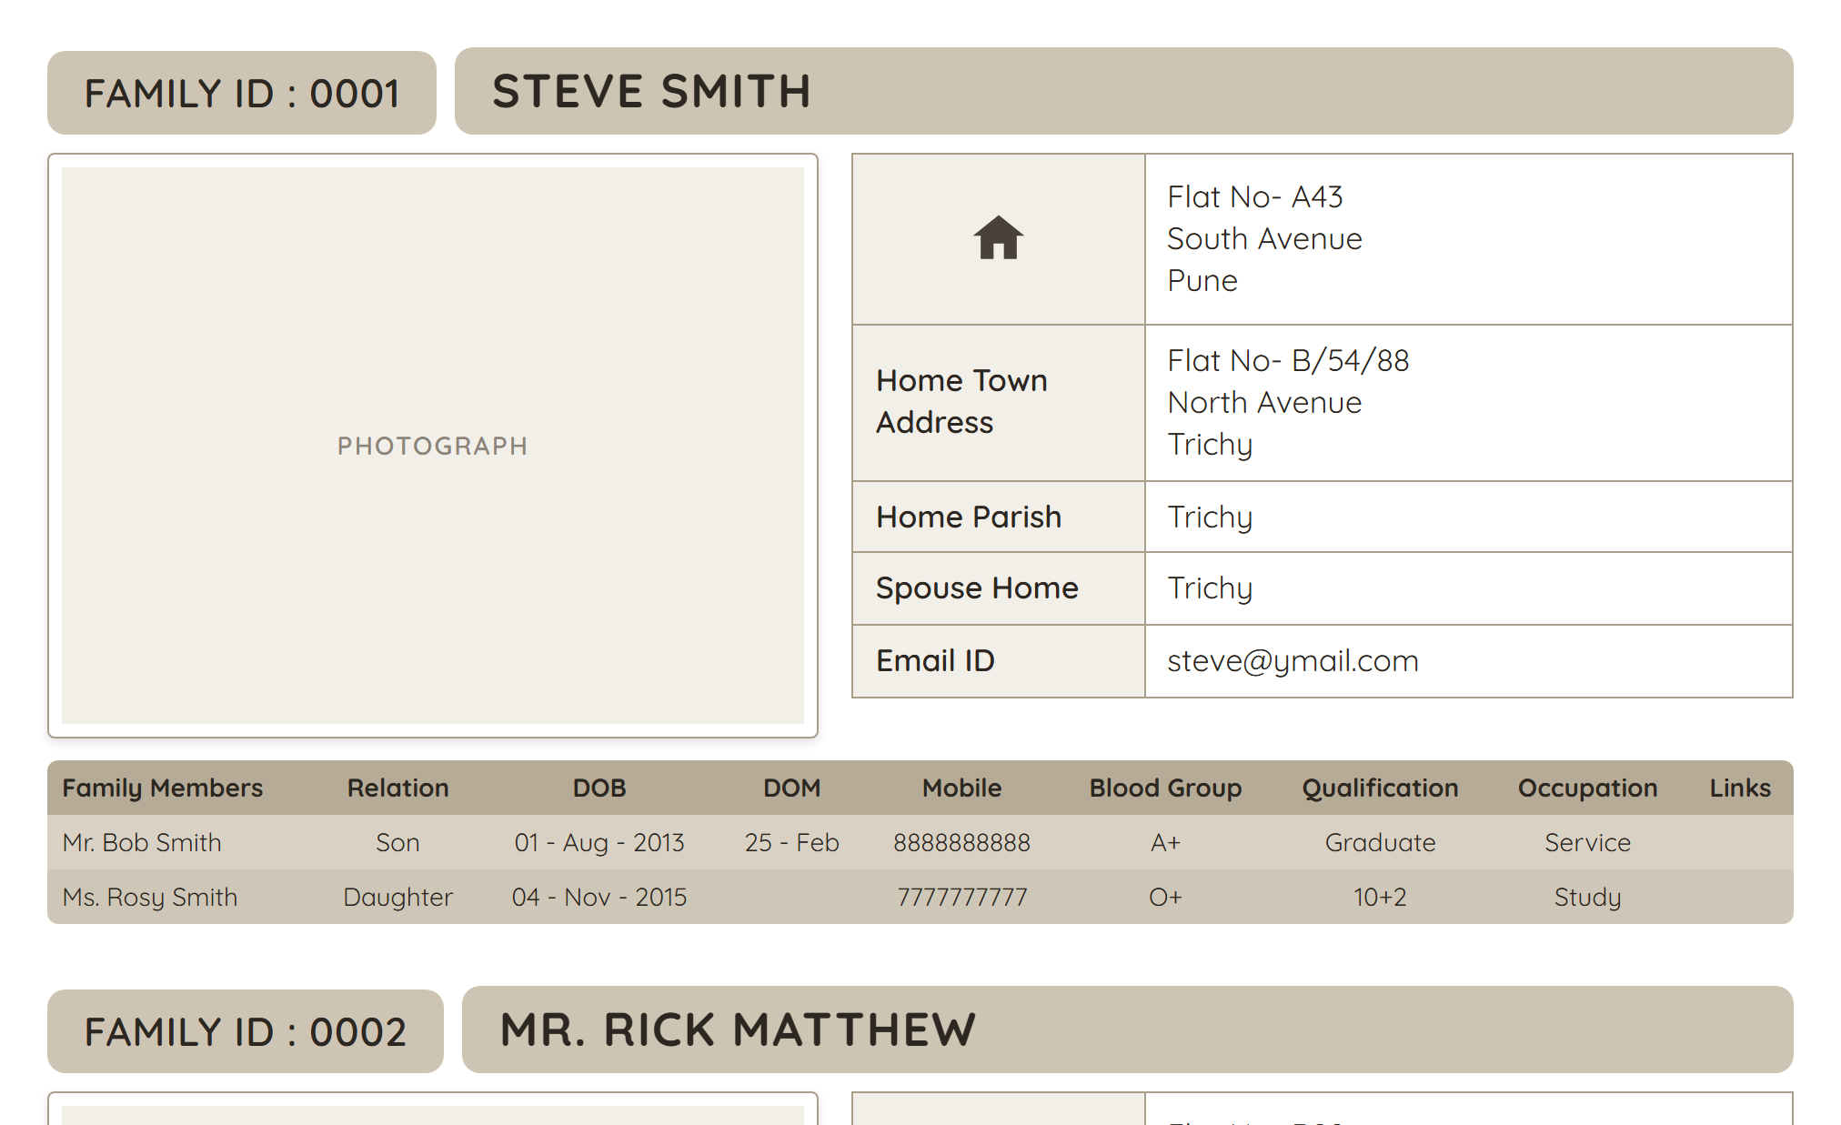
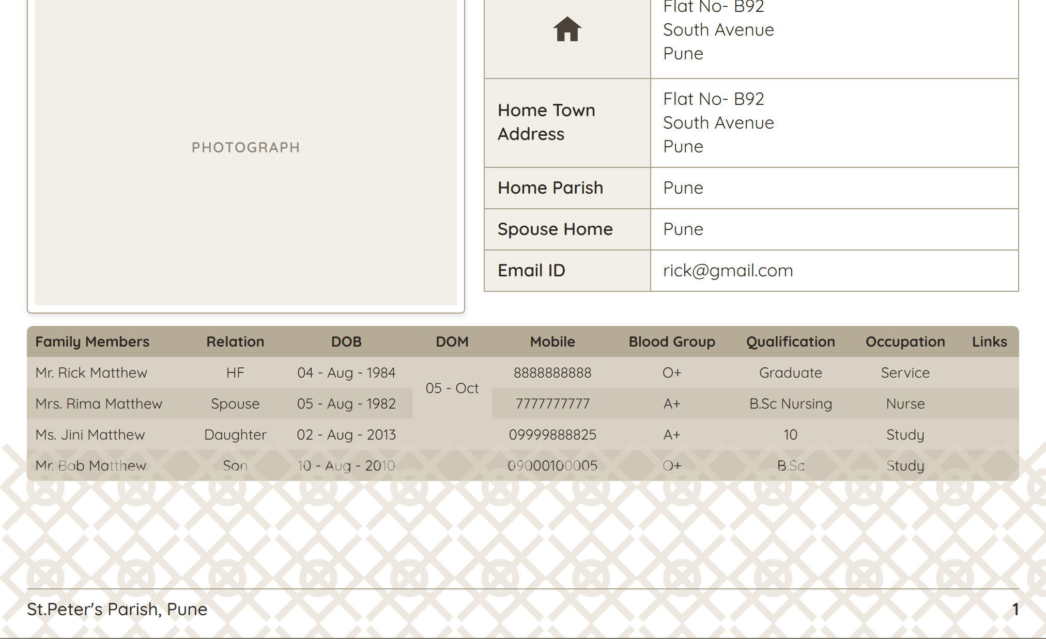
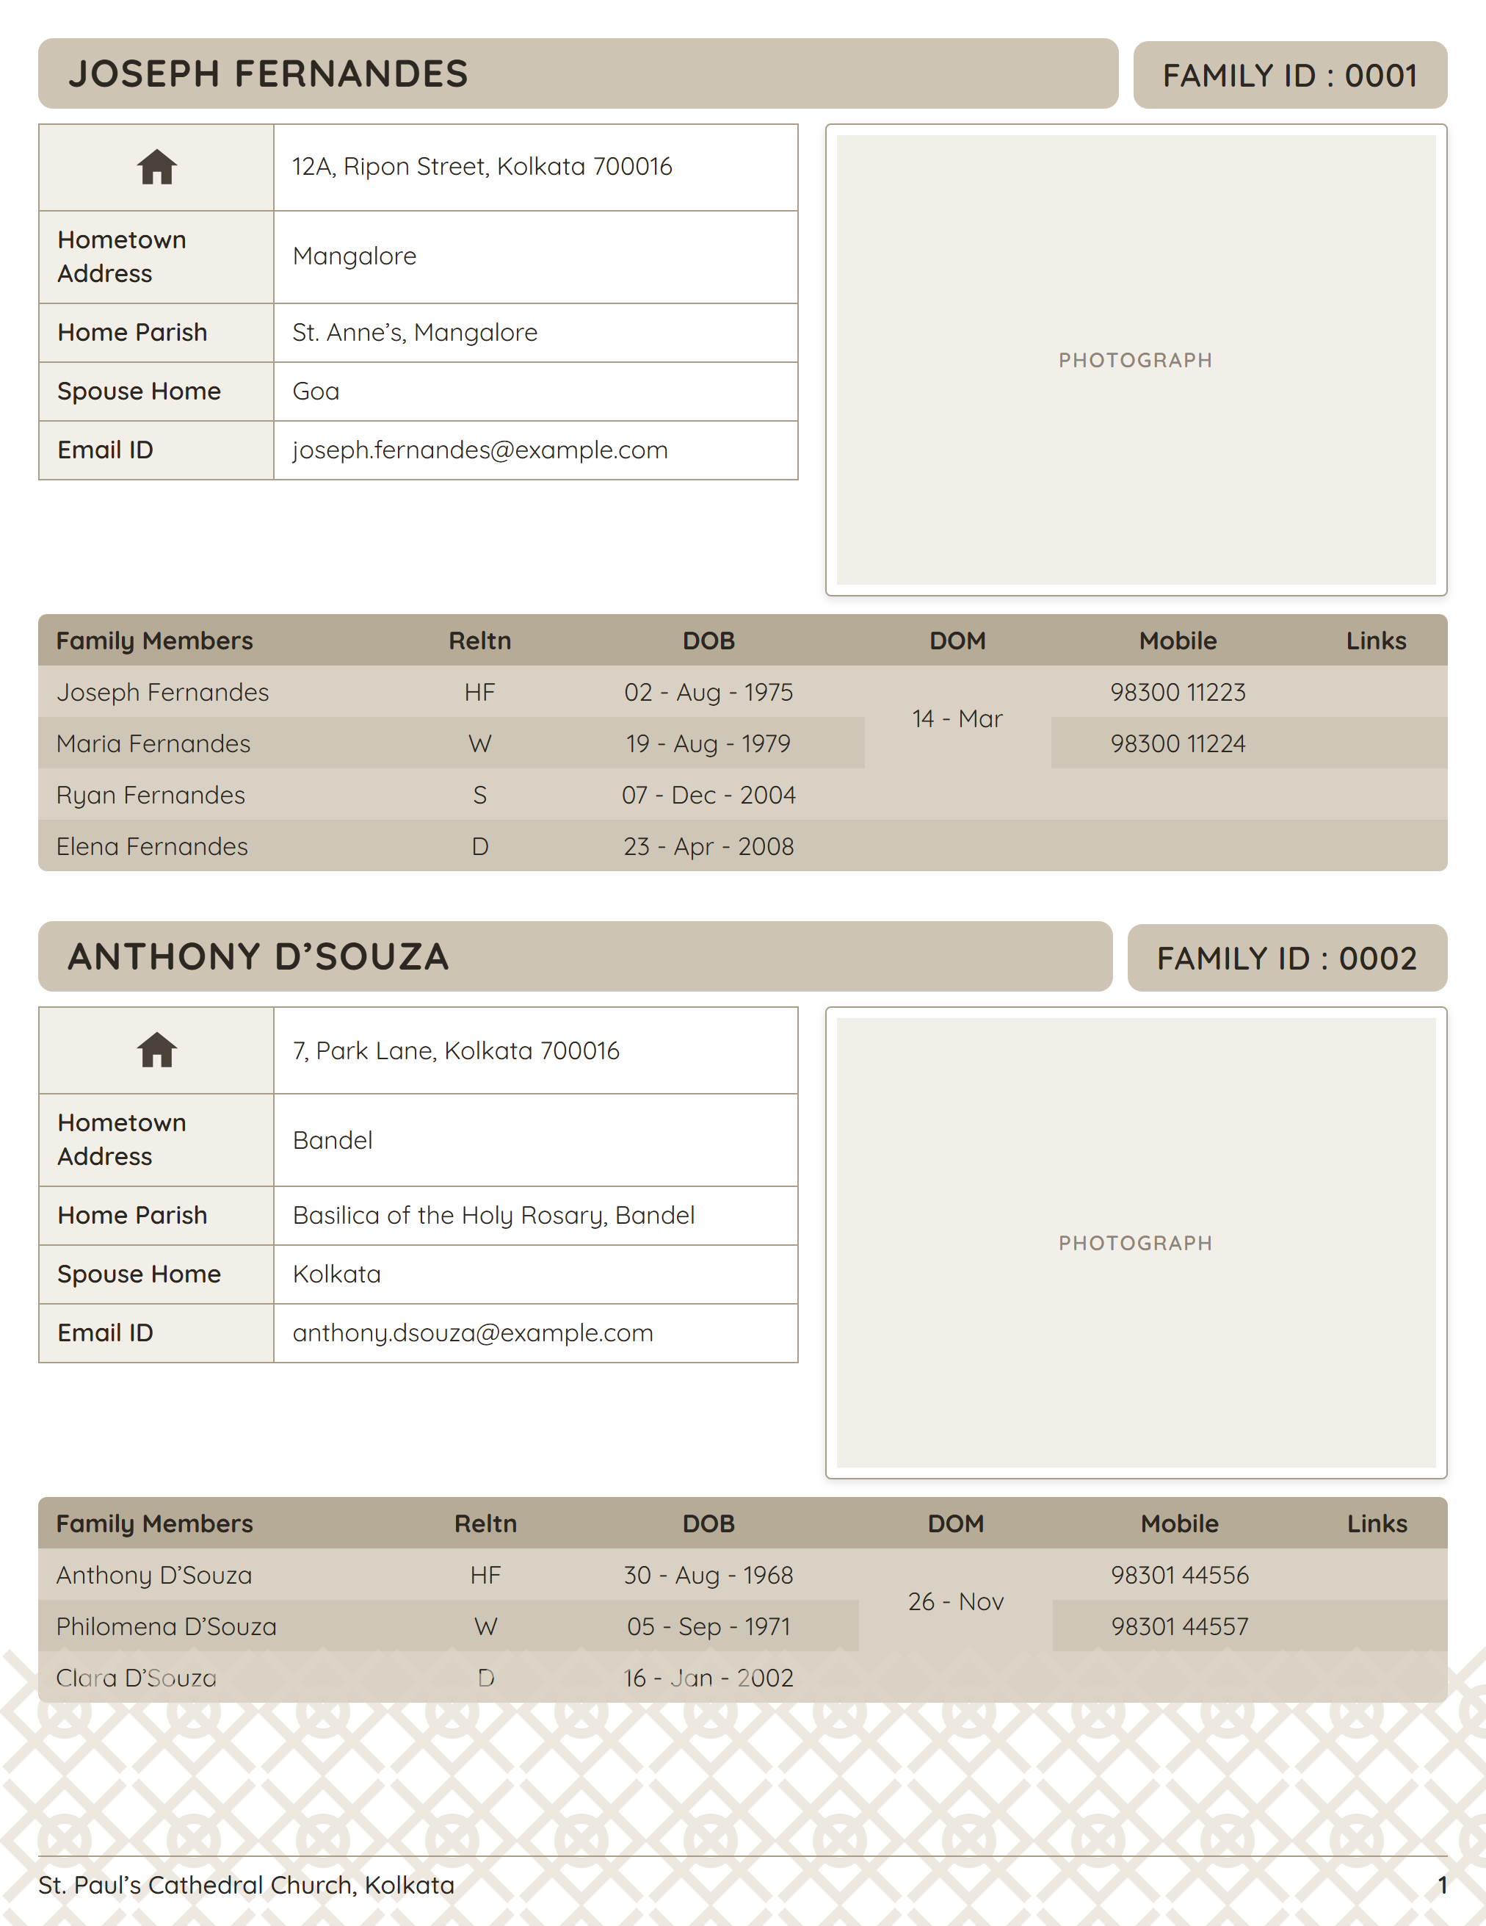
A printed page
/directory
One sheet of the book: the family ID and name band, the photograph and family details, and the members table — now with each member’s blood group, qualification and occupation alongside their date of birth and mobile. Dates of birth are in full, and the date of marriage is merged across the first two rows, without a year.
One A4 sheet, top on the left and foot on the right — two families to a page, as set in Settings.
14

Slide 15
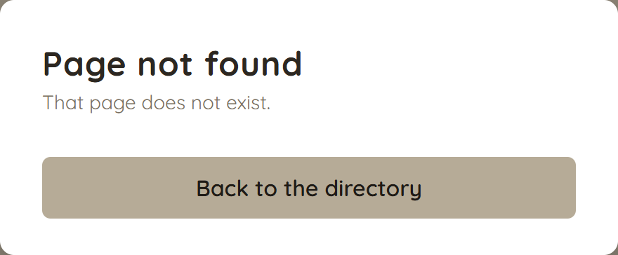
Page not found
—
The error page as a parish sees it. In development it also prints the stack trace.
15

Slide 16
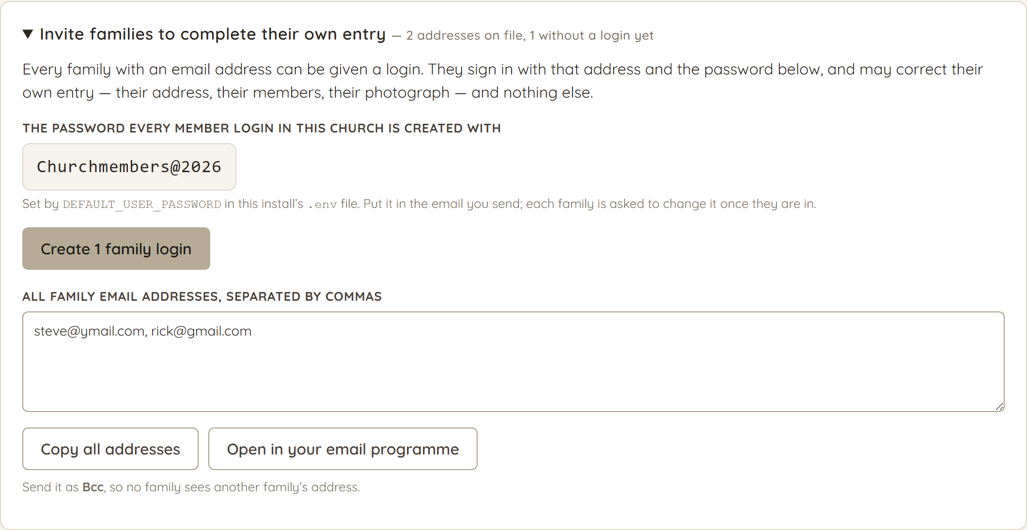
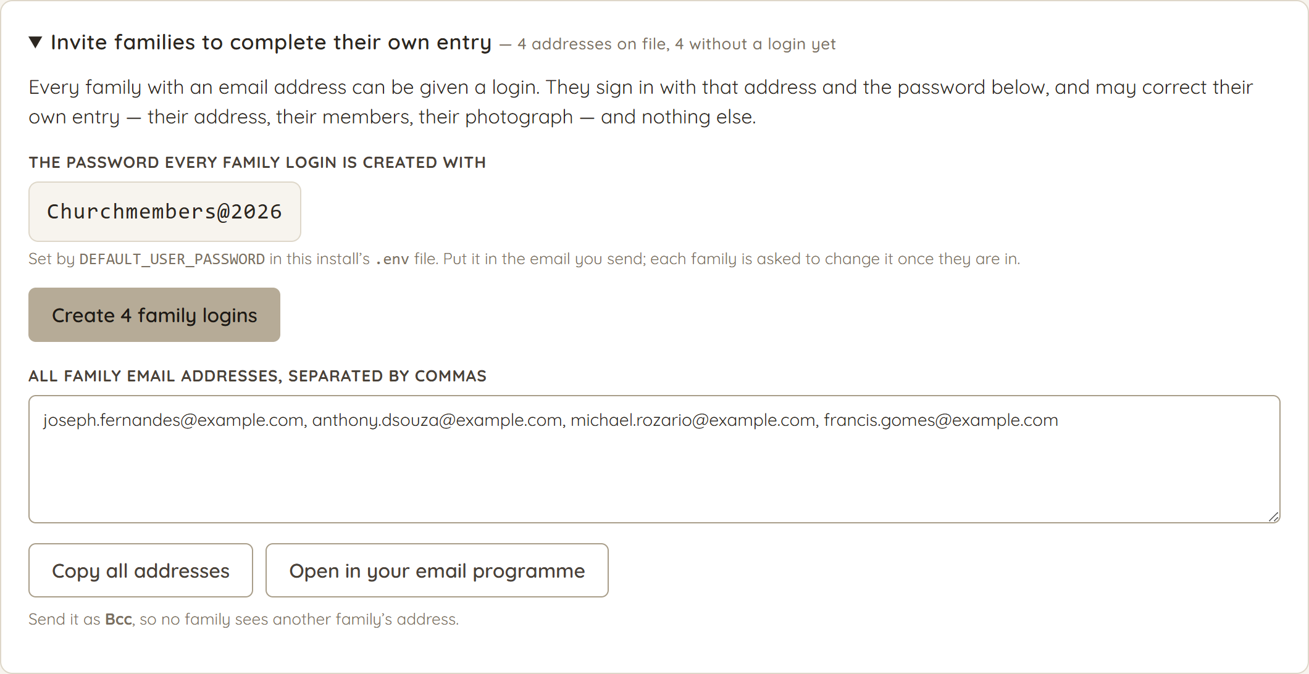
Inviting families
/families
Collecting a directory by hand is the slow part. One button gives every family with an email address a login; the box below hands back all of those addresses, comma separated, for the Bcc line of a single message.
16

Slide 17
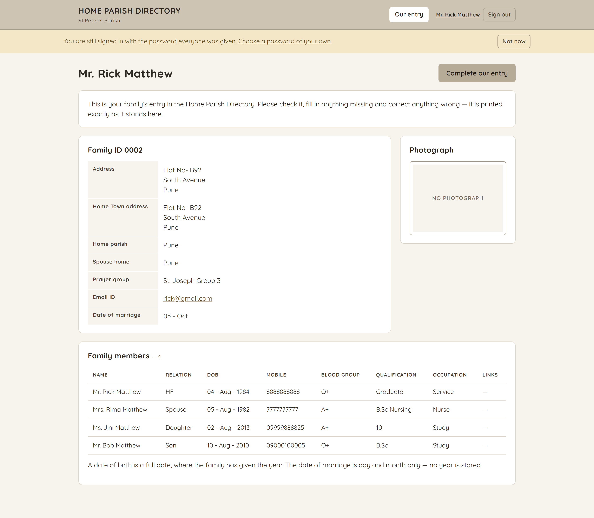
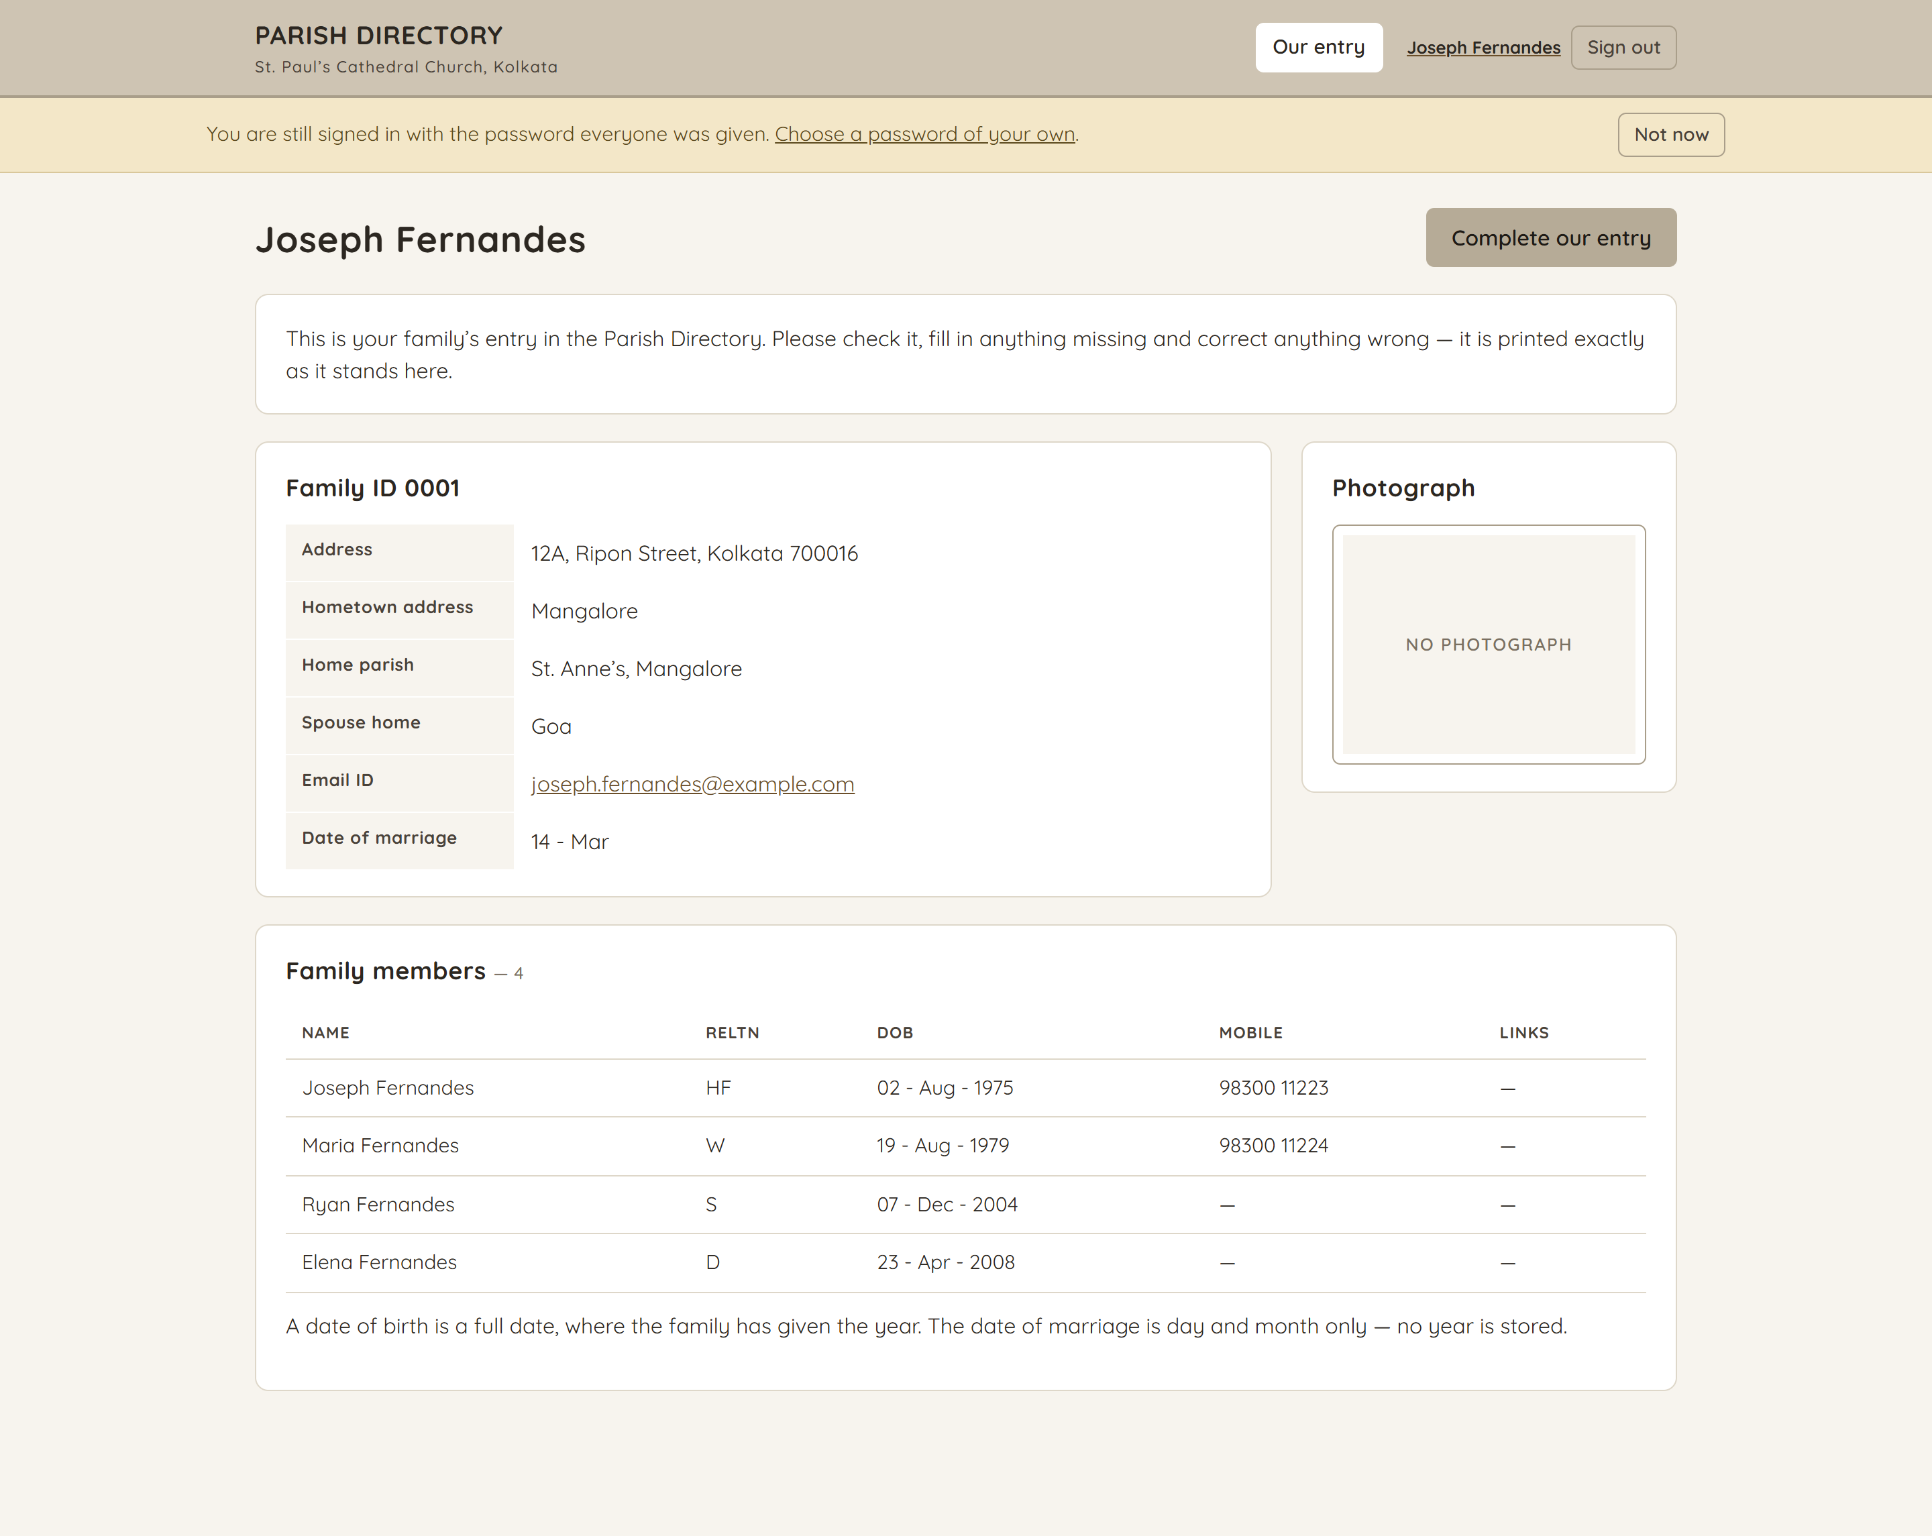
What a family sees
/families/:id
Their own entry and nothing else — no list, no dashboard, no printed book. The reminder stays until they choose a password of their own; “Not now” dismisses it for this visit.
17

Slide 18
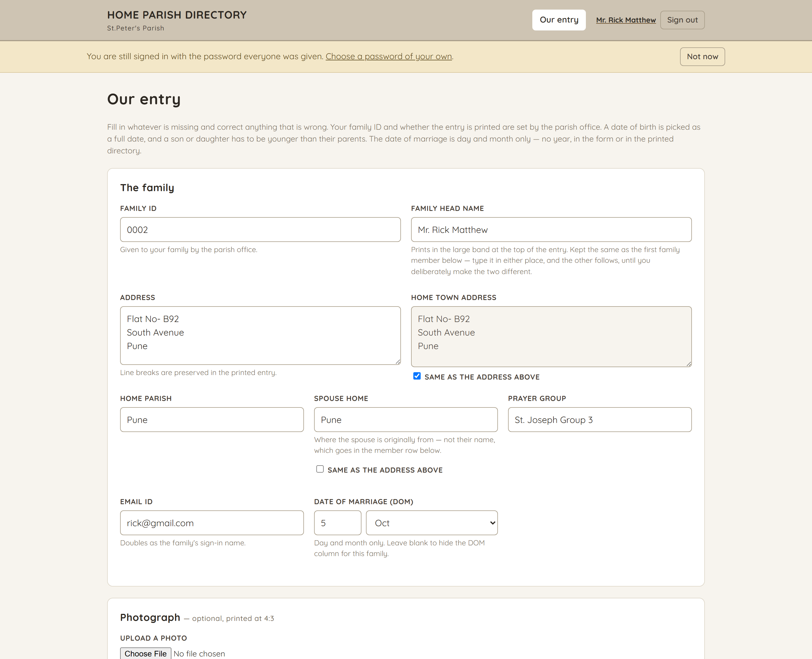
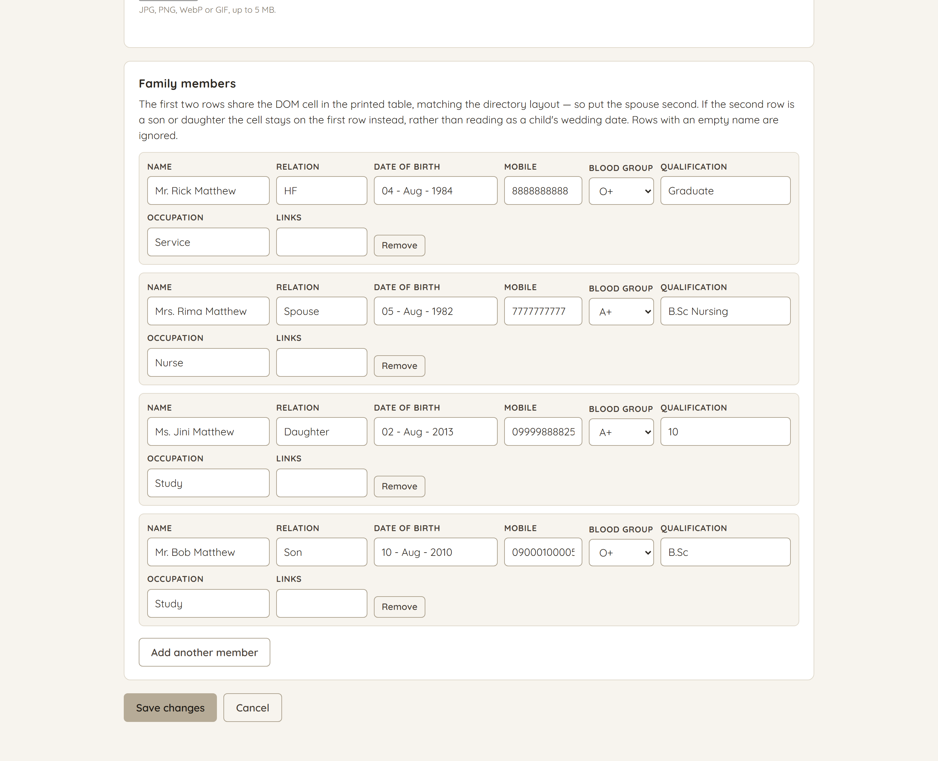
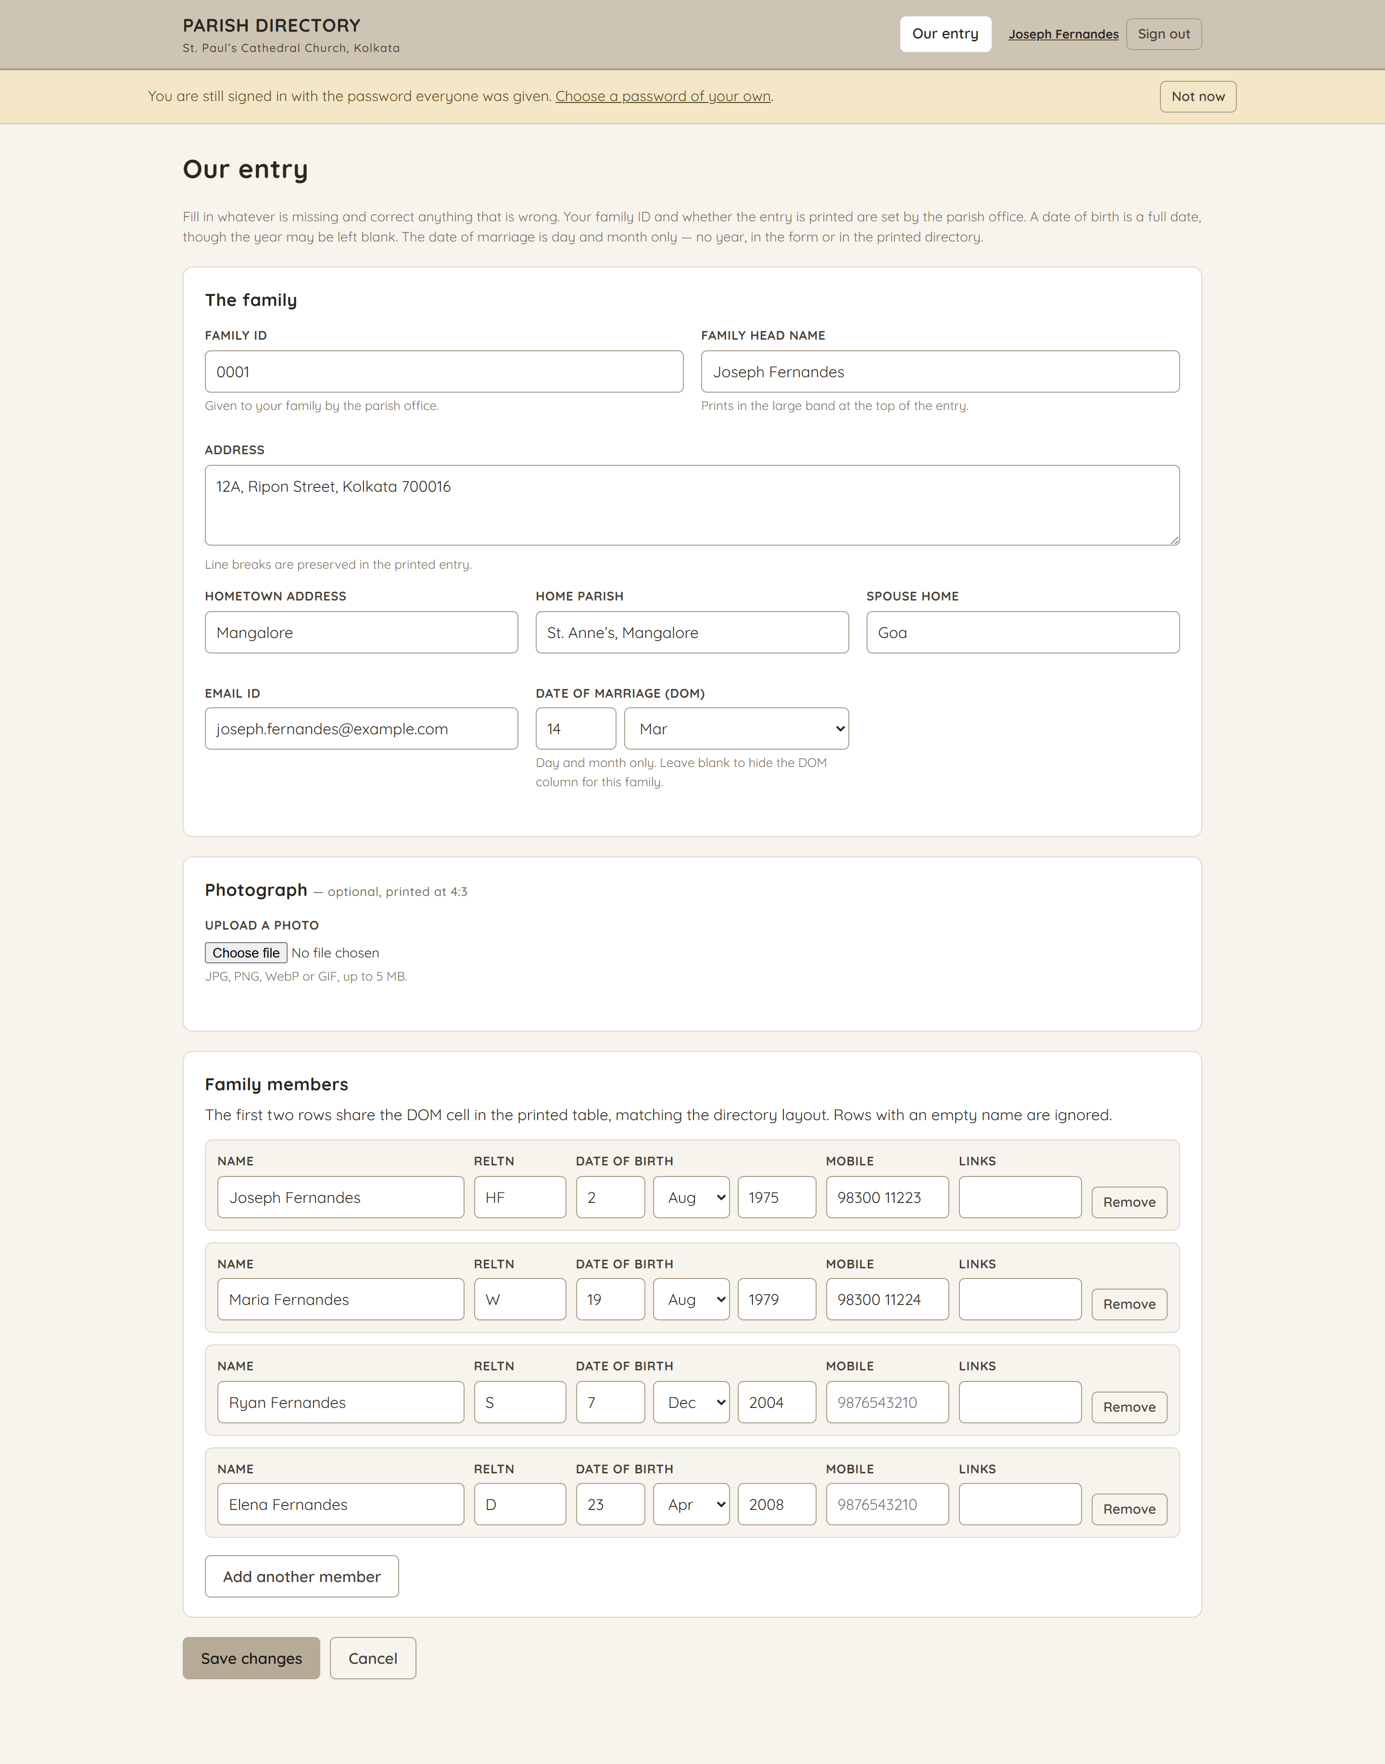
Their shorter form
/families/:id/edit
A household may change its address, its members, its dates and its photograph. The family ID and whether the entry is printed belong to the parish office, and there is no delete button.
The page continues on the right — one long form, shown in two halves.
18

Slide 19
Who can do what
Administrator
Everything, plus parish settings and user accounts
Editor
Add, edit and delete families
Viewer
Browse and print the directory; change nothing
Family
Complete and correct their own entry, and nothing else
Signing in
The shared password
Administrator peterparish@gmail.com / 12345678
Every family their own email address
/ Churchmembers@2026
Set by DEFAULT_USER_PASSWORD in this install’s .env file, and shown in full on the Families and Users pages — the office has to be able to put it in the email. Anyone still on it is reminded on every page until they choose their own.
19

