Slide 1
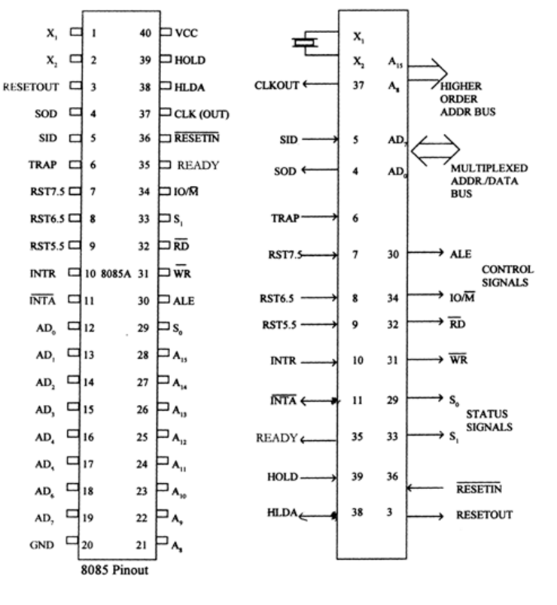
The 8085 Microprocessor Pinout and Signals
The 8085 Microprocessor
The device has forty pins, requires a +5 V single power supply and can operate with a 3Mhz signal phase clock.

Slide 2
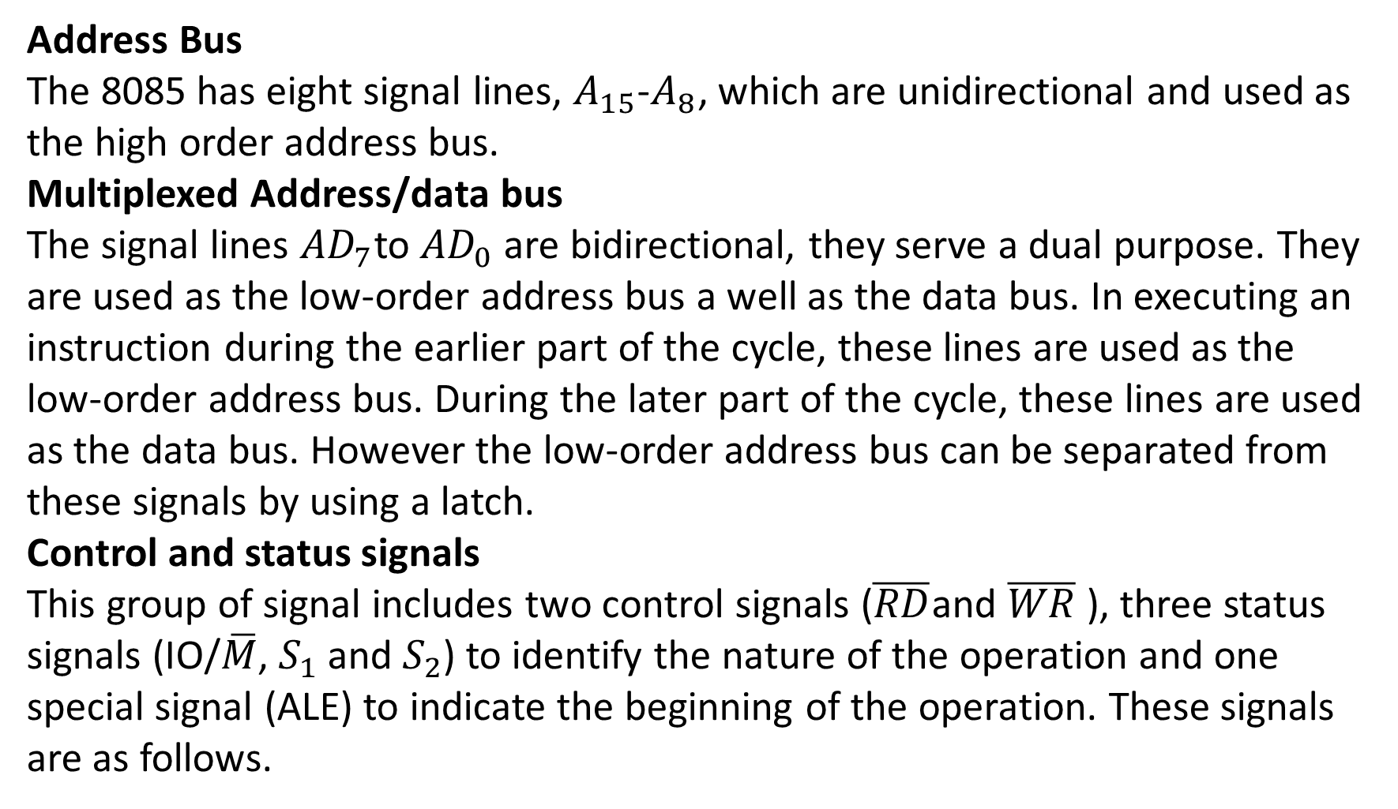

Slide 3
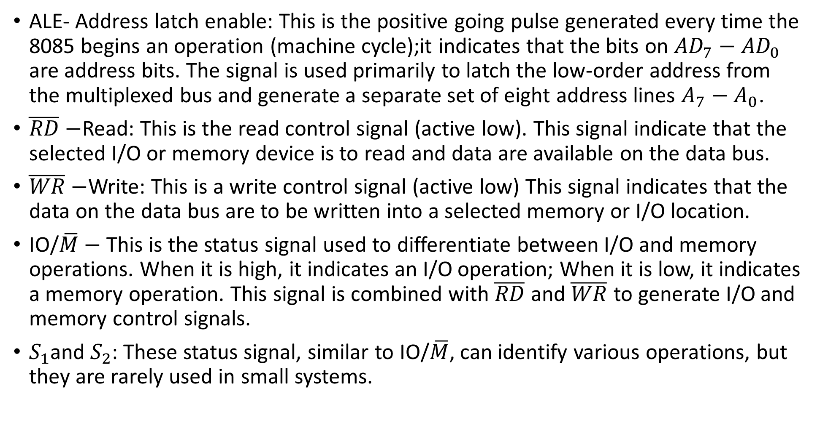

Slide 4
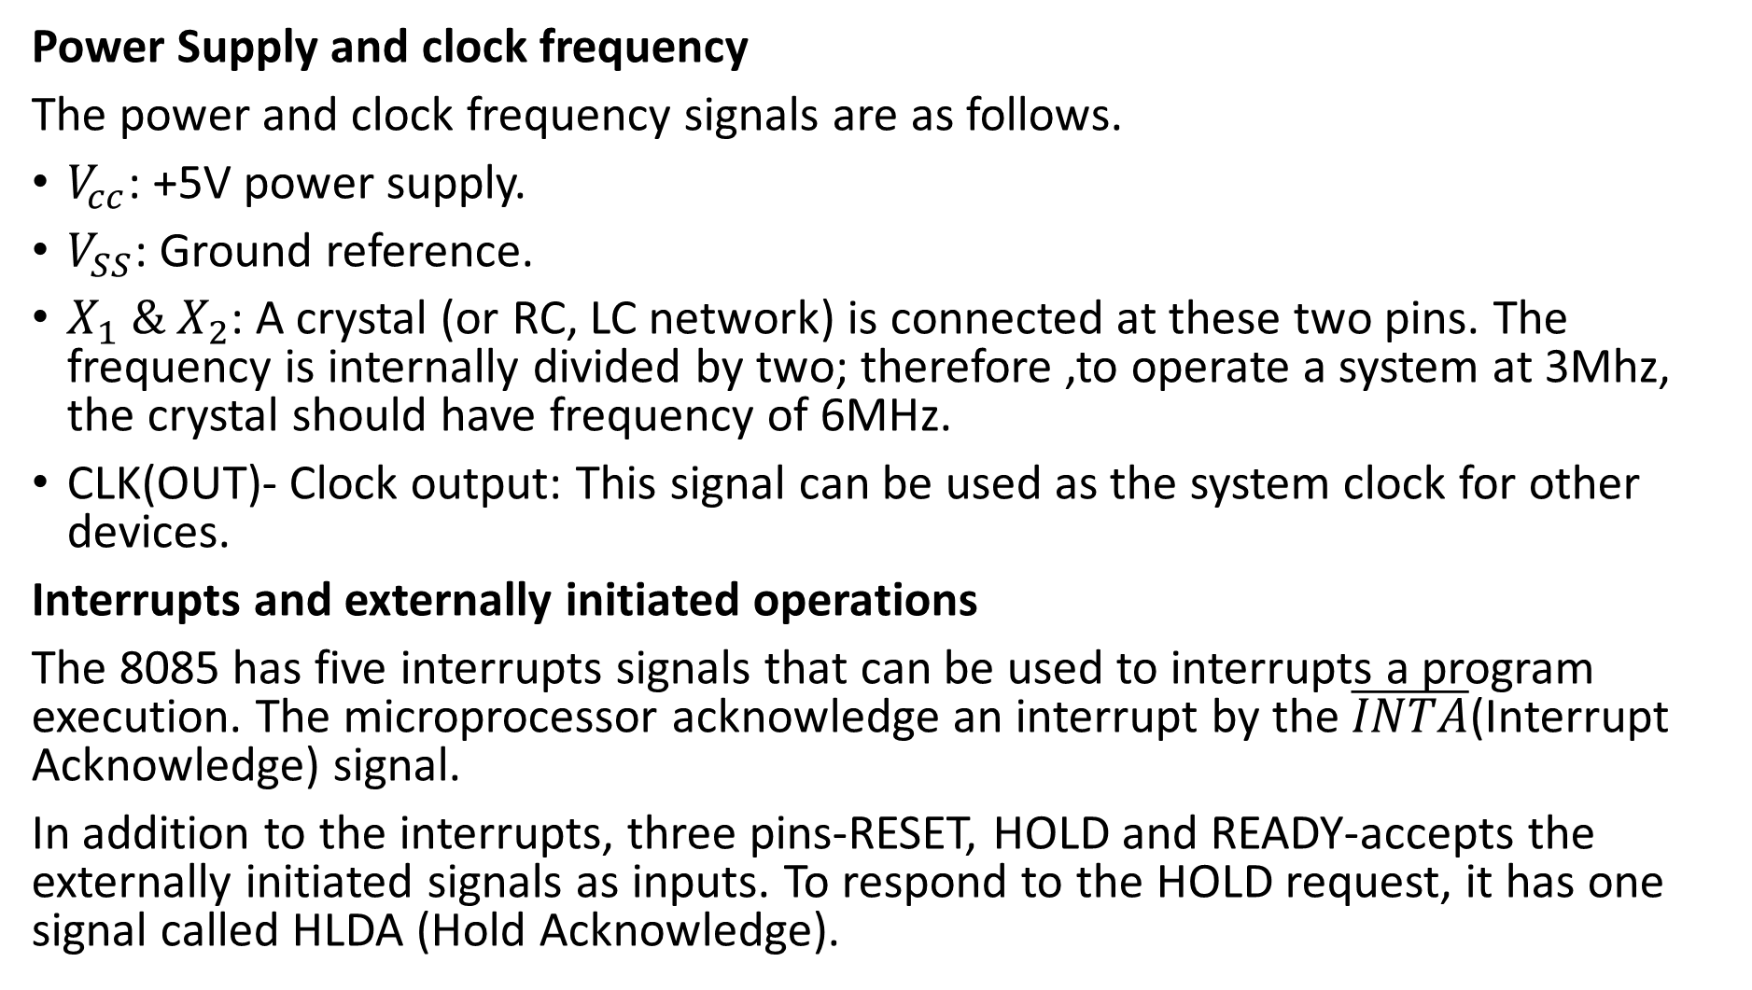

Slide 5
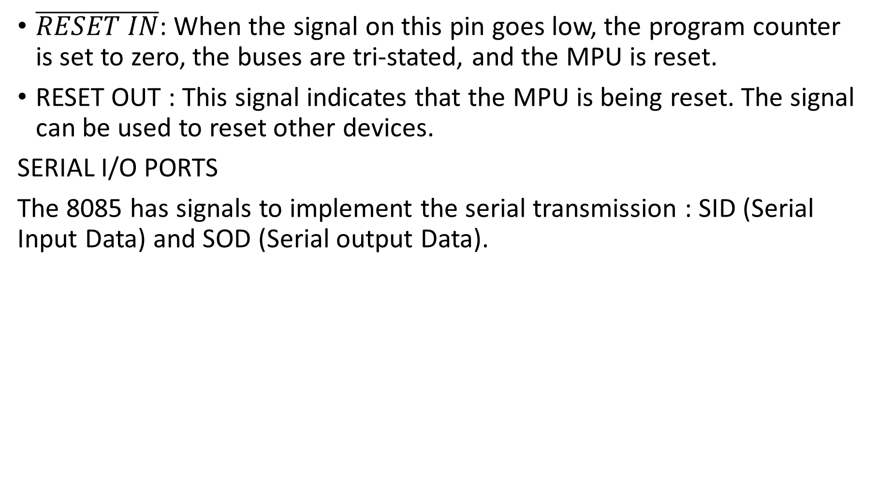

Slide 6
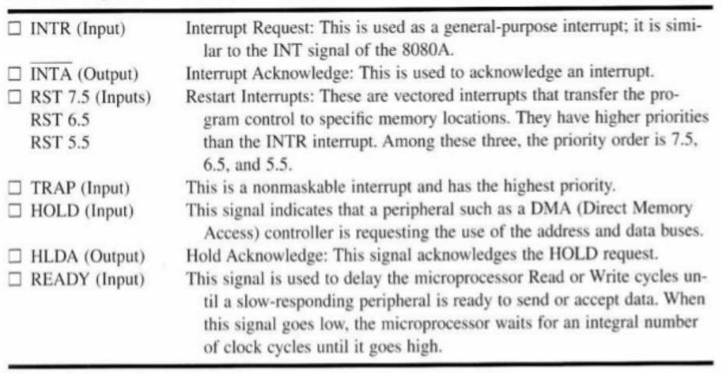
8085 Interrupts and Externally Initiated Signals

Slide 7
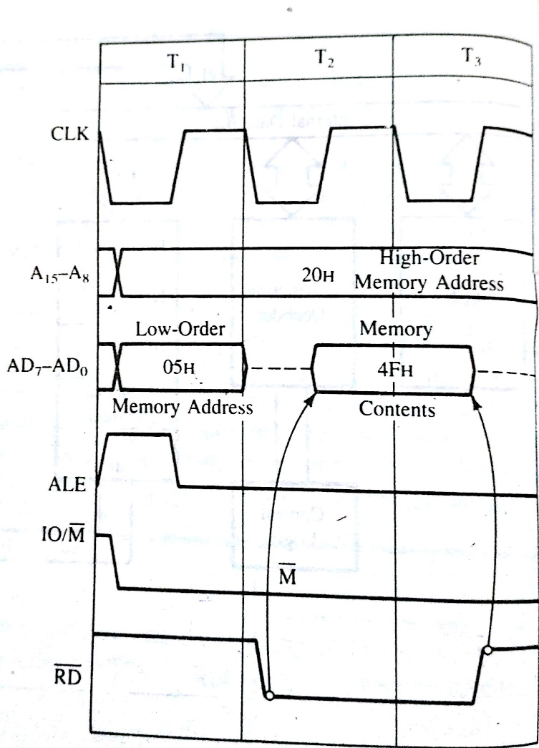
Timing: Transfer of Byte from Memory to MPU

Slide 8
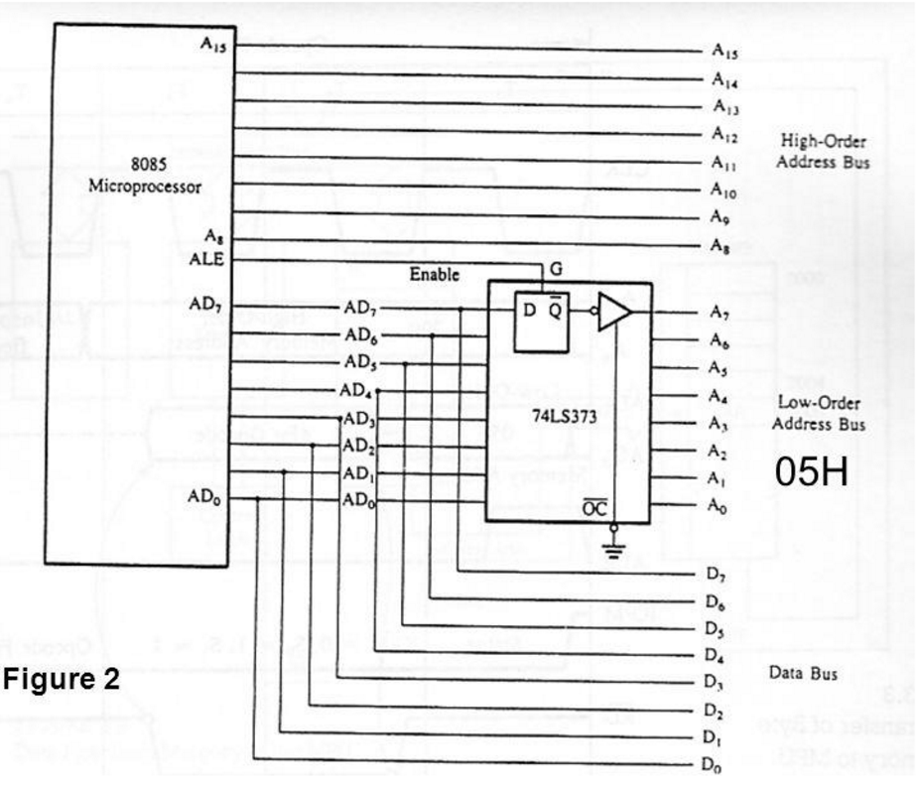
Schematic of Latching Low-Order Address Bus

Slide 9
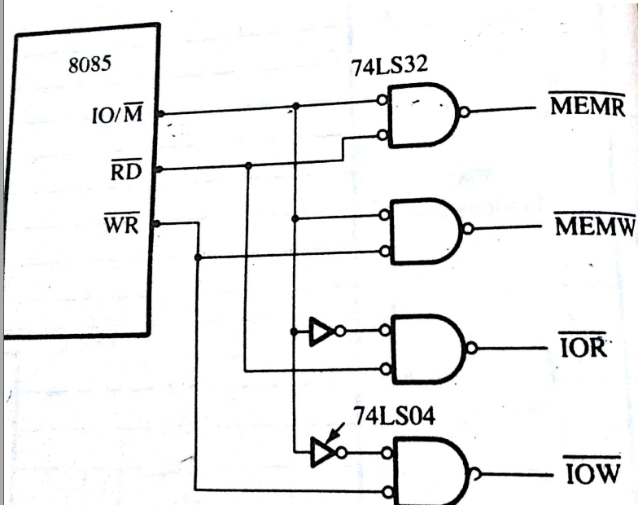
Systematic to Generate Read/Write Control Signals for Memory and I/O

Slide 10
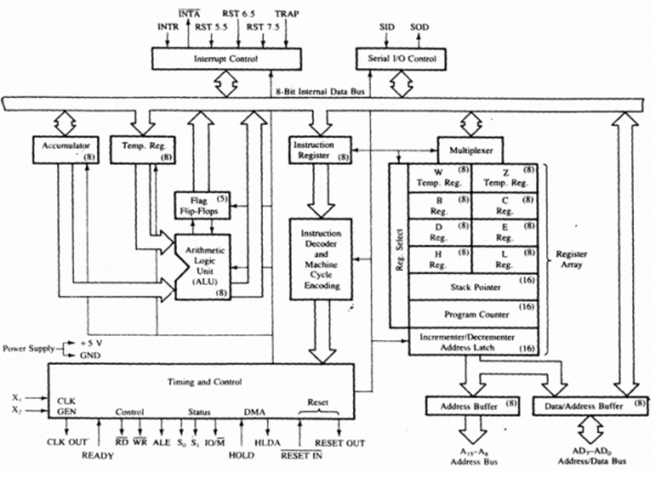
The 8085A Microprocessor : Functional Block Diagram

Slide 11
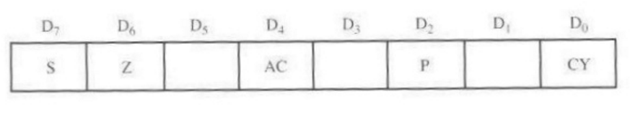
The ALU
The arithmetic logic performs the computing functions; it includes the accumulator , the temporary register, the arithmetic and logic circuits and five flags.
S- Sign flag Z-Zero Flag
AC-Auxiliary Carry Flag P-Parity Flag CY- Carry Flag

Slide 12
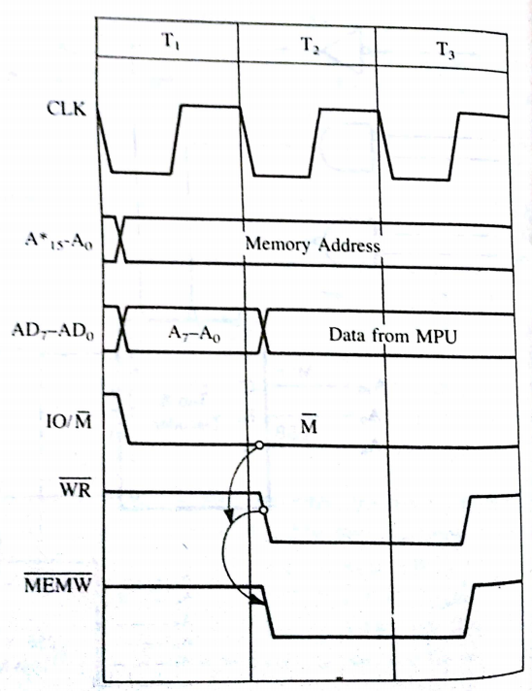
Timing of the memory Write Cycle
* Demultiplexed address bus

Slide 13
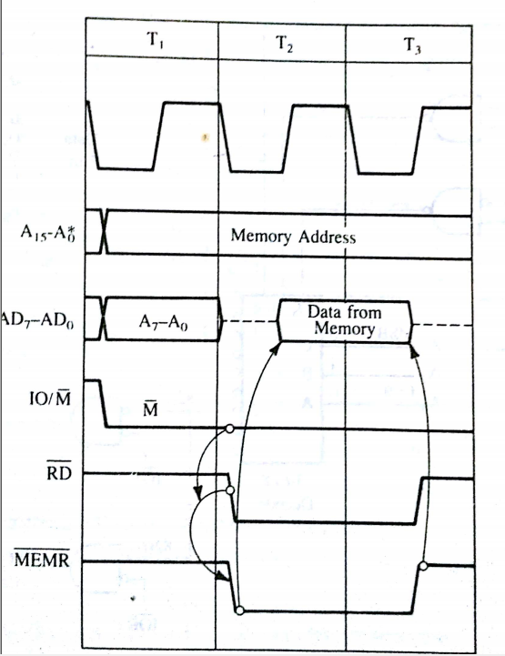
Timing of the memory Read Cycle

Slide 14
Data Copy Transfer Instruction
MOV: Move-Copy from Source to destination
Opcode | Operand | Bytes | M-Cycles | T-States
MOV | Rd, Rs | 1 | 1 | 4
MOV | M, Rs |  | 2 | 7
MOV | Rd, M
Description: This instruction copies the contents of the source register into the destination register; the contents of the source register are not altered. If one of the operands is a memory location, it is specified by the contents of HL register
Flags: No flags are affected.
Instructions:
MOV B,C
MOV B,D
MOV B,E
MOV B,H
MOV B,L
MOV B,M
MOV B,A
MOV C,B
MOV C,D
MOV C,E
MOV C,H
MOV C,L
MOV C,M
MOV C,A
MOV D,B
MOV D,C
MOV D,E
MOV D,H
MOV D,L
MOV D,M
MOV D,A
MOV E,B
MOV E,C
MOV E,D
MOV E,H
MOV E,L
MOV E,M
MOV E,A
MOV H,B
MOV H,C
MOV H,D
MOV H,E
MOV H,L
MOV H,M
MOV H,A
MOV L,B
MOV L,C
MOV L,D
MOV L,E
MOV L,H
MOV L,M
MOV L,A
MOV M,B
MOV M,C
MOV M,D
MOV M,E
MOV M,H
MOV M,L
MOV M,A
MOV A,B
MOV A,C
MOV A,D
MOV A,E
MOV A,H
MOV A,M
MOV A,L

Slide 15
MVI: Move Immediate 8- Bit
Opcode | Operand | Bytes | M-Cycles | T-States
MVI | Reg., Data | 2 | 2 | 7
 | Mem., Data | 2 | 3 | 10
Description: The 8-bit data are stored in the destination register or memory. If the operand is a memory location, it is specified by the contents of HL registers.
Flags: No flags are affected.
Instructions:
MVI B, 8-bit data
MVI C, 8-bit data
MVI D, 8-bit data
MVI E, 8-bit data
MVI H, 8-bit data MVI A, 02H
MVI L, 8-bit data
MVI M, 8-bit data
MVI A, 8-bit data

Slide 16
LDAX: Load Accumulator Indirect
Opcode | Operand | Bytes | M-Cycles | T-States
LDAX | B/D reg.pair | 1 | 2 | 7
Description: The contents of the designated register pair point to a memory location. This instruction copies the contents of that memory location into the accumulator. The contents of either the register pair or memory location are not altered.
Flags: No flags are affected.
Instructions
LDAX B
LDAX D

Slide 17
LHLD: Load H and L Register Direct
Opcode | Operand | Bytes | M-Cycles | T-States
LHLD | 16-bit address | 3 | 5 | 16
Description: The instruction copies the contents of the memory location pointed out by the 16-bit address in register L and copies the content of the next memory location in register H. The contents of source memory locations are not altered.
Flags: No flags are affected.
Instruction:
LHLD 16-bit Memory Address
LHLD 2600

Slide 18
LDA: Load Accumulator Direct
Opcode | Operand | Bytes | M-Cycles | T-States
LDA | 16-bit address | 3 | 4 | 13
Description: The contents of a memory location, specified by a 16-bit address in the operand, are copied to the accumulator. The contents of the source are not altered. This is a 3-byte instruction; the second byte specifies the low-order address and the third byte specifies the high-order address
Flags: No flags are affected.
Instruction
LDA 2600h

Slide 19
STAX: Store Accumulator Indirect
Opcode | Operand | Bytes | M-Cycles | T-States
STAX | B/D reg. pair | 1 | 2 | 7
Description: The contents of the accumulator are copied into the memory location specified by the contents of the operand (register pair). The contents of the accumulator are not altered
Flags: No flags are affected.
Instruction
STAX B
STAX D

Slide 20
SHLD: Store H and L Registers Direct
Opcode | Operand | Bytes | M-Cycles | T-States
SHLD | 16-bit address | 3 | 5 | 16
Description: The contents of register L are stored in the memory location specified by the 16-bit address in the operand and the contents of H register are stored in the next memory location by incrementing the operand. The contents of registers HL are not altered. This is a 3-byte instruction; the second byte specifies the low-order address and the third byte specifies the high-order address.
Flags: No flags are affected.
Instruction:
SHLD 2600h

Slide 21
STA: Store Accumulator direct
Opcode | Operand | Bytes | M-Cycles | T-States
STA | 16-bit | 3 | 4 | 13
Description: The contents of the accumulator are copied to a memory location specified by the operand. This is a 3-byte instruction; the second byte the low-order address and the third byte specifies the high-order address.
Flags: No flags are affected.
Instruction:
STA 2600H

Slide 22
LXI: Load Register Pair Immediate
Opcode | Operand | Bytes | M-Cycles | T-States
LXI | Reg. pair, 16-bit data | 3 | 3 | 10
Description: The instruction loads 16-bit data in the register pair designated in the operand. This is a 3-byte instruction, the second byte specifies the low-order byte and the third byte specifies the high-order byte.
Flags: No flags are affected.
Instructions:
LXI B, 2050h
LXI D, 2050h
LXI H, 2050h
LXI SP, 2050h

Slide 23
SPHL: Copy H and L Register to the Stack Pointer
Opcode | Operand | Bytes | M-Cycles | T-States
SPHL | None | 1 | 1 | 6
Description: The instruction loads the contents of the H and L registers into the stack pointer register; the contents of the H register provide the high-order address and the contents of the L register provide the low-order address. The contents of the H and L registers are not altered.
Flags: No flags are affected.
Instruction:
SPHL

Slide 24
XTHL: Exchange H and L with Top of Stack
Opcode | Operand | Bytes | M-Cycles | T-States
XTHL | None | 1 | 5 | 16
Description: The contents of the L register are exchanged with the stack location pointed out by the contents of the stack pointer register. The contents of the H register are exchanged with the next stack location (SP + 1); however the contents of the stack pointer register are not altered.
Flags: No flags are affected.
Instruction:
XTHL

Slide 25
XCHG: Exchange H and L with D and E
Opcode | Operand | Bytes | M-Cycles | T-States
XCHG | None | 1 | 1 | 4
Description: The contents of register H are exchanged with the contents of register D and the contents of register L are exchanged with the contents of register E.
Flags: No flags are affected.
Instruction:
XCHG

Slide 26
OUT: Out Data from Accumulator to a Port with 8-Bit Address
Opcode | Operand | Bytes | M-Cycles | T-States
OUT | 8-bit port address | 2 | 3 | 10
Description: The contents of the accumulator are copied into the output port specified by the operand.
Flags: No flags are affected.
Instruction:
OUT 02H

Slide 27
IN: Input Data to Accumulator from a port with 8-bit Address
Opcode | Operand | Bytes | M-Cycles | T-States
IN | 8-bit port address | 2 | 3 | 10
Description: The contents of the input port designated in the operand are read and loaded into the accumulator
Flags: No flags are affected.
Instruction:
IN 02h

Slide 28
PUSH: Push Register Pair onto Stack
Opcode | Operand | Bytes | M-Cycles | T-States
PUSH | Reg. pair | 1 | 3 | 12
Description: The contents of register pair designated in the operand are copied into the stack in the following sequence. The stack pointer register is decremented and the contents of the high-order register (B, D, H, A) are copied into that location. The stack pointer register is decremented again and the contents of the low-order register (C, E, L, flags) are copied to that location.
Flags: No flags are affected.
Instructions:
PUSH B
PUSH D
PUSH H
PUSH PSW

Slide 29
POP: Pop off Stack to Register Pair
Opcode | Operand | Bytes | M-Cycles | T-States
POP | Reg. pair | 1 | 3 | 10
Description: The contents of the memory location pointed out by the stack pointer register are copied to the low-order register (such as C, E, L and flags) of the operand. The stack pointer register is incremented by 1 and the contents of that memory location are copied to high-order register (B, D, H, A) of the operand. The stack pointer register is again incremented by 1.
Flags: No flags are modified.
Instructions:
POP B
POP D
POP H
POP PSW

Slide 30
Read the following Prog. And answer the questions
Line No. Mnemonics
1 LXI SP, 0400H
2 LXI B, 2055H
3 LXI H, 22FFH
4 LXI D, 2090H
5 PUSH H
6 PUSH B
7 MOV A,L
20 POP H
What is stored in SP register after the execution of Line 1?
What is the memory location of the stack where the Ist byte will be stored?
What is stored in memory location 03FE when Line 5 is executed?
After the execution of Line 6, what is the address in the SP register and what is stored in 03FD
Specify the contents of HL after the execution of Line 20.

Slide 31
Read the following Prog. And answer the questions
Memory Locations. Mnemonics
2000 LXI SP, 20CDH
2003 LXI H, 0008H
2006 MVI B, 0FH
2008 CALL 2060H
200B OUT 01H
DCR B
2060 PUSH H
2061 PUSH B
MVI B, 05H
LXI H, COUNT
POP B
POP H
RET
When the CALL inst. Is executed, list the contents stored at 20CC and 20CB, PC and the SP register.
List the stack locations and their contents after the execution of PUSH H and PUSH B in the subroutine
List the contents of SP register after the execution of PUSH B in the subroutine
List the contents of SP register after the execution of RET in the subroutine
Ans: a) 20CC=20H, 20CB=0BH, PC=2060, SP=20CB
20CA=00H, 20C9=08H, 20C8=0FH, 20C7=XXH
SP=20C7
SP=20CD

Slide 32
Read the following Prog. And answer the questions
Memory Locations. Mnemonics
2000 LXI SP, 2100H
2003 LXI B, 0000H
2006 PUSH B
2007 POP PSW
2008 LXI H, 200BH
200B CALL 2064H
200E OUT 01H
2010 HLT
2064 PUSH H
2065 PUSH B
2066 LXI B, 80FFH
2069 DCX B
206A MOV A,B
206B ORA C
206C JNZ 2069
206F POP B
2070 RET
What is the status of flags and contents of A after the execution of inst located at 2007?
Specify the stack locations and their contents after the execution of CALL inst. (not the CALL subroutine).
What are the contents of SP register and PC after the execution of CALL inst.?
Specify the memory location where the program returns after the subroutine.
What is the ultimate fate of this program?
Ans: a) All flags are cleared, A=00h
B) 20FE=0EH, 20FFH=20H
C) SP=20FE, PC=2064
D) 200B E) Endless loop

Slide 33
Arithmetic Instructions
ADD: Add Register to Accumulator
Opcode | Operand | Bytes | M-Cycles | T-States
ADD | Reg. | 1 | 1 | 4
 | Mem. | 1 | 2 | 7
Description: The contents of the operand (register or memory) are added to the contents of the accumulator and the results is stored in the accumulator. If the operand is a memory location, that is indicated by the 16-bit address in the HL register.
Flags: All flags are modified to reflect the result of the addition.
Instructions:
ADD B
ADD C
ADD D
ADD E
ADD H
ADD L
ADD M
ADD A

Slide 34
ADC: Add Register to Accumulator with Carry
Opcode | Operand | Bytes | M-Cycles | T-States
ADC | Reg. | 1 | 1 | 4
 | Mem. | 1 | 2 | 7
Description: The contents of the operand (register or memory) and the Carry flag are added to the contents of the accumulator and the results is placed in the accumulator. The contents of the operand are not altered; however the previous Carry flag is reset.
Flags: All flags are modified to reflect the result of the addition.
Instructions:
ADC B
ADC C
ADC D
ADC E
ADC H
ADC L
ADC M
ADC A

Slide 35
ADI: Add Immediate to Accumulator
Opcode | Operand | Bytes | M-Cycles | T-States
ADI | 8-bit data | 2 | 2 | 7
Description: The 8-bit data (operand) are added to the contents of the accumulator and the results is placed in the accumulator.
Flags: All flags are modified to reflect the result of the addition.
Instructions:
ADI 02h

Slide 36
ACI: Add Immediate to Accumulator with Carry
Opcode | Operand | Bytes | M-Cycles | T-States
ACI | 8-bit data | 2 | 2 | 7
Description: The 8-bit data (operand) and the Carry flag are added to the contents of the accumulator and the results is stored in the accumulator.
Flags: All flags are modified to reflect the result of the addition.
Instructions:
ACI 02h

Slide 37
SUB: Subtract Register or Memory from the Accumulator
Opcode | Operand | Bytes | M-Cycles | T-States
SUB | Reg. | 1 | 1 | 4
 | Mem. | 1 | 2 | 7
Description: The contents of the register or the memory location specified by the operand are subtracted from the contents of the accumulator and the results are placed in the accumulator. The contents of the source are not altered.
Flags: All flags are modified to reflect the result of the subtraction.
Instructions:
SUB B
SUB C
SUB D
SUB E
SUB H
SUB L
SUB M
SUB A

Slide 38
SBB: Subtract Source and Borrow from Accumulator
Opcode | Operand | Bytes | M-Cycles | T-States
SUB | Reg. | 1 | 1 | 4
 | Mem. | 1 | 2 | 7
Description: The contents of the operand (register or the memory)and the Borrow flag are subtracted from the contents of the accumulator and the results are placed in the accumulator. The contents of the operand are not altered. However the previous Borrow flag is reset.
Flags: All flags are altered to reflect the result of the subtraction.
Instructions:
SBB B
SBB C
SBB D
SBB E
SBB H
SBB L
SBB M
SBB A

Slide 39
SUI: Subtract Immediate from Accumulator
Opcode | Operand | Bytes | M-Cycles | T-States
SUI | 8-bit data | 2 | 2 | 7
Description: The 8-bit data (the operands) are subtracted from the contents of the accumulator and the results are placed in the accumulator.
Flags: All flags are modified to reflect the results of the subtraction.
Instruction:
SUI 02h

Slide 40
SBI: Subtract Immediate with Barrow
Opcode | Operand | Bytes | M-Cycles | T-States
SBI | 8-bit data | 2 | 2 | 7
Description: The 8-bit data (operand) and the borrow are subtracted from the contents of the accumulator and the results are placed in the accumulator.
Flags: All flags are altered to reflect the results of the operation.
Instruction:
SBI 02h

Slide 41
DAD: Add Register Pair to H and L Registers
Opcode | Operand | Bytes | M-Cycles | T-States
DAD | Reg. pair | 1 | 3 | 10
Description: The 16-bit contents of the specified register pair are added to the contents of the HL register and the sum is saved in the HL register. The contents of the source register pair are not altered.
Flags: If the result is larger than 16 bits the CY flag is set. No other flags are affected.
Instructions:
DAD B
DAD D
DAD H
DAD SP

Slide 42
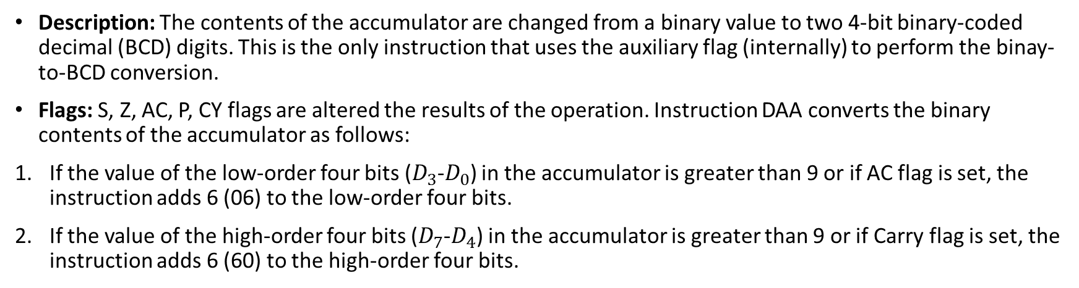
DAA: Decimal Adjust Accumulator
Opcode | Operand | Bytes | M-Cycles | T-States
DAA | None | 1 | 1 | 4
Instruction:
DAA

Slide 43
INR: Increment Contents of Register/Memory by 1
Opcode | Operand | Bytes | M-Cycles | T-States
INR | Reg. | 1 | 1 | 4
 | Mem. | 1 | 3 | 10
Description: The contents of the designated register/memory are incremented by 1 and the results are stored in the same place. If the operand is a memory location, it is specified by the contents of HL register pair.
Flags: S, Z, P, AC are modified to reflect the result of the operation. CY is not modified.
Instructions:
INR B
INR C
INR D
INR E
INR H
INR L
INR M
INR A

Slide 44
INX: Increment Contents of Register Pair by 1
Opcode | Operand | Bytes | M-Cycles | T-States
INX | Reg. pair | 1 | 1 | 6
Description: The contents of the specified register pair are incremented by 1. The instruction views the contents of the two register as a 16-bit number.
Flags: No flags are affected.
Instructions:
INX B
INX D
INX H
INX SP

Slide 45
DCR: Decrement Source by 1
Opcode | Operand | Bytes | M-Cycles | T-States
DCR | Reg. | 1 | 1 | 4
 | Mem. | 1 | 3 | 10
Description: The contents of the designated register/memory are decremented by 1 and the results are stored in the same place. If the operand is a memory location, it is specified by the contents of HL register pair.
Flags: S, Z, P, AC are modified to reflect the result of the operation. CY is not modified.
Instructions:
DCR B
DCR C
DCR D
DCR E
DCR H
DCR L
DCR M
DCR A

Slide 46
DCX: Decrement Register Pair by 1
Opcode | Operand | Bytes | M-Cycles | T-States
DCX | Reg. pair | 1 | 1 | 6
Description: The contents of the specified register pair are decremented by 1. This instruction views the contents of the two register as a 16-bit number.
Flags: No flags are affected.
Instructions:
DCX B
DCX D
DCX H
DCX SP

Slide 47
Logical Group Instructions
STC: Set Carry
Opcode | Operand | Bytes | M-Cycles | T-States
STC | None | 1 | 1 | 4
Description: The Carry flag is set to 1.
Flags: No flags are affected.
Instruction:
STC

Slide 48
ANA: Logical AND with Accumulator
Opcode | Operand | Bytes | M-Cycles | T-States
ANA | Reg. | 1 | 1 | 4
 | Mem. | 1 | 2 | 7
Description: The contents of the accumulator are logically ANDed with the contents of the operand (register or memory) and the results is placed in the accumulator. If the operand is a memory location, its address is specified by the contents of HL registers.
Flags: S, Z, P are modified to reflect the results of the operation. CY is reset. AC is set.
Instructions:
ANA B
ANA C
ANA D
ANA E
ANA H
ANA L
ANA M
ANA A

Slide 49
ANI: AND Immediate with Accumulator
Opcode | Operand | Bytes | M-Cycles | T-States
ANI | 8-bit data | 2 | 2 | 7
Description: The contents of the accumulator are logically ANDed with 8-bit data (operand) and the results are placed in the accumulator.
Flags: S, Z, P are modified to reflect the results of the operation. CY is reset, AC is set.
Instruction:
ANI 02h

Slide 50
XRA: Exclusive OR with Accumulator
Opcode | Operand | Bytes | M-Cycles | T-States
XRA | Reg. | 1 | 1 | 4
 | Mem. | 1 | 2 | 7
Description: The contents of the operand (register or memory) are Exclusive ORed with the contents of the accumulator and the results are placed in the accumulator. The contents of the operand are not altered.
Flags: Z, S, P are altered to reflect the results of the operation. CY and AC are reset.
Instructions:
XRA B
XRA C
XRA D
XRA E
XRA H
XRA L
XRA M
XRA A

Slide 51
XRI: Exclusive OR with Immediate with Accumulator
Opcode | Operand | Bytes | M-Cycles | T-States
XRI | 8-bit data | 2 | 2 | 7
Description: The 8-bit data (operand) are Exclusive Ored with the contents of the accumulator and the results are placed in the accumulator.
Flags: Z, S, P are altered to reflect the results of the operation. CY and AC are reset.
Instruction:
XRI 02h

Slide 52
ORA: Logically OR with Accumulator
Opcode | Operand | Bytes | M-Cycles | T-States
ORI | Reg. | 1 | 1 | 4
Description: The contents of the accumulator are logically ORed with the contents of the operand (register or memory) and the results are placed in the accumulator. If the operand is a memory location, its address is specified by the contents of HL registers.
Flags: Z, S, P are modified to reflect the results of the operation. CY and AC are reset.
Instructions:
ORA B
ORA C
ORA D
ORA E
ORA H
ORA L
ORA M
ORA A

Slide 53
ORI: Logically OR Immediate
Opcode | Operand | Bytes | M-Cycles | T-States
ORI | 8-bit data | 2 | 2 | 7
Description: The contents of the accumulator are logically Ored with the 8-bit data in the operand and the results are placed in the accumulator.
Flags: Z, S, P are modified to reflect the results of the operation. CY and AC are reset.
Instruction:
ORI 02h

Slide 54
CMP: Compare with Accumulator
Opcode | Operand | Bytes | M-Cycles | T-States
CMP | Reg. | 1 | 1 | 4
 | Mem. | 1 | 2 | 7
Description: The contents of the operand (register or memory) compared with the contents of the accumulator. Both contents are preserved and the comparison is shown by setting the flags as follows:
If (A)< (Reg./Mem.): Carry flag is set and Zero flag is reset.
If (A)=(Reg./Mem.): Zero flag is set and Carry flag is reset.
If (A)> (Reg./Mem.): Carry and Zero flags are reset.
The comparison of two bytes is performed by subtracting the contents of the operand from the contents of the accumulator; however, neither contents are modified.
Flags: S, P, AC are also modified in addition to Z and CY to reflect the result of the operation.
Instructions:
CMP B
CMP C
CMP D
CMP E
CMP H
CMP L
CMP M
CMP A

Slide 55
CPI: Compare Immediate with Accumulator
Opcode | Operand | Bytes | M-Cycles | T-States
CPI | 8-bit | 2 | 2 | 7
Description: The second byte (8-bit data) is compared with the contents of the accumulator. The values being compared remain unchanged and the results of the comparison are indicated by setting the flags as follows:
If (A)< Data: Carry flag is set and Zero flag is reset.
If (A)=Data: Zero flag is set and Carry flag is reset.
If (A)> Data: Carry and Zero flags are reset.
The comparison of two bytes is performed by subtracting the data byte from the contents of the accumulator; however, neither contents are modified.
Flags: S, P,AC are also modified in addition to Z and CY to reflect the result of the operation.
Instruction:
CPI 02h

Slide 56
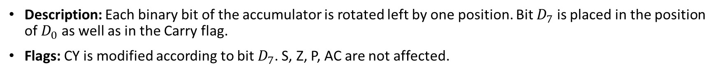
RLC: Rotate Accumulator Left
Opcode | Operand | Bytes | M-Cycles | T-States
RLC | None | 1 | 1 | 4
Instruction:
RLC

Slide 57
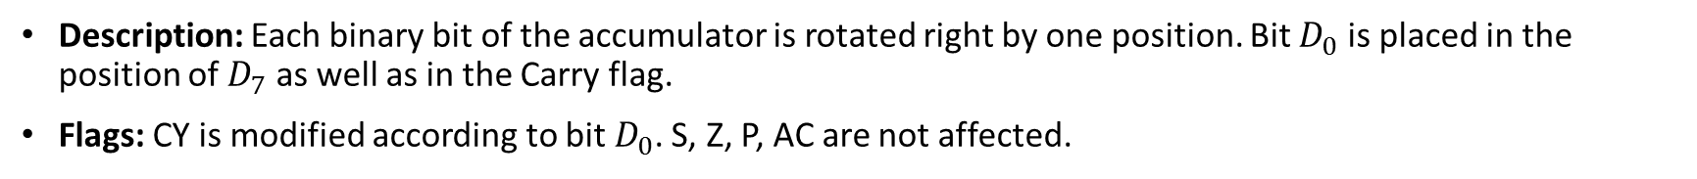
RRC: Rotate Accumulator Right
Opcode | Operand | Bytes | M-Cycles | T-States
RLC | None | 1 | 1 | 4
Instruction:
RRC

Slide 58
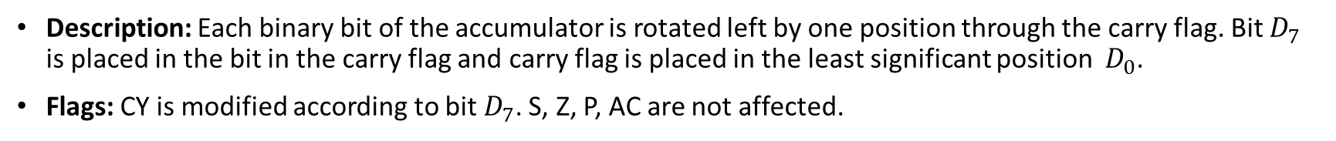
RAL: Rotate Accumulator Right
Opcode | Operand | Bytes | M-Cycles | T-States
RAL | None | 1 | 1 | 4
Instruction:
RAL

Slide 59
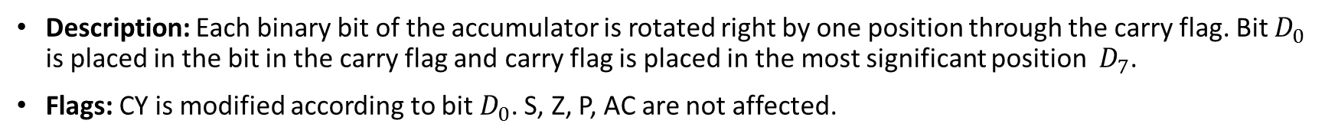
RAR: Rotate Accumulator Right through Carry
Opcode | Operand | Bytes | M-Cycles | T-States
RAL | None | 1 | 1 | 4
Instruction:
RAR

Slide 60
CMA: Complement Accumulator
Opcode | Operand | Bytes | M-Cycles | T-States
CMA | None | 1 | 1 | 4
Description: The contents of the accumulator are complemented.
Flags: No flags are affected
Instruction:
CMA

Slide 61
CMC: Complement Carry
Opcode | Operand | Bytes | M-Cycles | T-States
CMC | None | 1 | 1 | 4
Description: The Carry flag is complemented.
Flags: The carry flag is modified, no other flags are affected
Instruction:
CMC

Slide 62
Branching Instructions
JMP: Jump Unconditionally
Opcode | Operand | Bytes | M-Cycles | T-States
JMP | 16-bit | 3 | 3 | 10
Description: The program sequence is transferred to the memory location specified by the 16-bit address. This is a 3-byte instruction; the second byte specifies the low-order byte and the third byte specifies the high-order byte.
Instruction:
JMP 2600h

Slide 63
Jump Conditionally
Operand | Opcode | Description | Flag Status
16-bit address | JC | Jump on Carry | CY=1
16-bit address | JNC | Jump on No Carry | CY=0
16-bit address | JP | Jump on Positive | S=0
16-bit address | JM | Jump on negative | S=1
16-bit address | JPE | Jump on parity Even | P=1
16-bit address | JPO | Jump on parity Odd | P=0
16-bit address | JZ | Jump on Zero | Z=1
16-bit address | JNZ | Jump on non zero | Z=0
Instructions:
JNZ 2600h
JZ 2600h
JNC 2600h
JC 2600h
JPO 2600h
JPE 2600h
JP 2600h
JM 2600h
Flags: No flags are affected

Slide 64
PCHL: Load Program Counter with HL Contents
Opcode | Operand | Bytes | M-Cycles | T-States
PCHL | None | 1 | 1 | 6
Description: The contents of registers H and L are copied into the program counter. The contents of H are placed as a high –order byte and of L as a low-order byte .
Flags: No flags are affected.
Instruction:
PCHL

Slide 65
RST: Restart
Bytes | M-Cycles | T-States
3 | 3 | 12
Operand | Restart Address (H)
RST 0 | 0000
RST 1 | 0008
RST 2 | 0010
RST 3 | 0018
RST 4 | 0020
RST 5 | 0028
RST 6 | 0030
RST 7 | 0038
Flags: No flags are affected
Instructions:
RST 0
RST 1
RST 2
RST 3
RST 4
RST 5
RST 6
RST 7
Description: The RST instruction are equivalent to 1-byte call instruction to one of the eight memory locations on page 0. The instruction are generally used in conjunction with interrupts and inserted using external hardware. However, these can be used as software instruction in a program to transfer program execution to one of the eight locations.

Slide 66
CALL: Unconditional Subroutine Call
Opcode | Operand | Bytes | M-Cycles | T-States
CALL | 16-bit address | 3 | 5 | 18
Description: The program sequence is transferred to the address specified by the operand. Before the transfer, the address of the next instruction to CALL (the contents of the program counter) is pushed on the stack.
Flags: No flags are affected.
Instruction:
CALL 2100h

Slide 67
Conditional Call to Subroutine
Operand | Opcode | Description | Flag Status
16-bit address | CC | Call on Carry | CY=1
16-bit address | CNC | Call with No Carry | CY=0
16-bit address | CP | Call on Positive | S=0
16-bit address | CM | Call on minus | S=1
16-bit address | CPE | Call on parity Even | P=1
16-bit address | CPO | Call on parity Odd | P=0
16-bit address | CZ | Call on Zero | Z=1
16-bit address | CNZ | Call on non zero | Z=0
Instructions:
CNZ 2100h
CZ 2100h
CNC 2100h
CC 2100h
CPO 2100h
CPE 2100h
CP 2100h
CM 2100h
Flags: No flags are affected

Slide 68
RET: Return from Subroutine Unconditionally
Opcode | Operand | Bytes | M-Cycles | T-States
RET | None | 1 | 3 | 10
Description: The program sequence is transferred from the subroutine to the calling program. The two bytes from the top of the stack are copied into the program counter and the program execution begins at the new address. The instruction is equivalent to POP Program Counter.
Flags: No flags are affected.
Instruction:
RET

Slide 69
Return Conditionally
Operand | Opcode | Description | Flag Status
16-bit address | RC | Return on Carry | CY=1
16-bit address | RNC | Return with No Carry | CY=0
16-bit address | RP | Return on Positive | S=0
16-bit address | RM | Return on minus | S=1
16-bit address | RPE | Return on parity Even | P=1
16-bit address | RPO | Return on parity Odd | P=0
16-bit address | RZ | Return on Zero | Z=1
16-bit address | RNZ | Return on non zero | Z=0
Instructions:
RNZ
RZ
RNC
RC
RPO
RPE
RP
RM
Flags: No flags are affected

Slide 70
NOP: No operation
Opcode | Operand | Bytes | M-Cycles | T-States
NOP | None | 1 | 1 | 4
Description: No operation is performed. The instruction is fetched and decoded; however, no operation is executed.
Flags: No flags are affected
Instruction:
NOP

Slide 71
HLT: Halt and Enter Wait State
Opcode | Operand | Bytes | M-Cycles | T-States
HLT | None | 1 | 2 or more | 5 or more
Description: The MPU finishes executing the current instruction and halts any further execution. The MPU enters the Halt Acknowledge machine cycle and Wait states are inserted in every clock period. The address and the data bus are placed in the high impedance state. The contents of the register are unaffected during the HLT state. An interrupt or reset is necessary to exit from the Halt state.
Flags: No flags are affected
Instruction:
HLT

Slide 72
DI: Disable Interrupts
Opcode | Operand | Bytes | M-Cycles | T-States
DI | None | 1 | 1 | 4
Description: The Interrupt Enables flip-flop is reset and all the interrupts except the TRAP are disabled.
Flags: No flags are affected
Instruction:
DI

Slide 73
EI: Enable Interrupts
Opcode | Operand | Bytes | M-Cycles | T-States
EI | None | 1 | 1 | 4
Description: The Interrupt Enables flip-flop is set and all the interrupts are enabled.
Flags: No flags are affected.
Instruction:
EI

Slide 74
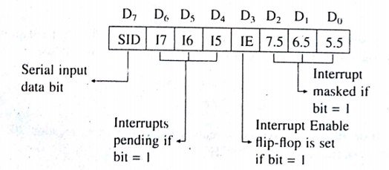
RIM: Read Interrupt Mask
Opcode | Operand | Bytes | M-Cycles | T-States
RIM | None | 1 | 1 | 4
Description: This is a multipurpose instruction used to read the status of interrupts 7.5, 6.5, 5.5 and to read serial data input bit. The instruction loads eight bits in the accumulator with the following interpretations:
Flags: No flags are affected.
Instruction:
RIM

Slide 75
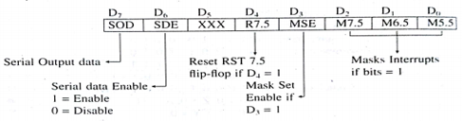
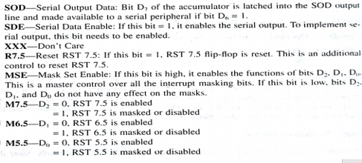
SIM: Set Interrupt Mask
Opcode | Operand | Bytes | M-Cycles | T-States
SIM | None | 1 | 1 | 4
Description: This is a multipurpose instruction and used to implement the 8085 interrupts (RST 7.5,6.5 and 5.5) and serial data output.
Flags: No flags are affected.
Instruction:
SIM

Slide 76
Example 1: Write instruction to load the 16-bit number 2050H in the register pair HL using LXI and MVI opcodes and explain the difference between the two instructions.
Using LXI
LXI H, 2050H
Using MVI
MVI H, 20H
MVI L,50H

Slide 77
Example 2: The memory location 2050H holds the data byte F7H. Write instructions to transfer the data byte to the accumulator using three different opcodes: MOV, LDAX and LDA.
Using MOV
LXI H, 2050H
MOV A, M
Using LDAX
LXI B, 2050H
LDAX B
Using LDA
LDA 2050H

Slide 78
Example 3: Write instruction to store the contents of register B (32H) in the memory location 8000H using the opcodes: MOV, STAX and STA.
Using MOV
LXI H, 8000H
MOV M, B
Using STAX
LXI D, 8000H
MOV A, B
STAX D
Using STA
MOV A, B
STA 8000H

Slide 79
Example 4: Write instruction to load the number 2050H in the register pair BC. Increment the number using the instruction INX B and illustrate whether the INX B instruction is equivalent to the instruction INR B and INR C.
Using INX B
LXI B, 2050H
INX B

Slide 80
Example 5: 16-BYTES of data are stored in memory locations at 2050h to 205Fh. Transfer the entire block of data bytes to new memory locations starting at 2070h.
LXI H, 2050
LXI D, 2070
MVI B, 10H
UP: MOV A,M
STAX D
INX H
INX D
DCR B
JNZ UP
HLT

Slide 81
Example 6: Write instructions to add the contents of memory location 2040 to A, and subtract the contents of memory location 2041 from the first sum. Assume the A has 30h, the memory location 2040 has 68h, and the memory location 2041 has 7Fh.
LXI H, 2040h
ADD M
INX H
SUB M
HLT

Slide 82
Example 7: Write instructions to load 59h in memory location 2040h and increment the contents of the memory location 2040h then load 90h in memory location 2041 and decrement the contents of the memory location 2041h.
LXI H, 2040h
MVI M, 59H
INR M
INX H
MVI M, 90H
DCR M
HLT

Slide 83
Example 8: 6-BYTES of data are stored in memory locations at 2050h. Add all the data bytes. Use register B to save any carries generated, while adding the data bytes. Display the entire sum at two output ports.
XRA A
MOV B,A
MVI C, 06H
LXI H, 2050
UP: ADD M
JNC DOWN
INR B
DOWN: INX H
DCR C
JNZ UP
OUT PORT 1
MOV A,B
OUT PORT 2
HLT

Slide 84
Example 9: Write instructions to load the A with data byte 64h, and verify whether the data byte in memory location 2050h is equal to the A contents. If both data bytes are equal, jump to location OUT 1.
LXI H, 2050h
MVI A, 64H
CMP M
JZ OUT 1
HLT

Slide 85
Example 10: A set of current readings is stored in memory locations starting at 2050h. The end of data string is indicated by the data byte 00h. Add the set of readings. The answer may be larger than FFh. Display the entire sum at two output ports.
DOWN 1: MOV A,C
OUT PORT 1
MOV A,B
OUT PORT 2
HLT
LXI H, 2050
MVI C, 00H
MOV B,C
UP: MOV A, M
CPI 00H
JZ DOWN 1
ADD C
JNC DOWN 2
INR B
DOWN 2: MOV C,A
INX H
JMP UP

Slide 86
Debugging
Means to look for any errors in a program or on circuit board
Static Debugging: Similar to visual inspection of a circuit board; it is the paper-and-pencil check of a flowchart and machine code.
Dynamic Debugging: Involves observing the output, or register contents, following the execution of each instruction (the single-step technique) or of a group of instructions (the breakpoint technique).
Dynamic Debugging Techniques:
Single Step
Register Examine
Breakpoint

Slide 87
Single Step: The single step key on a keyboard allows you to execute one instruction at a time, and to observe the results following each instruction. As you push the single step key, you will be able to observe addresses and codes as they are executed. With the single step technique you will be able to spot Incorrect Addresses, Incorrect jump locations for loops, Incorrect data or missing codes.
Register Examine: The register examine key allows you to examine the contents of the register. When appropriate keys are pressed, the monitor program can display the contents of the registers. This technique is used in conjunction either with the single step or the breakpoint facilities. After executing a block of instructions, you can examine the register contents at a critical juncture of the program and compare these contents with the expected outcomes.

Slide 88
Breakpoint: It is generally a software routine that allows you to execute a program in sections. The breakpoint can be set up in your program by using RST instructions. When you push the Execute Key your program will be executed until the breakpoint, where the monitor takes over again. The registers can be examined for expected results. If the segment of the program is found satisfactory, a second breakpoint can be set up at a subsequent memory address to debug the nest segment of the program. With the breakpoint facility you can isolate the segment of the program with errors. Then that segment of the program can be debugged with the single step facility.

