Slide 1
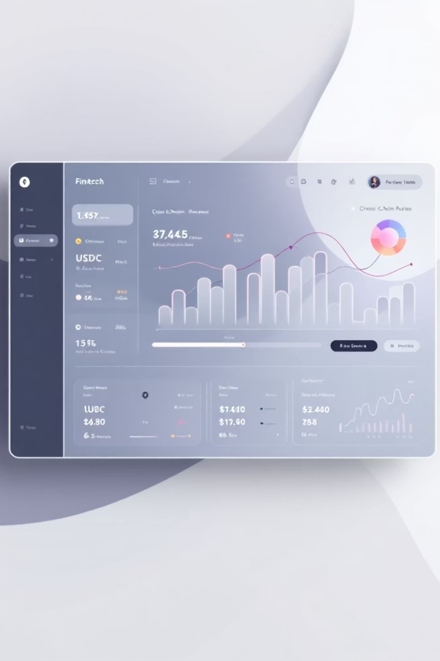
ArcTreasury Copilot: AI-Powered USDC Payouts, Policy & Treasury Automation
Full-stack treasury operations platform that automates multi-recipient USDC payouts across chains, enforces policy, runs an autonomous agent, and manages an RWA-backed treasury — integrates Circle Programmable Wallets, CCTP V2 bridging, and Circle Gateway fiat rails.

Slide 2

Problem Statement
Manual payout workflows are slow, error-prone, and opaque. Teams need policy-driven automation, auditable trails, reliable cross-chain execution, and a place to put idle USDC with measurable yield — all while keeping demo and real flows clearly separated.

Slide 3
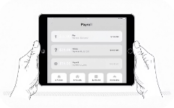
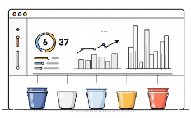
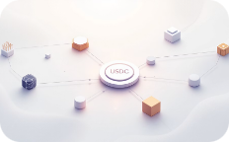
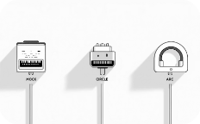
Solution Snapshot — What ArcTreasury Copilot Delivers
Payout Batch Ingestion
5-Rule Policy & Risk Engine
Multi-Recipient, Multi-Chain Payouts
Adapter Pattern
Seed or upload batches (payroll, vendors, revenue splits). Deterministic demo seeding for the agent.
Amount limits, chain validation, blocklist checks, velocity, duplicates → risk 0–100 → APPROVED/QUEUED/REVIEW/HELD/REJECTED.
Swap Mock / Circle / Arc adapters without changing business logic; Mock for demos, Circle for real USDC (ARC-TESTNET).
Payout-legs model across 7 chains (ETH, Polygon, Arbitrum, Solana, Avalanche, Base, Arc) with independent retry per leg.

Slide 4

Autonomous Agent & AutoPilot
Agent loop: Seed batch → run policy → auto-review → execute → log → repeat. Configurable strategies:
Conservative — approve only pre-approved items
Balanced — auto-approve risk < 50
Aggressive — auto-approve all except REJECTED
One-Click AutoPilot: Single button runs end-to-end pipeline with real-time progress UI and step-level statuses.

Slide 5
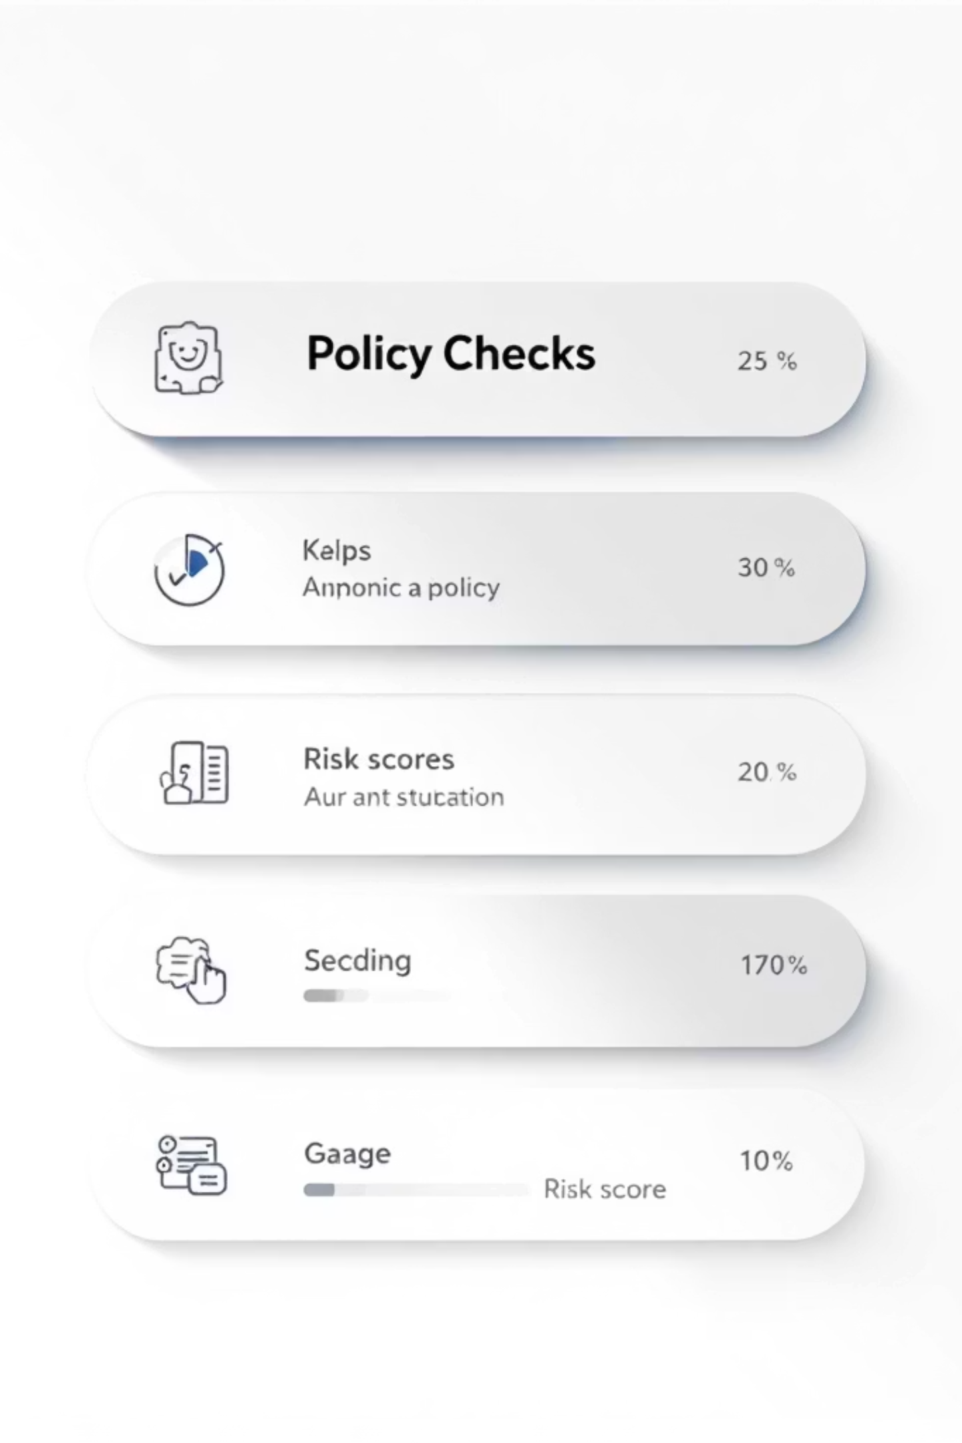
Policy Engine — Rules & Decision Mapping
Five sequential checks: Amount Limit, Chain Validation, Recipient Blocklist, Velocity, Duplicate Detection. Scores map to 5 buckets: APPROVED (0–24), QUEUED (25–49), REVIEW (50–74), HELD (75–89), REJECTED (90–100). All policy decisions are logged to the audit trail.

Slide 6

RWA-Backed Treasury — Yield, Liquidity & Auto-Rebalance
T-Bills — 5.25% APY
Money Market Fund — 4.8% APY
Low risk, instant liquidity. Included in liquidity ratio calculations.
Low risk, same-day liquidity for operational buffers.
Corporate Bonds — 6.1% APY
Real Estate Fund — 7.5% APY
Medium risk, T+2 liquidity; prioritized after liquid reserves.
Higher yield, longer lock (T+30). Used for yield enhancement with diversification.
Health score = composite of Liquidity Ratio (target ≥ 40%), Diversification Index, and Yield Composite. Auto-rebalance enforces reserve threshold by redeeming lower-priority positions.

Slide 7

CCTP V2 Bridge & Circle Gateway
CCTP V2: Route planner across 7 chains, 42 routes. Calculates burn → attest → mint per route with fee and time estimates; Arc-native routes get reduced fees.
Circle Gateway: Wire/ACH/SEPA rails in USD/EUR/GBP/SGD. FX conversion applied before minting USDC. Fee breakdown and bank instructions surfaced in UI.

Slide 8
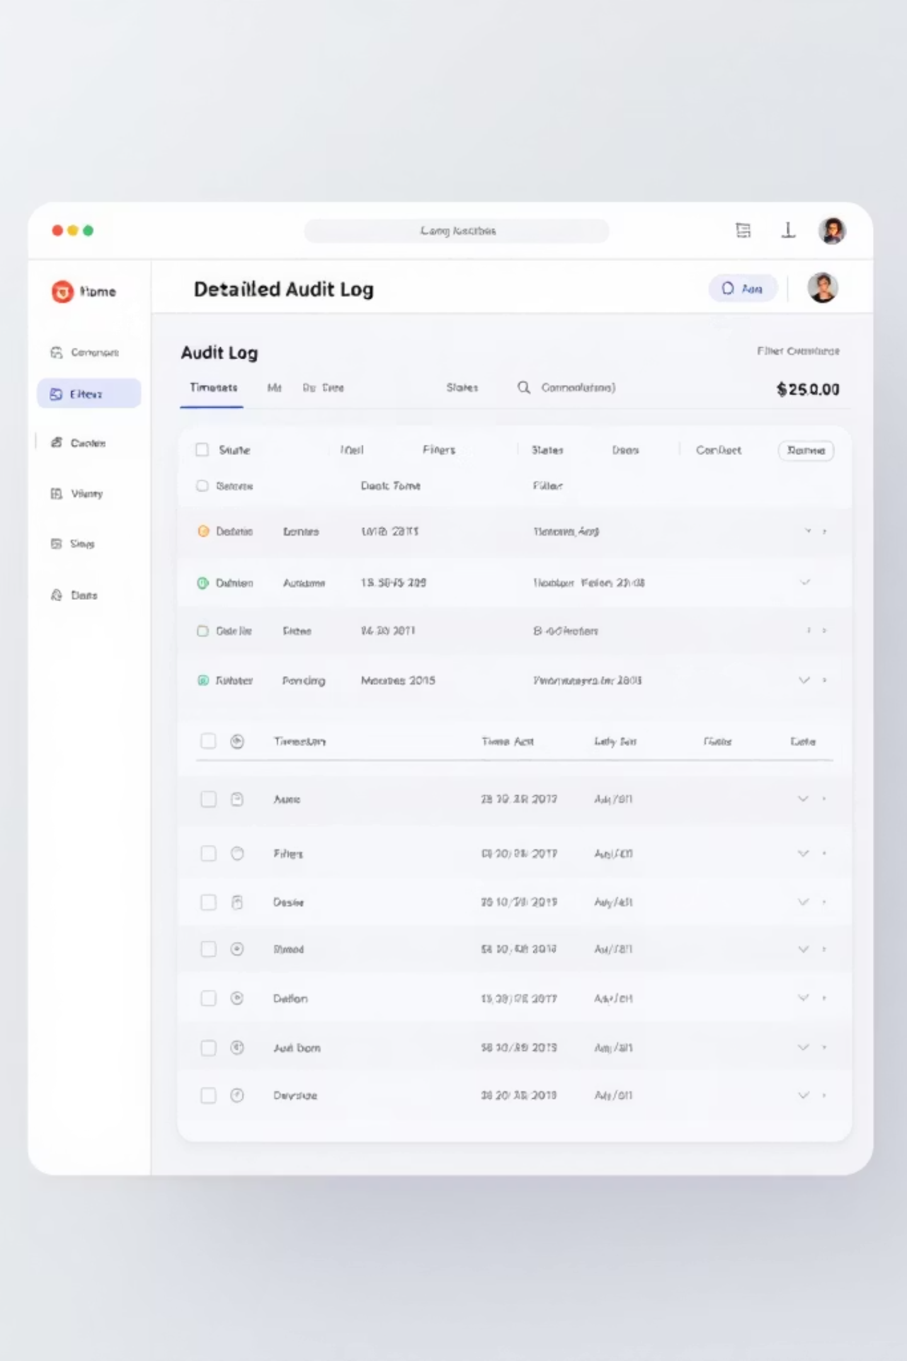
Observability & Audit
Every state transition is recorded: batch events, policy scores, reviews, agent actions, executions, retries, treasury operations. Audit schema captures entity, action, old→new state, details, and timestamps — enabling reproducibility and bounty review.

Slide 9
Architecture & Tech Stack
Frontend
Backend
Persistence & Adapters
React 18, Vite, TypeScript, Tailwind. 7 pages, 9 reusable components, real-time progress UI.
FastAPI (Python 3.12), modular services: policy, execution, agent, treasury, bridge, gateway, audit.
SQLite (WAL) with 9 tables. Adapter pattern: mock, circle (Circle Programmable Wallets), arc (Arc API).
APIs & Integrations
43 REST endpoints, Circle SDK v10.1.0, CCTP route planner, fiat rails (Wire/ACH/SEPA).

