Slide 1
DeepFake Voice Detection with SVM and MFCCs
Teli Abhishek Ashok (4AL21AI055) Mahim (4AL21AI022)
Group No. 5

Slide 2
Synopsis
DeepFake Voice Detection with SVM and MFCCs
Develops an AI system to distinguish real human voices from AI-generated deepfakes.
Uses Support Vector Machine (SVM) and Mel-Frequency Cepstral Coefficients (MFCCs).
Aims to enhance security in voice-based applications.
Provides automated reports with visualizations and metrics.

Slide 3
Problem Statement
Growing prevalence of AI-generated deepfake voices in 2025 poses significant security risks, including identity theft and fraud, by undermining voice-based authentication systems.
Challenge: Distinguish real human voices from synthetic deepfakes to enhance security and trust in voice-driven applications.

Slide 4
Objectives
1
Build an AI system using a Support Vector Machine (SVM) to classify audio samples as genuine (real human voices) or deepfake (synthetic) with high accuracy.
Extract and analyze voice patterns through advanced audio feature extraction to understand timbral differences between human and AI-generated voices.
Provide detailed, automated reports with results and performance metrics for transparency.
2
3

Slide 5
Methodology
Collect audio samples (genuine and AI-generated) in .wav format via a web interface.
Extract key audio features to analyze voice patterns and capture timbral differences.
Train an SVM model with a linear kernel to classify audio as genuine or deepfake.
Analyze new audio by extracting features and predicting its class.
Generate automated reports with visualizations and performance metrics.

Slide 6
What Are Deepfake Voices?
Synthetic audio created by AI to mimic a person’s voice.
Can replicate speech patterns, making it sound like someone said something they didn’t.
Risks: Misinformation, fraud, and compromised voice authentication.

Slide 7
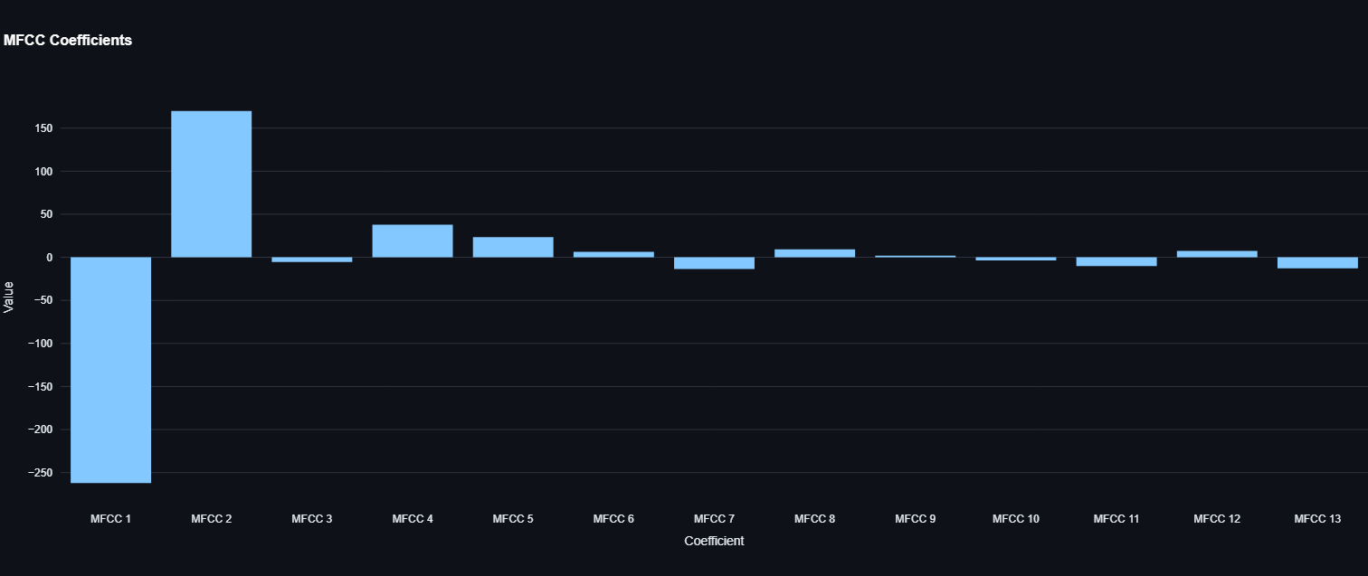
Mel-Frequency Cepstral Coefficients (MFCCs)
Features capturing timbral and spectral characteristics of audio.
Mimic human auditory perception using Mel scale.
Process: Framing (n_fft=2048, hop_length=512), FFT, Mel filter bank, DCT.
Output: 13 coefficients per audio, used for classification.

Slide 8
Support Vector Machine (SVM)
Machine learning model for binary classification.
Finds a hyperplane to separate genuine and deepfake audio in MFCC feature space.
Linear kernel chosen for simplicity and effectiveness.
Trained on 62 samples (32 real, 30 fake).

Slide 9
System Workflow
1
Upload Audio: Collect real and fake .wav files via Streamlit interface.
Feature Extraction: Compute 13 MFCCs per audio. Train SVM: Use labeled dataset to train linear SVM. Classify: Predict new audio as genuine or deepfake. Visualize: Display waveforms, MFCCs, and metrics.
2
3
4
5

Slide 10
Implementation Details
Language: Python with libraries (librosa, sklearn, streamlit).
Parameters: n_mfcc=13, n_fft=2048, hop_length=512.
Modules: Feature extraction, model training, audio classification, web interface.
Interface: Streamlit app for training, analysis, and reporting.

Slide 11
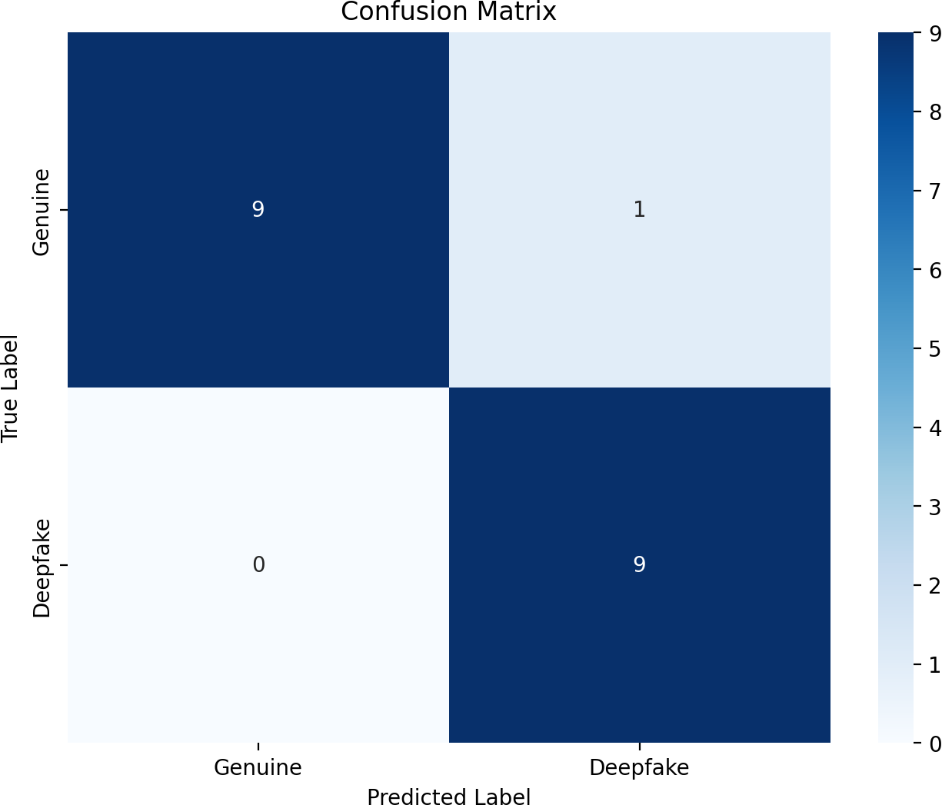
Results
Accuracy: 94.74% on test set.
Precision (Deepfake): 90.00%.
Recall (Deepfake): 100.00%.
AUC (ROC Curve): 0.99.

Slide 12
Challenges
Limited dataset (62 samples) risks overfitting.
Short or noisy audio can affect MFCC extraction.
Supports only .wav files, limiting compatibility.

Slide 13
Future Work
Expand dataset with diverse audio samples.
Support additional formats (e.g., .mp3) and noise reduction.
Explore neural networks (e.g., CNNs) for improved accuracy.
Enable real-time analysis for live audio streams.

Slide 14
Conclusion
Developed a robust system to detect deepfake voices using SVM and MFCCs.
Achieved 94.74% accuracy, enhancing voice authentication security.
User-friendly Streamlit interface with detailed reports.
Ready for further enhancements to improve robustness.
Thank You! Questions?

