Slide 1
Dependencies

Slide 2
What is dependency?
A dependency in DBMS is a relation between two or more attributes.

Slide 3
Types of Dependency
Functional Dependency
Fully-functional Dependency
Transitive Dependency
Multivalued Dependency
Partial Dependency

Slide 4
Functional Dependency
Functional dependency is a constraint introduced by E.F codd.
It helps to specify the relationship between two sets of attribute in the table.
It is denoted by X -> Y
X is known as determinant
Y is dependent.

Slide 5
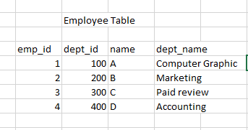
Empid -> {name, dept_name}
This means if we know of emp_id then we and easily find the name of employee
Their name and dept_name.
So emp_id is functional dependency of name, dept_name
Also if we lost emp_id then it is difficult to retrieve the name and other attributes.

Slide 6
Types of functional dependency
Trival functional dependency
Non-Trival functional dependency

Slide 7
Trival dependency
It denotes that if A -> B then, attributes of A is Superset of B or attributes of B is subset of A.

Slide 8
Suppose,
{dept_id, dep_name} -> dept_id
It is trivial dependency because dept_id is subset of dep_id and dep_name

Slide 9
Non-Trival Dependency
It is type of functional dependency where we need more than one attribute to determine the value of determinant i.e X.
X -> Y

Slide 10
Suppose,
Emp_id -> {dept_id, name, dept_name}
We cannot simply tell the emp_id with other attributes with only name or dept_name
Because there may be employee whose share same name in same department.
So we have to specify those three attributes to tell the id of an employee.

