Slide 1
Amazon
Ecommerce Analysis
“Optimizing E-Commerce Performance through Data-Driven Insights”
Power BI Project By Abhishek Kunwar
Tools Used – Power BI Desktop, MySQL Workbench, MS-Office

Slide 2
Agenda
Problem Statement
Data Description
Objective Key Metrics and Visualizations
Insights and Recommendations

Slide 3

“More than 60% of Amazon's sales come from third-party sellers, not Amazon itself.”

Slide 4
ABOUT AMAZON E-COMMERCE
Amazon uses customer purchase data to decide where to open new warehouses.
Amazon’s recommendation engine influences over 35% of total sales.
In India, Amazon promoted “Cash on Delivery” to match local shopping habits

Slide 5
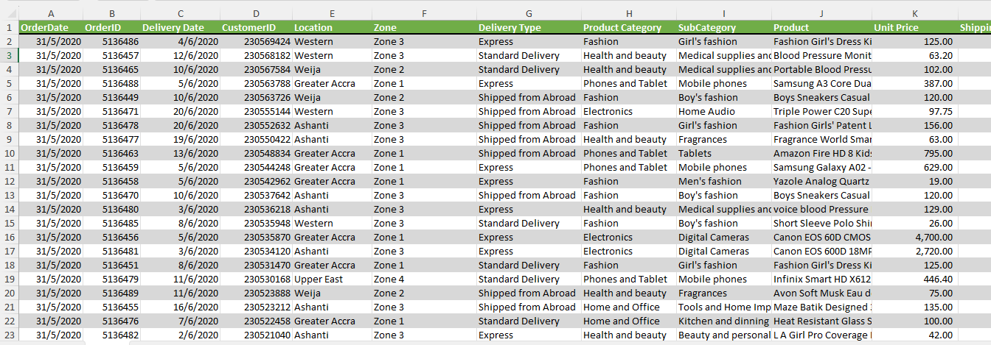
Problem Statement
You are working as a business analyst at Amazon, a company currently performing well. The stakeholders wish to maintain this level of performance and seek improvement. For this purpose, they want to devise new strategies. You are part of a team exploring new ways to benefit customers, such as offering more discounts and Prime membership perks. Could you suggest additional methods to identify and reward customers and enhance their shopping experience?

Slide 6
Data Overview
🛒 Total Sales: 603K units sold across various product categories.
💰 Total Revenue: ₹107.24M generated till date, showing strong market engagement.
⭐ Average Customer Rating: 2.73 – indicating a need for improved customer satisfaction.
🌍 Geographical Spread: Orders placed from diverse locations across India – major metros and tier-2 cities.
🚚 Delivery Types: Includes standard delivery and “Shipped from Abroad,” influencing wait times and satisfaction levels.

Slide 7
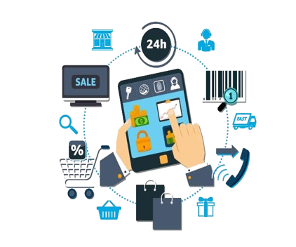
DATA CLEANING STEPS UNDERTAKEN:
Removed Duplicate Records: Checked for and eliminated duplicate rows to avoid redundancy in analysis.
Handled Missing Values: Filled or removed rows with missing entries in key fields like Ratings, Revenue, and Delivery Type.
Created Calendar Table: Added a separate calendar table for proper date-based analysis and time intelligence.
Calculated New Columns: Created new columns like Total Revenue, Waiting Time, and Sales Category for advanced insights.
Established Relationships: Linked tables like Orders, Customers, and Calendar using keys to ensure relational modeling in Power BI.

Slide 8

WHY THIS DATA IS CRUCIAL FOR ANALYSIS ?
📊 Tracks Overall Performance: Helps measure total sales, revenue, and customer satisfaction across product categories.
👥 Customer Insights: Reveals buying patterns, preferences, and behaviors across different genders, age groups, and locations.
📦 Product Evaluation: Identifies high-performing and underperforming products to guide inventory and marketing decisions.
🚚 Delivery & Experience: Allows analysis of delivery types and waiting times to improve logistics and customer service.

Slide 9
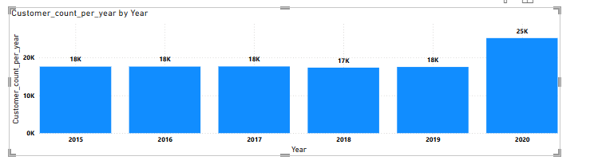
Metric 1: “YEAR WISE CUSTOMER COUNT”
INSIGHTS:
👥 Customer count remained stable around 17K–18K from 2015 to 2019.
📉 A slight dip in 2018 (17K), possibly due to service or product-related issues.
📈 Significant growth in 2020 (25K), indicating a successful strategy or higher demand

Slide 10
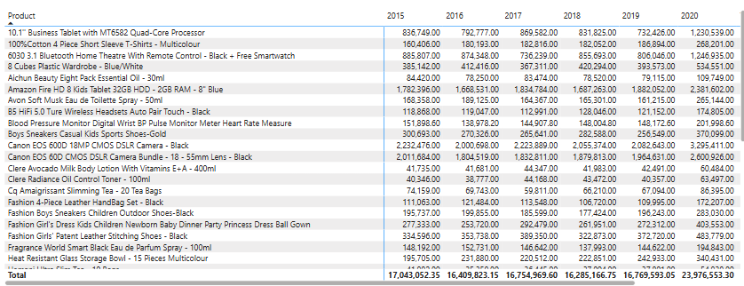
Metric 2: “REVENUE BREAKDOWN BY YEAR AND BY PRODUCT”
INSIGHTS:
📊 2020 had the highest total sales (23.97M), indicating strong growth and market expansion.
🛍️ Consistent top sellers include products like Amazon Fire HD 8 and Canon EOS Cameras.
📉 Several products showed declining or flat sales trends over the years, especially post-2017.

Slide 11
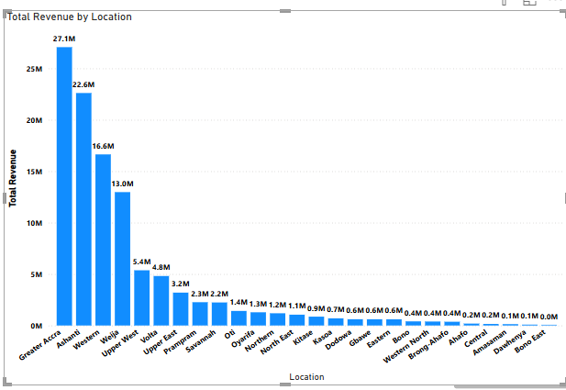
Metric 3: “TOTAL REVENUE BY LOCATION”
INSIGHTS:
📍 Greater Accra leads with the highest revenue (27.1M), followed by Ashanti and Western regions.
📉 Locations like Bono East, Dawhenya, and Amasaman generate very low revenue (under 0.2M)
🧭 Top 5 locations alone contribute a major portion of total revenue, showing strong regional imbalance.

Slide 12
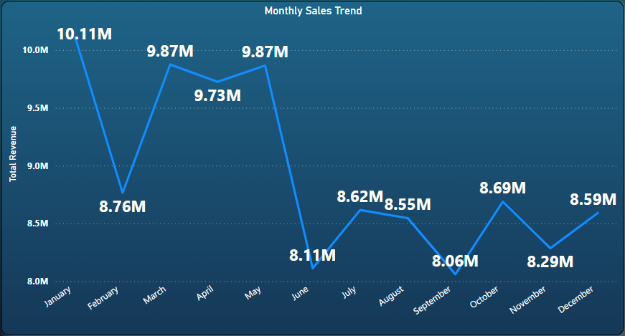
Metric 4: “TOTAL REVENUE MONTH WISE”
INSIGHTS:
📈 January (10.11M) had the highest revenue, likely due to post-holiday shopping.
📉 September (8.05M) saw the lowest revenue, indicating a potential seasonal dip.
🔁 Revenue shows fluctuations throughout the year, without a consistent upward trend.

Slide 13
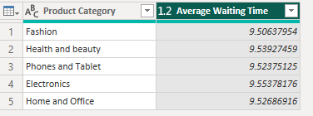
Metric 5: “AVERAGE WAIT TIME BY PRODUCT CATEGORY”
INSIGHTS:
⌛ Electronics has the highest average waiting time (9.55 days).
📦 All categories have an average waiting time close to 9.5 days, showing minimal variation.
👚 Fashion has the lowest waiting time (9.50 days), but only slightly better than others.

Slide 14
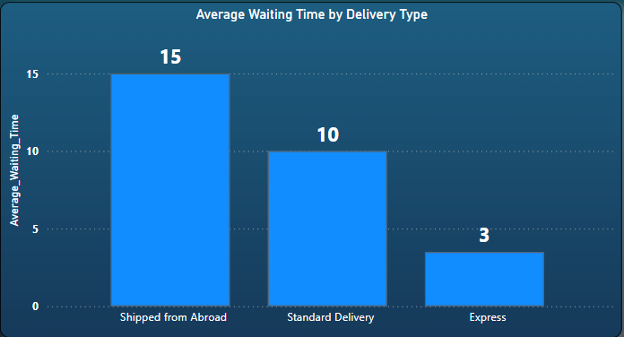
Metric 6: “AVERAGE WAITING TIME BY DELIVERY TYPE”
INSIGHTS:
✈️ Shipped from Abroad has the longest waiting time at 15 days.
📦 Standard Delivery takes 10 days, which is moderate.
⚡ Express Delivery is the fastest, with an average of only 3 days.

Slide 15
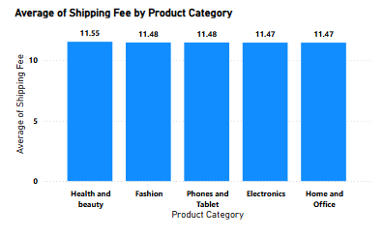
Metric 7: “AVERAGE SHIPPING COST BY PRODUCT CATEGORY”
INSIGHTS:
💄 Health and Beauty products have the highest average shipping fee at 11.55.
👗 Fashion and 📱 Phones and Tablet follow closely with an average fee of 11.48.
🏠 Home and Office and 💻 Electronics have the lowest shipping fee at 11.47, though the difference is minimal.

Slide 16
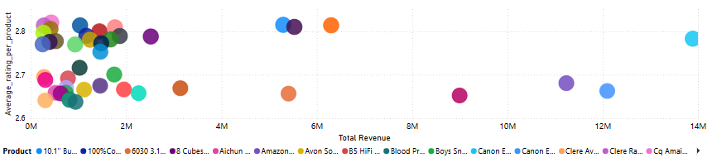
Metric 8: “Product Performance : Revenue vs Customer Rating”
INSIGHTS:
📉 Some high-revenue products (e.g., 12M–14M range) have relatively low average ratings (~2.7).
📊 Most products cluster below 3.0 in ratings, showing a general satisfaction gap.
💬 A few moderate-revenue products (~5M–6M) show slightly better ratings (~2.8).

Slide 17
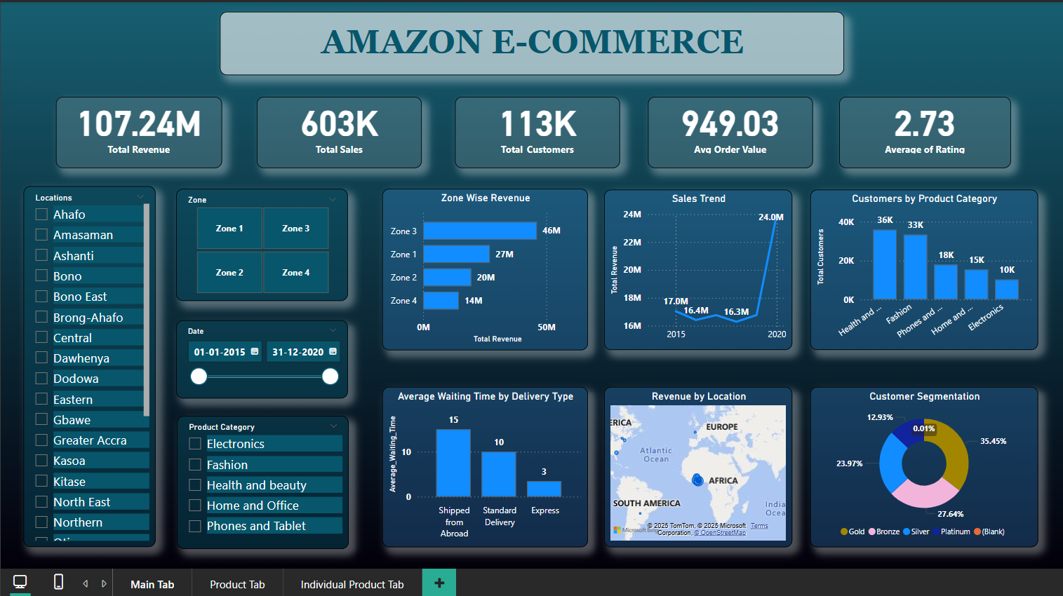
Dashboard

Slide 18
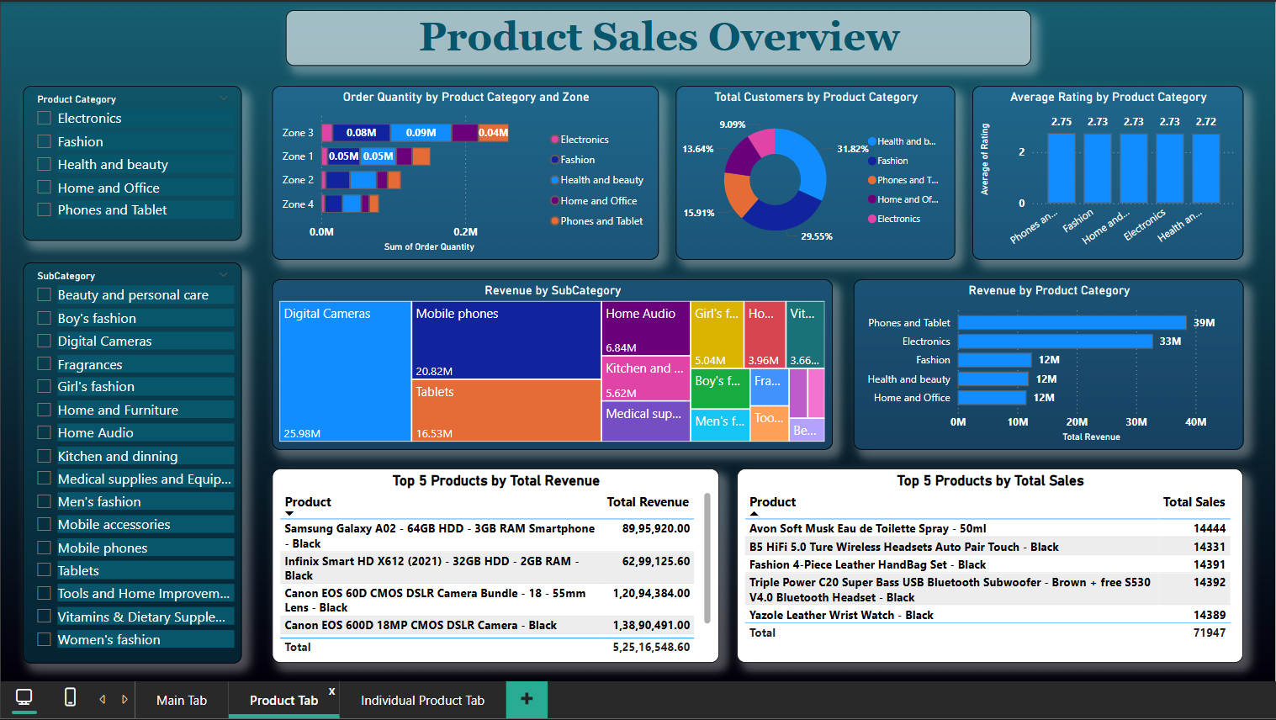
Dashboard

Slide 19
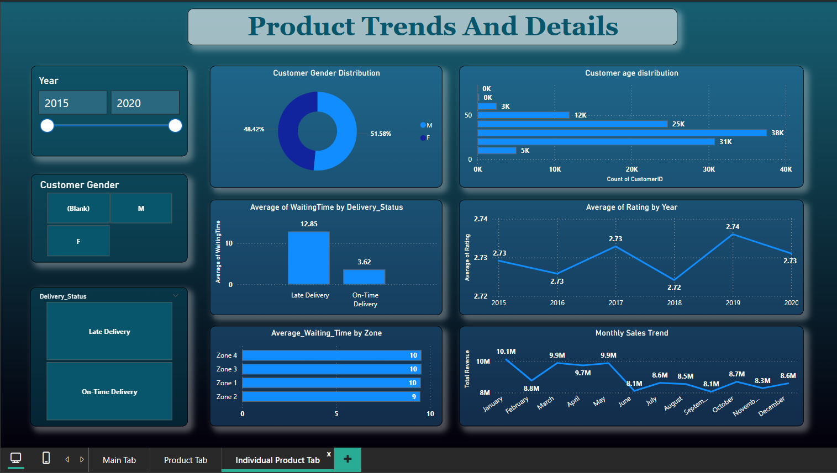
Dashboard

Slide 20
Conclusion
Sales peaked in 2020 – focus on what worked that year.
Top products drive most revenue – invest more in them.
Greater Accra and Ashanti lead in sales – target other regions more.
Sales dip in Sept – run offers and ads during low months.
Express delivery is fastest – promote it to boost satisfaction.
Long wait times link to low ratings – improve delivery efficiency.

Slide 21
Recommendations
Focus more on top-selling products like Canon cameras and Amazon tablets.
Run offers in locations with low sales to boost orders.
Invest more in high-sales areas like Greater Accra and Ashanti.
Give discounts during slow months like June to September.
Bundle cheap fast-selling items with big products to increase sales.
Give discounts to loyal customers to keep them coming back.

Slide 22
Thank You !!

