Slide 1
GRAPHQL
Introduction to GraphQL
An introduction and the fundamentals

Slide 2
Contents
AGENDA
Part 1 · Introduction
Part 2 · GraphQL Fundamentals
What is GraphQL?
Why GraphQL? The problems with REST
REST API vs GraphQL
How GraphQL works
Schema
Data types
Operations
Query: basic syntax
Arguments and variables
Aliases and fragments
Directives and introspection

Slide 3




What is GraphQL?
PART 1 · INTRODUCTION
GraphQL is an open-source query language for APIs and a server-side runtime for executing those queries against a defined data schema.
Origin
Exactly what you ask for
Created by Facebook in 2012, open-sourced in 2015, now maintained by the GraphQL Foundation
The client asks for exactly the fields it needs, and the server returns exactly that
One endpoint
Strongly typed
Usually one endpoint (e.g. /graphql), always over HTTP POST with a JSON body
Every API publishes a schema

Slide 4
Why GraphQL? The Problems with REST
PART 1 · INTRODUCTION
REST works well, but as apps grow, three problems keep showing up.
1
Over-fetching
2
Under-fetching
3
Versioning
The endpoint returns a fixed payload, such as 50 fields when you need 3
One screen needs several endpoints, such as country, languages and currency
Changes mean /v1, /v2, /v3 and old clients to support
Result: wasted bandwidth and more JSON to parse
Result: 3 round trips instead of 1
GraphQL adds fields without breaking existing queries and marks old ones @deprecated

Slide 5
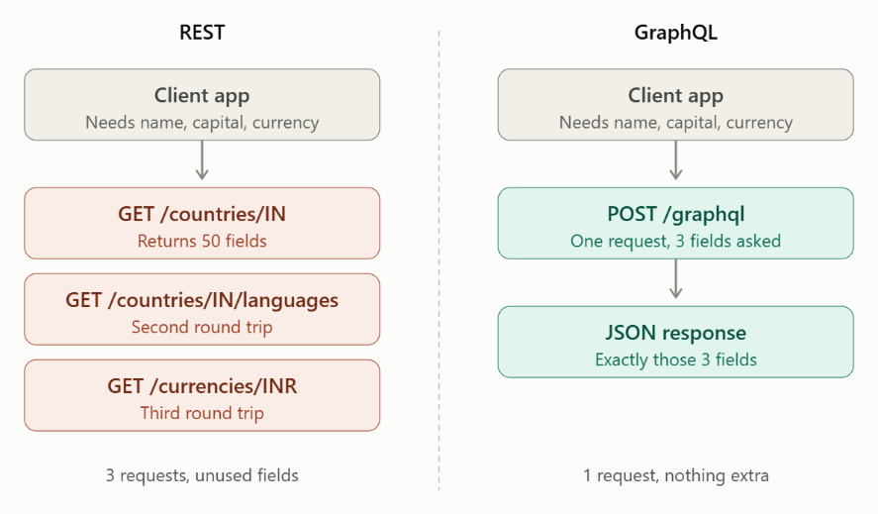
Example: REST API vs GraphQL
PART 1 · INTRODUCTION
3 → 1
requests for the same screen
50 → 3
fields returned, nothing extra

Slide 6





How GraphQL Works (Architecture)
PART 1 · INTRODUCTION
GraphQL follows a client-server architecture.
Client
GraphQL endpoint
GraphQL server
Resolver
Data source
Sends a GraphQL request
Receives the request, usually through HTTP
Validates the request against the schema
Fetches the requested data from databases or other services
Could be DB2, MySQL, REST APIs and other systems
Response: returns the requested data in JSON format

Slide 7
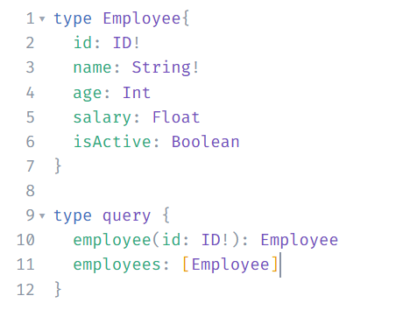
GraphQL Schema
PART 2 · FUNDAMENTALS
A schema defines the structure of data available through a GraphQL API.
It specifies:
What types of data are available
Which fields each type contains
What operations can be performed
What arguments a field accepts
What data type each field returns
Example schema

Slide 8
GraphQL Data Types
PART 2 · FUNDAMENTALS
Data type | Description | Example
Int | 32-bit integer | 25
Float | Double-precision decimal | 45000.50
String | UTF-8 text | "Abhishek"
Boolean | true/false | true
ID | Unique identifier, serialized as a string | "EMP101"
Additional type categories
Object types: Represent structured entities.
Enum types: Represent a fixed set of values.
List types: Represent collection of values.
Scalar types: Basic individual values.
Custom scalars: Application defined types.

Slide 9



GraphQL Operations
PART 2 · FUNDAMENTALS
GraphQL primarily supports three operation types:
Query
Mutation
Subscription
Used to retrieve or read data
Used to create, update or delete data
Used to receive real-time updates when data changes, usually through a persistent connection
Example: fetch employee information
Example: add a new employee
Example: receive notifications when an employee status changes

Slide 10
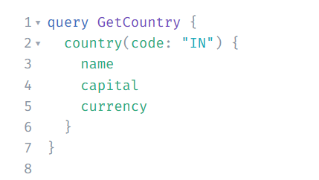
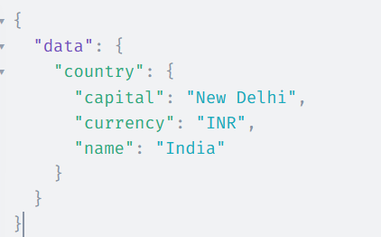
GraphQL Query: Basic Syntax
PART 2 · FUNDAMENTALS
A query specifies which data should be retrieved
QUERY
SAMPLE RESPONSE
query indicates operation type
GetCountry operation name (optional, but good practice)
country the field being requested
(code: "IN") arguments
{ name capital currency } selection set, the fields you want back

Slide 11

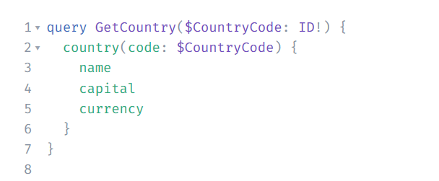
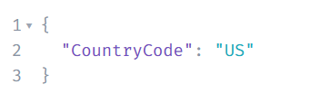
Arguments and Variables
PART 2 · FUNDAMENTALS
Using Arguments
Using Variables
GraphQL arguments allow us to filter or customize the requested data
Variables make queries reusable and avoid hardcoding values
Variables are passed separately:
code is an argument used to identify the country.

Slide 12
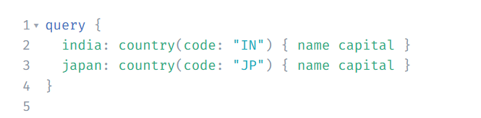
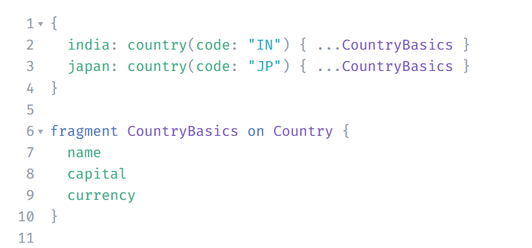
Aliases and Fragments
PART 2 · OTHER USEFUL CONCEPTS
Aliases
Rename fields in the response or request the same field with different arguments
Fragments
A fragment is a reusable set of fields, so you don’t repeat yourself
fragment CountryBasics on Country means “this field set applies to the Country type”
...CountryBasics spreads those fields in
Change the fragment once and every query that uses it changes

Slide 13
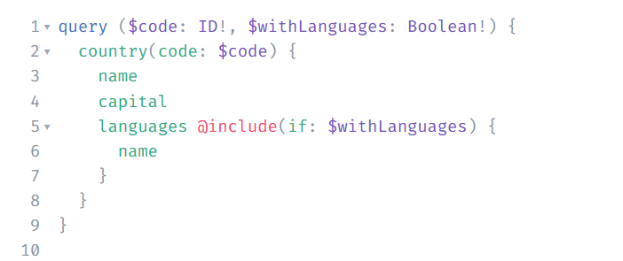

Directives
PART 2 · OTHER USEFUL CONCEPTS
Directives conditionally change a query. The two built-in ones are @include(if: ...) and @skip(if: ...).
With withLanguages: false, the languages field is left out of the response
@skip(if: true) does the opposite: it leaves the field out when the condition is true
This lets one query serve several use cases without string-building in SQL
One query, several use cases
switch fields on or off with a variable

Slide 14
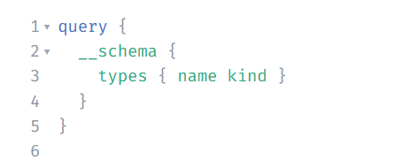

Introspection
PART 2 · OTHER USEFUL CONCEPTS
Introspection lets you query the API’s own schema, so you can discover which types and fields exist.
Introspection is how playgrounds like GraphiQL provide autocomplete and docs
Many production APIs disable it, so it may not work on every endpoint (it does on this public one)
Discover the schema
types and fields, straight from the API

Slide 15
Summary
1
GraphQL is a query language and runtime: ask for exactly the fields you need
2
It solves REST pain points: over-fetching, under-fetching and versioning
3
The schema defines the types, fields and operations an API offers
4
Three operations: query to read, mutation to change, subscription for real-time updates
5
Arguments, variables, aliases, fragments and directives keep queries flexible and reusable; introspection makes the API discoverable

Slide 16

Up next: GraphQL with Db2
NEXT SESSION
GraphQL
Db2

Slide 17
Thank you
Questions?

