Slide 1

TaxCraft
Machine Learning-Powered Automated Tax Assistant for Personalized Financial Empowerment
Team: Code Rangers
Members:
Abhishek V K
Shubhang Sethi
Vishal Daimane
Rudraprathap

Slide 2



WHAT IS THE PROBLEM?
1
Double taxation arises when the same income is subject to tax in multiple jurisdictions, leading to increased financial burden on individuals with foreign investments
2
Lack of personalized solutions for People who’s investments are diversifed accrosss geography
The problem is the absence of personalized tax planning for diverse investment portfolios, leading to tax inefficiencies and missed savings opportunities.
3

Slide 3
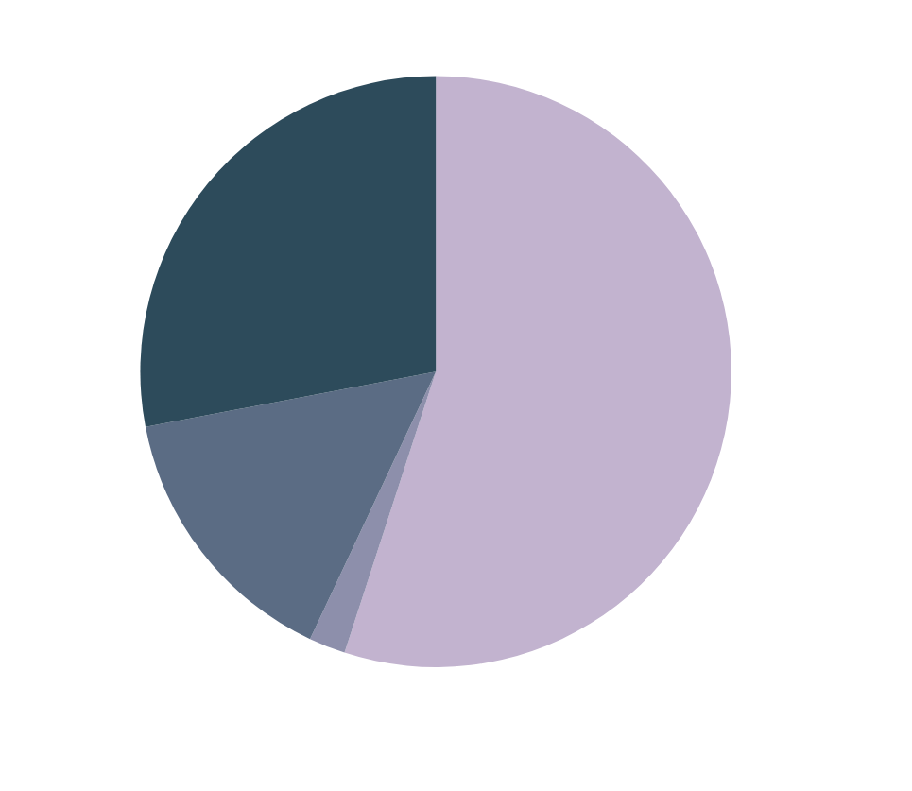
MARKET ANALYSIS

Slide 4
WHAT IS THE SOLUTION?
Identify Types of Income: Determine the types of income being brought back from the USA to India. This could include dividends, interest, capital gains, etc through an algorithm.
Diverse Investment Portfolio Planning: Create a system that can analyze a user's diverse investment portfolio and provide tax planning strategies that optimize tax efficiency.
Claim Foreign Tax Credits: If applicable, claim foreign tax credits in India for taxes paid in the USA on the income being brought back. This will help offset the Indian tax liability, reducing or eliminating double taxation.

Slide 5
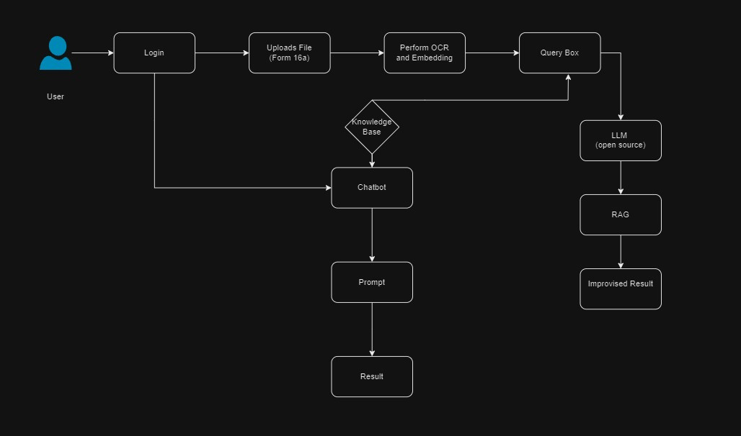
Architecture

Slide 6
THANK YOU

