Slide 1
MLSA INTERNSHIP Full Stack Development
PROJECT PRESENTATION
NAME : ABHISHEK KUMAR YADAV
ROLL NO : 2300290100013
YEAR : 2
SEM/SEC : 3_A
LIB ID : 2327CSE1182

Slide 2
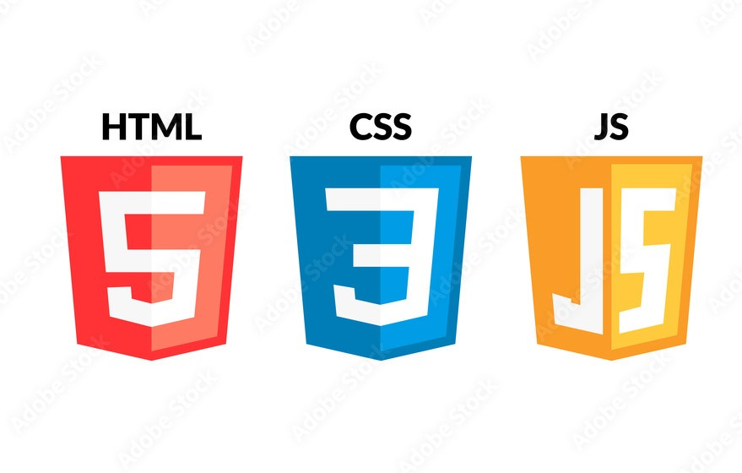
TECH STACK USED
HTML, CSS, and JavaScript are the core technologies for building web pages, each serving a specific purpose:
HTML (HyperText Markup Language): HTML is used to create the structure and content of a webpage.
CSS (Cascading Style Sheets): CSS is used to style and visually format HTML content, controlling the look and feel of a webpage.
JavaScript (JS): JavaScript adds interactivity and functionality to a webpage, enabling dynamic content updates, user interaction handling, and animations.

Slide 3
Project 1 : Personal Webpage (Easy)
Project Overview
This project involves creating a simple personal webpage using HTML and CSS. It displays a profile picture, name, brief bio, and social media links, serving as a professional landing page.
Design and Implementation
Layout: Centered profile section with profile picture, bio, and social media links.
Styling: Rounded profile picture, shadow effects, hover interactions for social links, and responsive design for desktop and mobile.

Slide 4

Conclusion: The project successfully provides a responsive, visually appealing personal webpage that meets all requirements, showcasing essential HTML and CSS skills.

Slide 5
Project 2 : Simple Calculator using JS (Intermediate)
Project Overview
This project involves the development of a simple calculator application using HTML, CSS, and JavaScript. The calculator performs basic arithmetic operations, including addition, subtraction, multiplication, and division, along with features for clearing input, deleting the last character, and calculating percentages.
Layout and Structure
The calculator is organized within a responsive container that includes:
A display area for showing input and results.
Buttons for numbers (0-9), operators (+, -, *, /), percentage (%), clear (AC), delete (DEL), and equals (=).

Slide 6
Styling
CSS is applied to enhance the visual appearance:
Buttons have a consistent size and padding for ease of use.
Hover effects are included for user feedback.
The layout is designed to be centered and visually appealing with rounded corners and shadows.
Functionality
JavaScript provides interactivity through several key functions:
clearDisplay(): Resets the display.
deleteLastCharacter(): Removes the last character from the input.
appendToDisplay(value): Adds a value to the display.
calculatePercentage(): Divides the current display value by 100.
calculateResult(): Evaluates the expression shown in the display, with error handling for invalid calculations.

Slide 7
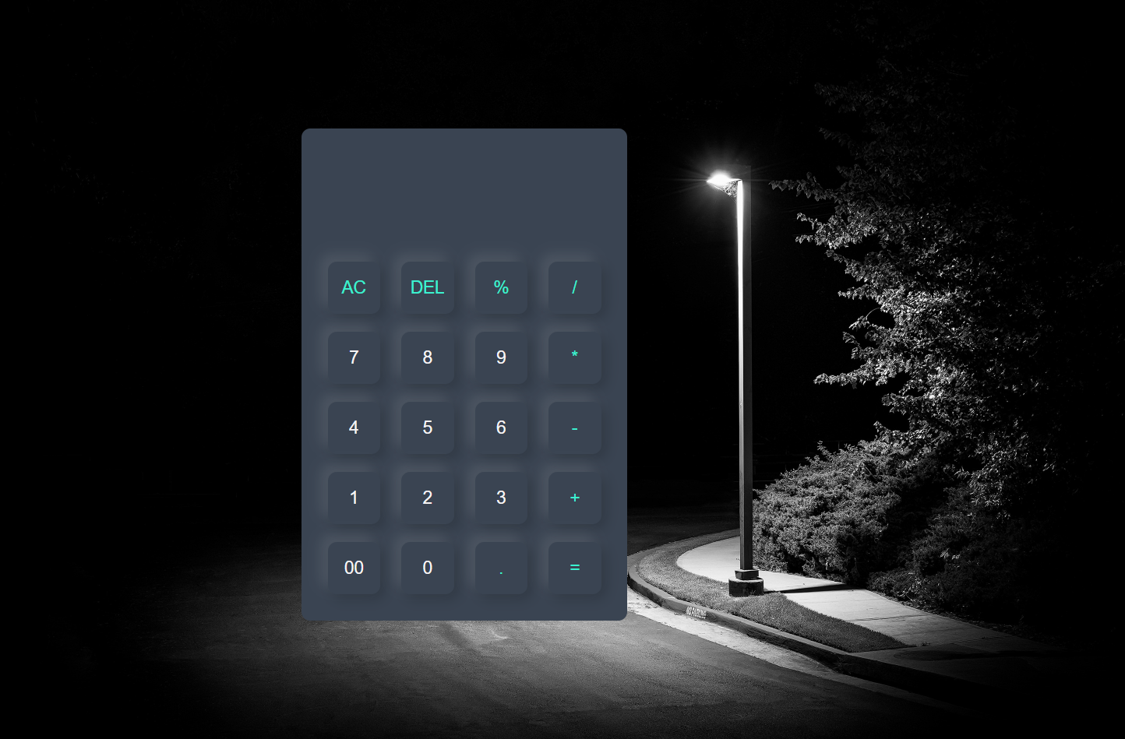
Conclusion
The calculator application successfully meets its objectives by providing a functional and visually appealing tool for basic arithmetic operations. It demonstrates effective use of HTML for structure, CSS for styling, and JavaScript for functionality, making it a solid example of a web-based application. Further enhancements could include additional mathematical functions or keyboard support for improved user interaction.

