Slide 1
MLSA INTERNSHIP Full Stack Development
PROJECT REPORT
NAME : ABHISHEK KUMAR YADAV
ROLL NO : 2300290100013
YEAR : 2
SEM/SEC : 3_A
LIB ID : 2327CSE1182

Slide 2

PROJECT 1 (EASY)
Objective : Create a simple personal Webpage
Description : include a profile picture, a brief bio, and links to social media profiles
Technologies used : HTML & CSS

Slide 3
Project Requirements
Functional Requirements
Display a profile picture, name, brief bio, and social media links.
Link social media icons to external profiles.
Ensure the layout is easy to navigate and visually cohesive.
Non-functional Requirements
The webpage should be responsive for different screen sizes.
Use a clean and minimalistic design that emphasizes readability and usability.

Slide 4
IMPLEMENTATION
HTML
The HTML file contains a structured layout with a container that holds the profile image, bio, and social media links.
CSS
CSS is used to style the webpage, providing:
Centered and card-like layout with shadow effects for a modern look.
Rounded profile picture and hover effects on social media links.
Simple, responsive design that adjusts well to mobile and desktop views.

Slide 5
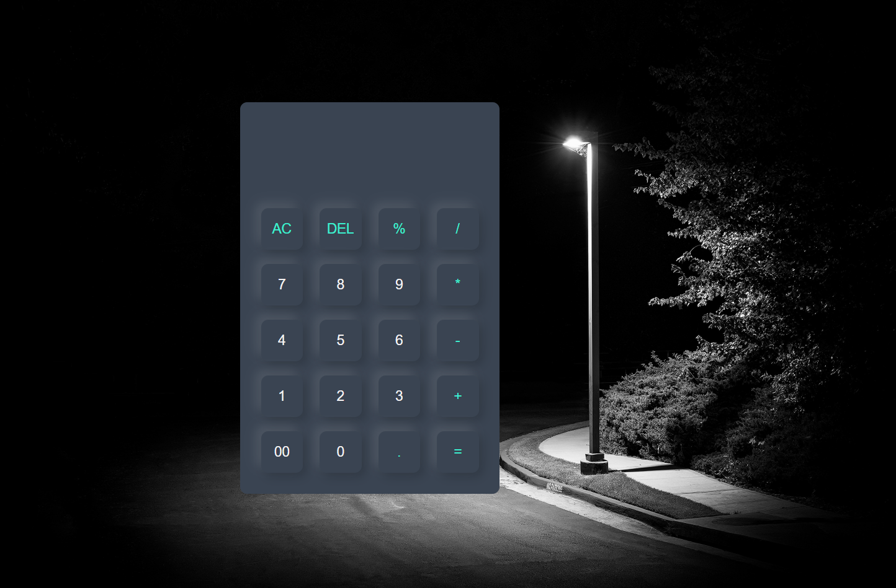
PROJECT 2 (INTERMEDIATE)
Objective : Create a simple Calculator
Description : develop a calculator application that perform basic arithmetic operations using JavaScript
Technologies used : HTML, CSS & JS

Slide 6
Project Requirements
Functional Requirements:
Perform basic arithmetic operations.
Support clear (AC) and delete (DEL) functions.
Include a percentage calculation feature.
Non-functional Requirements:
Provide a user-friendly and responsive interface.
Ensure that the application functions smoothly across modern web browsers.

Slide 7
Design & IMPLEMENTATION
Layout and Structure
The calculator is organized within a responsive container that includes:
A display area for showing input and results.
Buttons for numbers (0-9), operators (+, -, *, /), percentage (%), clear (AC), delete (DEL), and equals (=).
Styling
CSS is applied to enhance the visual appearance:
Buttons have a consistent size and padding for ease of use.
Hover effects are included for user feedback.
The layout is designed to be centered and visually appealing with rounded corners and shadows.

Slide 8
Functionality
JavaScript provides interactivity through several key functions:
clearDisplay(): Resets the display.
deleteLastCharacter(): Removes the last character from the input.
appendToDisplay(value): Adds a value to the display.
calculatePercentage(): Divides the current display value by 100.
calculateResult(): Evaluates the expression shown in the display, with error handling for invalid calculations.
Conclusion
The calculator application successfully meets its objectives by providing a functional and visually appealing tool for basic arithmetic operations. It demonstrates effective use of HTML for structure, CSS for styling, and JavaScript for functionality, making it a solid example of a web-based application. Further enhancements could include additional mathematical functions or keyboard support for improved user interaction.

