Slide 1
Executive Sales Performance Dashboard
Superstore Sales Financial Analysis
Abhishek Shete
MCA IT / DATA ANALYST
February 2026

Slide 2
🔍 Strategic Insights
The business demonstrates stable revenue growth with positive profitability.
Technology category drives the majority of total sales.
The West region contributes the highest revenue share.
Sales performance shows consistent upward trend over time.

Slide 3
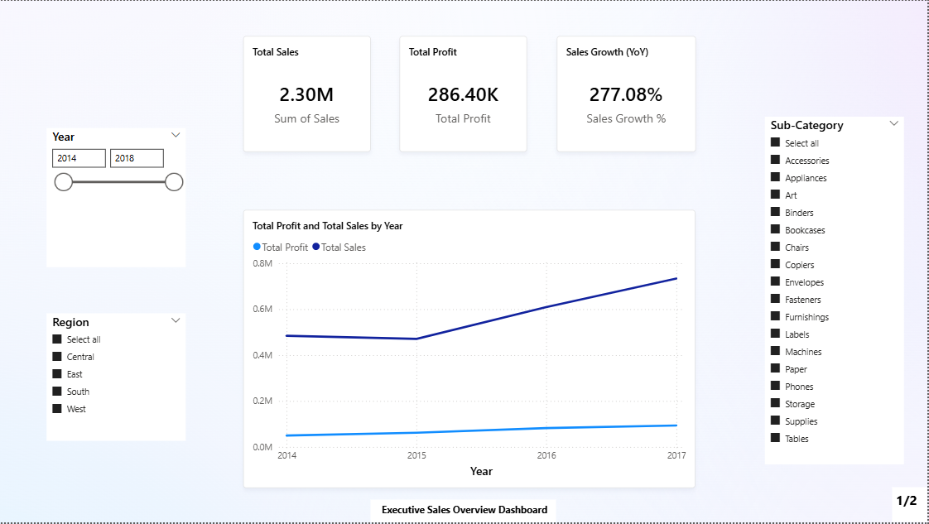
Dashboard Overview

Slide 4
Performance Analysis
Strong total sales with consistent profitability
Steady year-over-year growth
Technology is top-performing category
West region generates highest revenue

Slide 5
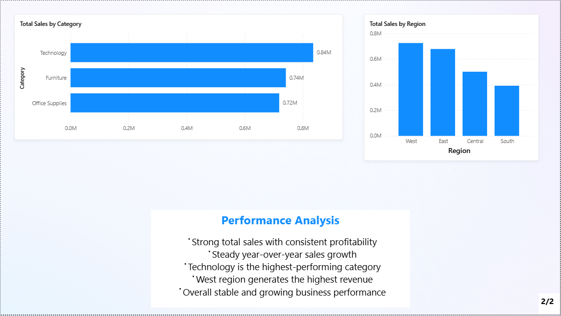
Performance Insights View

Slide 6
🚀 Action Plan
Increase investment in high-performing categories like Technology.
Strengthen marketing in lower-performing regions to balance growth.
Monitor yearly performance trends to sustain long-term profitability.

