Slide 1
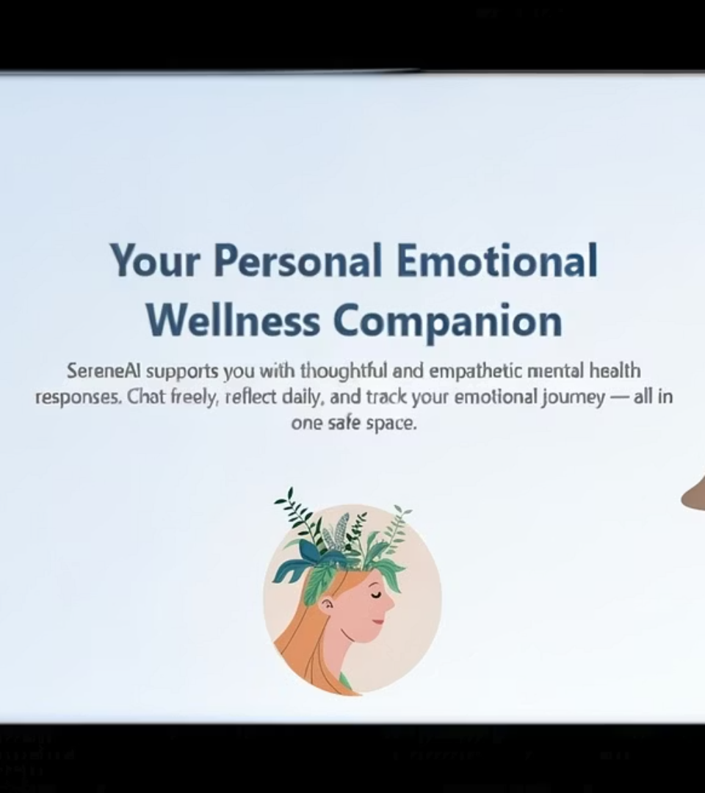
SereneAI:
Your Personal Emotional Wellness Companion
An AI-based mental health chatbot
fostering emotional support and wellbeing.

Slide 2
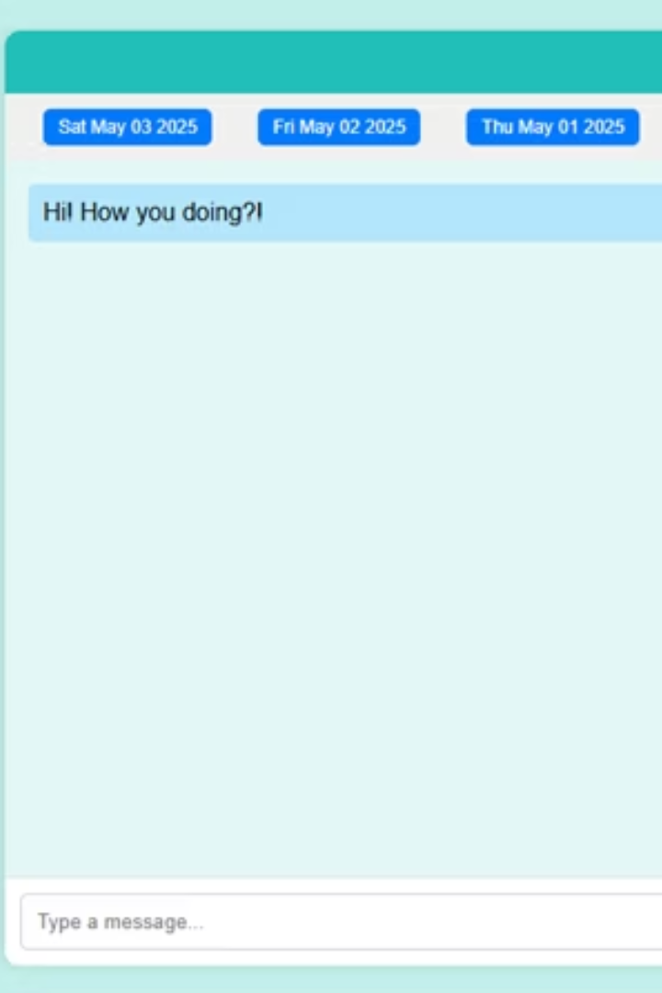
Introduction
Purpose
The project aims to create a safe, friendly, and intelligent space where users can share their thoughts and feelings and receive meaningful responses — not to replace clinical support, but to supplement everyday emotional care.
SereneAI is a browser-based artificial intelligence chatbot designed to offer emotional support and mental wellness assistance to users through natural language conversation.

Slide 3

Objectives
Safe Conversations
Provide a secure, non-judgmental conversational platform.
Thoughtful Support
Deliver empathetic, non-clinical mental health assistance.
Facilitates empathetic conversations with users.
Daily Well-being
Integrate prompts and save chat history for continuity.
Provides motivational content ("Thought of the Day").
Performance
Ensure lightweight client with low response latency.
Stores and manages chat history for reflective purposes.
Uses modern AI models (Gemini API) to simulate intelligent responses.

Slide 4
Technology Stack Used
AI & API
Frontend
Backend & Hosting
Gemini 1.5 Flash API
HTML, CSS, Vanilla JavaScript
Supabase for Authentication & User Management
LottieFiles for animations
Google Fonts integration
GitHub Pages for hosting

Slide 5

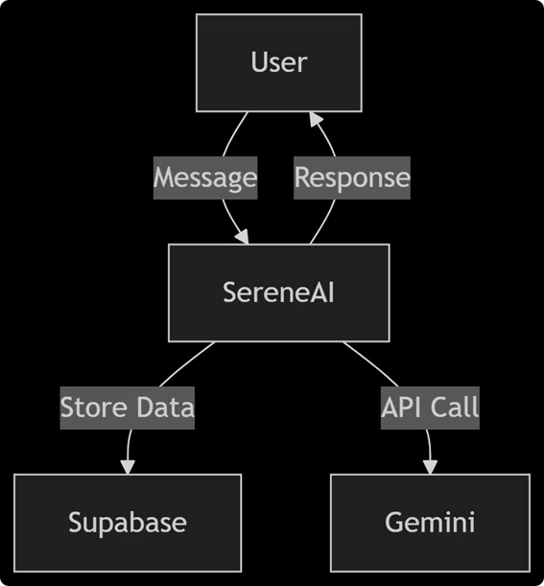




System Architecture
Frontend
User interface for chat and profile features.
Authentication
Supabase handles login, profiles, and session management.
AI Model
Requests flow to Gemini 1.5 Flash for response generation.
Serverless Cloud
Cloud functions power the API calls and backend logic.

Slide 6

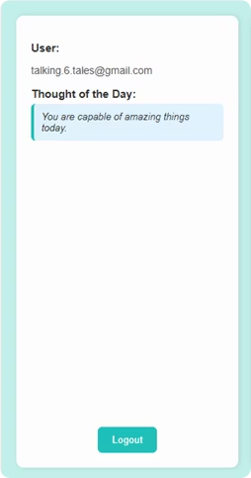




Features
Sign Up & Login
Personalized Sidebar
Chat History
Daily Thought
Includes secure logout and smooth Lottie animations.

Slide 7
System Architecture
The system architecture of SereneAI connects four main components working seamlessly together:
Frontend (UI/UX) provides a responsive user interface through which users interact with the chatbot.
Authentication, profile management, and data storage are handled by Supabase.
User requests are routed to the Gemini 1.5 Flash API, which generates intelligent and empathetic chatbot responses.
The backend logic and API calls are powered by a Serverless Cloud infrastructure for scalability and efficiency.
This architecture ensures smooth communication between components, providing secure and responsive emotional support to users.

Slide 8
Future Scope
AI Upgrades
Feature Expansion
Technical Enhancements
Integration
Sentiment analysis for emotional awareness
Guided meditation and mindfulness
Calendar for mood logging
PWA for offline access
Journaling with mood tracking
Voice input/output accessibility
Wearable device data correlation
Community Features
Anonymous forums and group chats
Volunteer listener programs
SereneAI's modular foundation supports easy incremental feature development.

Slide 9

Conclusion
SereneAI delivers thoughtful AI-powered mental health support.
Secure authentication and engaging UX enable daily emotional wellness.
SereneAI is a meaningful step toward providing supportive mental health tools powered by AI.
It offers secure login, thoughtful responses, and a simple user experience tailored for daily emotional well-being.

Slide 10
Thank You
Project by:
Supervised by: Mr. Sahil Sehrawat
Abhishikta Pal
Designation: Assistant Professor
10323210323
B.tech CSE Core 'J'
SRM University

