Slide 1
TRAVEL PLANNER AGENT
CAPSTONE PROJECT
Presented By:
Abhishikta Pal
SRM University, Delhi-NCR Sonepat
B.Tech Computer Science

Slide 2
OUTLINE
Problem Statement
Proposed System/Solution
System Development Approach (Technology Used)
Algorithm & Deployment
Result (Output Image)
Conclusion
Future Scope
References

Slide 3
Problem Statement
A Travel Planner Agent is an AI-powered assistant that helps users plan trips efficiently and intelligently. It uses real-time data to suggest destinations, build itineraries, and recommend transport and accommodation options. By understanding user preferences, budgets, and constraints, it tailors personalized travel plans. Integrated with maps, weather updates, and local guides, it ensures a smooth travel experience.
The agent can also manage bookings, alert users to changes, and optimize schedules on the go. This smart assistant transforms complex travel planning into a seamless, enjoyable process

Slide 4
Proposed Solution
Data Collection:
User inputs about travel preferences such as location, duration, budget, and interests. Information retrieved from online sources.
Data Processing:
Convert user queries into structured information requests and use embedded knowledge to match destinations, accommodations, and activities.
AI Agent Algorithm:
Leverages Granite/Mistral foundation models for Natural Language Processing.
Retrieves destination details, generates itineraries, and provides contextual travel advice.
Uses Wikipedia and web search integration for up-to-date information.
Deployment:
Built in Watsonx.ai Studio’s Agent Lab.
Integrated with search tools (Wikipedia, Webcrawler, Google Search).
Deployed via Watsonx.ai Runtime for interactive Q&A.
Evaluation:
Test with multiple user scenarios (budget trips, family vacations, adventure travel).
Assess accuracy of itineraries and relevance of suggestions.

Slide 5
System Approach
System Requirements
Platform: IBM Cloud Lite account
Services:
Watsonx.ai Studio (for building the agent)
Watsonx.ai Runtime (for executing models)
Hardware: Standard laptop/PC with stable internet connection
Storage: IBM Object Storage (Free plan) for uploading documents
User Requirements: Basic IBM Cloud login credentials
Libraries/Tools Required
Mistral Foundation Model for NLP
Watsonx.ai Agentic Lab for agent creation and orchestration
NLTK/Transformers (pre-installed in IBM Cloud runtime) for text preprocessing (if required)

Slide 6
Algorithm & Deployment
Algorithm Selection: The chosen approach is a Granite-based NLP agent with retrieval-augmented responses.
Selected because it handles natural language travel queries effectively.
Provides context-aware and personalized itinerary recommendations.
Data Input:
User queries like:
“Plan a 5-day trip to Goa.”
“Suggest budget hotels in Bali near the beach.”
Online data from Wikipedia and web search results.
Training Process:
Uses pre-trained Mistral LLM, no custom training required.
Prompt engineering to ensure travel-specific answers.
Prediction Process:
User submits a travel-related query.
Agent retrieves relevant travel information (destinations, hotels, attractions).
Generates structured responses including day-wise plans, budgets, and travel tips.

Slide 7
Deployment Steps in IBM Cloud
Login to IBM Cloud → cloud.ibm.com.
Create a Watsonx.ai Project → Select Lite Plan.
Associate Watsonx.ai Runtime Service → via Manage → Services & Integrations.
Build New Agent in Agent Lab → Select Granite/Mistral model.
Add Tools → Wikipedia Search, Google Search, Webcrawler.
Write Agent Instructions → e.g., “You are a Travel Planner Agent that provides itineraries, hotel suggestions, and budgets.”
Test Queries → Example: “Plan a 5-day trip to Goa.”
Save the Agent → Click Save As → Agent → Travel_Planner_Agent.
Create Deployment Space
Deploy Agent → Click Promote to Space → New Deployment → Online Deployment.
Final Testing → Interact with deployed agent and capture screenshots.

Slide 8
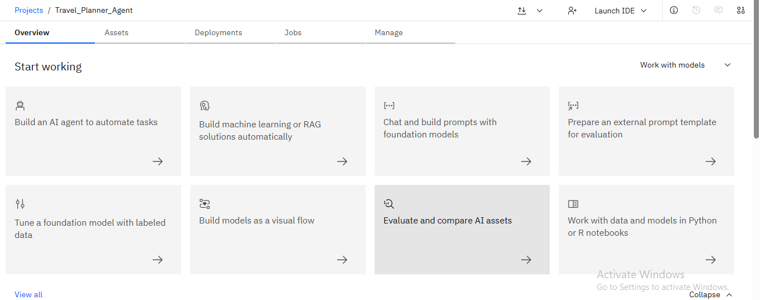
Result

Slide 9
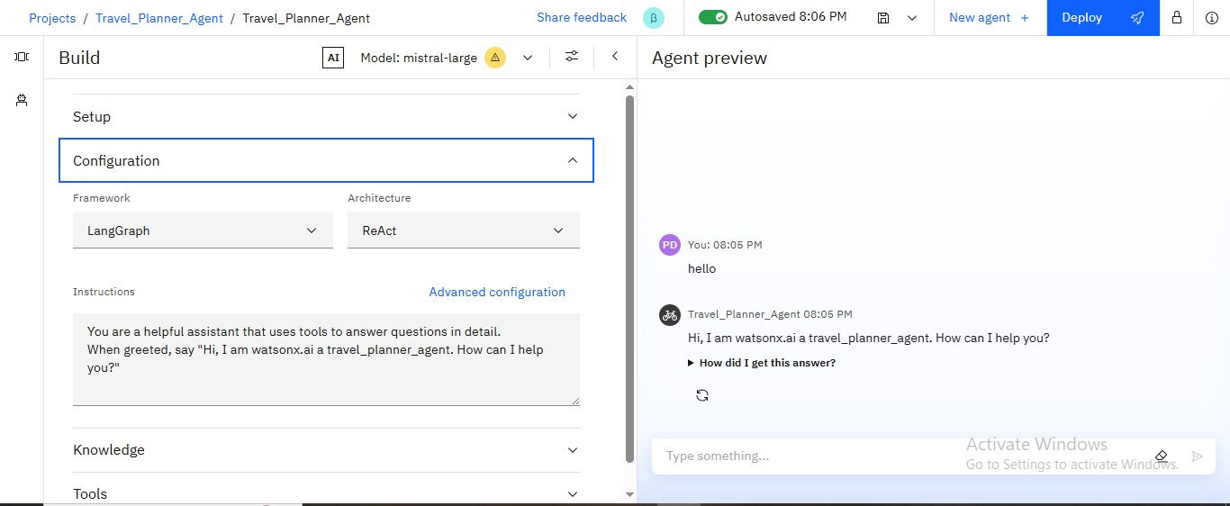

Slide 10
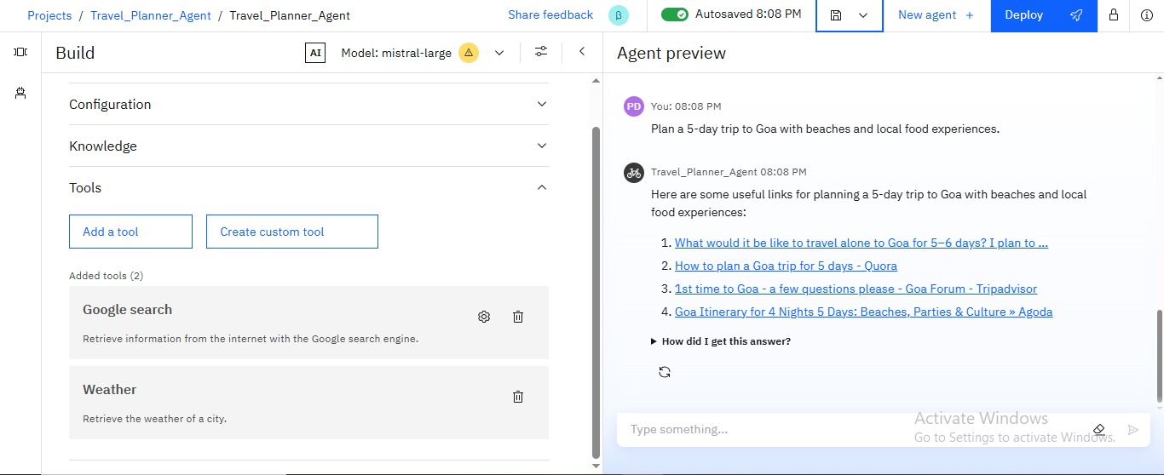

Slide 11
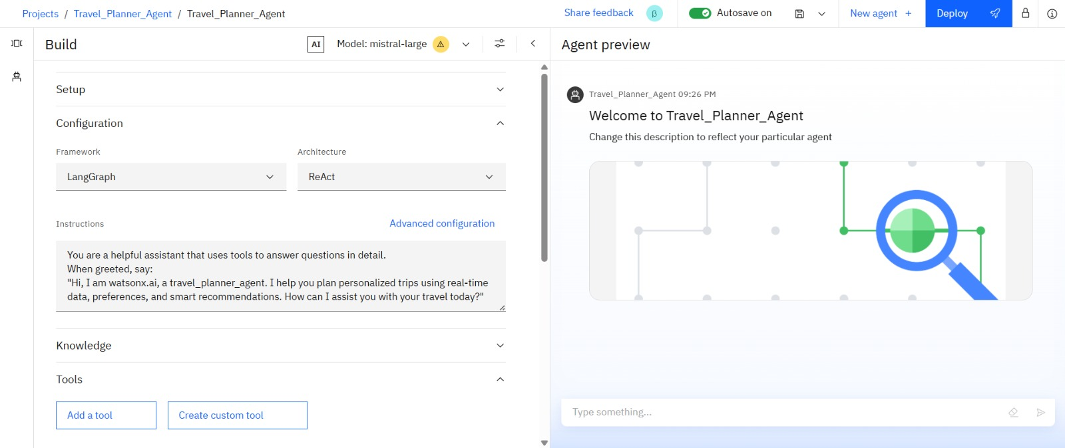

Slide 12
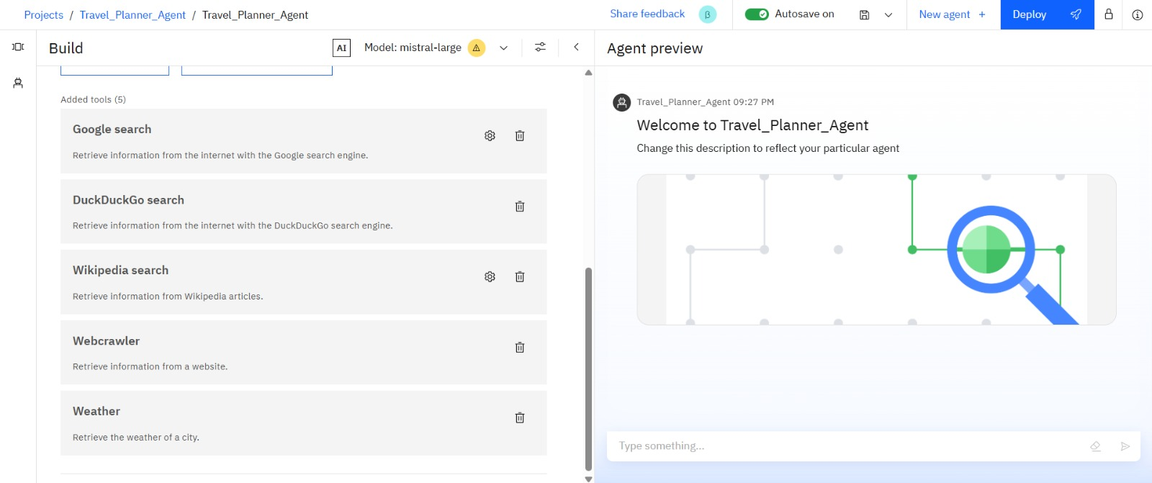

Slide 13
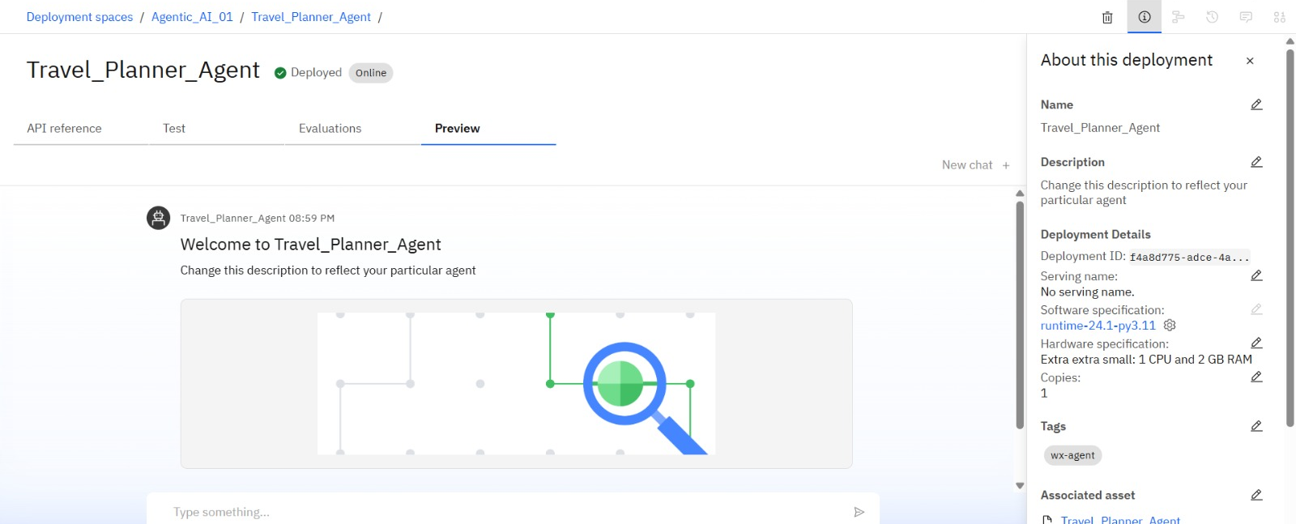

Slide 14
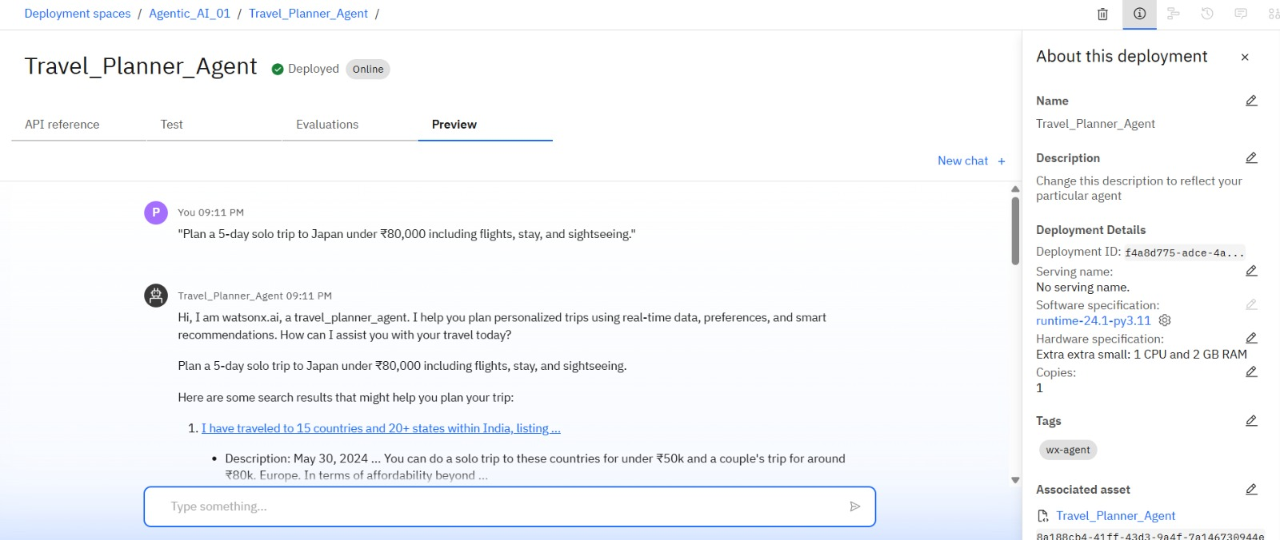

Slide 15
Conclusion
The Travel Planner Agent demonstrates how AI can simplify and personalize trip planning.
Convenience: Quick answers to travel-related questions.
Personalization: Itineraries tailored to preferences and budgets.
Efficiency: Reduces hours of manual research into minutes.
Scalability: Can serve multiple users simultaneously on IBM Cloud.

Slide 16
Integration with real-time flight and hotel booking APIs.
Personalized suggestions using past travel history.
Multi-language support for international users.
Integration with weather forecasts for better itinerary planning.
Voice-enabled travel assistant.
Future scope

Slide 17
References
IBM Watsonx.ai Documentation
Granite Foundation Model Resources
SB4Academia Problem Statements 2025
Wikipedia Travel Pages
IBM Tutorial: Agentic RAG with Granite models
IBM Agentic AI Use Cases

Slide 18
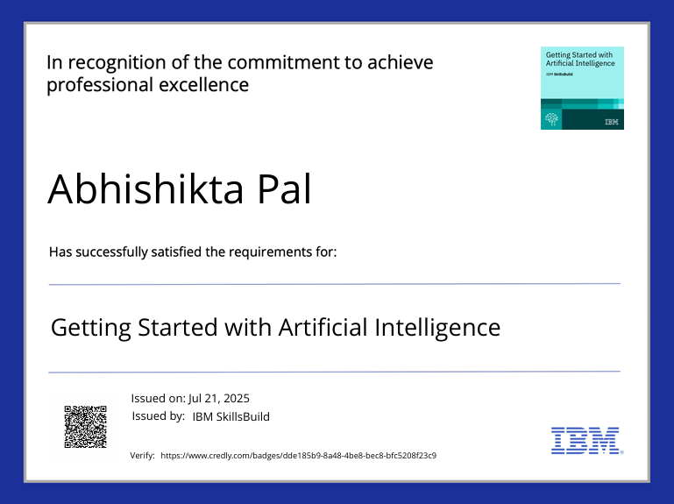
IBM Certifications

Slide 19
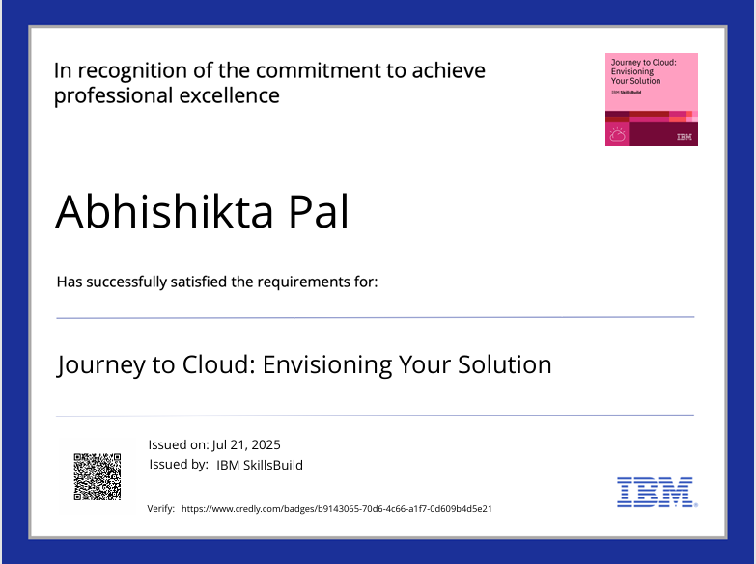
IBM Certifications

Slide 20
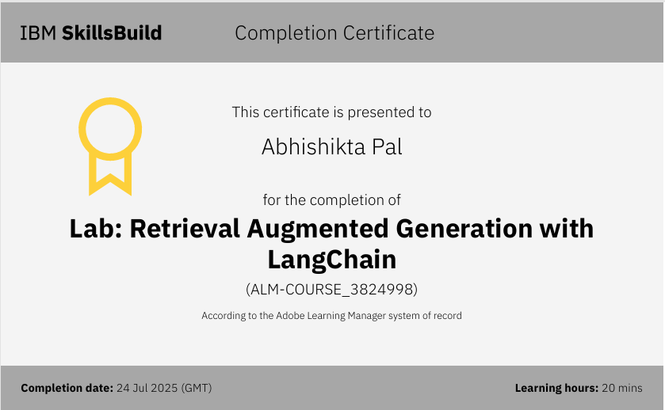
IBM Certifications

Slide 21
THANK YOU

