Slide 1
SalesMatrix
Data Analysis & PivotTable Insights
Project By Abhinav Shirke

Slide 2
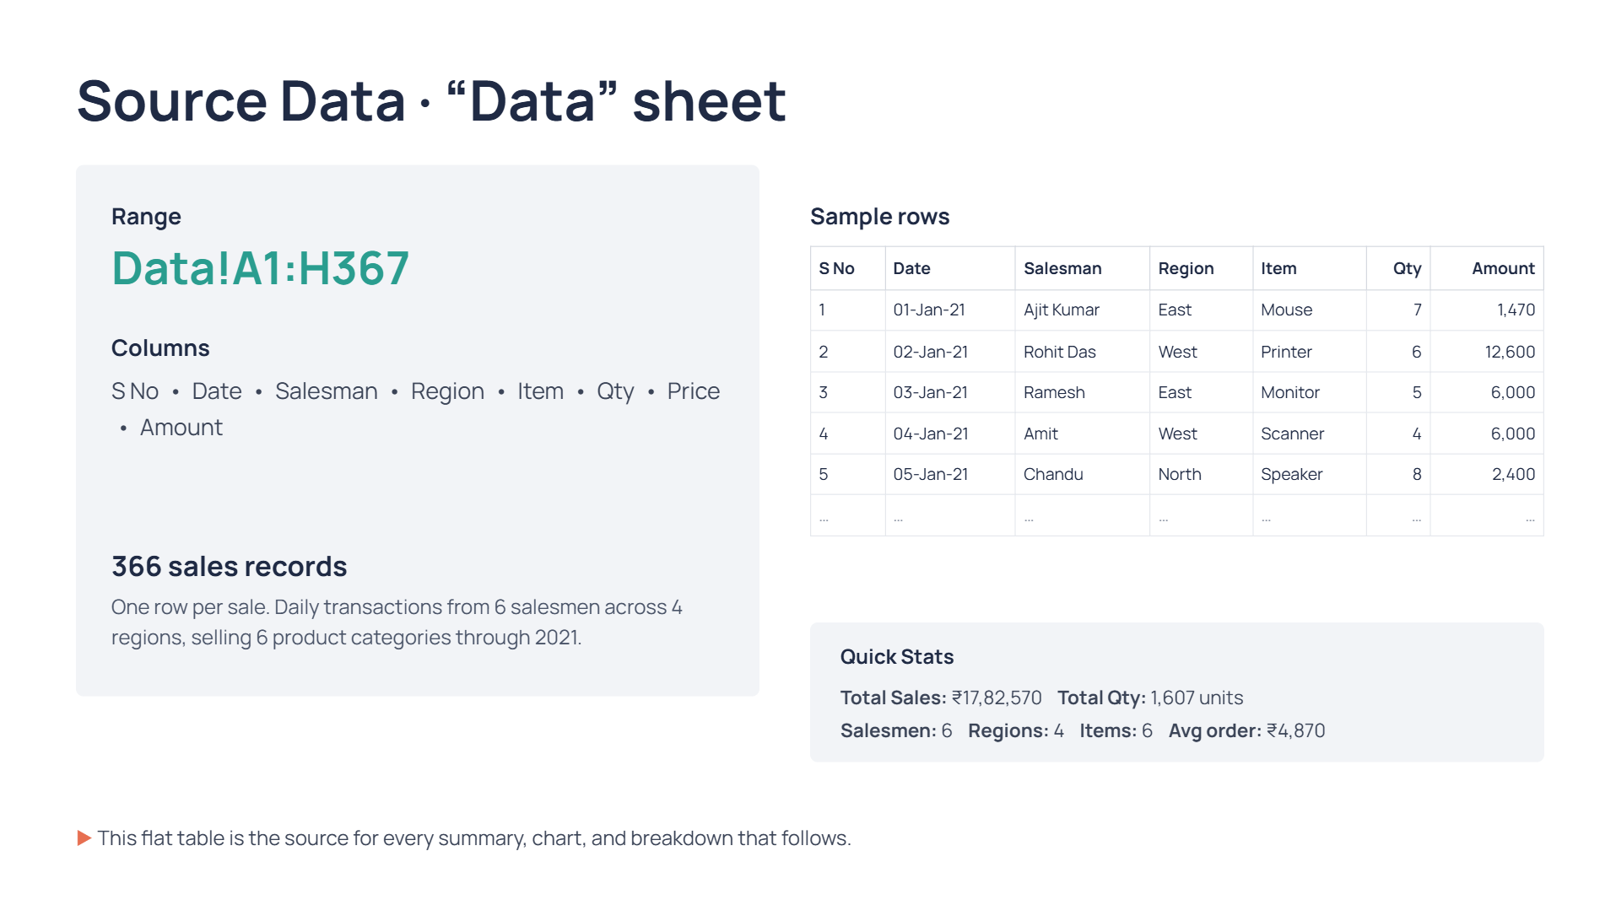

Slide 3
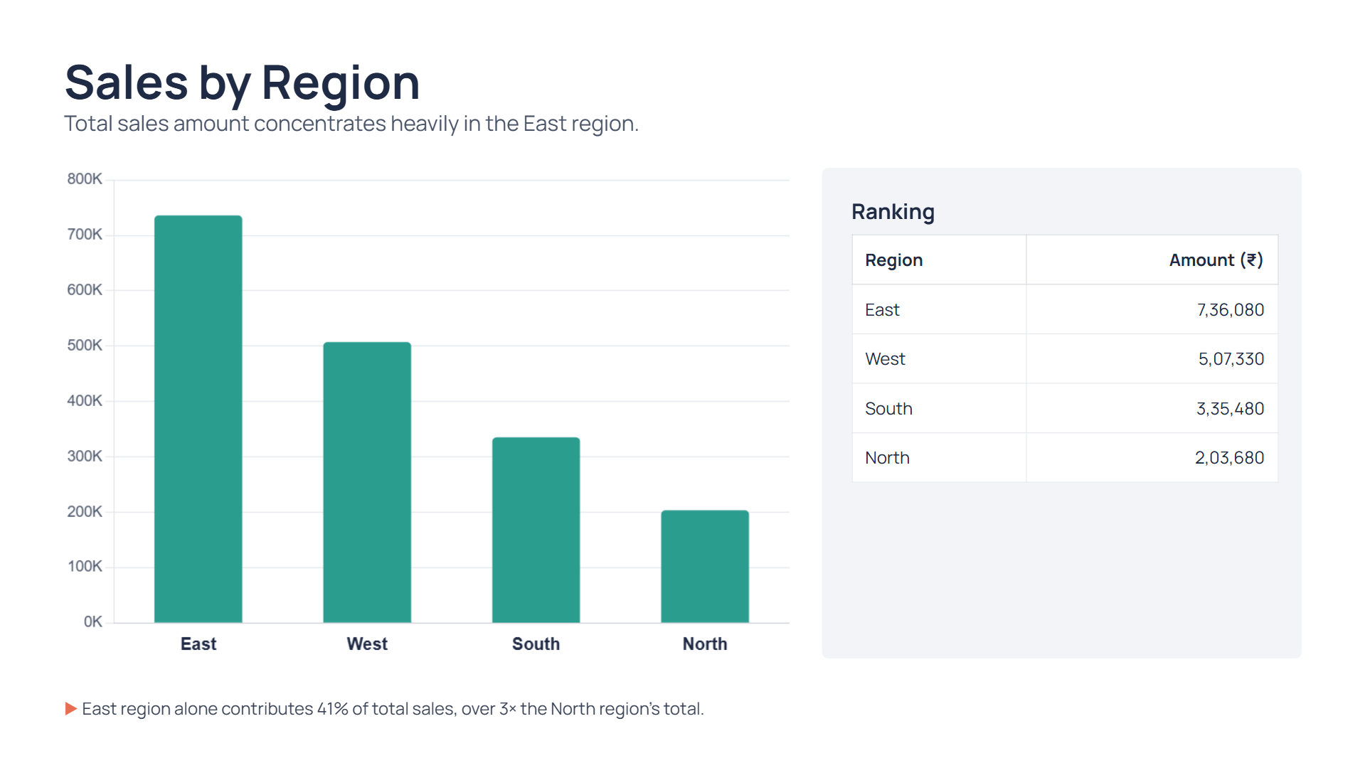

Slide 4
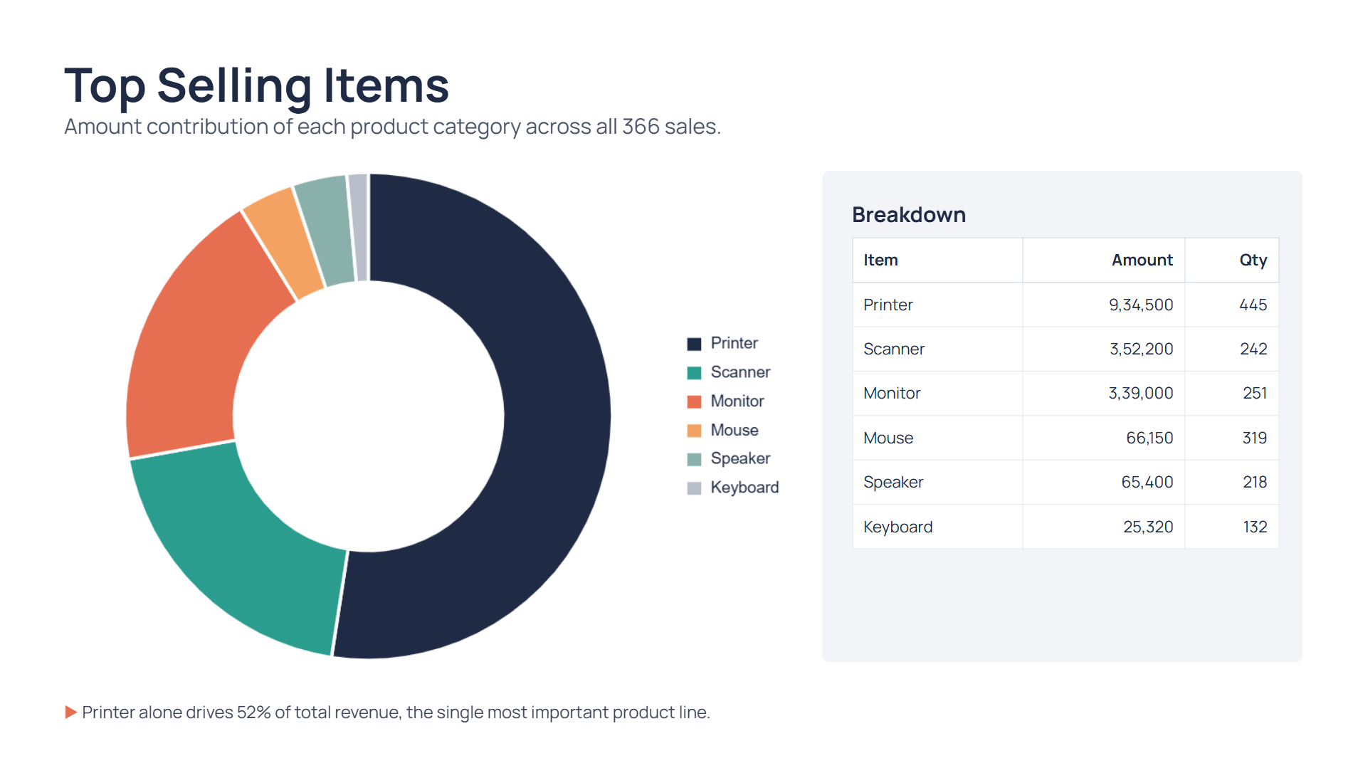

Slide 5
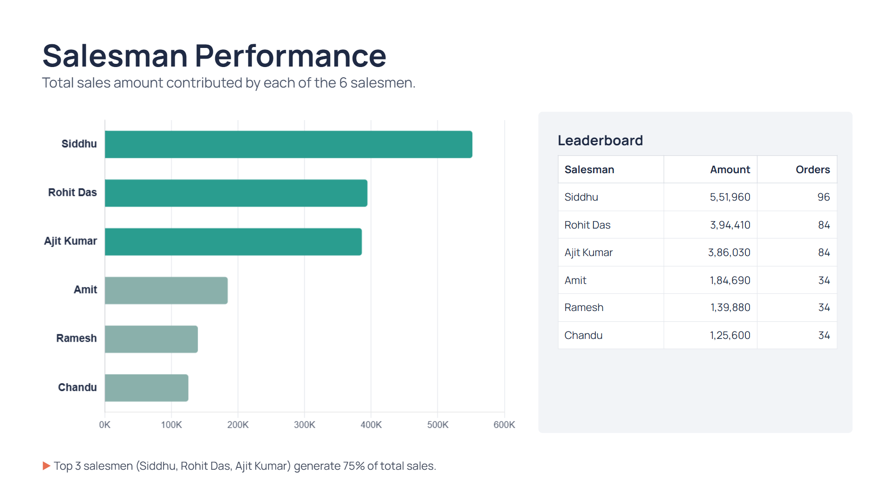

Slide 6
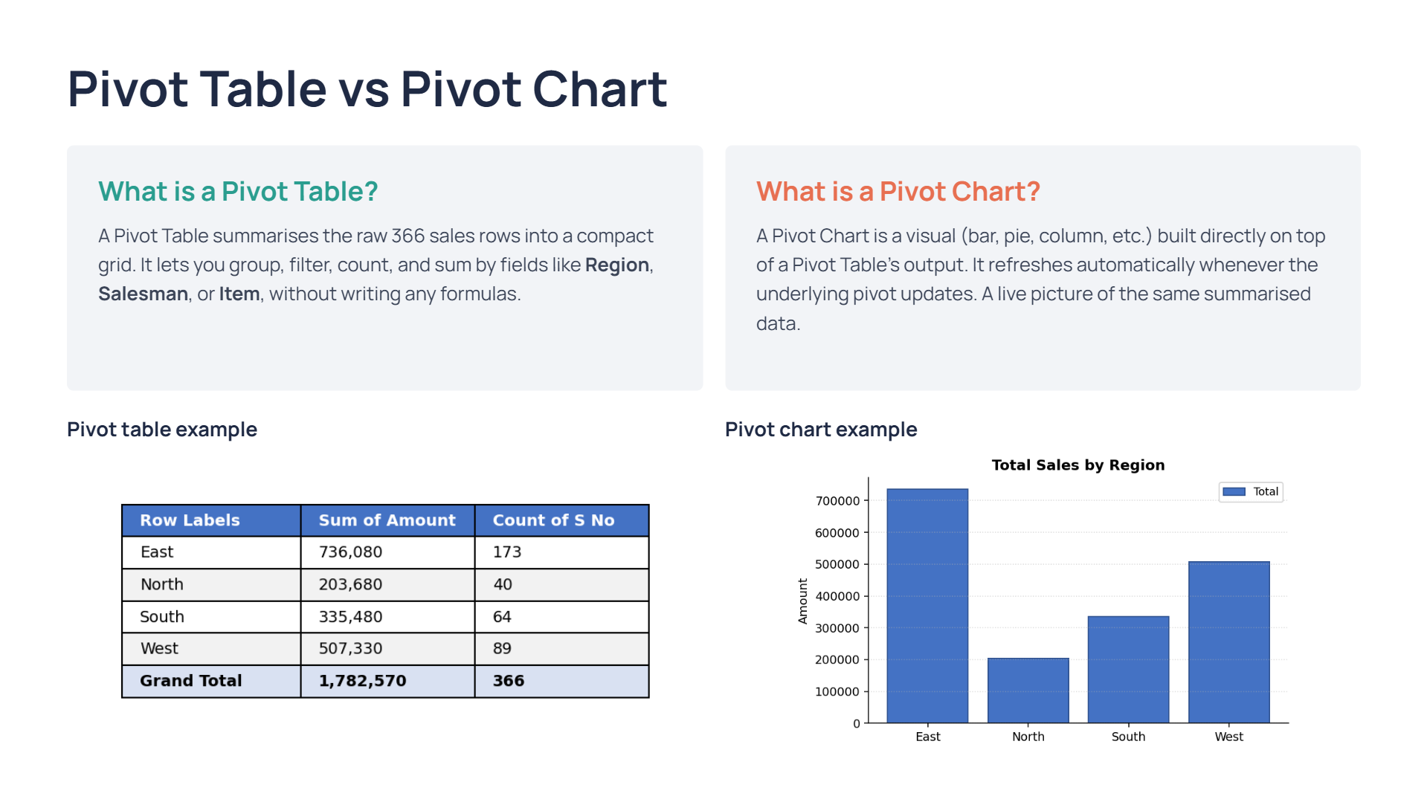

Slide 7
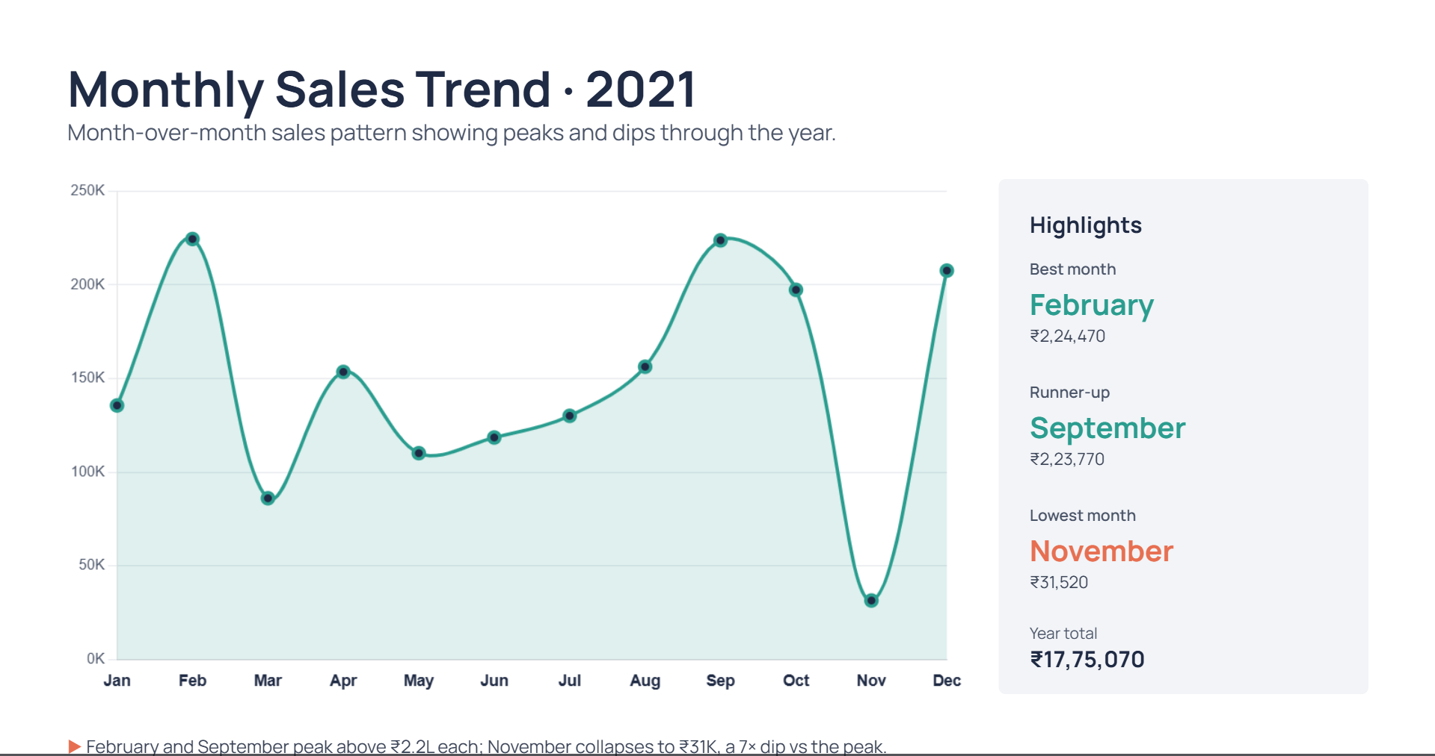

Slide 8
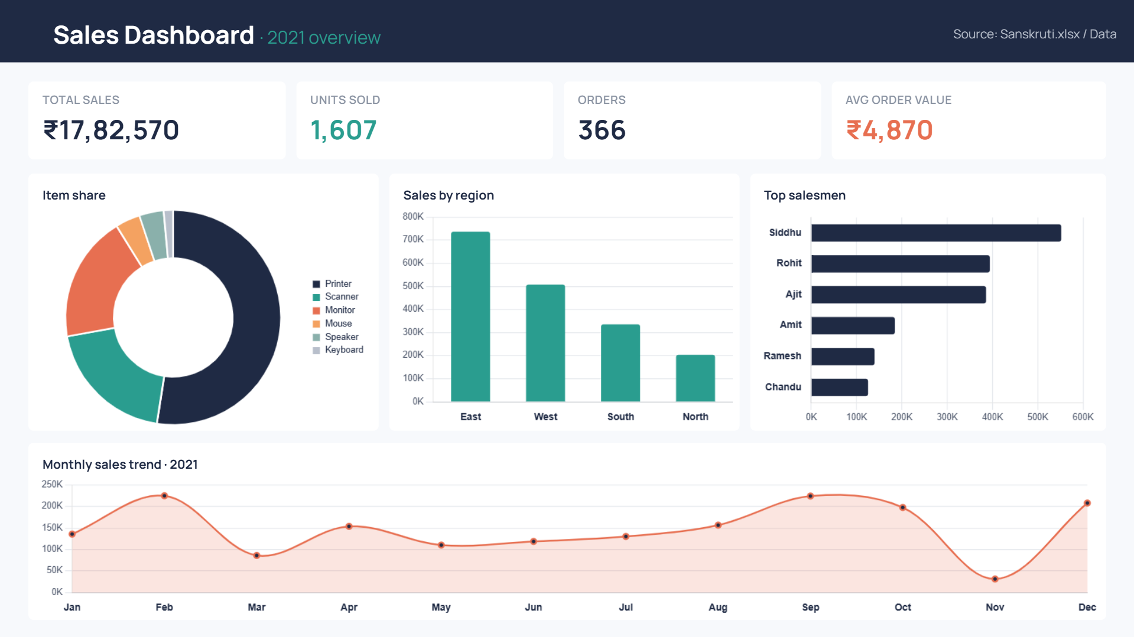

Slide 9
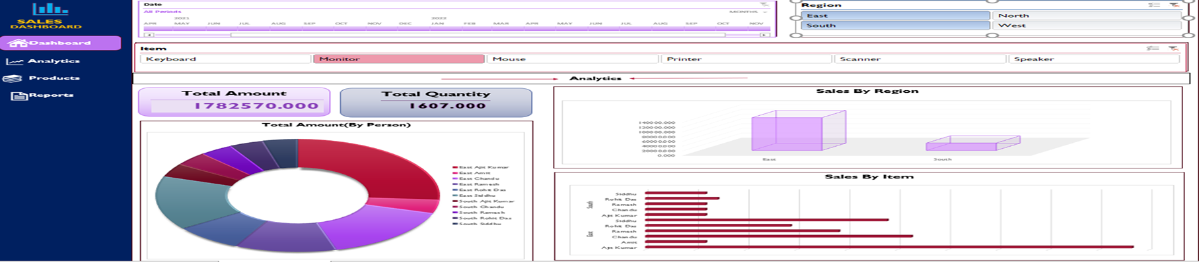
Dashboard

Slide 10
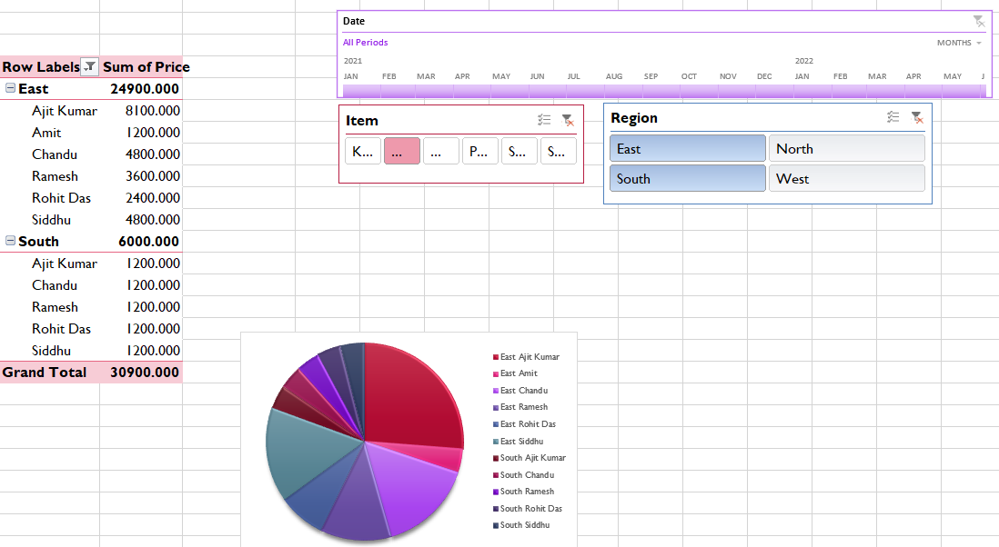
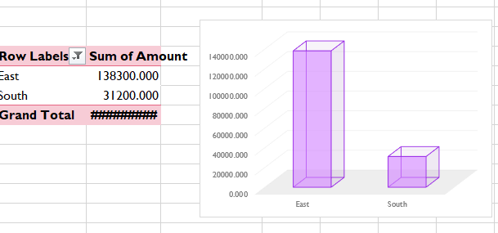
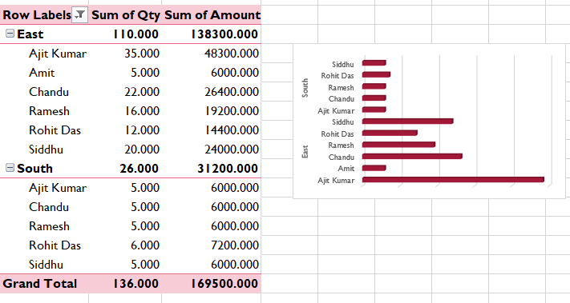
Pivot Table Screenshots — All 3 Views
Same Data!A1:H367 source, sliced with the Date / Item / Region slicers.
1
2
3
Salesman × Region (East/South), Sum of Price, with Date/Item/Region slicers — donut chart alongside.
Region-level Sum of Amount (East 1,38,300 · South 31,200) with a 3D column chart.
Same regions broken down by Qty & Amount per salesman, with a horizontal bar chart.
▸ All three are just different Rows/Values choices on the same pivot cache — that's why East + South always foots to the same Grand Total (30,900 / 1,69,500) across views.

Slide 11



