Slide 1
Model Performance with varying sample size and order of complexity
Abhisikta Biswas
Roll No : D18001
Praxis Business School

Slide 2
Content :
Objective
Section 1 : Regression model with different sample size on Order of 7 Degree Polynomial
Section 2 : Regression model with sample size of 20 with different Degree Polynomial.
Section 3 : Performance of model Test error Vs Complexity sample size of 20.
Section 4 : 4 Different sample each having same size of 90
Section 5 : Plotting RMSE for Train and Test Vs model Complexity.
Remarks

Slide 3
OBJECTIVE :
To study the nature of increasing sample size and order of linear regression equations on error and linear fits .In short how model performs under several circumstances.
The dataset considered here is the Cars93 dataset having 93 observations and 27 variables. Library “MASS” is required to fetch R inbuilt dataset.
“MPG.City” is taken as the target variable and “Weight” is the independent variable.
**Code used to stand the result /graphs is available at:

Slide 4
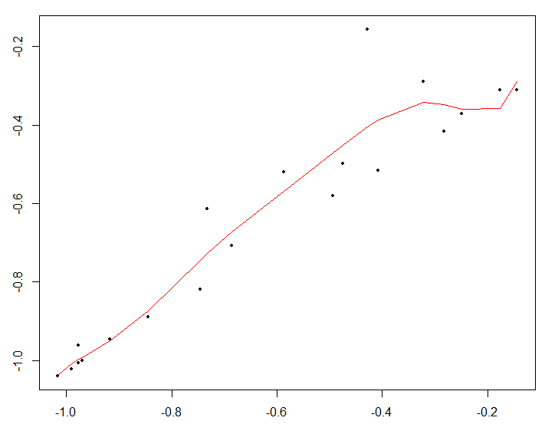
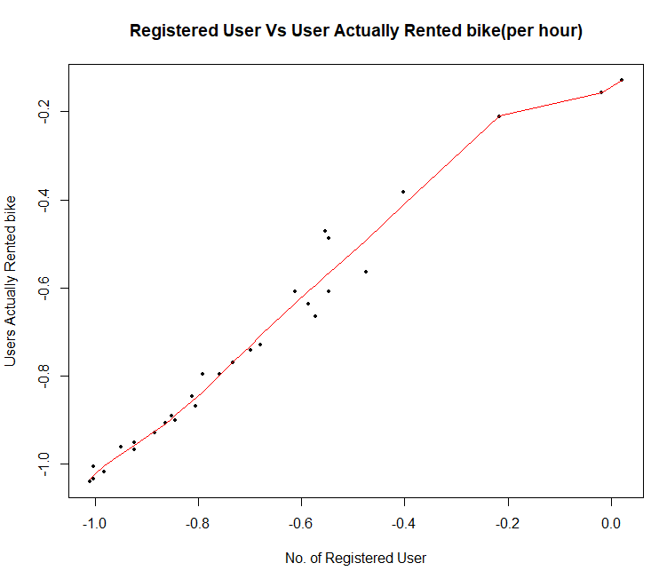
Regression model with different sample size on Order of 7 Graph of Test Error Vs Sample size
Sample size : 20
Order : 7
Test RSS : 14.1928785
Train RSS : 0.12625921
Sample size : 30
Order : 7
Test RSS : 0.5995062
Train RSS : 0.03508139

Slide 5
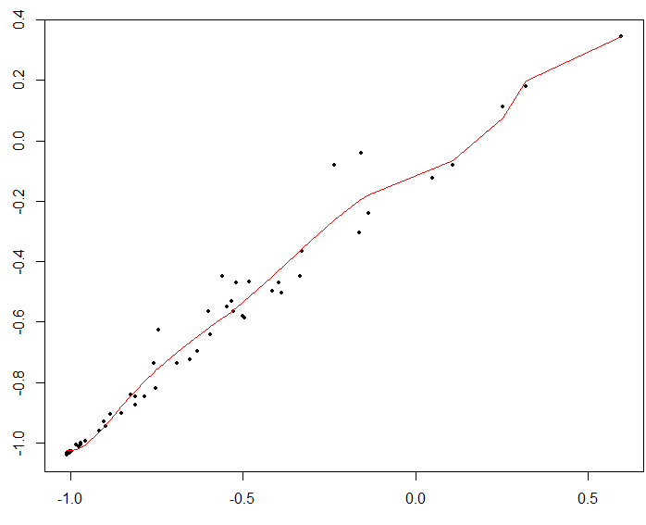
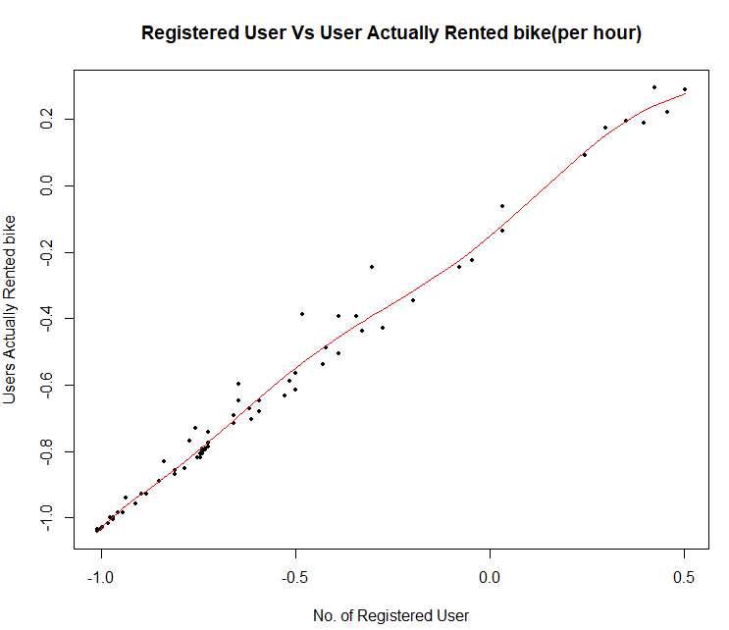
Sample size : 50
Order : 7
Test RSS : 0.7069292
Train RSS : 0.16725886
Sample size : 70
Order : 7
Test RSS : 0.8136689
Train RSS : 0.10619339

Slide 6
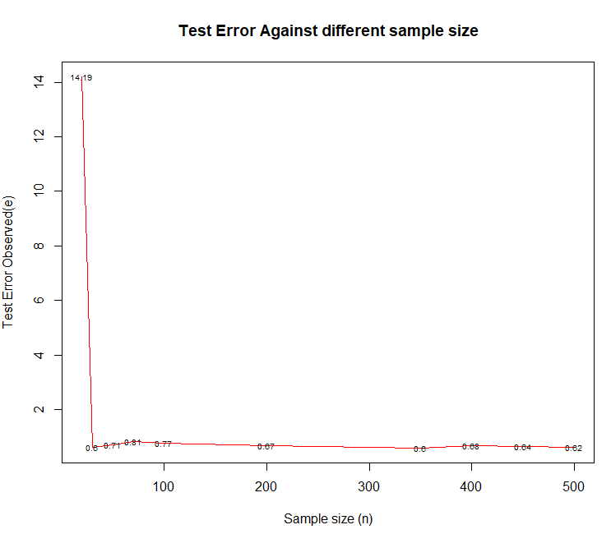
For Different Sample Size plotted graph for Polynomial of order 7

Slide 7
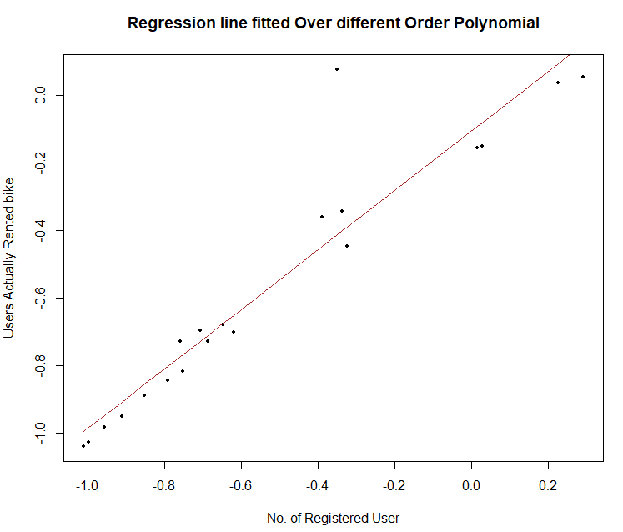
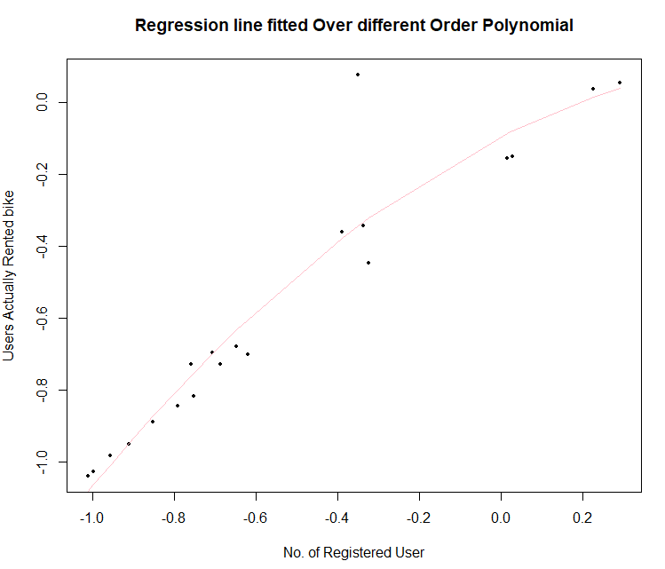
Regression model with sample size of 20 with different Degree Polynomial .
Sample size : 20
Order : 1
Test RSS : 1.494537
Train RSS : 0.023944417
Sample size : 20
Order : 2
Test RSS : 1.527573
Train RSS : 0.017142112

Slide 8
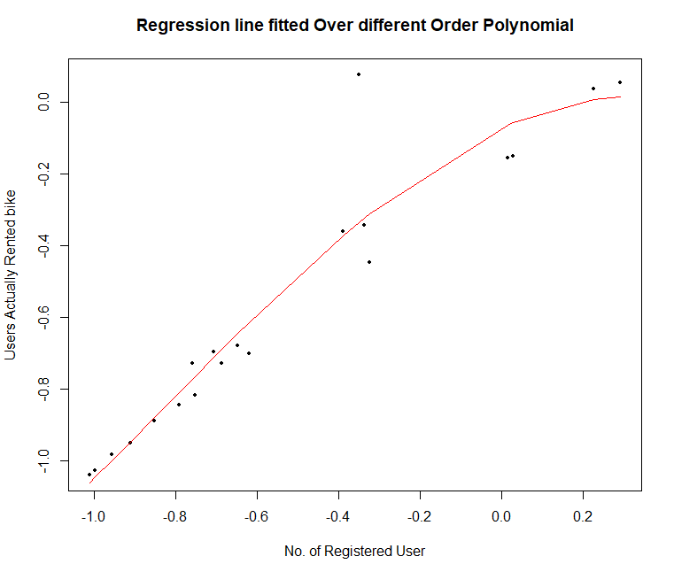
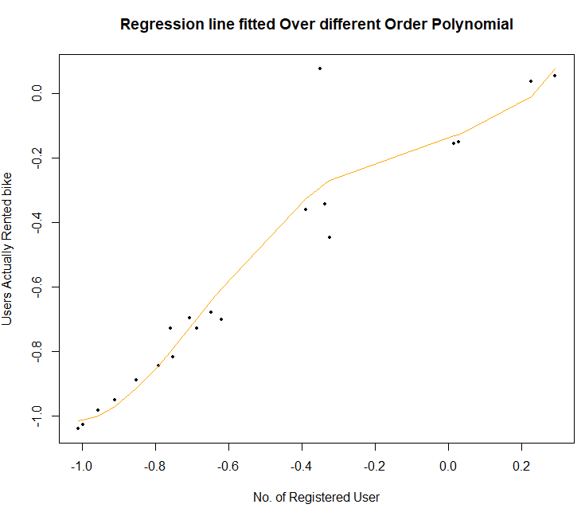
Sample size : 20
Order : 3
Test RSS : 1.675819
Train RSS : 0.013543124
Sample size : 20
Order : 4
Test RSS : 1.514156
Train RSS : 0.012919151

Slide 9
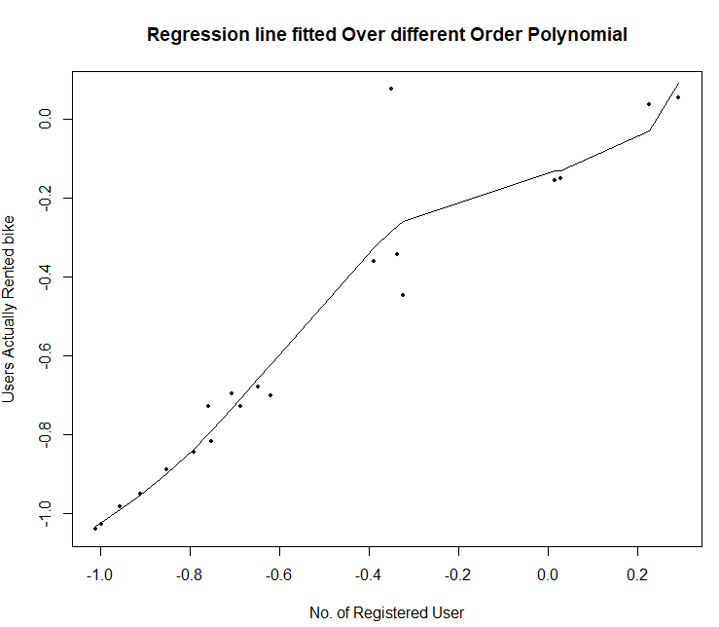
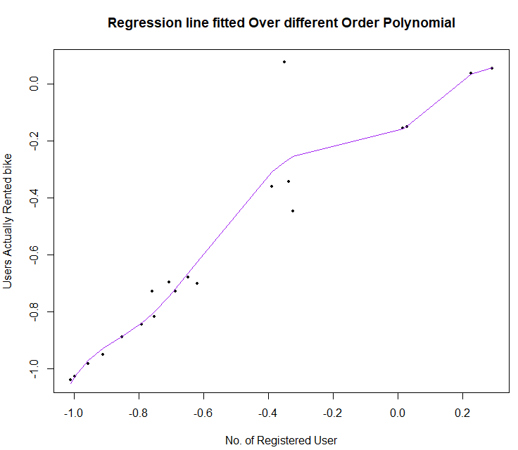
Sample size : 20
Order : 5
Test RSS : 2.609075
Train RSS : 0.010258961
Sample size : 20
Order : 6
Test RSS : 137.095334
Train RSS : 0.008974613

Slide 10
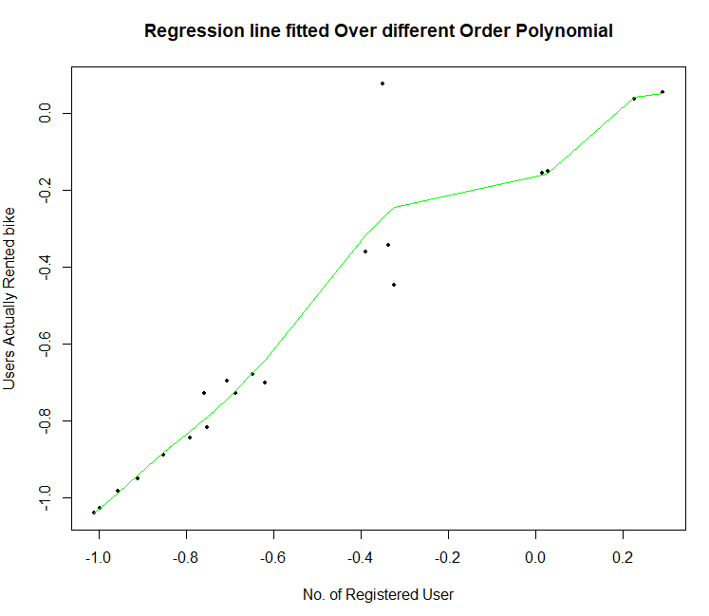
Sample size : 20
Order : 7
Test RSS : 3342.204568
Train RSS : 0.008505546

Slide 11
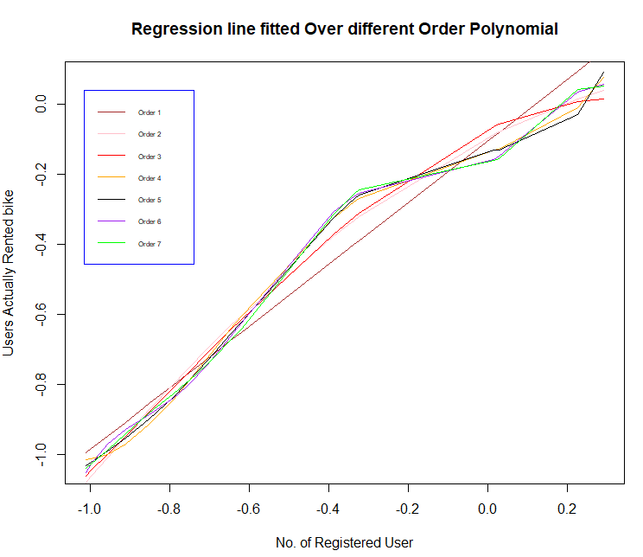
Combined Graphs with Different Orders (1,2,3,4,5,6,7) on Sample size 20

Slide 12
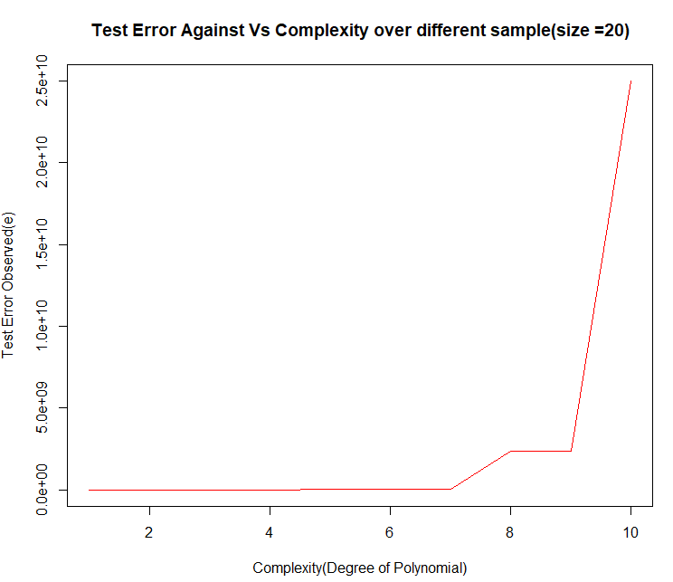
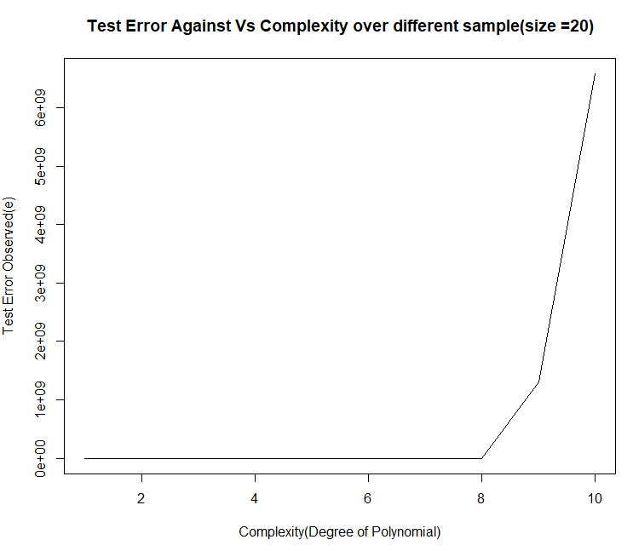
Different sample each having same size=20.
Graph of Test error Vs Complexity
Sample size : 20 (Sample 1)
Order : 1,2,7,8,9,10
Test RSS(for sample in Order) : 1.157355e+00,1.453050e+00,3.143822e+07,2.368101e+09,2.368101e+09, 2.498648e+10
Sample size : 20 (Sample 2)
Order : 1,2,7,8,9,10
Test RSS(for sample in Order) :
8.958420e-02,8.616827e-02,1.385228e+04,3.384460e+05, 1.313401e+09,6.583872e+09

Slide 13
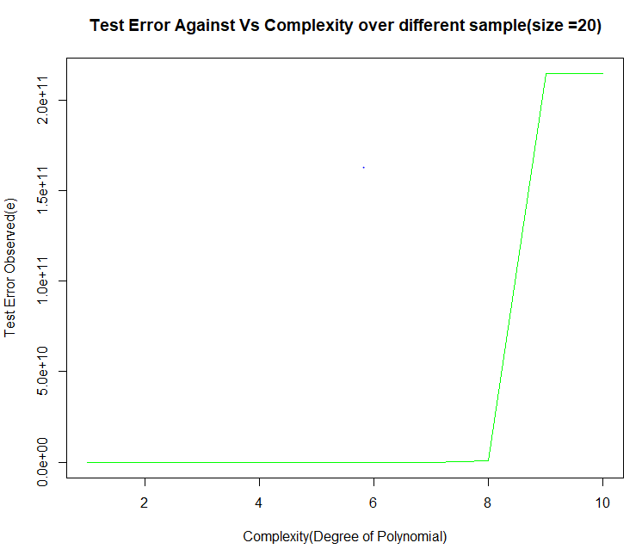
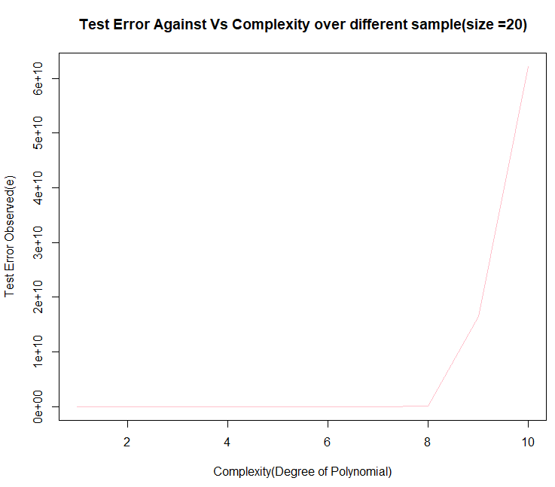
Sample size : 20 (Sample 3)
Order : 1,2,7,8,9,10
Test RSS(for sample in Order) : 9.184346e-02,8.612340e-02,2.616011e+05, 8.012522e+08,2.145882e+11,2.145882e+11]
Sample size : 20 (Sample 4)
Order : 1,2,7,8,9,10
Test RSS(for sample in Order) :[6.437694e-01,2.760828e+00,3.137856e+06, 1.121238e+08,1.645786e+10,6.214913e+10]

Slide 14
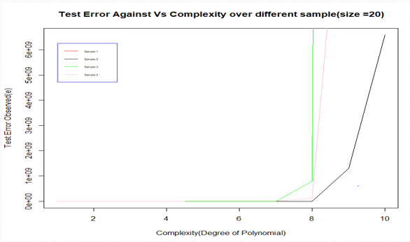
Graph : Test Error with different Order(1,2,7,8,9,10)

Slide 15
Note: 4 Different sample each having same size(100). Perform differently when plotted Test error Vs Complexity.
As observations of dataset considerably small could not run the code(code is attached on github)

Slide 16
RMSE vs Model complexity
Plot: RMSE for Train and Test Vs model Complexity.
Sample size : 20
Order : 1,2,7,8,9,10

Slide 17
REMARK:
The train error increases as the sample size increases. For smaller sample sizes the difference in error is small, but it increases as sample size increases. For the same order linear regression model, the error increases as sample size increases.
The train RMSE increases initially and then decreases flat with small incremental increase, the test RMSE reduces initially then increases as the model complexity increases.
While selecting we must assess our sample size and the use of polynomial regression so that requirement of parsimonious model is fulfilled as well as error is minimum.

Slide 18
Thank You

