Slide 1
Project Name: Uncover Insights from Real Sales Data
Presented by:
Abhishek Bhowmick

Slide 2
Database Description:
Customers: Contains customer information, including cust_id, first_name, last_name, email, phone, primary_pincode, gender, dob, joining_date. •
Products: Contains product information, including product_id, product_name, brand, category, procurement_cost_per_unit, mrp. •
Pincode: Contains pincode-related information, including the pincode, city and state. •
Delivery Person: Contains information about delivery personnel, including delivery_person_id, name, joining_date, pincode •
Orders: Contains order details, including order_id, order_type, cust_id, order_date, delivery_date, tot_units, displayed_selling_price_per_unit, total_amount_paid, product_id, delivery_person_id, payment_type, delivery_pincode

Slide 3
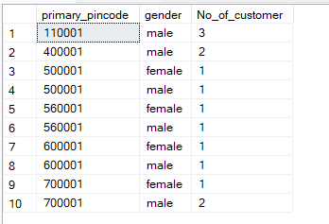
1. How many customers do not have DOB information available?
2. How many customers are there in each pin code and gender combination?
Solution:
select primary_pincode, gender, count(*) No_of_customer
from customers
group by primary_pincode, gender
order by primary_pincode, gender;
Solution
select count(*) DOB_NA
from Customers
where dob is null;
Output:

Slide 4
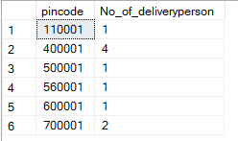
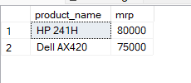
3. Print product name and mrp for products which have more than 50000 MRP?
4. How many delivery personal are there in each pincode?
Solution:
select pincode, count(*) No_of_deliveryperson
from Delivery_person
group by pincode;
Solution
select product_name,mrp
from Products
where mrp > 50000;
Output:
Output:

Slide 5

5. For each Pin code, print the count of orders, sum of total amount paid, average amount paid, maximum amount paid, minimum amount paid for the transactions which were paid by 'cash'. Take only 'buy' order types.
Solution
select count(order_id) Total_order, SUM(total_amount_paid) Total_amount, AVG(total_amount_paid) average_amount, max(total_amount_paid) Max_amount, min(total_amount_paid) Min_amount
from Orders
where order_type = 'buy' and payment_type = 'cash';
Output:

Slide 6
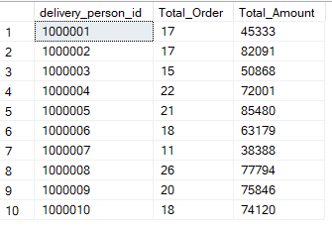
6. For each delivery_person_id, print the count of orders and total amount paid for
product_id = 12350 or 12348 and total units > 8. Sort the output by total amount paid in descending order. Take only 'buy' order types.
Solution
select delivery_person_id, COUNT(order_id) Total_Order,SUM(total_amount_paid) Total_Amount
from orders
where product_id = '12350' or product_id = '12348' and order_type = 'buy' and payment_type = 'cash' and tot_units>8
group by delivery_person_id;
Output:

Slide 7
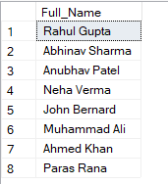
7. Print the Full names (first name plus last name) for customers that have email on "gmail.com"?
Solution
select CONCAT(first_name,' ',last_name) Full_Name
from customers
where email like '%gmail.com';
Output:

Slide 8
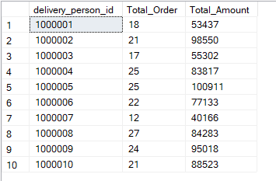
8. Which pincode has average amount paid more than 150,000? Take only 'buy' order types.
Solution
select delivery_person_id, COUNT(order_id) Total_Order,SUM(total_amount_paid) Total_Amount
from orders
where product_id = '12350' or product_id = '12348' and order_type = 'buy' and payment_type = 'cash'
group by delivery_person_id;
Output:

Slide 9
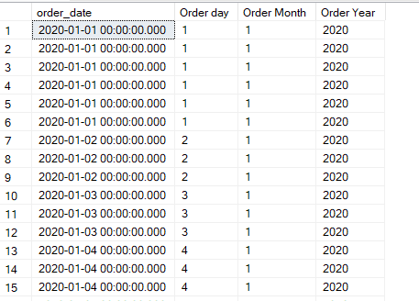
9. Create following columns from order_dim data -
Order_date
Order day
Order month
Order year
Solution
select order_date, day(order_date) [Order day], month(order_date) [Order Month], year(order_date) [Order Year]
from Orders;
Output:

Slide 10
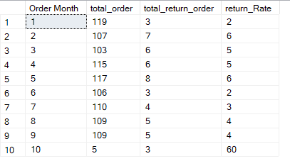
10. How many total orders were there in each month and how many of them were returned? Add a column for return rate too.
Solution
with cte1 as(
select month(order_date) [Order Month], Count(Order_type) total_order
from Orders
where Order_type = 'buy'
group by month(order_date)),
cte2 as(
select month(order_date) [Order Month],
Count(Order_type) total_return_order
from Orders
where Order_type = 'return'
group by month(order_date))
select cte1.[Order Month], cte1.total_order, cte2.total_return_order,
(100* cte2.total_return_order)/cte1.total_order return_Rate
from cte1
join
cte2 on cte1.[Order Month] = cte2.[Order Month]
Output:

Slide 11

11. How many units have been sold by each brand? Also get total returned units for each brand.
Solution
with cte1 as(
select p.brand, Sum(displayed_selling_price_per_unit) Total_unit
from Products p join Orders o
on p.product_id = o.product_id
where order_type = 'buy'
group by p.brand),
cte2 as(
select p.brand, Sum(displayed_selling_price_per_unit) Total_return_unit
from Products p
join Orders o
on p.product_id = o.product_id
where order_type = 'return'
group by p.brand)
select cte1.brand,Total_unit, Total_return_unit
from cte1
join cte2
on cte1.brand = cte2.brand;
Output:

Slide 12
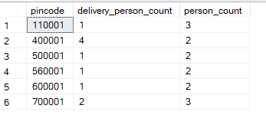
12. How many distinct customers and delivery boys are there in each state?
Solution
with cte1 as(
select pincode, count(d.name) delivery_person_count
from Delivery_person d
group by pincode),
cte2 as(
select primary_pincode, count(first_name) person_count
from Customers
group by primary_pincode)
select pincode, delivery_person_count,person_count
from cte1
join cte2
on cte1.pincode = cte2.primary_pincode
Output:

Slide 13
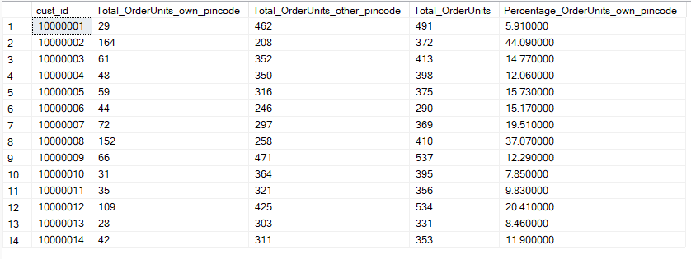
13. For every customer, print how many total units were ordered, how many units were ordered from their primary_pincode and how many were ordered not from the primary_pincode. Also calulate the percentage of total units which were ordered from primary_pincode(remember to multiply the numerator by 100.0). Sort by the percentage column in descending order
Solution
with cte1 as(
select c.cust_id, SUM(tot_units) Total_OrderUnits_own_pincode
from customers c join orders o on c.cust_id = o.cust_id
and c.primary_pincode = o.delivery_pincode group by c.cust_id),
cte2 as(
select c.cust_id, SUM(tot_units) Total_OrderUnits_other_pincode from customers c
join orders o on c.cust_id = o.cust_id and c.primary_pincode <> o.delivery_pincode
group by c.cust_id),
cte3 as(
select cte1.cust_id, Total_OrderUnits_own_pincode,Total_OrderUnits_other_pincode
from cte1 join cte2 on cte1.cust_id = cte2.cust_id),
cte4 as(
select c.cust_id, SUM(tot_units) Total_OrderUnits
from customers c join orders o on c.cust_id = o.cust_id group by c.cust_id )
select cte3.cust_id, Total_OrderUnits_own_pincode,Total_OrderUnits_other_pincode,Total_OrderUnits,
round((Total_OrderUnits_own_pincode/Total_OrderUnits)*100,2) Percentage_OrderUnits_own_pincode
from cte3 join cte4 on cte3.cust_id = cte4.cust_id
order by cte3.cust_id
Output:

Slide 14
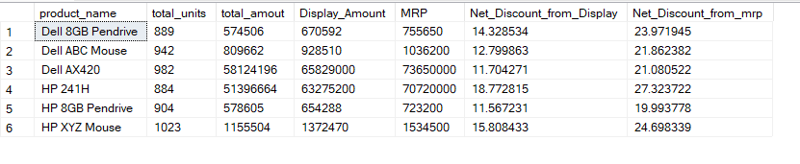
14. For each product name, print the sum of number of units, total amount paid, total
displayed selling price, total mrp of these units, and finally the net discount from selling
price.
Solution
with cte1 as(
select p.product_name, Sum(tot_units) total_units, sum(total_amount_paid) total_amout, sum(tot_units*displayed_selling_price_per_unit) Display_Amount,
sum(tot_units*mrp) MRP
from orders o
join Products p
on o.product_id = p.product_id
group by p.product_name)
select *, (100-100*total_amout/Display_Amount) Net_Discount_from_Display, (100-100*total_amout/MRP) Net_Discount_from_mrp
from cte1;
Output:

Slide 15
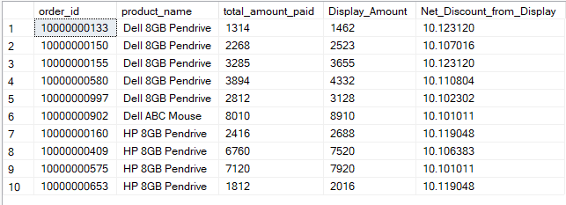
15. For every order_id (exclude returns), get the product name and calculate the discount
percentage from selling price. Sort by highest discount and print only those rows where
discount percentage was above 10.10%.
Solution
with cte1 as(
select o.order_id, p.product_name, Sum(total_amount_paid) total_amount_paid,
sum(tot_units*displayed_selling_price_per_unit) Display_Amount
from orders o
join products p
on o.product_id = p.product_id
where order_type = 'buy'
group by o.order_id, p.product_name)
select *,(100-100*total_amount_paid/Display_Amount) Net_Discount_from_Display
from cte1
where (100-100*total_amount_paid/Display_Amount)>10.10;
Output:

Slide 16
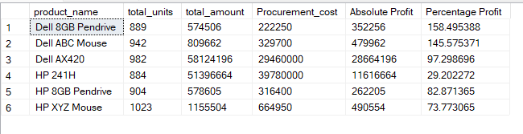
16. Using the per unit procurement cost in product_dim, find which product category has
made the most profit in both absolute amount and percentage Absolute Profit = Total Amt Sold - Total Procurement Cost Percentage Profit = 100.0 * Total Amt Sold / Total Procurement Cost - 100.0
Solution
with cte1 as(
select p.product_name, Sum(tot_units) total_units, sum(total_amount_paid) total_amount, sum(tot_units*procurement_cost_per_unit) Procurement_cost
from orders o
join Products p
on o.product_id = p.product_id
group by p.product_name)
select *, (total_amount - Procurement_cost) [Absolute Profit], (100*total_amount/Procurement_cost - 100) [Percentage Profit]
from cte1;
Output:

Slide 17
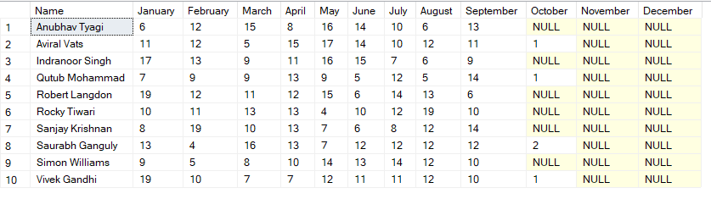
17. For every delivery person(use their name), print the total number of order ids (exclude
returns) by month in separate columns i.e. there should be one row for each delivery_person_id and 12 columns for every month in the year.
Solution
with cte1 as(
select name, month(order_date) Month, count(order_id) Total_Order
from orders o join Delivery_person d
on o.delivery_person_id = d.delivery_person_id where order_type = 'buy'
group by name,month(order_date))
select name as Name, sum(case when month = '1' then Total_Order end) as 'January',
sum(case when month = '2' then Total_Order end) as 'February',
sum(case when month = '3' then Total_Order end) as 'March',
sum(case when month = '4' then Total_Order end) as 'April',
sum(case when month = '5' then Total_Order end) as 'May',
sum(case when month = '6' then Total_Order end) as 'June',
sum(case when month = '7' then Total_Order end) as 'July',
sum(case when month = '8' then Total_Order end) as 'August',
sum(case when month = '9' then Total_Order end) as 'September',
sum(case when month = '10' then Total_Order end) as 'October',
sum(case when month = '11' then Total_Order end) as 'November',
sum(case when month = '12' then Total_Order end) as 'December'
from cte1
group by name;
Output:

Slide 18
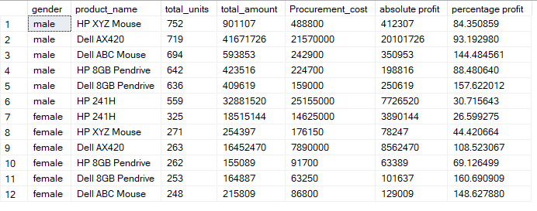
18. For each gender - male and female - find the absolute and percentage profit (like in Q16) by product name
Solution
with cte1 as(
select c.gender,p.product_name, Sum(tot_units) total_units, sum(total_amount_paid) total_amount, sum(tot_units*procurement_cost_per_unit) Procurement_cost
from orders o
join Customers c
on o.cust_id = c.cust_id
join Products p
on o.product_id = p.product_id
group by c.gender,p.product_name)
select *, (total_amount - Procurement_cost) [absolute profit], (100*total_amount/Procurement_cost - 100) [percentage profit]
from cte1
order by total_units desc;
Output:

Slide 19


