Slide 1
Watson Studio and its capabilities
Raghavendra Deshpande
Developer Advocate/ragdeshp@in.ibm.com

Slide 2
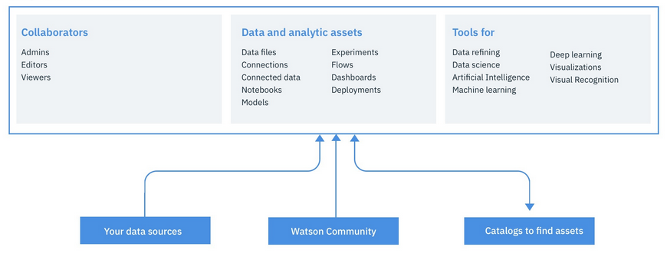
Watson Studio overview
Notes:
Watson Studio provides you with the environment and tools to solve your business problems by collaboratively working with data. You can choose the tools you need to analyze and visualize data, to cleanse and shape data, to ingest streaming data, or to create, train, and deploy machine learning models.
These are the most important resources in a project:
Collaborators are the team who works with the data. Three roles provide different permissions.
Data assets point to your data. Here's what you can do to prepare your data:
Access data from connections to your cloud or on-premises data sources
Access data from your organization's catalogs
Upload files to the project's object storage
Ingest and analyze streaming data with the Streams Designer tool
Cleanse and shape data with the Data Refinery tool
Analytical assets and tools are how you derive insights from data. You customize your project with the tools you need. Here's what you can do to analyze your data:
Analyze data with Jupyter notebooks or RStudio.
Build, train, test, and deploy machine learning and deep learning models.
Run deep learning model experiments in parallel with neural networks.
Classify images by training deep learning models to recognize image content.
Create and share dashboards of data visualizations without coding.

Slide 3
Security Encryption: All files uploaded are stored in IBM Cloud Object Storage buckets and are encrypted on disk. All network communication is encrypted with TLS/SSL. Connections to on-remises data sources require secure gateway Resiliency: Metadata stored in three-node dedicated Cloudant Enterprise cluster spanning multiple geographic locations The files associated with projects and catalogs are protected by the level of resiliency specified by the IBM Cloud Object Storage plan
Notes:
All the files that you upload or save into a project or catalog are stored in dedicated IBM Cloud Object Storage buckets and are encrypted on disk. See About IBM Cloud Object Storage. All network communication is encrypted with TLS/SSL. Connections to on-premises data sources require a secure gateway

Slide 4
Keep your data secure and compliant Client data security is paramount. The following information outlines some of the ways that client data is protected when using IBM Watson apps, IBM Watson Studio, and their component services, such as IBM Watson Machine Learning, and what you are expected to do to help in these efforts. Client responsibility IBM's commitment to GDPR Content and Data Protection GDPR statement that applies to IBM Watson Machine Learning log files Secure deletion from the IBM Watson Machine Learning service

Slide 5
Organize resources in a project If you have the Watson Studio app, your project resources can include: 1. Data asset files, connections, and connected data 2. Analytic assets that describe how to work with data 3. Runtime environments 4. Deployments of models 5. Collaborators 6. Bookmarks to community resources 7. A readme file to document the project 8. Other project-wide settings: Tools Access tokens A link to a GitHub repository for publishing notebooks Associated services, such as Watson Machine Learning

Slide 6
Types of assets which can be added: 1.Data assets from local files, catalogs, or the Community 2.Connections to cloud, on-premises, and streaming data sources 3.Connected data from an existing connection asset 4.Jupyter Notebooks to analyze data 5.Modeler flows to automate the flow of data through a model 6.Streams flows to ingest streaming data 7.Models to analyze data 8.Experiments to train deep learning models 9.Visual Recognition models to categorize images 10.Dashboards to visualize data without code 11.Data flows to refine data

Slide 7
Data science If you want to analyze data by writing code, create notebooks or use RStudio. If you want to visualize your data without coding, create analytic dashboards
Notes:
Jupyter notebooks
Jupyter notebooks give you a lot of flexibility in coding, visualizing, and computing. With notebooks, you run small pieces of code that process your data, and you can immediately view the results of your computation. When you create notebooks in Watson Studio, you can:
Use any of the many pre-installed libraries and packages, including:
Spark libraries
Visualization libraries
SPSS predictive analytics algorithms
Decision Optimization APIs
Install any other libraries you need.
Choose the runtime environments that best suit your needs or create customized environments.
Code in Python, R, or Scala.
Schedule notebooks to run automatically.
Share or publish your notebooks.
RStudio is an IDE for analyzing data with the R statistical analysis and machine-learning package within Watson Studio.
Analytic dashboards
With analytic dashboards, you can build sophisticated visualizations of your analytics results without writing code. You create analytic dashboards by combining these types of elements on a canvas:
Data assets in the project.
Graphs to format the display of your data.
Widgets such as text, media, web pages, images, and shapes.

Slide 8
Machine learning & AI in Watson Studio IBM Watson Studio is a collaborative environment with AI tools that you and your team can use to collect and prepare training data, and to design, train, and deploy machine learning models. You can think of Watson Studio AI tools in three categories: Machine learning Deep learning Visual recognition
Notes:
Machine learning
Tools for designing, training, and managing models:
Model builder guides you, step by step, through building a model that uses Spark ML algorithms.
Flow editor presents a graphical view of your model while you build it by combining nodes representing objects or actions (including SPSS Modeler nodes, Spark ML algorithm nodes, and neural network nodes.)
Notebooks provide a collaborative environment for working with data, and rapid prototyping and testing of models.
Machine learning command line interface lets you build and work with models in your local environment.
Deep learning
Tools for running experiments to train complex neural networks with larger data sets:
Experiment Builder automates running hundreds of batch training runs while tracking and storing results.
Hyperparameter optimization automates evaluating training performance across a range of hyperparameters to identify the best model within a predetermined compute period.
Distributed deep learning speeds up training with the largest data sets by distributing the training runs across multiple servers and using multiple GPUs.
Visual recognition
Tools focussed specifically on visual recognition:
Built-in models list keywords describing a given image, or analyze faces in images for age range and gender.
Custom model builder makes it quick and easy to train a model to classify images according to classes you define.
Core ML support for using your visual recognition custom models in iOS apps.

Slide 9
Explore the code pattern https://developer.ibm.com/code/patterns/analyze-san-francisco-traffic-data-with-ibm-pixiedust-and-data-science-experience/

