Slide 1
Agentic RAG Chatbot for Multi-Format Document QA using Model Context Protocol (MCP)
SUBMITTED BY:
ABHITESH MADHARAM | abhitesh1369@gmail.com | +91 8019711288 |
GitHub: https://github.com/Abhitesh-1369/Agentic-RAG-System |
LinkedIn: https://www.linkedin.com/in/abhitesh-madharam/

Slide 2
Agent Based Architecture with MCP Integration
This system uses a modular, multi-agent architecture where each component has a specific, dedicated role.
Ingestion Agent: Parses documents, creates text chunks, and generates embeddings.
Retrieval Agent: Manages the vector store and finds relevant context for a user's query.
LLM Response Agent: Uses the retrieved context to generate a final, accurate answer with the Cohere model.
Communication is managed by a central Dispatcher using a structured Model Context Protocol (MCP), ensuring a clear and traceable workflow.
The flow begins with document ingestion and indexing, followed by a query, retrieval, and generation cycle to produce the final answer.

Slide 3
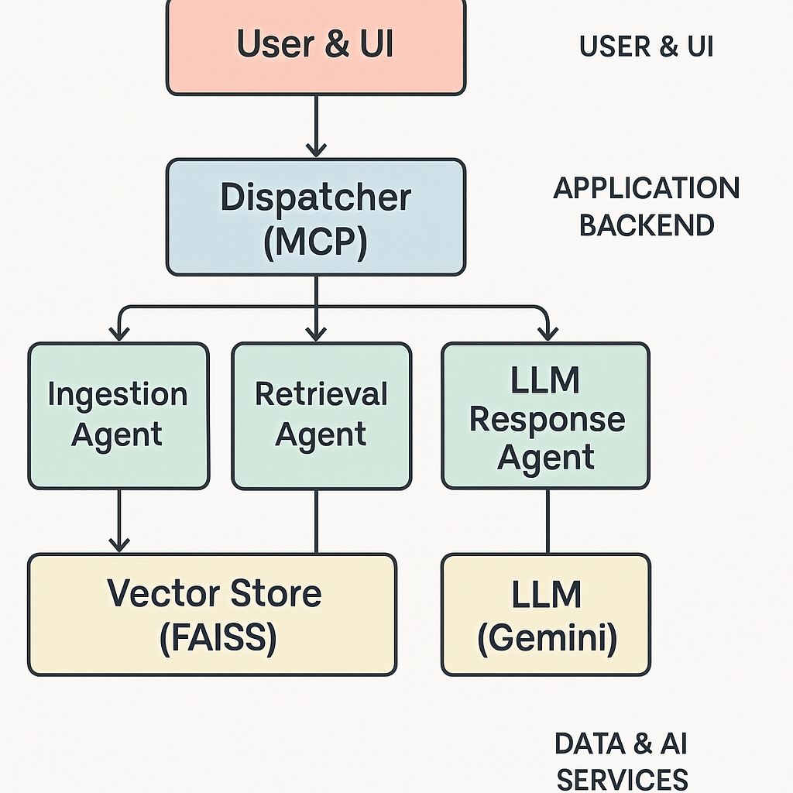
System Flow Diagram

Slide 4
Tech Stack Used
Backend: Python
UI Framework: ipywidgets
LLM: gemini-2.5-flash-lite
Vector Embeddings: all-MiniLM-L6-v2
Vector Store: Facebook AI Similarity Search (FAISS)
Document Parsers: PyMuPDF (for PDF), python-docx, python-pptx, Pandas

Slide 5
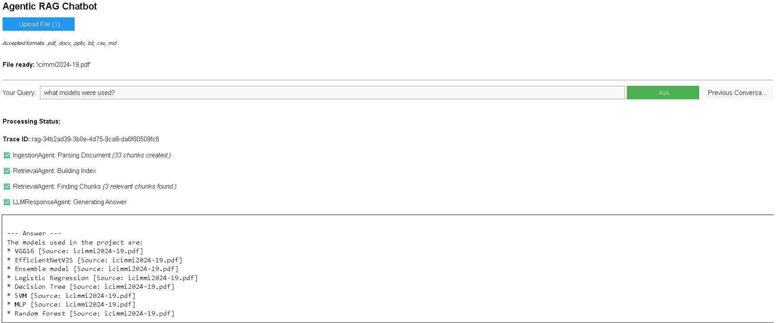
UI Screenshot

Slide 6
Challenges Faced
Prompt Engineering: Crafting precise prompts to ensure the LLM answered only from the provided document context, preventing it from using outside knowledge.
UI State Management: Building a responsive chat interface required careful management of the application's state (like file processing status and chat history) to provide clear user feedback.
Future Scope / Improvements
Persistent Vector Store: Integrate a database like ChromaDB to save document indexes, so files don't need to be re-processed each session.
Advanced Retrieval: Add a re-ranking model to further refine search results before sending them to the LLM, improving accuracy on complex documents.

