Slide 1
Designing an Event-Driven Architecture on Azure
https://aka.ms/event-driven-workshop

Slide 2

About Me
{
“name”: “David Barkol”,
“title”: “Azure Architect at Microsoft – Global Black Belt (GBB) Cloud Native team”,
“location”: “Southern California”,
“twitter”: “@dbarkol”,
“email”: “dabarkol@microsoft.com”,
“github”: “https://github.com/dbarkol,
“blog”: “https://madeofstrings.com”
}

Slide 3

Customer situation
Contoso provides an eCommerce web site for their customers. It averages about 10 million clicks a day
They have a ‘recently viewed’ feature on the site that is critical to their business and revenue
The ‘recently viewed’ functionality takes a long time to process and has many issues
Notes:
Our good old friends at Contoso are at it again…
Issues:
Built on cookies
Challenges with private browsing
Processed in daily in batches

Slide 4

Customer situation
Most of their systems rely on batch processing
They are concerned about the amount of time it takes to react to changes and apply updates to their business
Contoso is confident that most of their processing can be done in near-real time
Notes:
Batch processing is necessary for some of their systems but most of them don’t need it. They want to move away from batch processing if they can and only leverage it when it makes sense.

Slide 5
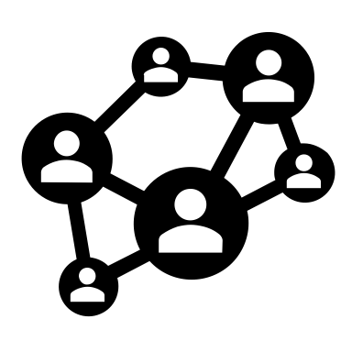
Customer situation
Today, a point-to-point architecture is heavily used throughout Contoso
Directors want to explore the notion of an event-driven architecture and see if there are long-term performance and costs benefits
They would like to add new features to the website (recommendations, trends, etc.)

Slide 6

Customer needs
Unified integration pipeline
Near-real time processing
Product changes (example: change data capture)
Analytics (anomaly detection, trends, etc.)
Provide support for batch processing where necessary
Notes:
Unified data platform
Move away from the point-to-point architecture
Provide a service/solution that can be used by any department or service within the company
Near-real time processing

Slide 7
Customer needs
Scalable solution that can handle unexpected demand
Strong preference towards managed services and serverless technologies
Support different types of producers and consumers.
Embrace OSS tools and ecosystem

Slide 8

Use case – Analytics
Contoso would like to support near-real time analytics so that they could:
Identify trends
Catch anomalies
Enhance recommendations

Slide 9

Use case – Real time updates
Products updates
Currently stored in Cosmos DB
Would like to reflect changes immediately on website
Customer and product feedback
Share updates from 3rd party sources

Slide 10

Use case – Partner notifications
Notify partners of product changes through some form of publish and subscribe (pub/sub) mechanism.
Partners can provide an endpoint (example: WebHook) to receive relevant updates.

Slide 11

Customer objections
Can we have a consistent format for all the events and messages?
What about business continuity (disaster recovery)?
Can we replicate the data to another region?

Slide 12
Customer objections
We need a way to continue to support our batch jobs within this new architecture.
Ideally, we’d like to incorporate it into an event-driven architecture.
Is this possible?

Slide 13
Design the solution
Outcome
Design a solution and prepare to present it to the target customer audience in a 15-minute chalk-talk format.
Business needs (15 minutes) | Respond to questions outlined in your guide and list the answers on a flipchart.
Design (35 minutes) | Design a solution for as many of the stated requirements as time allows. Show the solution on a flipchart.
Prepare (15 minutes) | Identify any customer needs that are not addressed with the proposed solution. Identify the benefits of your solution. Determine how you will respond to the customer’s objections. Prepare for a 15-minute presentation to the customer.
https://aka.ms/event-driven-workshop

Slide 14

Before: Point-to-point pipelines
Accounting
Search
Feedback
Logs
Monitoring
Customers
Social
Security

Slide 15
After: Reversal of dependencies
Accounting
Search
Feedback
Unified pipeline
Logs
Monitoring
Customers
Social
Security

Slide 16





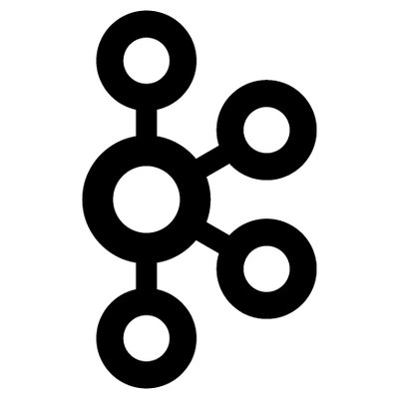





Preferred solution
Producers
Stream processors
Databases
Applications
Devices
Legacy applications
Event Hubs (Kafka enabled)
Applications
Logic Apps
Functions
Consumers
Notes:
Databases
---------------
Kafka Connect for some databases
Cosmos -> Functions -> Event Hubs

Slide 17



Preferred solution: Batch processing
Event Hubs Capture
Container instance
1
2
3
Event Hubs
Storage
Event Grid
Azure Function
(1) Event Hubs capture
(2) Storage event
(3) Event handlers

Slide 18
Preferred solution: Partner notifications
Azure Event Grid
Customer A
Customer B
Contoso
Event Grid
Customer C
Contoso will publish events to an Event Grid topic.
Customers can subscribe to events and apply filters that are relevant to them. This could include event types, product categories and so on.

Slide 19
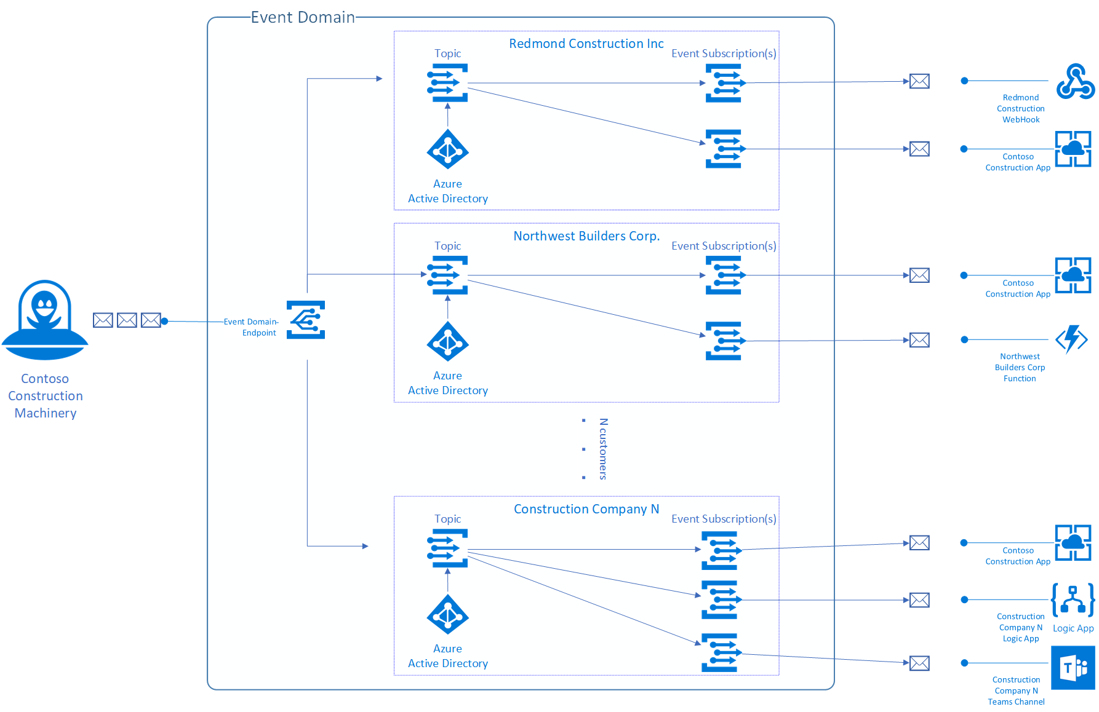
Preferred solution: Partner notifications
Azure Event Grid Domains

Slide 20
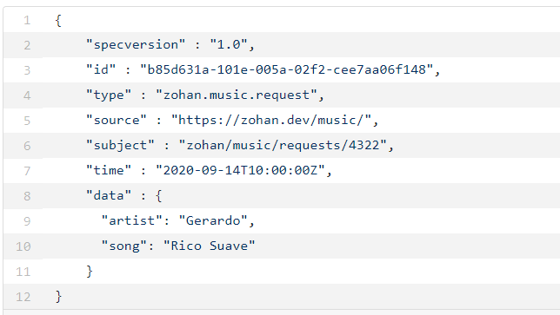

Customer objections: Data format
Can we have a consistent format for all the events and messages?

Slide 21

Customer objections: Disaster recovery
What about business continuity (disaster recovery)?
Event Hubs GeoDR will provide Contoso with a secondary/failover region.

Slide 22
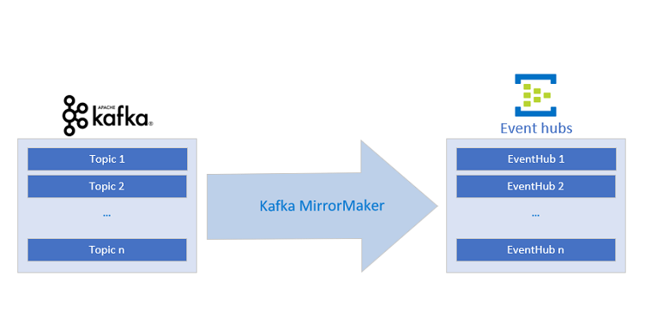
Customer objections: Data replication
Can we replicate the data to another region?
Apache Mirror Maker will handle the replication

Slide 23
Thank you!
https://aka.ms/event-driven-workshop

Slide 24

Connectors
Notes:
OSS integration:
Kafka Connect for Debezium (CDC)
Flink
Apache Spark
Mirror Maker

Slide 25


