Slide 1
EMOTIONS ANALYSER
A facial emotion detection concept/website using React JS & the face-api.js.
It consists of a photo capture mode with a gallery, and a real-time face-detection mode .

Slide 2
TECH STACK USED: (1) Frontend -> ReactJS (2) Tensorflow used for ML part. (3) API used -> Face-API (4) Written in Javascript
.

Slide 3
In This Project I have used real time face detection through a webcam using AI. This AI is so quick that I was able to display in real time the various faces and expressions of every person in the video without much performance overhead. I have used the face api js library built on TensorFlow to setup the face detection here.

Slide 4
It works as follows: When I open my live server of my face-app ,live preview of my laptop’s webcam opens up in my local host browser. Now I have used various models from my face-api, some of them are: (1)tinyfacedetector - which is just like normal face detector but it is going to be smaller and quicker so it will run in real time in the browser as opposed to being very slow. (2)facelandmark68net - it is used to register different parts of my face my mouth,my eyes, my nose etc. (3)facerecognitionnet - it is going to allow the api to recognize where my face is in the box around it (4)faceexpressionnet - it is going to allow us to recognize when we are smiling,frowning,happy and sad. Loading these models does takes a little bit of time but is fairly quick.

Slide 5
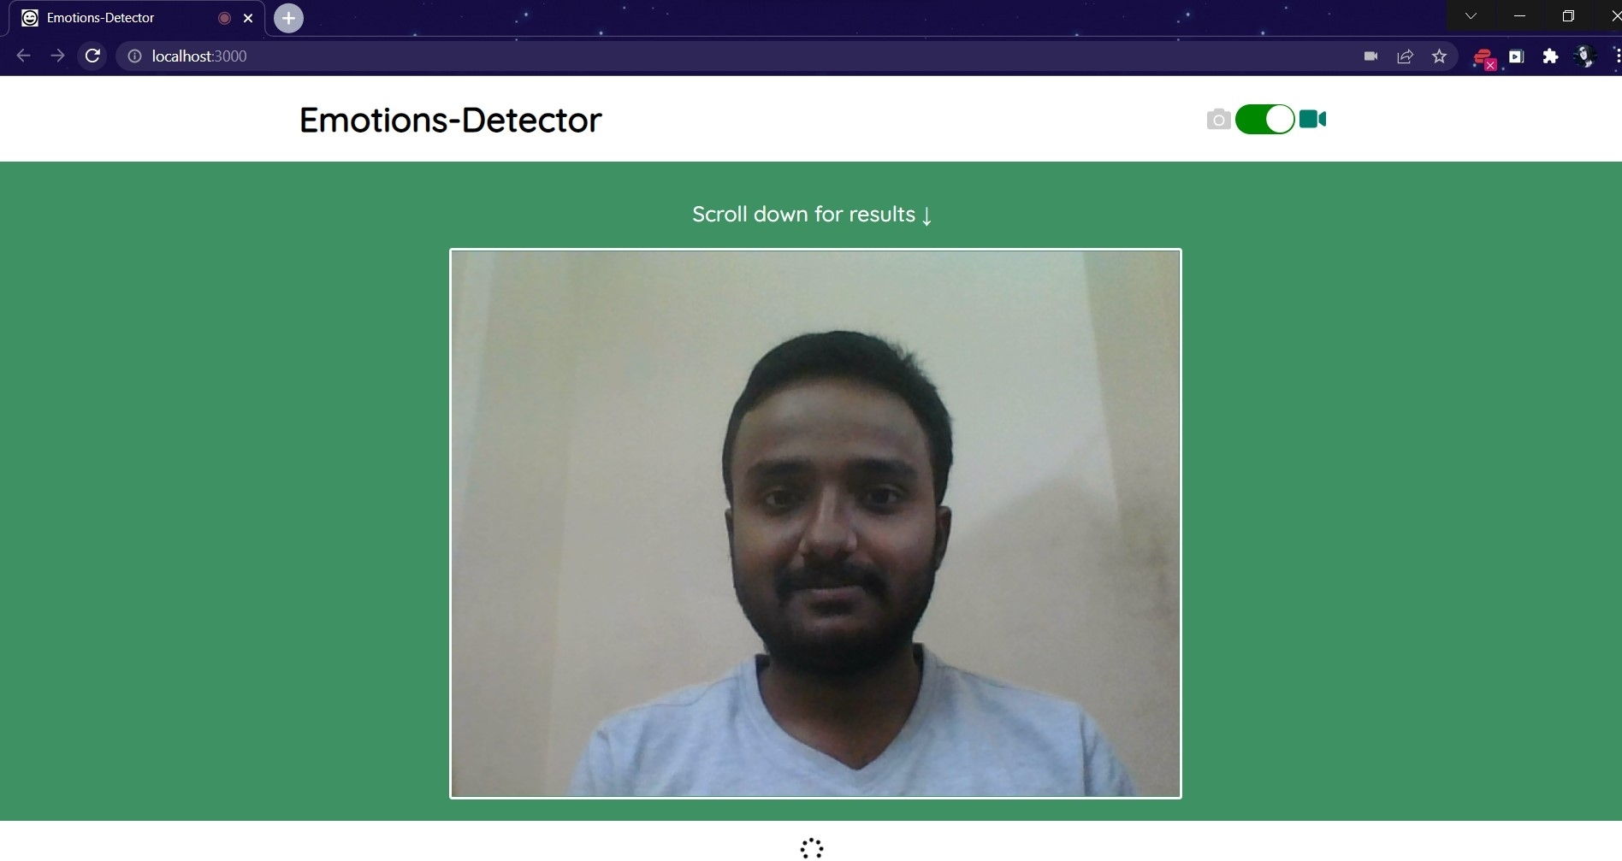
.
Phase 1: Webcam opens up

Slide 6
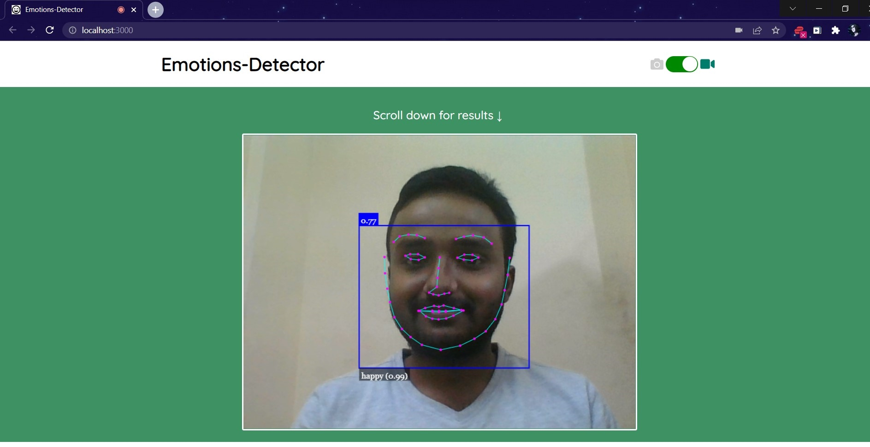
.
Phase 2 : A rectangular canvas gets displayed which encloses my face and it also displays probability factor(0.99) of my current facial reaction/emotion which is happy here.

Slide 7
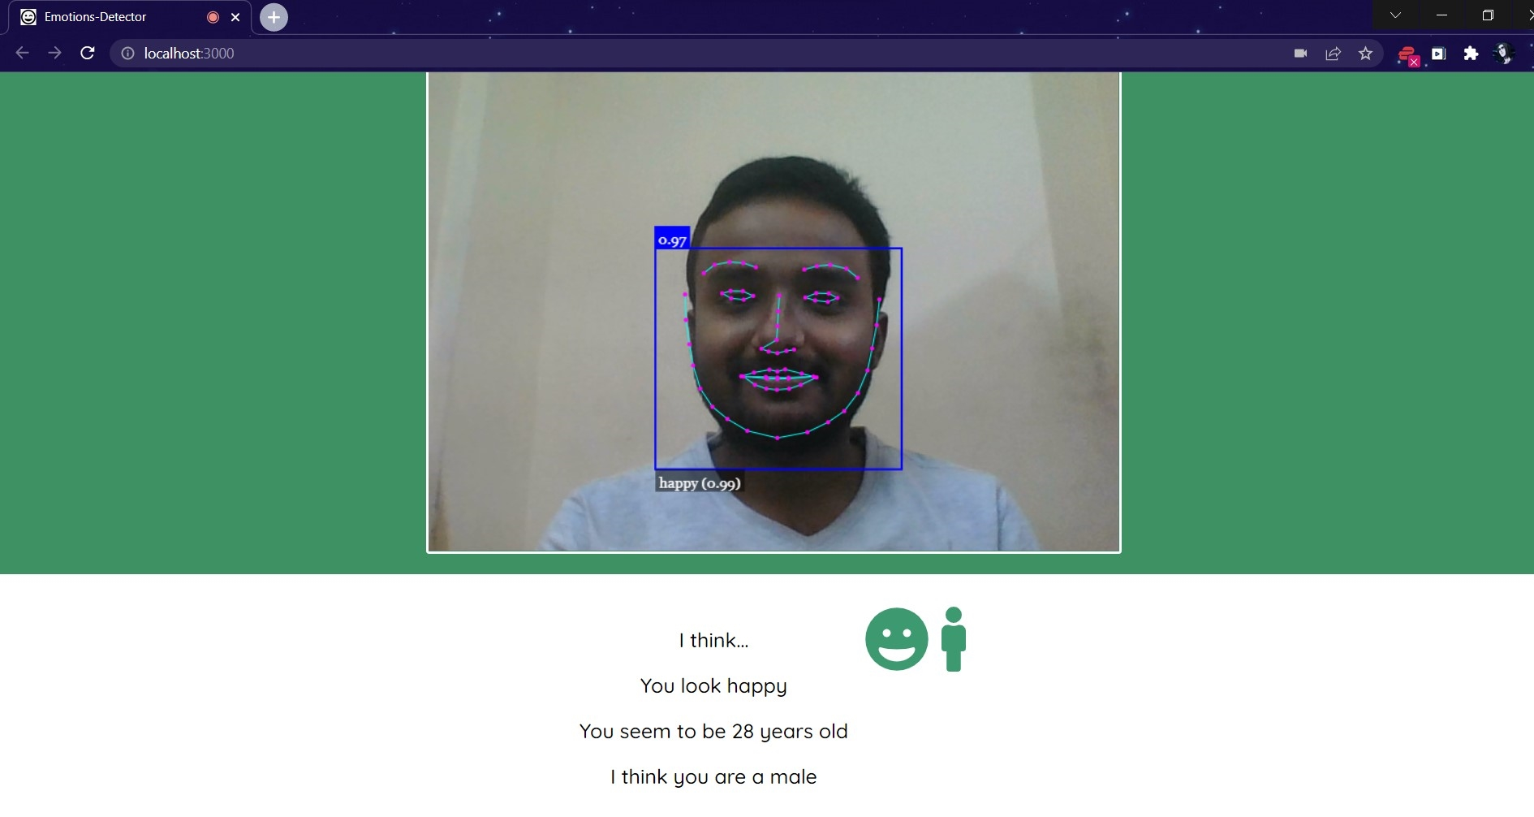
.
Phase 3 : Finally with the help of Face-API.JS , my emotion analyser / detector detects my current facial emotion of being happy(which is also being shown as a smiling emoji character) , as well as it also predicts my age(approximate) and gender as male(correctly).

Slide 8
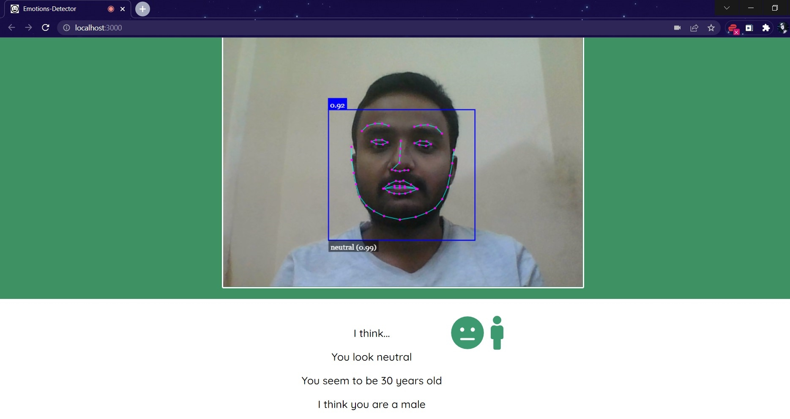
.
Phase 4 : In another situation ,when I show a neutral/emotionless kind of face ,my emotion analyser / detector detects it as being neutral(which is also being shown as a neutral emoji character) .Again here my age shown here is approximate(not correct but close to my real age of 22 years).

