Slide 1


M.Tech/MCA Program
Advanced Industry Integrated Programs
Jointly offered by University and LTIMindTree
Review III
NEXUS — Supply Chain Disruption Intelligence Platform
Abhiti Rachel Kannapogu
Knowledge partner | Implementation partner

Slide 2
NEXUS — Supply Chain Disruption Intelligence Platform
Introduction
Problem
Supply chains are interconnected dependency networks.
Disruptions at ports, suppliers or factories can propagate downstream.
Assessing disruption impact requires information from multiple data sources.
NEXUS
Agentic AI platform for end-to-end supply chain disruption assessment.
Integrates Graph, RAG, SQL, Simulation and Recommendation agents.
Converts natural-language queries into explainable disruption assessments.
Impact → Severity → Urgency → Financial Risk → Action

Slide 3
NEXUS — Supply Chain Disruption Intelligence Platform
Objective
Trace downstream supply-chain dependencies.
Retrieve relevant operational evidence.
Query structured data using natural language.
Simulate hypothetical disruptions.
Estimate financial value at risk.
Evaluate inventory-based operational urgency.
Generate explainable recommendations.
Key Principle: Severity ≠ Urgency

Slide 4
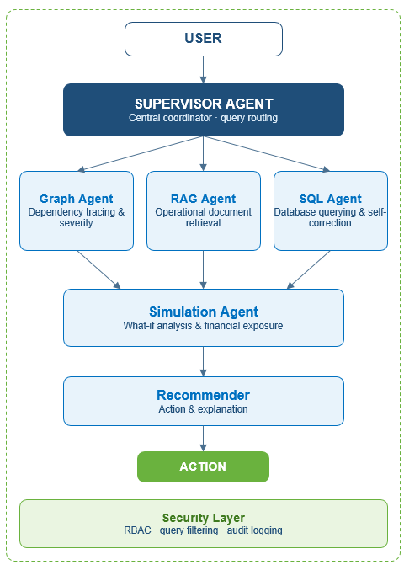
NEXUS — Supply Chain Disruption Intelligence Platform
Agentic AI Modules
Supervisor Agent:Routes each query to the relevant specialist agent(s).
Graph Agent: Traces supply-chain dependencies and assesses severity.
RAG Agent: Retrieves relevant contracts, disruption notices and reports.
SQL Agent: Generates read-only SQL and self-corrects failed queries.
Simulation Agent: Checks inventory buffers and estimates financial exposure.
Recommender: Converts the analysis into an explainable action.
Security: RBAC • Query Filtering • Tamper-Evident Audit Log

Slide 5
NEXUS — Supply Chain Disruption Intelligence Platform
Problem Statement
Modern supply chains are increasingly vulnerable to disruptions caused by port congestion, supplier failures, transportation delays, and inventory shortages. These disruptions can affect production, delay shipments, and increase operational costs.
Traditional monitoring approaches often lack an integrated way to connect supply chain dependencies, retrieve supporting evidence, quantify financial risk, and evaluate alternative mitigation strategies.
NEXUS addresses this challenge by developing an AI-driven, multi-agent platform that analyzes supply chain disruptions, identifies affected entities, estimates potential losses, and recommends actionable mitigation strategies through graph analysis, RAG, SQL analytics, and what-if simulation.

Slide 6
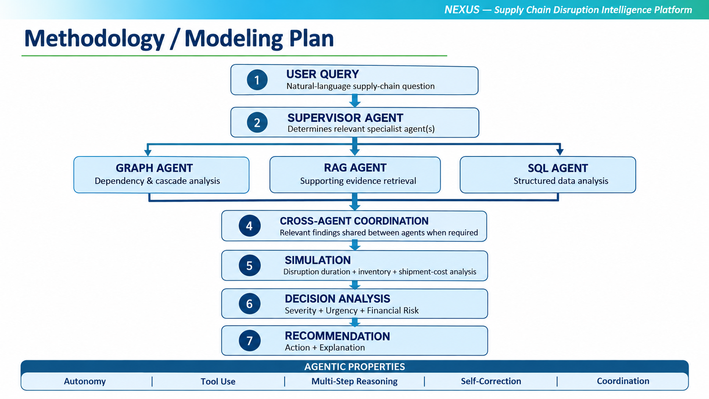
NEXUS — Supply Chain Disruption Intelligence Platform
Methodology/Modeling Plan

Slide 7
NEXUS — Supply Chain Disruption Intelligence Platform
Approach/Algorithms/Tools
Agentic Approach
  Multi-agent orchestration
  Tool calling
  ReAct / self-correction
  Cross-agent coordination
Algorithms
  Knowledge Graph Traversal
  TF-IDF + Cosine Similarity
  Natural Language → SQL
  Inventory Buffer Analysis
  Financial Risk Estimation
Technology
  Python | FastAPI | Streamlit | SQLite | JSON
Security
RBAC | Query Filtering | Hash-Chained Audit Log

Slide 8
NEXUS — Supply Chain Disruption Intelligence Platform
Findings and Results
Graph Analysis: Achieved 100% accuracy across 8 disruption scenarios, identifying affected supply chain entities.
RAG Performance: Achieved 100% Precision@1 (5/5) with document-type hints.
Agent Orchestration: Standard supervisor routing achieved 100% accuracy (11/11).
SQL Safety: Successfully blocked all 10 malicious SQL test cases and passed 3/3 offline self-correction tests.
Risk Simulation: Evaluated disruption scenarios, estimated financial exposure, assessed inventory buffers, and generated mitigation recommendations.
Security and Audit: Passed all 12 RBAC permission tests and 4 audit-log integrity tests.
System Validation: All 78 automated tests passed, and the platform was deployed on Google Cloud Run.
Demonstration Result: An 86-day Keelung port disruption was classified as HIGH severity, with approximately $1.79 million in estimated value at risk and three factories exhausting their inventory buffers.
Areas for Improvement: Paraphrased query routing, live SQL numeric accuracy, and paraphrased prompt-injection detection require further enhancement.

Slide 9
NEXUS — Supply Chain Disruption Intelligence Platform
Conclusion
NEXUS demonstrates an integrated approach to supply chain disruption intelligence by combining graph analysis, retrieval-augmented generation (RAG), SQL analytics, and what-if simulation.
The platform transforms disruption-related queries into impact assessments, evidence retrieval, financial-risk estimates, and actionable mitigation recommendations.
Role-based access control, SQL safeguards, and hash-chain audit logging provide security and traceability mechanisms.
Cloud deployment and automated testing demonstrate the feasibility of running the platform as an accessible application.
Benchmark results demonstrate strong performance in several core functions while highlighting opportunities to improve paraphrased query handling, live SQL accuracy, and prompt-injection detection.
Future Scope
Improve semantic query understanding and robustness against paraphrased prompts.
Enhance live SQL generation and numeric accuracy.
Strengthen prompt-injection detection and expand evaluation datasets.
Integrate real-time supply chain data and more advanced graph-based analytics.

Slide 10
NEXUS — Supply Chain Disruption Intelligence Platform
Acknowledgement
Calibri body 28

Slide 11
NEXUS — Supply Chain Disruption Intelligence Platform
Reference
Lewis, P. et al. (2020). Retrieval-Augmented Generation for Knowledge-Intensive NLP Tasks. Advances in Neural Information Processing Systems (NeurIPS).
Yao, S. et al. (2023). ReAct: Synergizing Reasoning and Acting in Language Models. International Conference on Learning Representations (ICLR).
LangChain. LangGraph Documentation. https://docs.langchain.com/oss/python/langgraph/overview
FastAPI. FastAPI Documentation. https://fastapi.tiangolo.com/
Streamlit. Streamlit Documentation. https://docs.streamlit.io/
Google Cloud. Cloud Run Documentation. https://cloud.google.com/run/docs
scikit-learn. User Guide. https://scikit-learn.org/stable/user_guide.html
PyJWT. PyJWT Documentation. https://pyjwt.readthedocs.io/

