Slide 1
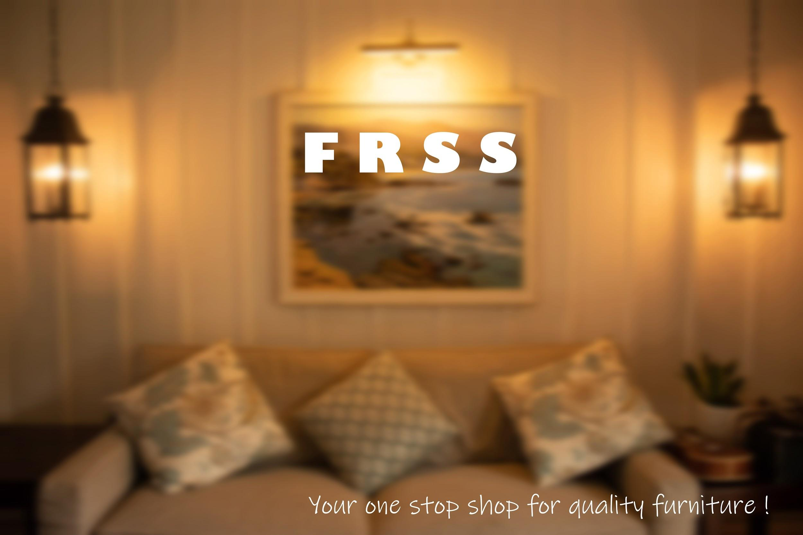
Kunal Singh - 19CS30025
Abhinandan De - 19CS10069
Suryam Arnav Kalra - 19CS30050

Slide 2
The problem statement
And Why did we choose this topic ??

Slide 3
An overview
A platform where people can search, rent and loan furniture
The two actors in the system are:
The admin :
Creates accounts and maintain inventory
The Customer :
Loans/rents furniture
Storage of details for furniture:
Type,
Relevant images
Rental price
Cost price
Interest rate
Reviews
Useful for people who are looking to refurbish their house after relocation
and this was our motivation!

Slide 4
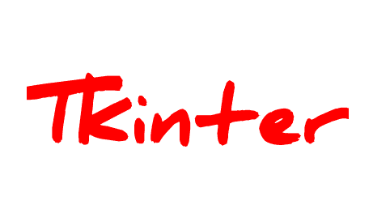

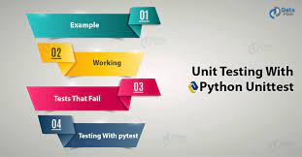
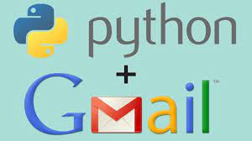


Tools used

Slide 5
Features and Functionalities

Slide 6
Addition/ removal of furniture
Maintaining inventory
Sign Up/ Login
Admin
Verifying returns
Miscellaneous
Maintaining user database

Slide 7
Searching &
Checking price
Sign Up/ Login
Rents / Loans
Customer
Miscellaneous
Payments
Return products

Slide 8
MySQL syntax
Abstract Base Classes
Database Management
Images in text-boxes
MySQL connector
Display of graph
Implementation Challenges
E-Mail verification with smtplib
Functions inside function
SQL queries from python

Slide 9
Use of Efficient testing functions.
unittest module of python
Avoiding precision error
Backend Testing
Testing Challenges
Database Management
MySQL
connector
SQL queries from python

Slide 10
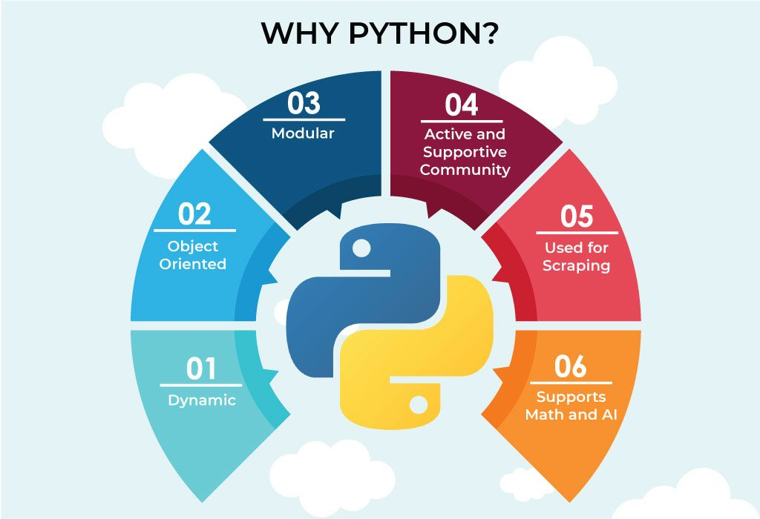
Motivation to Choose Python
Simplified Syntax and similarity with natural language.
Excellent libraries which reduce time and effort of development.
Ultimate tool to play with graphs and data science.
Great integration of MySQL as a database management tool.
Easy to use GUI with Tkinter.
Vast support of error detection with the VSCode editor.

Slide 11
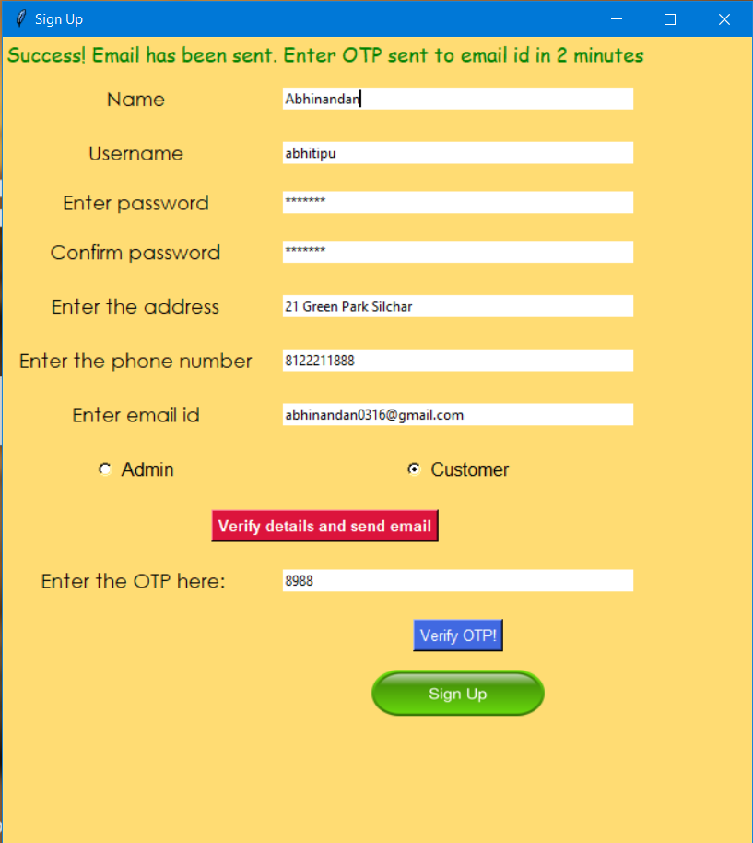
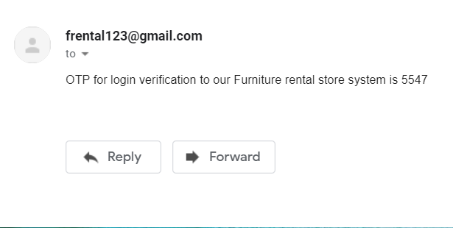
e-mail verification
ft. smtplib

Slide 12


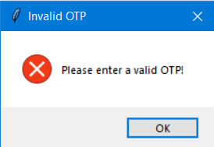
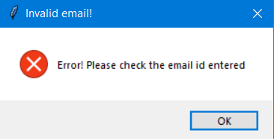
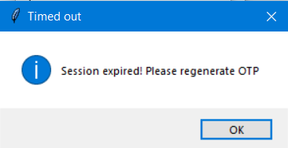
Use of the smtplib library to verify e-mail
Using random library to generate random OTPs.
ERRORS!!
Email id validation
Final validation
2 min limit

Slide 13


Price Calculation while Buying Furniture
Interest Rate based on past order history
Price Calculation while buying on loan
Price Calculation while buying on rent

Slide 14
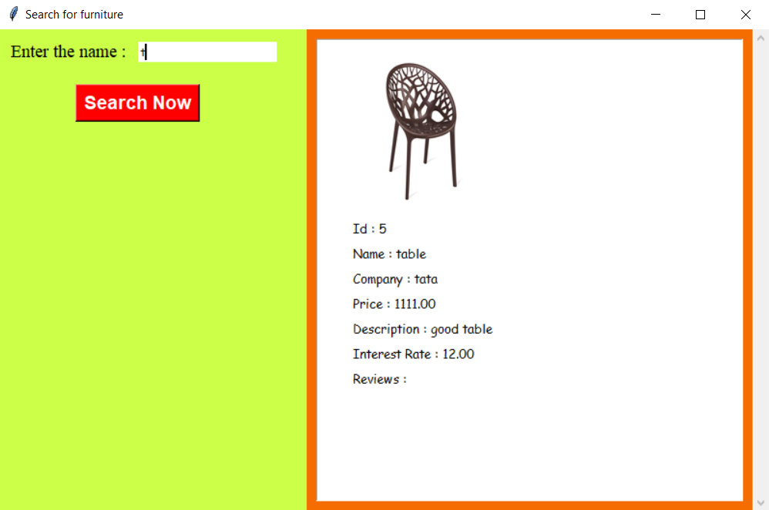
Furniture id , image , description
Substring Search
Non-rented items
Searching Furniture
Distinct items
Past reviews , price
Search based on name

Slide 15
Extension of Desktop GUI to a website
ML model to tell admin what prices to change for better profit
ML model to tell the admin which furnitures to add / delete
Multiple Images and video description for furnitures
Feature to check currently rented item
Post Work Improvements
Option For admin to check losses
Customer can return item with full cash back within 1 month

Slide 16
unittest module of python
01
Verification of each functionality
Validation by the QA team
UnitTest Module
02
First level of software testing
Unit testing each class
Integration testing
Validation and Verification
03
Test Fixture
Test Case
Test Suite
Test Runner
OOP Concepts supported by framework
04
OK
FAIL
ERROR
Possible Outcomes

Slide 17
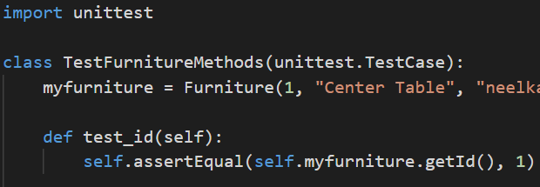
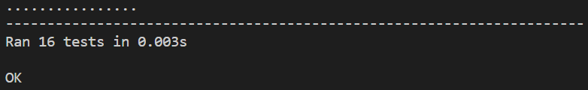
How to Use unittest module of python
Process 1
Process 2
Process 3
Process 4
Process 5
Import unittest module and Define Testcase Subclass
Define a function or a class (in our case) that is to be tested.
Define a Test class as a subclass of unittest.TestCase .
In the class defined in Process 3 test each of the functions or methods of the class one by one.
Then Execute the tests by the command $ python -m unittest {filename}.py

Slide 18
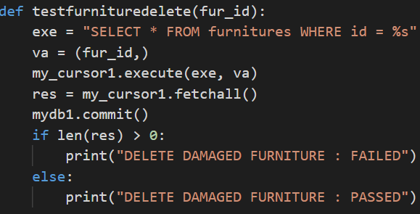
Backend / Database Testing
Made a test.py file
test.py file contains all the function used for testing
.
1
test.py is used to Test all the operations that involve any kind of reading and writing to the database.
2
Imported test.py in the main program and checked at each step whether the right query is made and the desired changes are being done or not in the main database.
3

Slide 19
A SHORT DEMO

Slide 20
