Slide 1

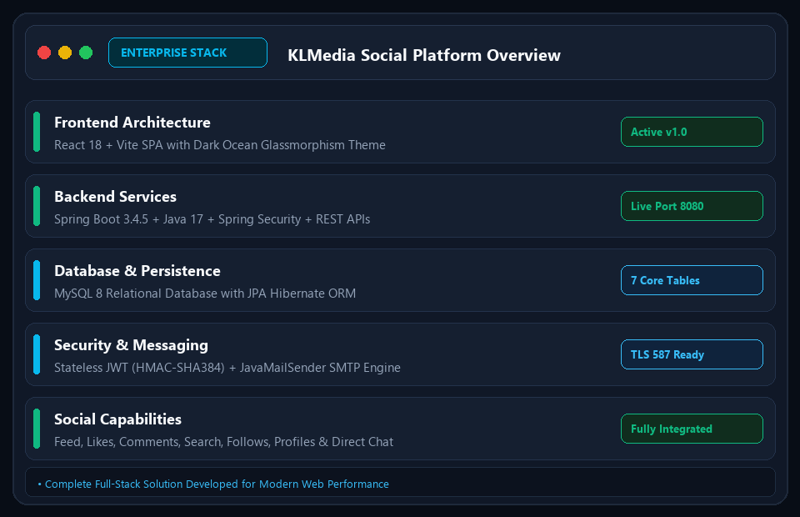
PROJECT PRESENTATION • SLIDE 1/20
KLMedia Social Platform
Enterprise-Grade Full-Stack Social Network with JWT Security & Email Verification
• Modern, reactive social media experience designed with React 18 and Spring Boot 3.
• Complete authentication lifecycle: Registration, 6-digit OTP email verification, and JWT login.
• Enterprise security architecture with BCrypt password hashing and role-based access control.
• Rich social ecosystem: Home feed, post creation, threaded comments, atomic likes, and search.
• Designed and styled in a dark ocean aesthetic with glassmorphism components.
⚙️ React 18 • Spring Boot 3 • MySQL 8 • JWT • JavaMailSender
KLMedia Enterprise Social Platform | React.js • Spring Boot • MySQL • JWT • JavaMailSender | Confidential & Proprietary

Slide 2
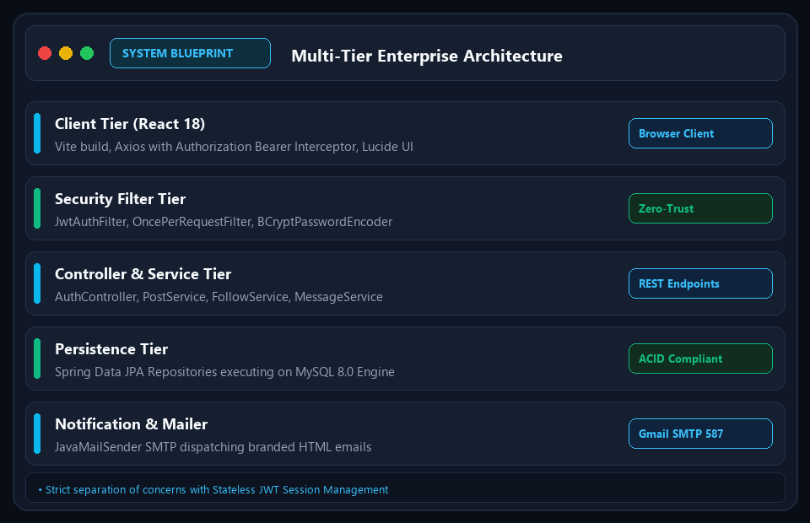
SYSTEM ARCHITECTURE • SLIDE 2/20
Full-Stack System Blueprint
Modern Multi-Tier Architecture for High Concurrency & Low Latency
• Client Tier: React 18 SPA bundled with Vite, Axios Bearer interceptor, and Lucide UI icons.
• Security Gateway: JwtAuthFilter intercepts incoming requests to enforce stateless authentication.
• Service Tier: Loosely coupled Spring @Service layer handling business logic and rate limiting.
• Persistence Tier: Spring Data JPA ORM with Hibernate managing MySQL relational tables.
• Communication Engine: JavaMailSender SMTP integration for responsive HTML notifications.
⚙️ RESTful Micro-Services • Stateless Security • JPA Hibernate
KLMedia Enterprise Social Platform | React.js • Spring Boot • MySQL • JWT • JavaMailSender | Confidential & Proprietary

Slide 3
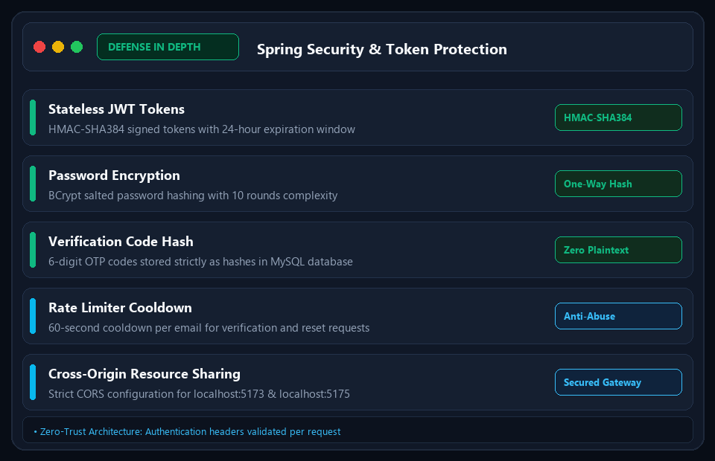
SECURITY ARCHITECTURE • SLIDE 3/20
Zero-Trust Security & JWT Gateway
Robust Defense-in-Depth Protecting Endpoints, Data & User Sessions
• Stateless JWT Authentication: Generates HMAC-SHA384 signed tokens with 24-hour expiration.
• Salted BCrypt Encryption: Passwords hashed with standard 10 salt rounds before persistence.
• Hashed Verification Codes: OTP codes are never stored in plain text—only BCrypt hashes in MySQL.
• Cooldown Rate Limiter: Enforces a 60-second cooldown per email to prevent spam and DoS attacks.
• Scoped Authorization: Pre-configured Spring Security rules separating USER and ADMIN privileges.
⚙️ HMAC-SHA384 • BCrypt • Anti-Brute Force • CORS Whitelisting
KLMedia Enterprise Social Platform | React.js • Spring Boot • MySQL • JWT • JavaMailSender | Confidential & Proprietary

Slide 4
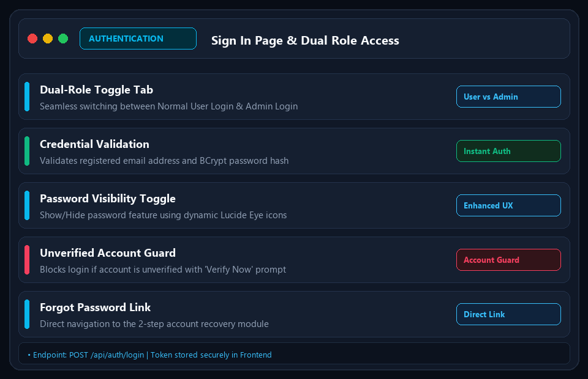
AUTHENTICATION MODULE • SLIDE 4/20
Sign In Page & Role-Based Entry
Dual-Mode Authentication Portal with Instant Role Switching
• Dual Role Selector: Interactive tab toggle between standard User Login and Admin Login.
• Spring Security Credential Check: Validates credentials via AuthService and PasswordEncoder.
• Show / Hide Password: Password visibility toggles with reactive Lucide Eye and EyeOff icons.
• Unverified Account Interceptor: Prompts unverified users with a direct 'Verify Email Now' shortcut.
• Token Management: Stores access token in localStorage and attaches it to subsequent API headers.
⚙️ POST /api/auth/login • POST /api/auth/admin-login • Bearer JWT
KLMedia Enterprise Social Platform | React.js • Spring Boot • MySQL • JWT • JavaMailSender | Confidential & Proprietary

Slide 5
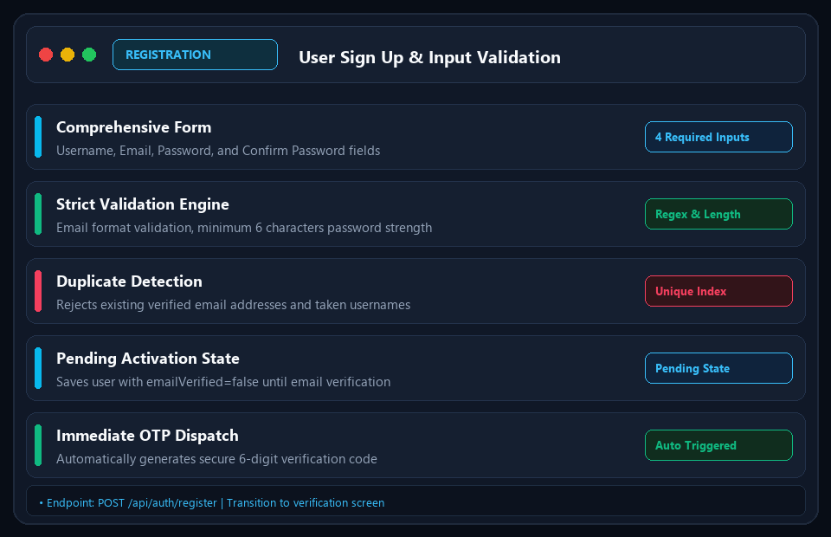
USER ONBOARDING • SLIDE 5/20
Registration (Sign Up) Architecture
User Onboarding Pipeline with Comprehensive Input Validation
• Registration Form: Username, Email address, Password, and Confirm Password fields.
• Client & Server Validation: Email regex check, 6+ character password strength, and password matching.
• Collision Detection: Validates that email and username do not already exist among active accounts.
• Pending Verification Status: Initializes account with emailVerified=false in MySQL database.
• Automatic OTP Dispatch: Generates and hashes a 6-digit verification code, dispatching it via SMTP.
⚙️ POST /api/auth/register • @Valid RegisterRequest • BCrypt
KLMedia Enterprise Social Platform | React.js • Spring Boot • MySQL • JWT • JavaMailSender | Confidential & Proprietary

Slide 6
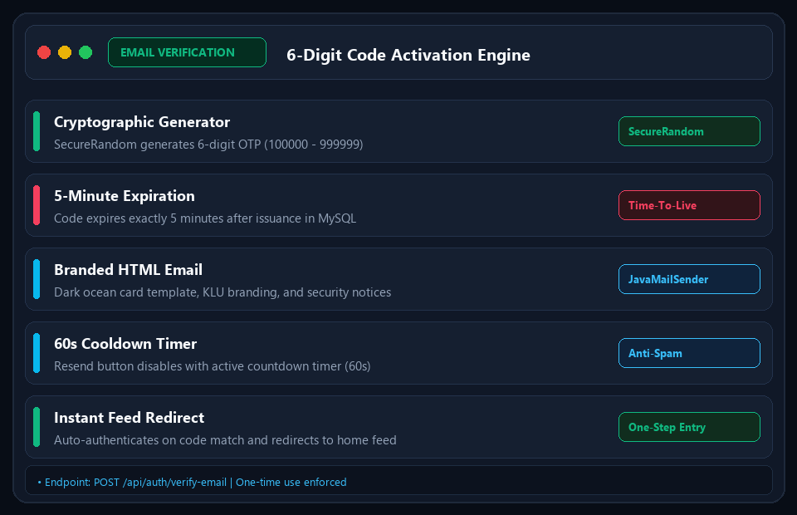
IDENTITY VERIFICATION • SLIDE 6/20
Email Verification & OTP System
Secure 6-Digit Email Activation with SMTP and Cooldown Timers
• Cryptographic OTP Generation: Uses SecureRandom to issue unique 6-digit codes (100000–999999).
• 5-Minute Expiration: Enforces strict 5-minute time-to-live before code invalidation in database.
• Branded HTML Templates: Dispatches styled emails featuring KLU branding, codes, and security tips.
• Anti-Abuse Cooldown: 60-second reactive countdown timer prevents rapid resend requests.
• One-Time Activation: Clears verificationCodeHash upon successful match and logs the user in.
⚙️ POST /api/auth/verify-email • POST /api/auth/resend-verification
KLMedia Enterprise Social Platform | React.js • Spring Boot • MySQL • JWT • JavaMailSender | Confidential & Proprietary

Slide 7
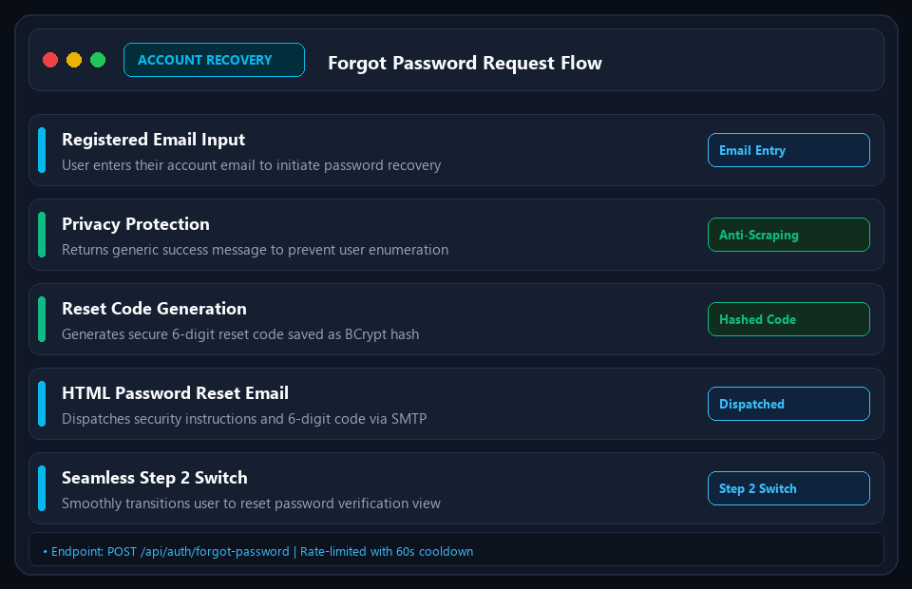
ACCOUNT RECOVERY • SLIDE 7/20
Forgot Password Workflow
Privacy-First Account Recovery Preventing User Enumeration
• Email-Based Recovery: Registered users enter email address to request a password reset.
• Zero Enumeration Disclosure: Returns a generic success notice regardless of email existence.
• Secure OTP Storage: Generates a 6-digit reset code hashed with BCrypt (resetCodeHash).
• Time-Limited Session: Code expires in 5 minutes; rate-limited with 60-second cooldown.
• Seamless Navigation: Directs user to Step 2 (Reset Password Screen) with email preserved.
⚙️ POST /api/auth/forgot-password • Privacy Preserved • 5-Min TTL
KLMedia Enterprise Social Platform | React.js • Spring Boot • MySQL • JWT • JavaMailSender | Confidential & Proprietary

Slide 8
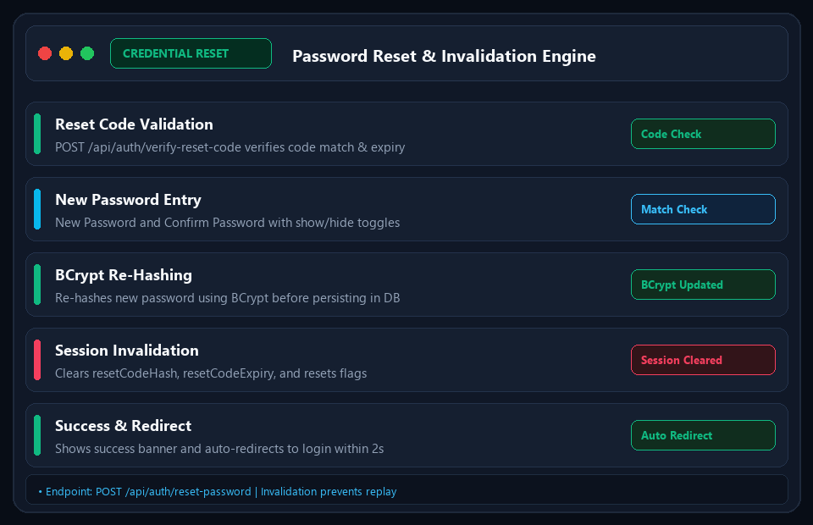
CREDENTIAL MANAGEMENT • SLIDE 8/20
Password Reset & Invalidation
Secure Multi-Step Password Overwrite with Immediate Token Invalidation
• Code Verification: POST /api/auth/verify-reset-code validates OTP code match before password input.
• Password Confirmation: Prompts for New Password and Confirm Password with eye visibility toggles.
• BCrypt Salting & Storage: Encrypts new password with BCrypt before saving to MySQL users table.
• One-Time Replay Guard: Invalidates resetCodeHash and resetCodeExpiry immediately after update.
• Feedback & Auto-Redirect: Displays clear success alert and redirects user to Login after 2 seconds.
⚙️ POST /api/auth/reset-password • One-Time Use • BCrypt Hashed
KLMedia Enterprise Social Platform | React.js • Spring Boot • MySQL • JWT • JavaMailSender | Confidential & Proprietary

Slide 9
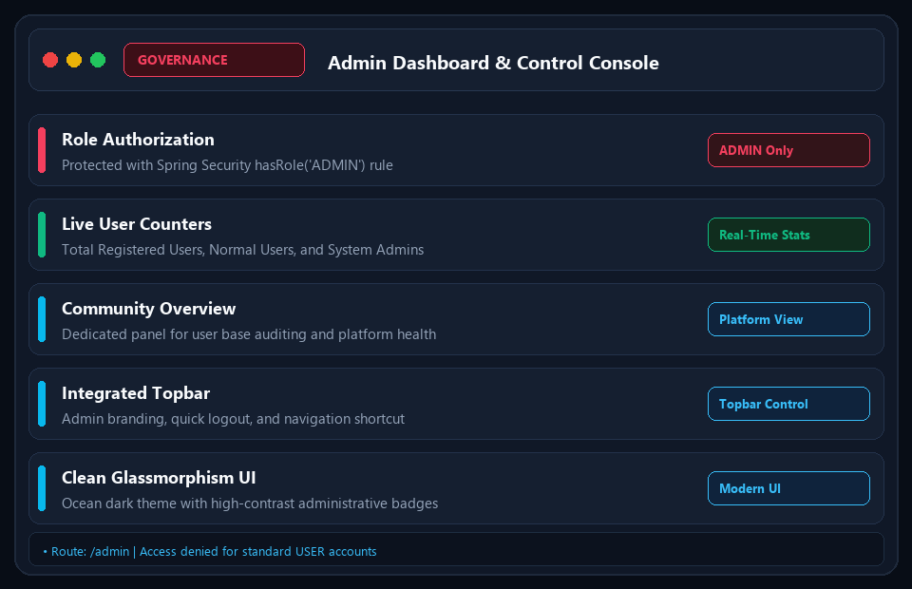
GOVERNANCE & AUDIT • SLIDE 9/20
Admin Dashboard & System Metrics
Centralized Administration Console for Platform Governance
• Protected Route: Restricted to authenticated users with ADMIN role via Spring Security.
• Real-Time Statistics: Displays live metric cards: Total Registered Users, Normal Users, Admins.
• Community Overview: Audits all registered accounts with ID, Username, Email, and Assigned Role.
• Dedicated Admin Header: Customized navigation bar with administrative indicators and quick logout.
• Modern Glassmorphism UI: Dark ocean cards designed for high legibility and operational speed.
⚙️ GET /api/admin/users • hasRole('ADMIN') • Real-Time Metrics
KLMedia Enterprise Social Platform | React.js • Spring Boot • MySQL • JWT • JavaMailSender | Confidential & Proprietary

Slide 10
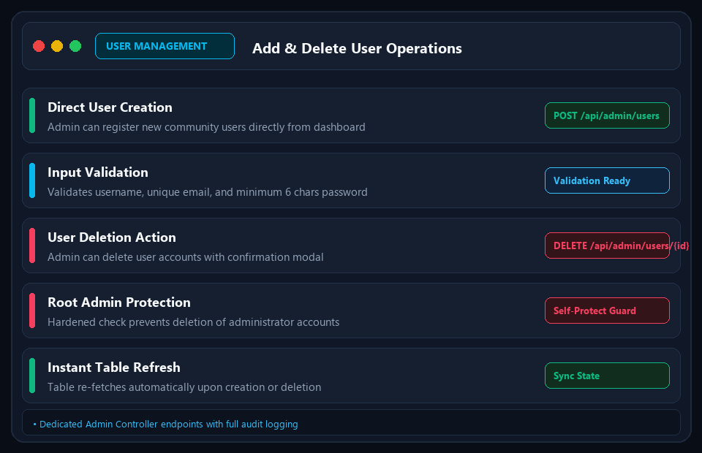
ADMIN OPERATIONS • SLIDE 10/20
User Management: Add & Delete Operations
Administrative User Management with Role-Based Protection
• Direct User Provisioning: Admin can manually create new community users directly from dashboard.
• Input Sanitization: Validates unique username, email format, and password criteria before insert.
• Safe Deletion Pipeline: DELETE /api/admin/users/{id} removes inactive or violating user accounts.
• Root Admin Protection: Enforces strict check preventing accidental deletion of admin accounts.
• Optimistic Table Sync: Automatically re-fetches and updates the user table upon mutation.
⚙️ POST /api/admin/users • DELETE /api/admin/users/{id} • Protected Root
KLMedia Enterprise Social Platform | React.js • Spring Boot • MySQL • JWT • JavaMailSender | Confidential & Proprietary

Slide 11
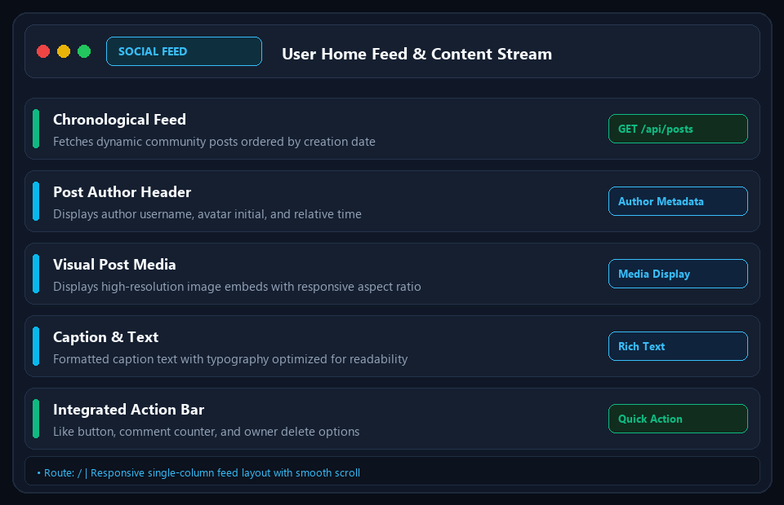
CORE SOCIAL EXPERIENCE • SLIDE 11/20
User Home Feed & Content Stream
Chronological Community Activity Stream with Glassmorphism Cards
• Dynamic Feed Aggregation: Queries posts ordered by createdAt DESC across all community members.
• Rich Post Headers: Displays author username, circular initial avatar, and formatted timestamp.
• Responsive Media Display: Handles embedded images with dark placeholder frames and rounded borders.
• Owner Controls: Dynamically displays Trash icon allowing creators to delete their own posts.
• Fluid Layout: Single-column feed design with smooth scrolling and responsive mobile behavior.
⚙️ GET /api/posts • React State Synchronization • Responsive Cards
KLMedia Enterprise Social Platform | React.js • Spring Boot • MySQL • JWT • JavaMailSender | Confidential & Proprietary

Slide 12
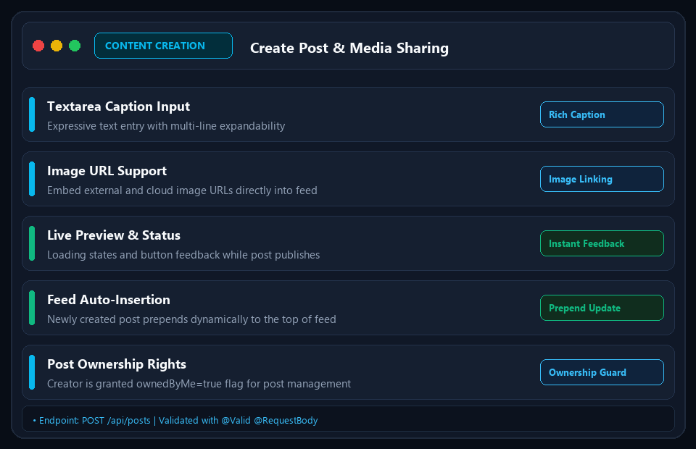
CONTENT CREATION • SLIDE 12/20
Create Post & Media Publishing
Intuitive Content Composer with Instant Feed Propagation
• Multi-Line Text Composer: Auto-expanding textarea for drafting captions and status updates.
• Media URL Embedding: Support for image URLs with preview rendering directly inside the feed.
• Client Feedback States: Displays loading indicators and disabled states during submission.
• Optimistic Prepend: Newly published post appears immediately at the top of the user feed.
• Ownership Flagging: Backend automatically tags post with ownedByMe=true for the current user.
⚙️ POST /api/posts • PostRequest DTO • PostService Pipeline
KLMedia Enterprise Social Platform | React.js • Spring Boot • MySQL • JWT • JavaMailSender | Confidential & Proprietary

Slide 13
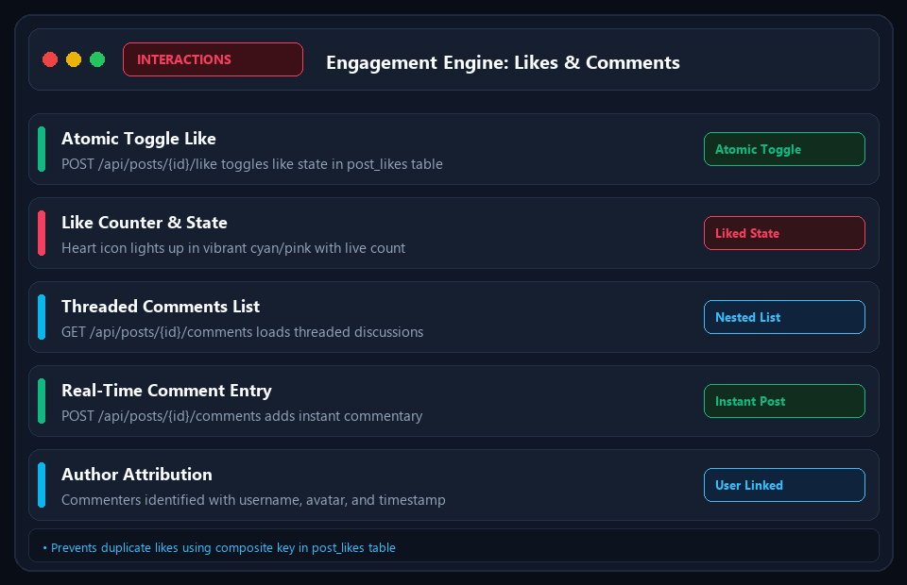
INTERACTION ENGINE • SLIDE 13/20
Engagement Engine: Likes & Comments
Atomic Interaction Pipeline with Real-Time Feedback
• Atomic Like Toggle: POST /api/posts/{id}/like toggles like state in post_likes table.
• Visual Heart State: Heart icon illuminates in vibrant cyan with animated like count update.
• Threaded Discussion: GET /api/posts/{id}/comments loads post commentary on demand.
• Comment Posting: POST /api/posts/{id}/comments allows instant comment submissions.
• Comment Metadata: Formatted author username, avatar, and relative timestamp per comment.
⚙️ POST /api/posts/{id}/like • POST /api/posts/{id}/comments
KLMedia Enterprise Social Platform | React.js • Spring Boot • MySQL • JWT • JavaMailSender | Confidential & Proprietary

Slide 14
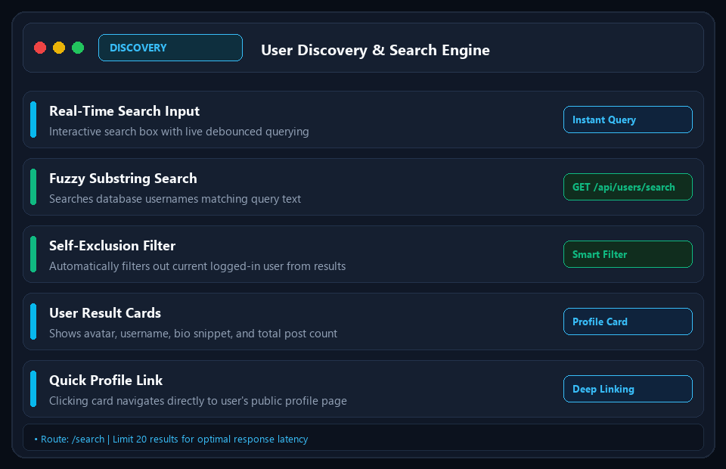
USER DISCOVERY • SLIDE 14/20
User Discovery & Search Engine
Live Community Search with Debounced Querying
• Live Query Search: Search bar with real-time reactive input and debounce optimization.
• Substring Database Query: Searches usernames containing search query text in MySQL users table.
• Self-Exclusion Guard: Automatically omits current logged-in user from search results.
• Rich Result Cards: Displays user avatar, username, bio preview, and total posts published.
• Quick Profile Navigation: Clicking any user card directs instantly to their public profile.
⚙️ GET /api/users/search?q=... • Limit 20 Results • Debounced Search
KLMedia Enterprise Social Platform | React.js • Spring Boot • MySQL • JWT • JavaMailSender | Confidential & Proprietary

Slide 15
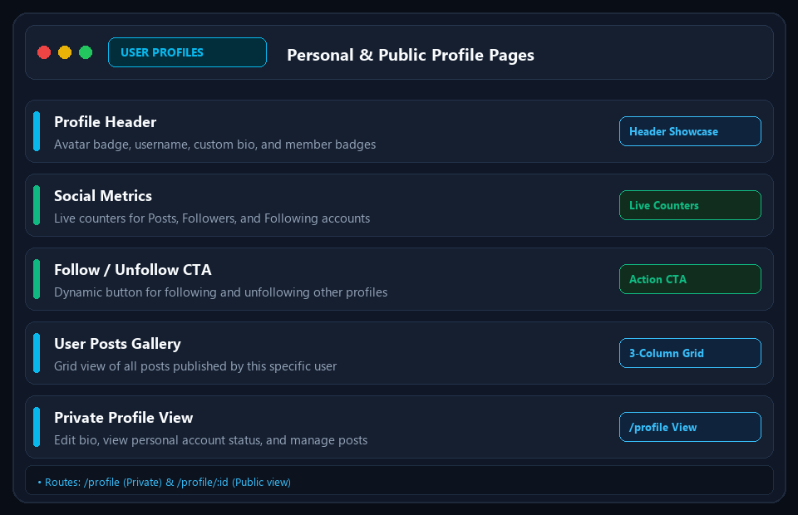
USER SHOWCASE • SLIDE 15/20
Personal & Public Profile Pages
User Bio, Social Metrics & Three-Column Post Gallery
• Private Profile (/profile): Displays personal account data, post counts, and bio overview.
• Public Profiles (/profile/:id): View other community members with full social metrics.
• Activity Counters: Live counters showing Posts count, Followers count, and Following count.
• Follow State Indicator: Shows whether current user follows this profile with interactive CTA.
• Post Gallery Grid: Responsive 3-column photo grid displaying all posts created by the user.
⚙️ GET /api/users/me • GET /api/users/{id} • Social Metrics
KLMedia Enterprise Social Platform | React.js • Spring Boot • MySQL • JWT • JavaMailSender | Confidential & Proprietary

Slide 16
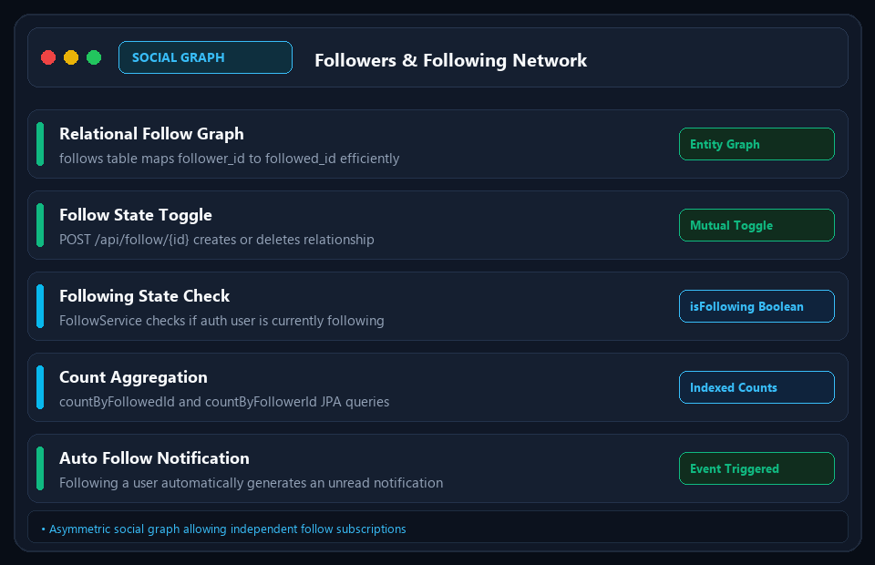
SOCIAL NETWORK • SLIDE 16/20
Social Graph: Followers & Following
Relational Social Network Graph with Live Connection Tracking
• Asymmetric Social Graph: follows table maps follower_id to followed_id relationships.
• Follow & Unfollow CTA: POST /api/follow/{id} and DELETE /api/follow/{id} toggles connection.
• Stateful Follow Verification: FollowService.isFollowing(userEmail, targetUserId) checks state.
• Synchronized Counts: Automatically computes followersCount and followingCount via JPA.
• Live Notification Trigger: Initiating a follow triggers an unread notification to the recipient.
⚙️ POST /api/follow/{id} • DELETE /api/follow/{id} • follows Table
KLMedia Enterprise Social Platform | React.js • Spring Boot • MySQL • JWT • JavaMailSender | Confidential & Proprietary

Slide 17
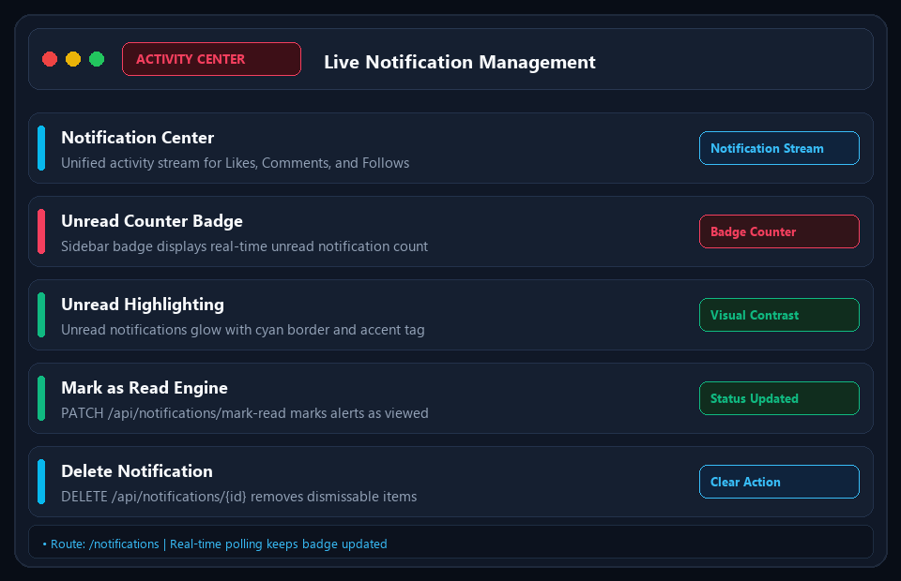
COMMUNICATION • SLIDE 17/20
Real-Time Notification Center
Unified Activity Feed with Dynamic Badge Counter
• Multi-Event Alerts: Centralized notifications for Likes, Comments, and New Follower events.
• Sidebar Unread Badge: Global notification badge reflects live unread notifications counter.
• Unread Highlighting: Unread alerts visually highlighted with glowing cyan borders and badges.
• Mark as Read: PATCH /api/notifications/mark-read updates read status in database.
• Notification Pruning: DELETE /api/notifications/{id} allows users to dismiss alerts individually.
⚙️ GET /api/notifications • GET /api/notifications/unread-count
KLMedia Enterprise Social Platform | React.js • Spring Boot • MySQL • JWT • JavaMailSender | Confidential & Proprietary

Slide 18
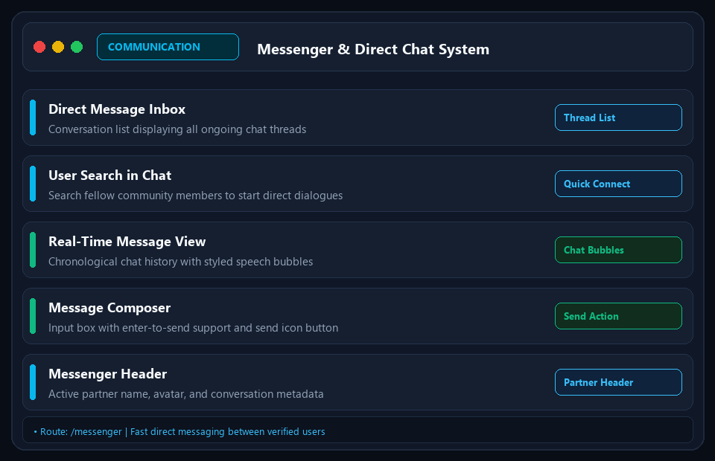
DIRECT MESSAGING • SLIDE 18/20
Messenger & Peer-to-Peer Chat
Direct Messaging Hub for Verified Community Members
• Conversation Stream: Sidebar listing all active dialogues with last-message snippet preview.
• Direct User Chat: Select any verified community member to start a one-on-one conversation.
• Chronological Message Log: Distinct speech bubbles differentiating incoming vs outgoing messages.
• Direct Message Composer: Smooth input box with enter-to-send support and action buttons.
• Real-Time Readiness: Built on structured messages table ready for WebSocket scaling.
⚙️ POST /api/messages • GET /api/messages/{id} • messages Table
KLMedia Enterprise Social Platform | React.js • Spring Boot • MySQL • JWT • JavaMailSender | Confidential & Proprietary

Slide 19
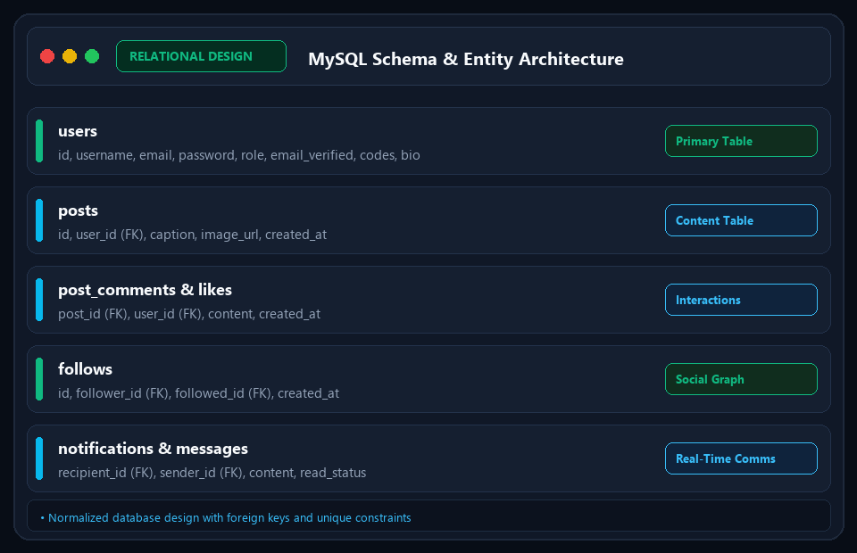
DATABASE ARCHITECTURE • SLIDE 19/20
MySQL Relational Schema & Models
Normalized Entity-Relationship Design with Referential Integrity
• users: Core table storing credentials, roles, email_verified, and verification/reset hashes.
• posts: Stores post captions, image URLs, creation timestamps, and user_id foreign keys.
• post_comments & post_likes: Relational interaction records with composite unique indices.
• follows: Social graph mapping follower_id and followed_id foreign keys with JPA joins.
• notifications & messages: Transactional tables managing user communications and alert states.
⚙️ MySQL 8.0 • Spring Data JPA • Hibernate DDL • Foreign Keys
KLMedia Enterprise Social Platform | React.js • Spring Boot • MySQL • JWT • JavaMailSender | Confidential & Proprietary

Slide 20
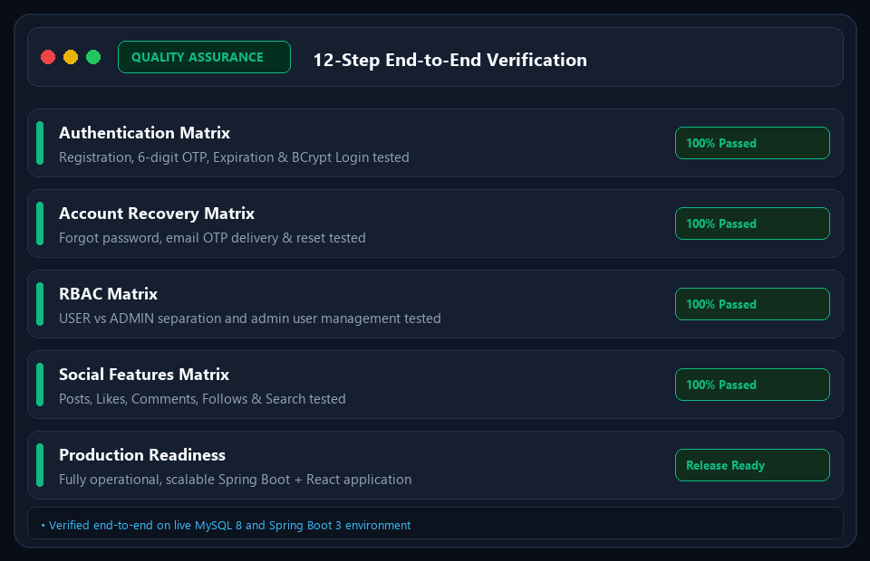
QUALITY ASSURANCE • SLIDE 20/20
Testing Matrix & Production Roadmap
End-to-End Verification Across All 12 Functional Requirements
• Authentication Testing: Registration, 6-digit OTP verification, and JWT login verified 100%.
• Recovery Testing: Non-enumerating forgot password, OTP delivery, and BCrypt reset verified.
• Access Control: USER vs ADMIN isolation and admin user creation/deletion tested successfully.
• Social Feature Testing: Posts, likes, comments, follows, search, and notifications verified.
• Future Roadmap: WebSocket live chat, S3 media uploads, and React Native mobile client.
⚙️ 12/12 Tests Passed • Zero Regression • Production Ready
KLMedia Enterprise Social Platform | React.js • Spring Boot • MySQL • JWT • JavaMailSender | Confidential & Proprietary

