Slide 1


Introduction
to
Deep Learning
By:
Dr. Suneet Gupta

Slide 2
Public Notice regarding Use of Images
This document contains images obtained by routine Google Images searches. Some of these images may perhaps be under copyright. They are included here for educational and noncommercial purposes and are considered to be covered by the doctrine of Fair Use. In any event they are easily available from Google Images.
It's not feasible to give full scholarly credit to the creators of these images. We hope they can be satisfied with the positive role they are playing in the educational process.

Slide 3

AI and Deep Learning Skilling and Research

Slide 4
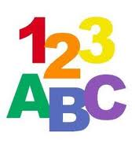
Prerequisites
Commitment to Persevere
One Programming Language
Interest in Deep Learning and AI

Slide 5
Motivation for the future
It is redefining the way computing is being used to solve societal problems
Some of the existing jobs are going to vanish or change and most attractive jobs are in deep learning
It is one of fastest growing technology being adapted across disciplines
Most of the startups now have an element of AI to build new applications

Slide 6
Objectives and Outcomes
Knowledge of deep learning concepts
To apply appropriate tuning to improve the accuracy of network
To enable you to develop sample projects

Slide 7
Course Coverage
Foundational Concepts and Machine Learning Basics
Deep Learning Fundamentals, Models and Intuition
Convolutional Neural Networks
Recurrent Neural Networks

Slide 8
References and Resources
GitHub Code and sample projects provided by many programmers
Online Courses of Machine Learning, Deep LearningSeries of Courses by Andrew Ng
and Data Science on edX, Udacity, Coursera
Resources page of leadingindia.ai
Blogs and Articles on the latest issues and trends in Deep Learning

Slide 9

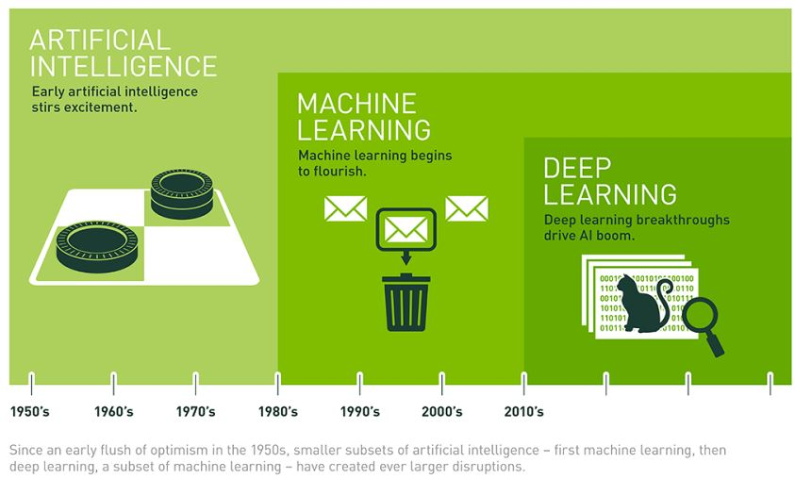

Slide 10
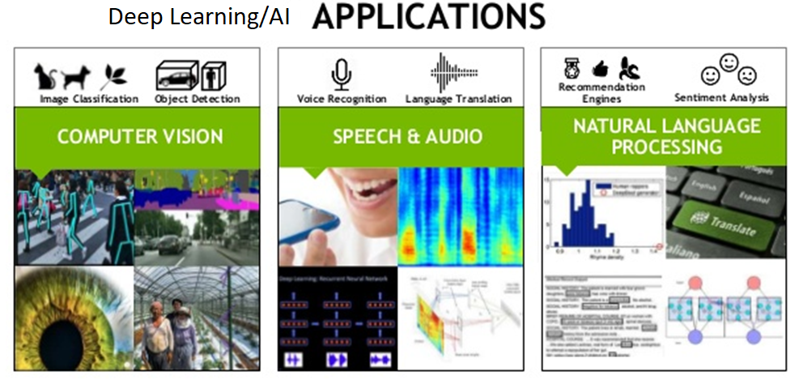

Slide 11

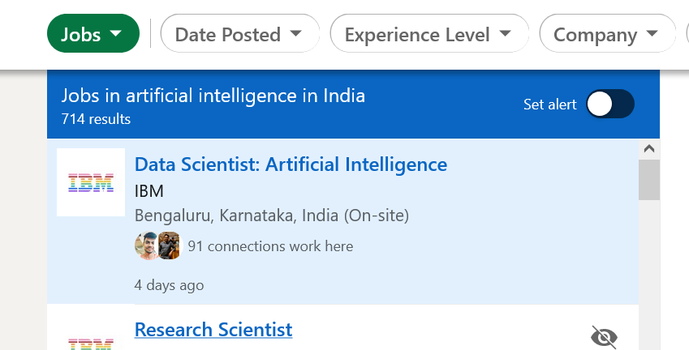
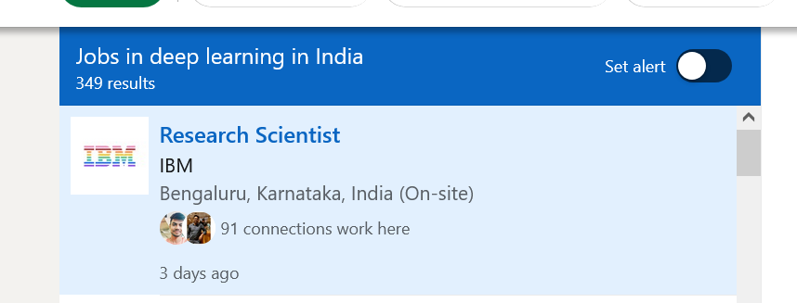

Slide 12
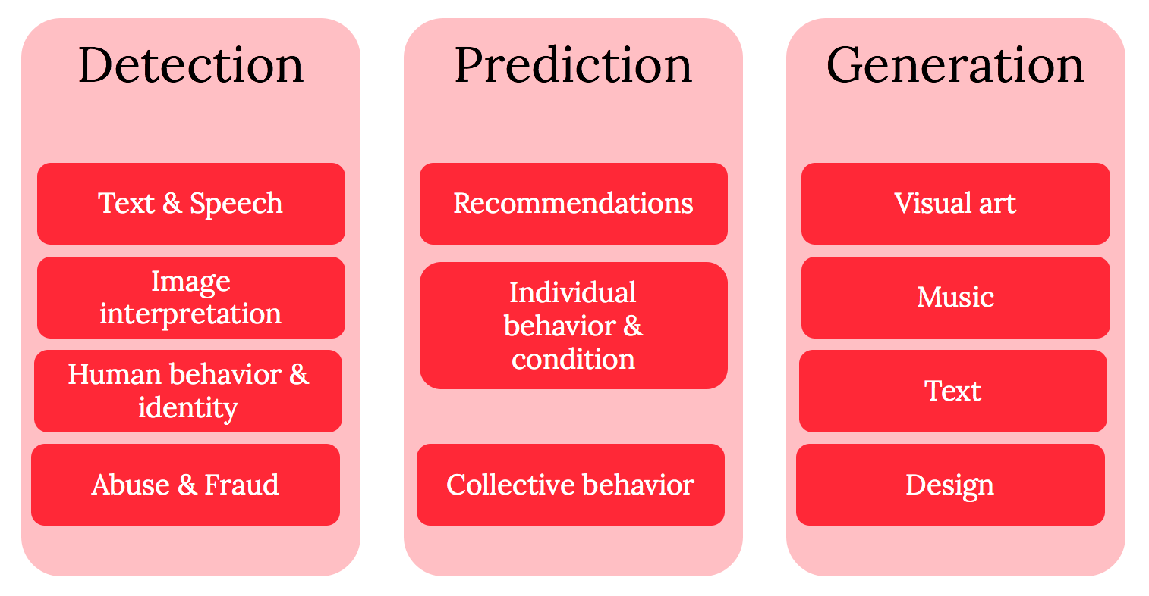
Three main areas where Deep learning is being prominently applied

Slide 13
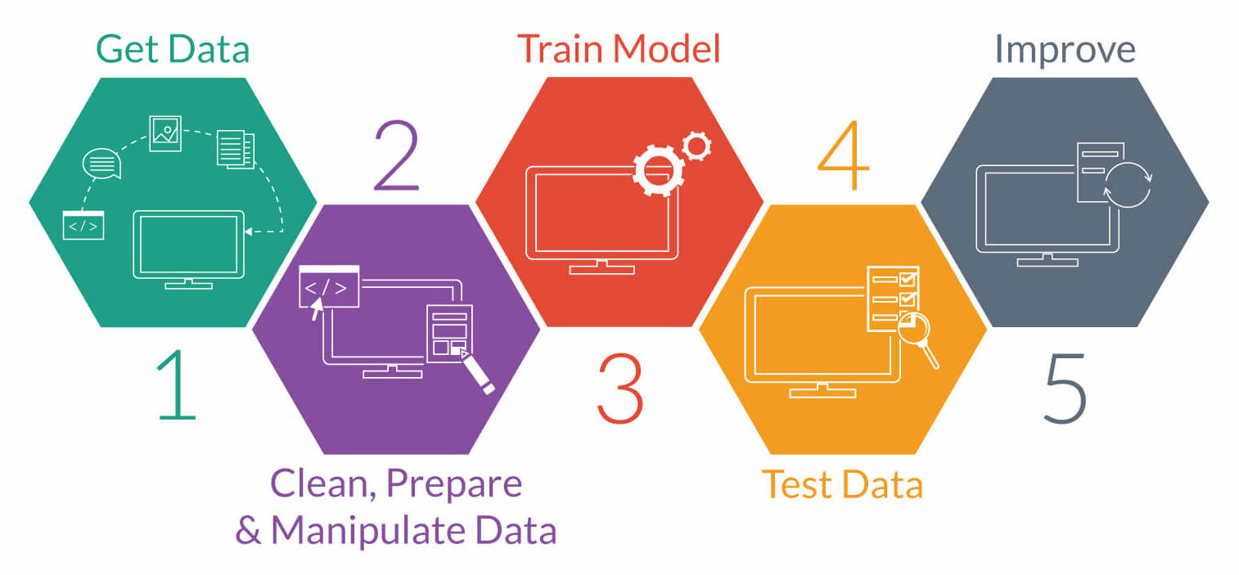

Slide 14
1. Problems where a) There is no deterministic algorithm (not even of evil complexity) e.g. Recognizing a 3D object from a given scene, Handwriting recognition, Speech recognition
2. Problems which don’t have a fix solution and goal posts keep changing. System adapts and learns from experience e.g. SPAM emails, Financial fraud, IT Security Framework
3. Where Solutions are Individual specific or time dependent. e.g. recommendations and targeted advertisements
4. For prediction based on past and existing patterns (not defined or defined by huge number of weak rules) e.g. prediction of share prices etc.

Slide 15
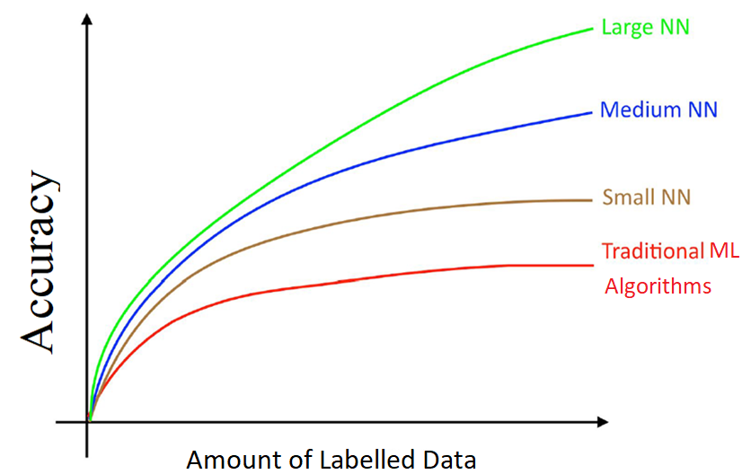
Why it has taken off now
Availability of Data has increased due to explosion in Smart Mobiles and devices
Release/development of new algorithms, APIs and Platforms for Deep Learning Applications
More Computing Power is available due to coming of NVIDIA GPUs

Slide 16
Essential Tools
Git and Github
Python
Jupyter Notebooks
Numpy for Matrix and Vector calculations
Pandas for Data handling, curation and manipulation
Matplotlib for plotting of graphs for different analysis on data
So many other Python APIs to make your life easy to develop DL models

Slide 17
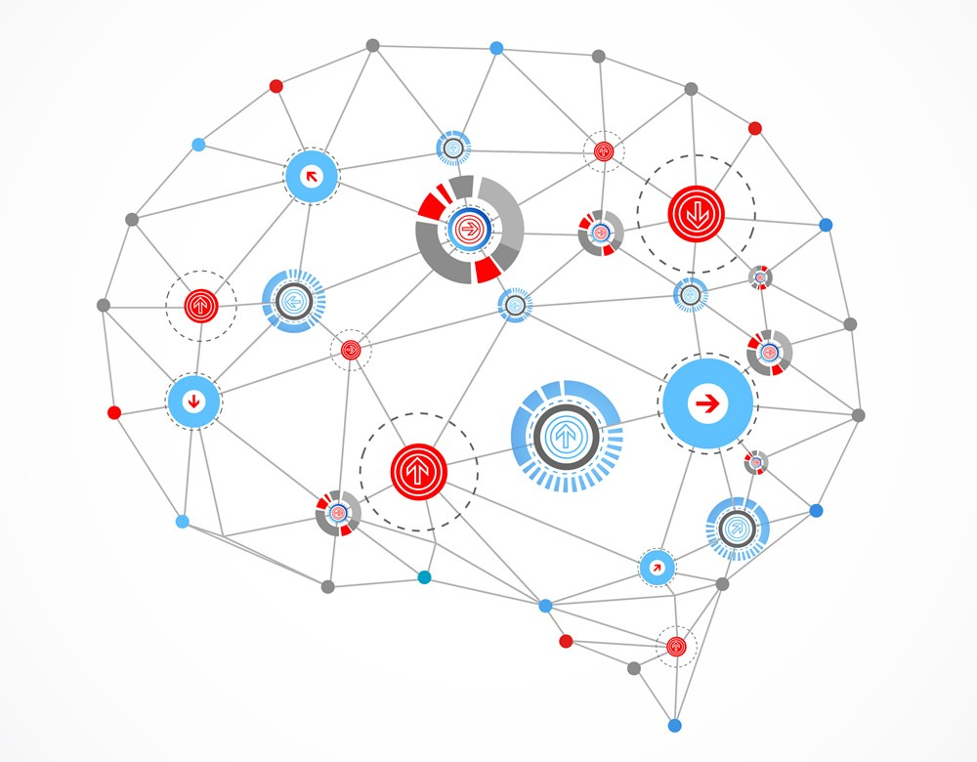
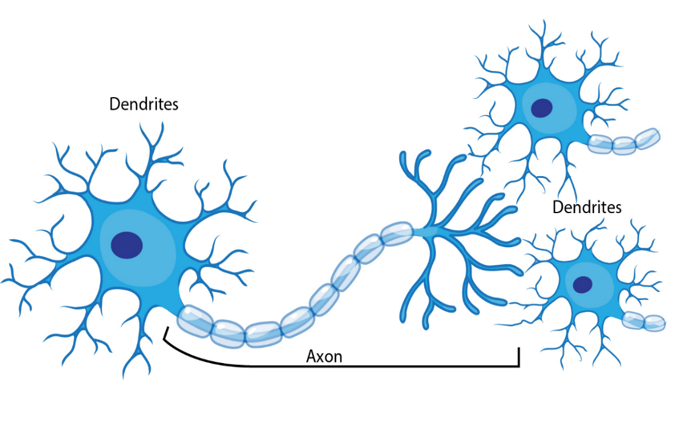
Deep Learning Magic competing with
Natural Intelligence

Slide 18
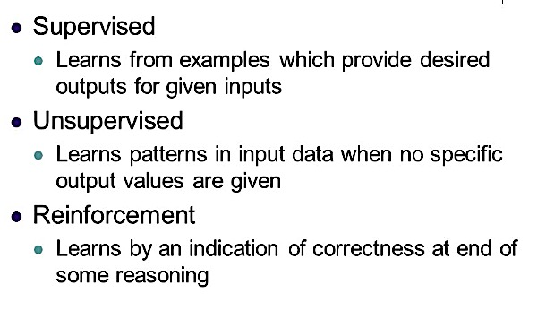
Types of Learning Algorithms

Slide 19
Features
The features are the elements of your input vectors. The number of features is equal to the number of nodes in the input layer of the network
Category | Features
Housing Prices | No. of Rooms, House Area, Air Pollution, Distance from facilities, Economic Index city, Security Ranking etc.
Spam Detection | presence or absence of certain email headers, the email structure, the language, the frequency of specific terms, the grammatical correctness of the text etc.
Speech Recognition | noise ratios, length of sounds, relative power of sounds, filter matches
Cancer Detection | Clump thickness, Uniformity of cell size, Uniformity of cell shape, Marginal adhesion, Single epithelial cell size, Number of bare nuclei, Bland chromatin, Number of normal nuclei, Mitosis etc.
Cyber Attacks | IP address, Timings, Location, Type of communication, traffic details etc.
Video Recommendations | Text matches, Ranking of the video, Interest overlap, history of seen videos, browsing patterns etc.
Image Classification | Pixel values, Curves, Edges etc.

Slide 20
Weights
Weights correspond to each feature.
Weights denote how much the feature matters in the model.
Higher weight of a particular feature means that it is more important in deciding the outcome of the model.
Weights of a feature represent that how much evidence it gives in favor or against the current hypothesis in context of the existence or non-existence of the pattern you are trying to identify in the current input.
Generally weights are initialized randomly.
we try to bring them to near optimal values so that they are able to fit the model well and can help in prediction of unseen values

