Slide 1






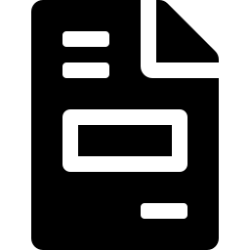



TESTING STRATEGY
Our QA Approach — Moving Beyond ATOP Jumbo
ATOP Jumbo is retired — replaced by a purpose-built, in-house Python + web framework giving full control over coverage, reporting, and team visibility.
COMPLETE COVERAGE
1
Connect & Map
Register every source/target and define column mappings + business rules — no hand-editing.
2
Plan Scenarios & Test Cases
Historical Data
Incremental Loads
Group test cases into test scenarios; each case is a configurable validation hop.
Point-in-time immutability vs a prior-quarter baseline snapshot — nothing already loaded is allowed to change.
Delta-load checks: only approved columns update, no unexpected deletes between loads.
3
Execute
Run one case, or a whole scenario sequentially, with live progress — from the app or CLI.
4
Validate
15 data-consistency checks + 2-phase report validation run automatically.
5
Triage & Sign Off
Pass-rate trends, new-vs-recurring failures, and evidence drill-down per run.
Report Testing
Data Quality
6
GVC / MD&A: Phase 1 structure gate, then Phase 2 row + measure validation, Snowflake vs legacy.
Completeness, null-handling, dedup & reconciliation across curated Gold tables, always-on.
Alert
Data-quality failures notify the team in Teams automatically.
Why it's more reliable: Deterministic pandas comparison drives every pass/fail — AI drafts SQL & test-case content for human review, but never decides a result.
Carlyle ValDB → Snowflake Migration · QA Testing Approach
1

Slide 2
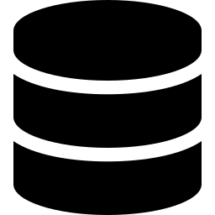
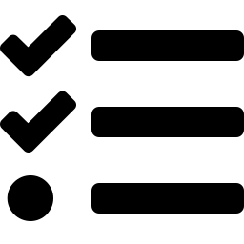




THE APPLICATION
ETL Test Console — What the QA Team Built
A single Next.js control-plane app over a reusable Python engine — replaces terminal-only scripts and ATOP configuration entirely.
Connections
Suites (Test Cases)
Test Scenarios
Every source & target (Access, Snowflake, files) managed centrally; secrets never leave .env.
Configurable validation hops — 15 check categories, business rules, referential integrity.
Group test cases; run an entire scenario sequentially with one click and a live rollup.
Mappings & Rules
Report Testing
Command Center
Table/column mappings and business rules edited as forms — no hand-edited YAML.
GVC / MD&A tabs: structure gate + data/measure checks, Snowflake vs legacy Access.
Per-run dashboard: pass-rate trend, new vs. recurring failures, evidence drill-down.
DQ Alerts
Team Collaboration
Scheduled Runs
Automatic Teams notification via Power Automate the moment quality rules trip.
Shared run history across the QA team via OneDrive — everyone sees every run.
Report validation runs unattended at quarter-end + 6 days via Task Scheduler.
Carlyle ValDB → Snowflake Migration · QA Testing Approach
2

Slide 3



DELIVERABLES & ROADMAP
Outcomes for QA — and What's Next
QA DELIVERABLES
PHASED ROADMAP
✓
Automated validation framework covering every migration hop (ValDB, GPE, Global Credit, AlpInvest → Snowflake)
Framework Build COMPLETE
Core engine: connectors, 15 validators, mapping/business-rule model.
✓
Historical & incremental load coverage with baseline-snapshot comparisons
Console + Report Testing COMPLETE
GVC / MD&A report sign-off packages (structure + data validated per tab)
Web app, Command Center, GVC/MD&A 2-phase validation, scheduling.
✓
Scenarios & Team Rollout COMPLETE
✓
Live data-quality alerting wired into Teams
Test-scenario grouping, batch runs, shared team run history & alerting.
✓
A single, team-shared, auditable run history — no more scattered local results
Real Data Onboarding IN PROGRESS
Connect live Snowflake/Access systems; populate real GVC/MD&A report SQL.
15+
2-Phase
0
Full Regression & Sign-off UPCOMING
End-to-end regression across all scenarios; formal sign-off for cutover.
automated check
categories
report validation
(structure + data)
manual terminal
steps required
Carlyle ValDB → Snowflake Migration · QA Testing Approach
3

