Slide 1

BDM CAPSTONE PROJECT PRESENTATION
DESCRIPTIVE INSIGHTS:ANALYSING TRENDS IN A MEDICAL STORE
PRESENTED BY:-
ABHIVYAKTI JHA
23DS300017

Slide 2
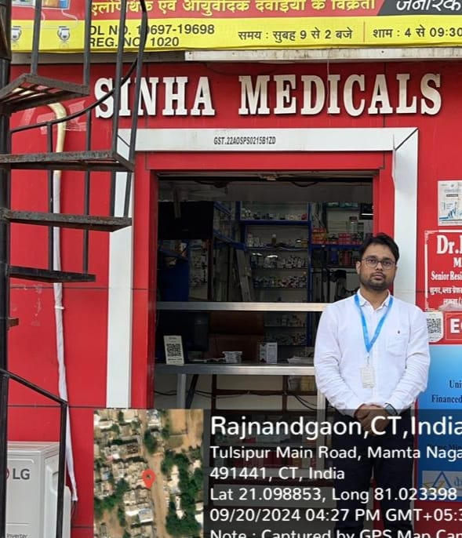
ORGANISATION BACKGROUND
Name of organisation: Sinha Medicals
Location: Rajnandgaon , Chhattisgarh
Established : 2004
Brief Background:Sinha Medical Store is a pharmaceutical store located in Rajnandgaon (C.G) that sells OTC medicines, general medicines & medical devices.This store is established by his owner Sant Lal Sinha which is running successfully.
It is a small medical store which is well organized by its owner and all medicines are arranges in a way that they are accessible & visible to every employee of that store.

Slide 3
PROBLEM STATEMENT
Understanding revenue decline: What factors contribute to the revenue decline for some period?
Management issues: In what way can we enhance planning of inventory to improve business performance and efficiency
Types of data collected:
Sales Data
Inventory Data:
Productwise inventory
Item wise Inventory
Process and Analysis Method
Data Collection: Data is collected from software and then convert it into excel.
Cleaning Process : Ensured data quality by cleaning with tools like Excel, pandas in python making it reliable for analysis.
Exploratory Data Analysis (EDA) : Used graphs, charts and stats to understand data patterns and find outliers.
Seasonal Decomposition Analysis : Broke down data to see trends, seasons, and outliers, revealing sales patterns.
Visualization Techniques : Showcased data using simple charts to make trends easy to understand.

Slide 4
GRAPHICAL ANALYSIS
Rs 1604677
The peak of sales is in September and suddenly drastically drops in February
Rs 381366
The trend line shows slight downwards trend peak
The highest growth rate is observed in March
Average growth rate in financial year is 18%
February month show low revenue but its average revenue per customer is Rs 620.

Slide 5
DESCRIPTIVE STATISTICS
Descr. Stats. | Total revenue | Customer
Sum | 13968113 | 22721
Mean | 1164009.417 | 1893.41
Standard Error | 84156.98 | 122.4
Median | 1213825.5 | 2013.5
Standard Dev. | 291528.33 | 424.0
Sample Variance | 84988768164 | 179810.1
Kurtosis | 5.012255412 | 8.25
Skewness | -1.68756219 | -2.73
Range | 1222791 | 1598
Minimum | 381886 | 637
Maximum | 1604677 | 2235
Seasonal Variation: The sales revenue is highest during the rainy season (5,404,726), followed by the summer season (4,524,943), and lowest in winter (4,038,444). This indicates a noticeable increase in sales during the rainy season.
Trends: There is a gradual increase in revenue moving from winter to summer and then a sharper increase in the rainy season
Both revenue and customer data shows left-skewed distributions.
An outlier is shown from the high kurtosis value
There are variations in revenue and customers as seen from standard deviation.
Revenue variance is exceptionally high and Customer variance is lower

Slide 6
Medicines are divided into two categories
Medicines that bring revenue>Rs 1000
Medicines that bring revenue>Rs 10000
1700 medicines
265 medicines
Total medicines= 8225
Medicines whose revenue is greater than 1000 contributes 68.45% of total revenue
The other 6260 contribute 31.55 % of the revenue. They are slow-moving products.
A total of 1475 medicines are dead stock( Zero sales).

Slide 7
Total manufacturers – 756
Total items sold – 1122730
A total of 64 manufacturers generate revenue greater than Rs 50000
A total of 687 generates revenue between Rs 0 to Rs 50000
The top five contributors to the revenue share are SUN, MAPLE, INTAS, LUPI, and CIPLA having revenue share of Rs 826012, Rs 668917, Rs 581484, Rs 413946, Rs 342730, and the items sold are 73742, 62068, 50556, 18456, 25569 respectively.

Slide 8
 | Total inventory | Dead stock in inventory
No of medicines | 8225 | 1475(17.94%)
Inventory values(Rs) | Rs 16564940 | Rs 2441005
Total of 17.94% of medicines are dead stock which means their contribution towards revenue is zero.
Total of 17.73% (in terms of money) has been given zero return

Slide 9
MATHEMATICAL KEY FEATURES
Total Revenue=Rs 13968113
Average Growth Rate=18.071%
Dead stock=17.94%
Average price per item= Rs 12.49
Revenue per medicine= Rs 1937.4
Dead stock=18.254%
Stock turnover ratio = 2.96

Slide 10
RECOMMENDATIONS:
Improves sales growth consistency
Identify slow-moving products: Regularly review inventory and identify products with low sales and try not to overstock them.
Medicines that contribute high in revenue should be closely monitored to avoid shortages.
Manufacturers with high sales performance should be prioritized for new products or exclusive deals
manufacturers contributing to dead stock (18.25%) should be evaluated for product relevance
Loyalty program: Introduce a customer loyalty program to incentivize repeat purchases.

Slide 11
THANK-YOU

