Slide 1
Deep learning for
automated image captioning using CNN & RNN
GNR638 - Machine Learning in Remote sensing - II
Abhishek Kumar Pandey -193170007 Saurabh Mishra - 193170011
Nelson Manvel Dial - 193170009
Guided by
Prof. Biplab Banarjee

Slide 2
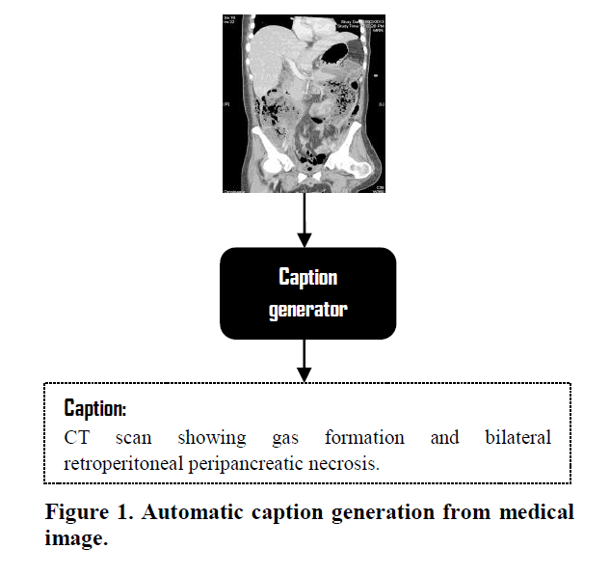
Problem Statement
To automatically generate meaningful caption for a given image based on the semantic features present in the image.
This can be applied to solve multiple real-world problems. Some examples are:
From a CT Scan image, predicting body ailments
By a X-ray image of patient's lung, a caption can be provided about patient's pneuomonia condition

Slide 3
Dataset details
For this project, we used MS-COCO dataset. This dataset contains photos of 91 objects types that would be easily recognizable by a 4 year old.
Following are the details of training, validation and test dataset details:
The training dataset contains 82,783 images with 5 captions associated with each image
The validation dataset have 40,504 images, and
The test dataset has 40,775 images for testing

Slide 4
Data visualizations
Apart from images, our dataset has captions. We found that length of each caption can be instrumental in generating batches:
Following are the findings from the data:
Large number of captions have length varying from 8 words to 15 words.
Count of captions with 10 words is highest among all captions.
This gives us intuition that while generating batch we have to ensure that the probability that caption of any length is drawn is proportional to the number of captions with that length in the dataset.

Slide 5
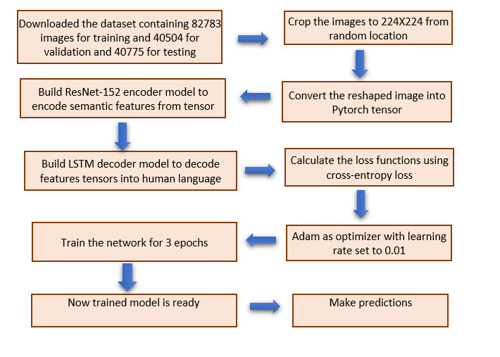
Methodology

Slide 6
Image and captions preprocessing
To feed the data into CNN-RNN model, we need to preprocess it
1. Image preprocessing:
a) Image were of different sizes, they were randomly cropped into 224 X 224 images.
b) Using “transforms” function of “torchvision” library they were converted into pytorch tensor
2. Caption preprocessing:
a) Using “tokenizer” of “nltk”, each caption was transformed into list of words.
b) Then these word are given index using “word2idx” python dictionary
c) Then these list of indices was transformed into pytorch tensors.
After all this, these tenssors are fed into CNN-model having ResNet50 architecture

Slide 7
ResNet 152 CNN encoder
We are using ResNet152 architecture for extracting features from image, due to following reasons:
1. ResNet uses Batch Normalization at its core. The Batch Normalization adjusts the input layer to increase the performance of the network.
2. The problem of covariate shift is mitigated.
3. ResNet makes use of the Identity Connection, which helps to protect the network from vanishing gradient problem.
4. Deep Residual Network uses bottleneck residual block design to increase the performance of the network.

Slide 8
RNN – LSTM decoder
To decode the features tensor provided by CNN we used a single LSTM layer followed by followed by one fully connected linear layer.
LSTM have internal mechanisms called gates that can regulate the flow of information.
These gates can learn which data in a sequence is important to keep or throw away.
LSTM layer is used due to following reasons:
During back propagation, recurrent neural networks suffer from the vanishing gradient problem.This problem is when the gradient shrinks as it back propagates through time. If a gradient value becomes extremely small, it doesn’t contribute too much learning.

Slide 9
Hyperparameters for training LSTM
Following is the best estimates of hyper-parameter we got:
1. Batch size=32
2. Optimization technique= Adam
3. Epsilon=10^(-8)
4. Beta1=0.9
5. Beta2=0.999
6. Epochs=3
7. Loss=CrossEntropyLoss

Slide 10
Optimization technique
1. We found satisfactory low values of loss for “Adam” optimization technique
2. We also compared it with Adagrad and RMSprop.
3.These were unable to compete with Adam because learning rate of dense features decreased rapidly hence it took more epochs to reach minima.

Slide 11
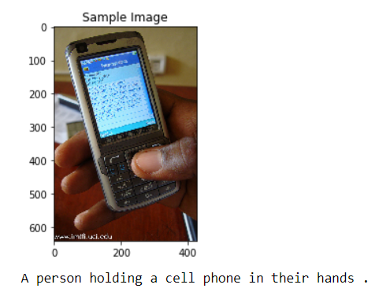
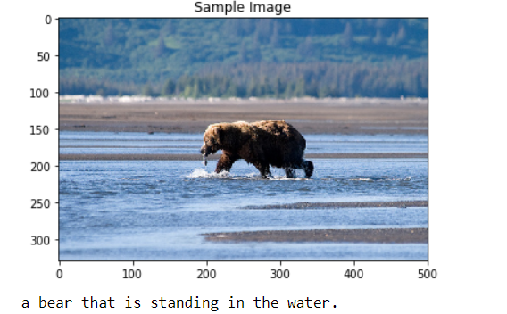
Results
We tested the model against randomly selected images from test data set and found satisfactory performance. Follwing are some examples

Slide 12
Team Members and contribution
Saurabh Mishra - data analysis and problem identification
Abhishek Kumar Pandey - methodolgy and coding Nelson Manvel Dias - data analysis and visualization
Epoch [1/1], Step [12942/12942], Loss: 2.0380, Perplexity: 7.6756

