Slide 1







STACK OVERFLOW DEVELOPER SURVEI TREND
Athalla Abhiyoga
7/13/2024

Slide 2



OUTLINE
Executive Summary
Introduction
Methodology
Results
Visualization – Charts
Dashboard
Discussion
Findings & Implications
Conclusion
Appendix

Slide 3

EXECUTIVE SUMMARY
Data contextualization and analysis goal
Methodology
Data Collecting
Data Wrangling
Data Analysis
Data Visualization
Result presentation with graph and trend
Finding and implication regarding the result
Final Conclusion

Slide 4

INTRODUCTION
This presentation report utilize data analytics to highlight current and projected trends in the need for skills related to programming languages, databases, platforms and web frames.
The data set used in this presentation is Stack Overflow’s annual Developer Survey which has data around 90,000 developers.
The following inquiries were investigated
Which of programming language is the most demand today and the future?
Which database tools is the most demand today and the future?
How is the Developers demographic?

Slide 5

METHODOLOGY
Collect the survei data
APIs
Webscraping
Data Wrangling
Exploratory data analysis
Analyzing data distribution
Handling outliers
Finding correlations
Data Visualization
Visualize the data distribution, correlation, and composition
Dashboard

Slide 6
RESULTS

Slide 7
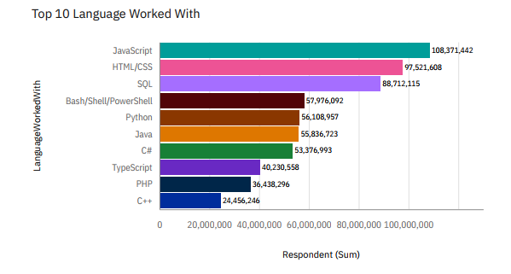
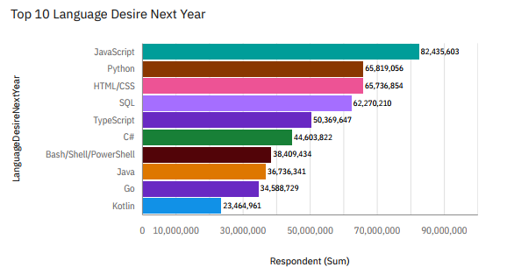
PROGRAMMING LANGUAGE TRENDS
Current Year
Next Year

Slide 8
PROGRAMMING LANGUAGE TRENDS - FINDINGS & IMPLICATIONS
Findings
Javascript, HTML/CSS, and SQL are the most used language currently
Javascript, HTML/CSS, and Python will be the most desired language in the future
Python will have more demand than HTML /CSS and SQL in the future
Implications
Javascript and HTML are used in web development that implies web development skill has highest demand
Python demand has fastest growing due to increase in demand of AI and Machine Learning

Slide 9
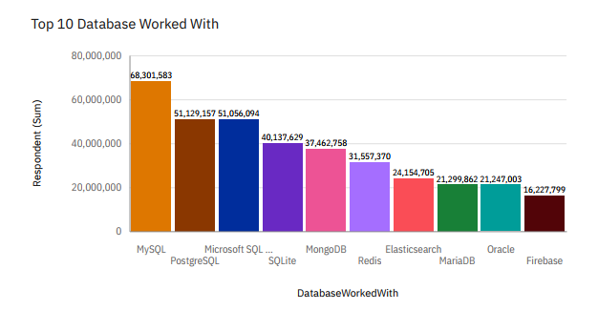
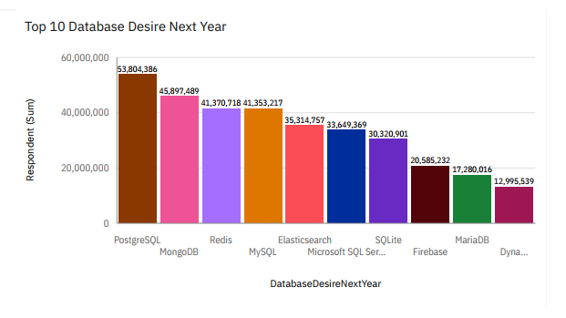
DATABASE TRENDS
Current Year
Next Year

Slide 10
DATABASE TRENDS - FINDINGS & IMPLICATIONS
Findings
MySQL, PostgreSQL, and Microsoft SQL server is the most database used at the moment
The demand on MySQL as database is decrease in next year
PostgreSQL, MongoDB, and Redis have more demand in the future
Implications
MySQL is the most popular database at present but in next year the demand will decrease
Open Source database like Redis is high on demand in the market
NoSQL database will be significant skill to develop in the future

Slide 11

DASHBOARD
https://github.com/Abhiyoga1/IBM-Data-Analyst-Capstone-Project

Slide 12
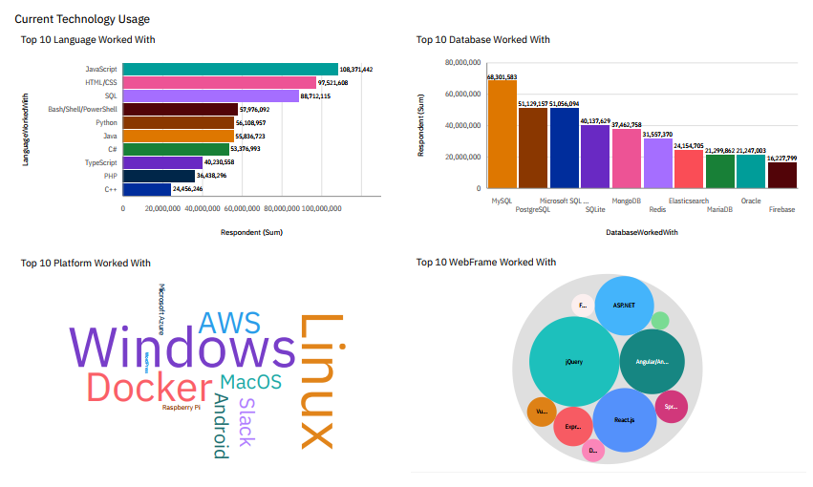
DASHBOARD TAB 1

Slide 13
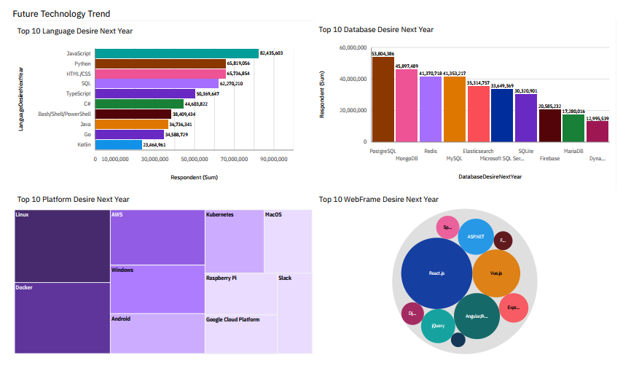
DASHBOARD TAB 2

Slide 14
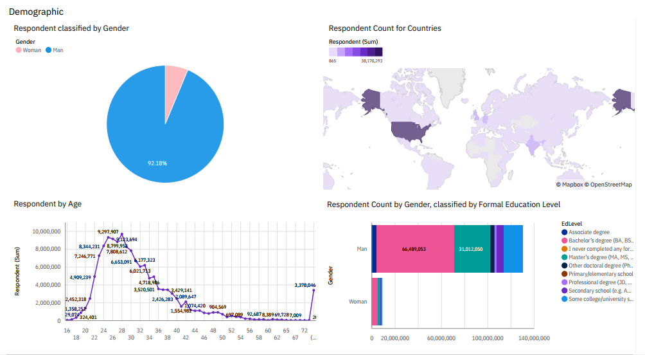
DASHBOARD TAB 3

Slide 15
DISCUSSION

Slide 16
OVERALL FINDINGS & IMPLICATIONS
Findings
Majority of developer are young male around the age 22 - 36
Developer are mostly located in developed country
Most people in the IT field have a Bachelors' degree.
Web Development language are the most popular.
NoSQL database will become high demand next year
Implications
There are polarization of developer by location and gender
Less developed countries need more access to tech trainings and education
Significant skill to learn in the future is NoSQL aside of SQL database
Web Development still profitable skill to learn in the future.

Slide 17

CONCLUSION
Based on how the trend keep changing over time in the tech sector it is important to stay update and adaptive in order to stay relevant.
There are job to be done in order to make this IT sector labor market more accessible to a developing country.

Slide 18

APPENDIX

Slide 19
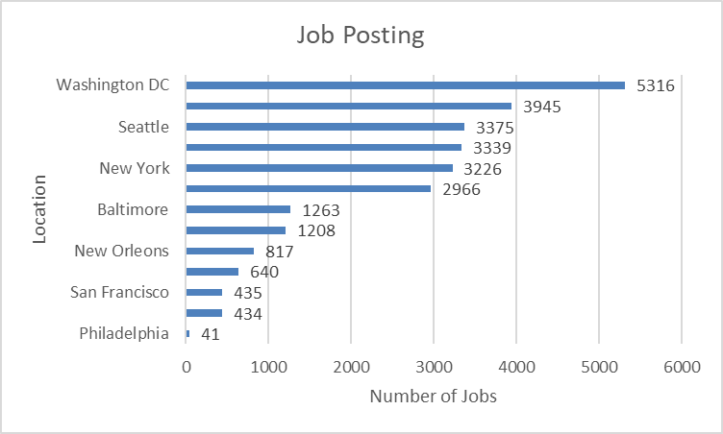
JOB POSTINGS

Slide 20
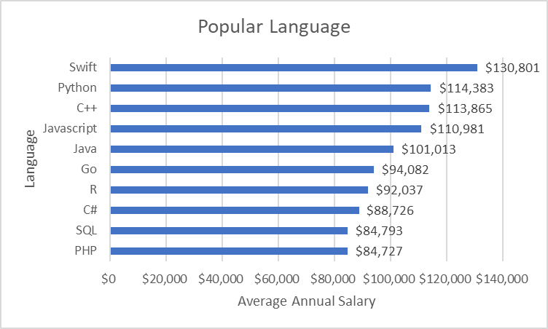
POPULAR LANGUAGES

