Slide 1
Insurance Premium Prediction
Project by -
Abhishek Suryawashi
Devesh Gautam
Shubham Jeware
Piyush Kharalkar
Kaustubh Patil
Guided by-
Mr. Milind Kapse

Slide 2
Objectives :
Predict insurance Premium using Machine Learning Algorithms.
Compare results between different Models
Explore impact of regularization on our models.
Provide insights for real world implementation.
Handle data challenges and ensure fair prediction.

Slide 3
Technologies Used :
Pyspark & its ecosystem
Machine learning
Power BI
FastAPI (Backend)
HTML/CSS/JS (Frontend)

Slide 4
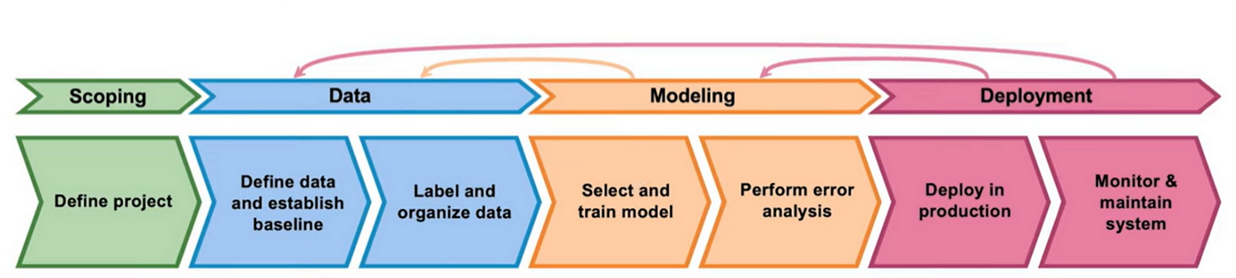
Machine Learning LifeCycle
The project lifecycle for our insurance premium prediction model began with understanding the problem—how to accurately assess risk and set fair premiums. We then gathered and preprocessed a large dataset (~10 lakh rows), ensuring data quality and normalization. Feature selection using Lasso Regression helped identify the most relevant factors, followed by training XGBoost and LightGBM models to optimize predictions. Finally, we evaluated performance, compared models, and derived insights for real-world applications in the insurance industry.

Slide 5
Data Preprocessing (Pyspark):
Data cleaning
Null value removal
Label Encoding

Slide 6
Exploratory Data Analysis (EDA) :
Data Visualization: Histograms, scatter plots to check distributions
Correlation Analysis: Checking relationships between features.
Multicollinearity Test: Using VIF to detect redundant features

Slide 7
Feature Selection/Transformation :
Variance was not present in the data, so Log Transform and Power Transformation did not work as variance remained unchanged.
To address this, we applied business assumptions and scaled the data accordingly.
Scaling: Custom Scaling according business requirements

Slide 8
Business Assumptions for Scaling :
Higher Income → Lower Risk → Lower Premium
Higher Health Score → Lower Risk → Lower Premium
Lower Credit Score → Higher Risk → Higher Premium
Age-Based Risk & Premium Structure:
Older Individuals → Higher Risk → Higher Premium
2. Younger Individuals → Not Earning Enough → Higher Risk → Higher Premium
3. Middle-Aged Individuals → Stable Earnings & Good Health → Lower Risk → Lower Premium

Slide 9
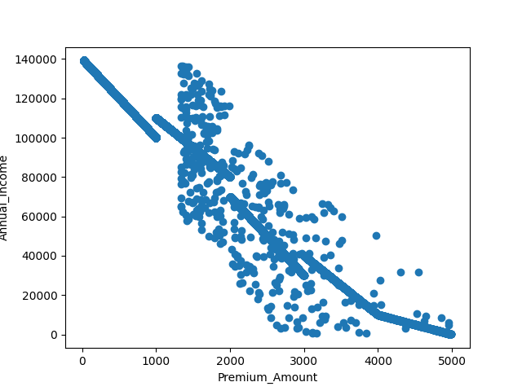
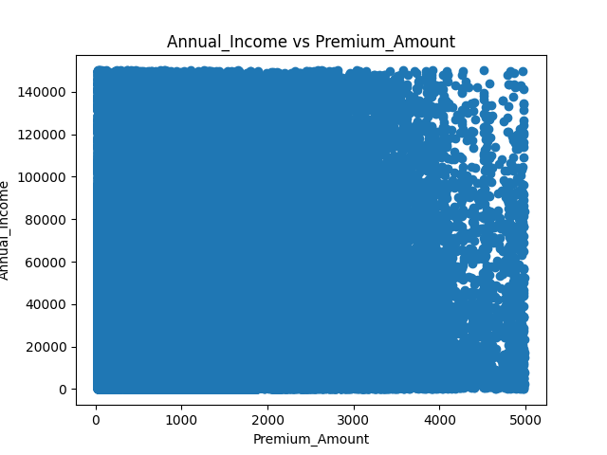
Model Scaling Using assumptions

Slide 10
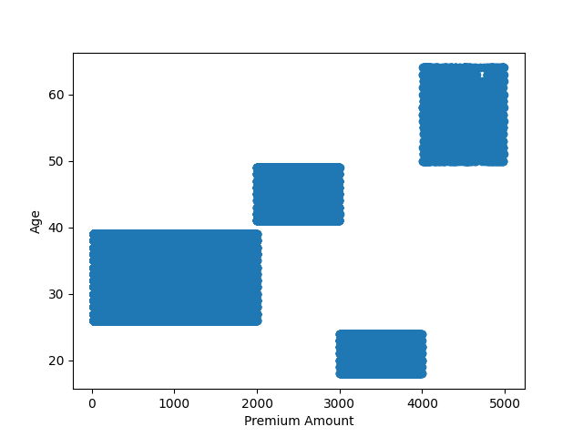
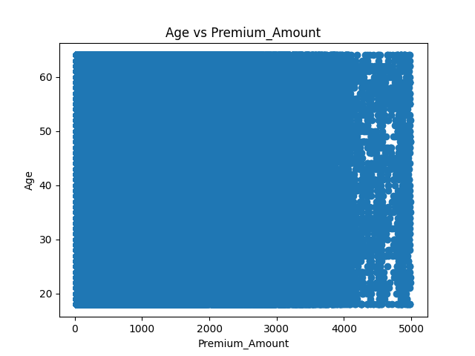
Model Scaling Using assumptions

Slide 11
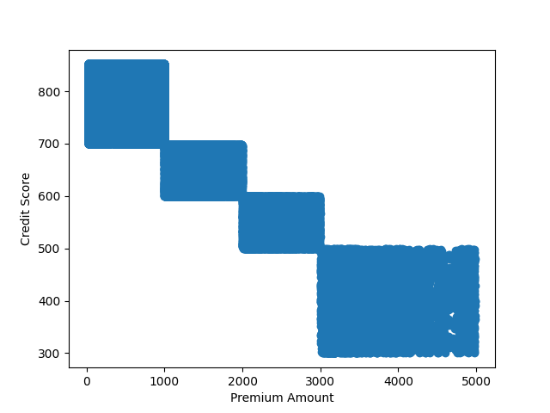
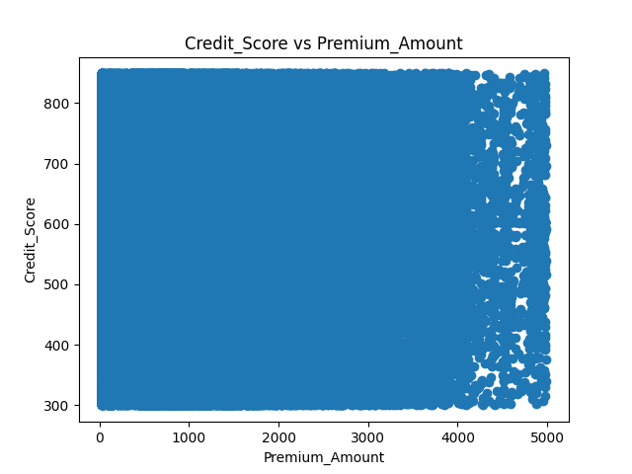
Model Scaling Using assumptions

Slide 12
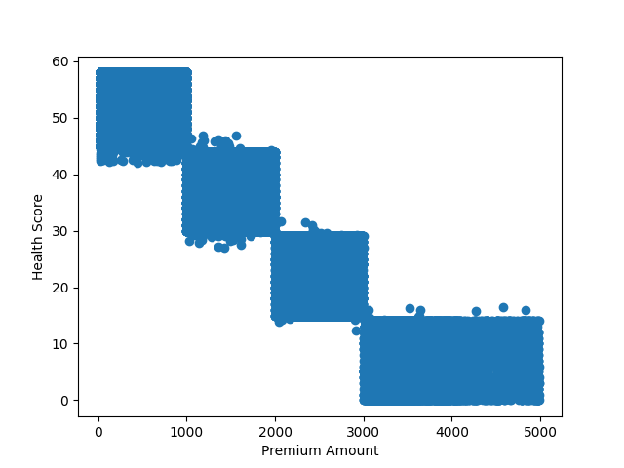
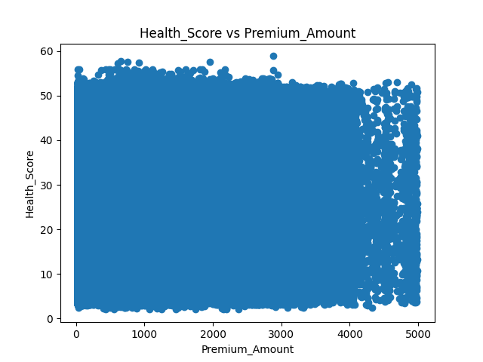
Model Scaling Using assumptions

Slide 13
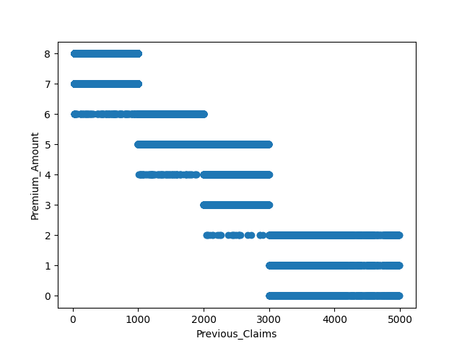
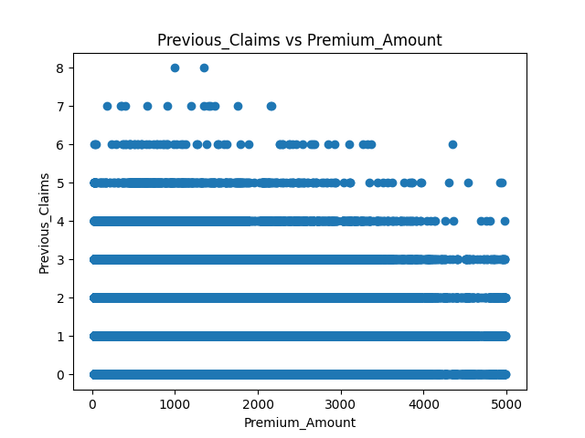
Model Scaling Using assumptions

Slide 14
Model Training - Linear Regression :
Used as a baseline model to predict insurance premiums.
Assumes a linear relationship between features and premium amount.
Limitations:
Could not capture complex, nonlinear relationships in the data.
Sensitive to multicollinearity, affecting coefficient stability.
Findings:
Provided an initial benchmark but performed worse than tree-based models like XGBoost and CatBoost.

Slide 15
Model Training - Lasso Regression :
Lasso (Least Absolute Shrinkage and Selection Operator)
Applied L1 regularization to reduce overfitting and improve feature selection.
Automatically eliminates less important features by shrinking their coefficients to zero.
Benefits:
Helped in handling multicollinearity by selecting key features.
Improved model interpretability compared to Linear Regression.
Limitations:
Could not fully capture nonlinear relationships in the data.
Performance was lower than Gradient Boosting models like XGBoost and CatBoost.

Slide 16
Model Training - XGBoost :
Used gradient boosting to improve prediction accuracy by combining multiple weak decision trees.
Limitations:
Requires hyperparameter tuning to avoid overfitting.
Higher computational cost compared to simpler models.
Findings:
Performed better than Linear and Lasso Regression.
Comparable or superior to CatBoost and Decision Tree models in prediction accuracy.

Slide 17
Model Training - Decision Tree :
Used tree-based splitting to predict insurance premiums by learning decision rules from data.
Handles both numerical and categorical data efficiently.
Limitations:
Prone to overfitting, especially with deep trees.
Less robust compared to boosting models like XGBoost and CatBoost.
Findings:
Provided reasonable accuracy, but boosting models outperformed it.
Works best with pruning or ensemble methods to improve stability.

Slide 18
Model Training - Catboost :
A gradient boosting algorithm optimized for categorical data.
Handles categorical variables efficiently without extensive preprocessing.
Reduces overfitting through built-in regularization techniques.
Faster training time compared to other boosting algorithms like XGBoost.
Findings:
Achieved high accuracy in premium prediction.
Performed competitively with XGBoost, sometimes better on categorical-heavy features.
Required careful hyperparameter tuning for optimal results.

Slide 19
Model Evaluation & Comparison
Metrics | Linear Reg | Lasso Reg. | XG Boost | Decision Tree Reg. | CatBoost
MSE | 11364.241857344 | 11364.327874815 | 618.28630509589 | 496.90964620614 | 503.94822168769
MAE | 75.483000211146 | 75.502013355569 | 5.3982651676582 | 0.7668584451003 | 6.3175458068354
RMSE | 106.60319815720 | 106.60360160339 | 24.865363562511 | 22.291470256718 | 22.448791096352
R-squared | 0.9848624035094 | 0.9848622889309 | 0.9991764194462 | 0.9993380977093 | 0.9993287220627

Slide 20
Model Evaluation & Comparison
Feature | SVR (RBF Kernel) | Lasso Regression | Gradient Boosting
Handles Nonlinear Data | Yes (Kernel trick) | No (Linear model) | Yes (Decision trees)
Feature Selection | No | Yes (L1 Regularization) | Implicit (Tree-based)
Overfitting Control | Regularization (C, Epsilon) | L1 penalty (reduces complexity) | Boosting reduces bias
Computational Efficiency | Slow for large datasets | Fast (Linear Model) | Slower (More trees, complex calculations)
Performance on Test Data | Moderate | Good | Best
Robust to Outliers? | Yes (Margin-based) | No | Yes (Boosting corrects errors)
Final Prediction Type | Continuous Values | Continuous Values | Continuous Values

Slide 21
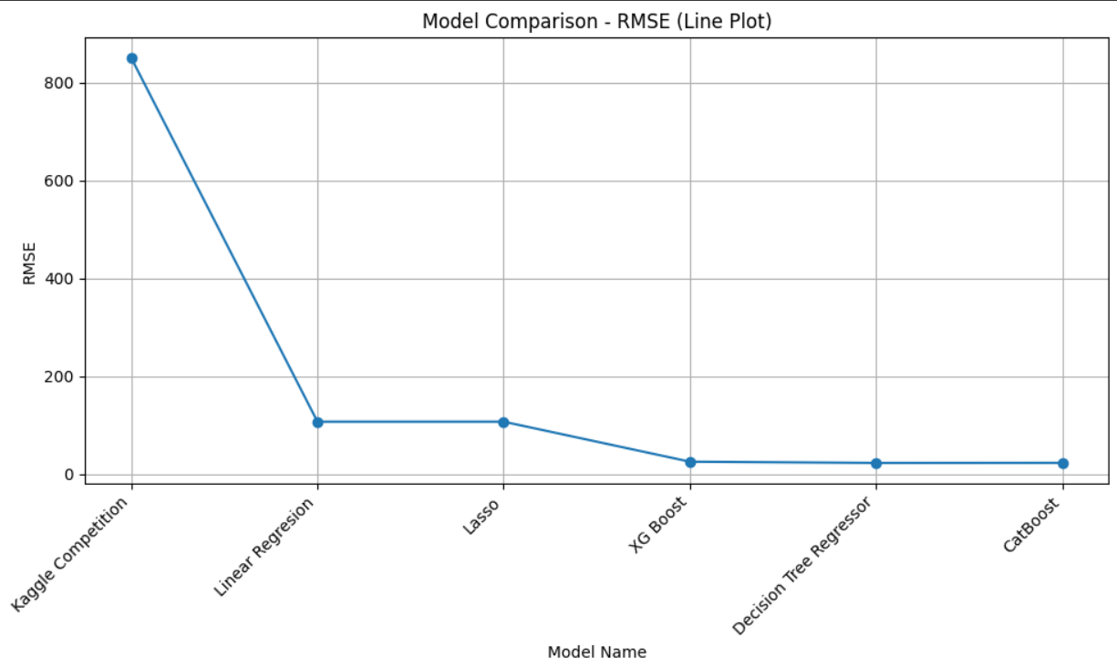
Model Comparison :

Slide 22
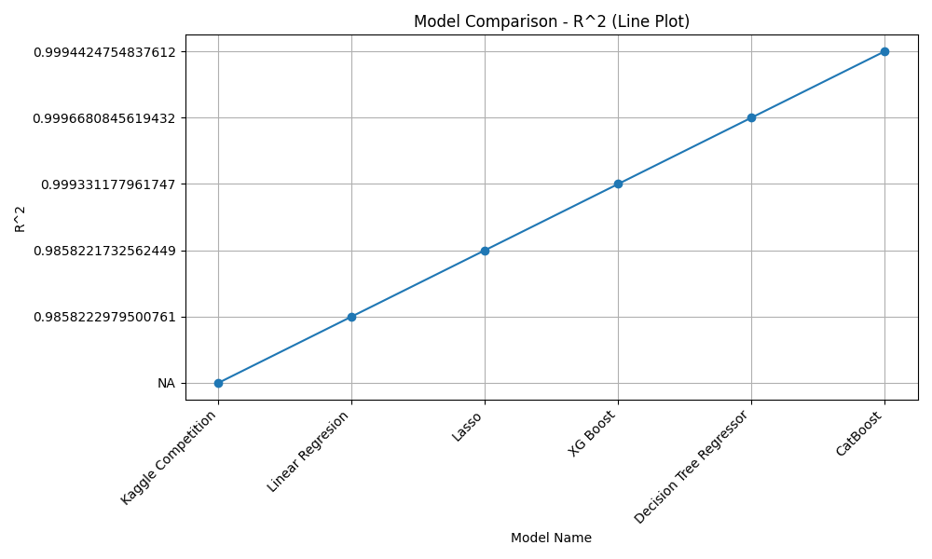

Slide 23
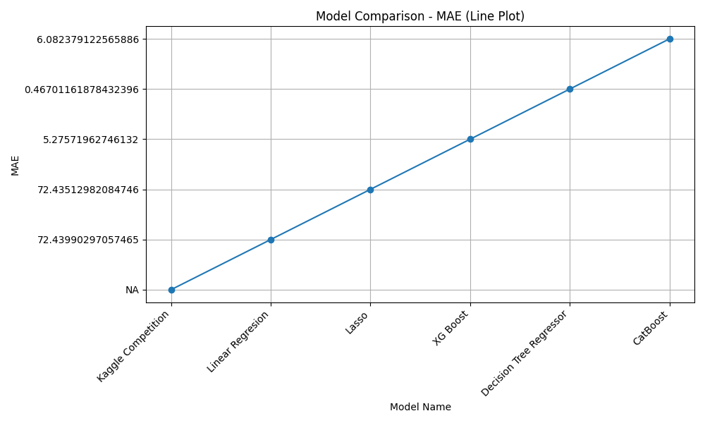

Slide 24
Deployment :
Koyeb:
Koyeb is a serverless platform for deploying web applications and APIs.
It provides automatic scaling, global deployment, and built-in networking.
Enables seamless CI/CD workflows.
Netlify :
Netlify is a cloud-based platform for deploying web applications and static websites.
Enables fast and scalable front-end deployments.

Slide 25
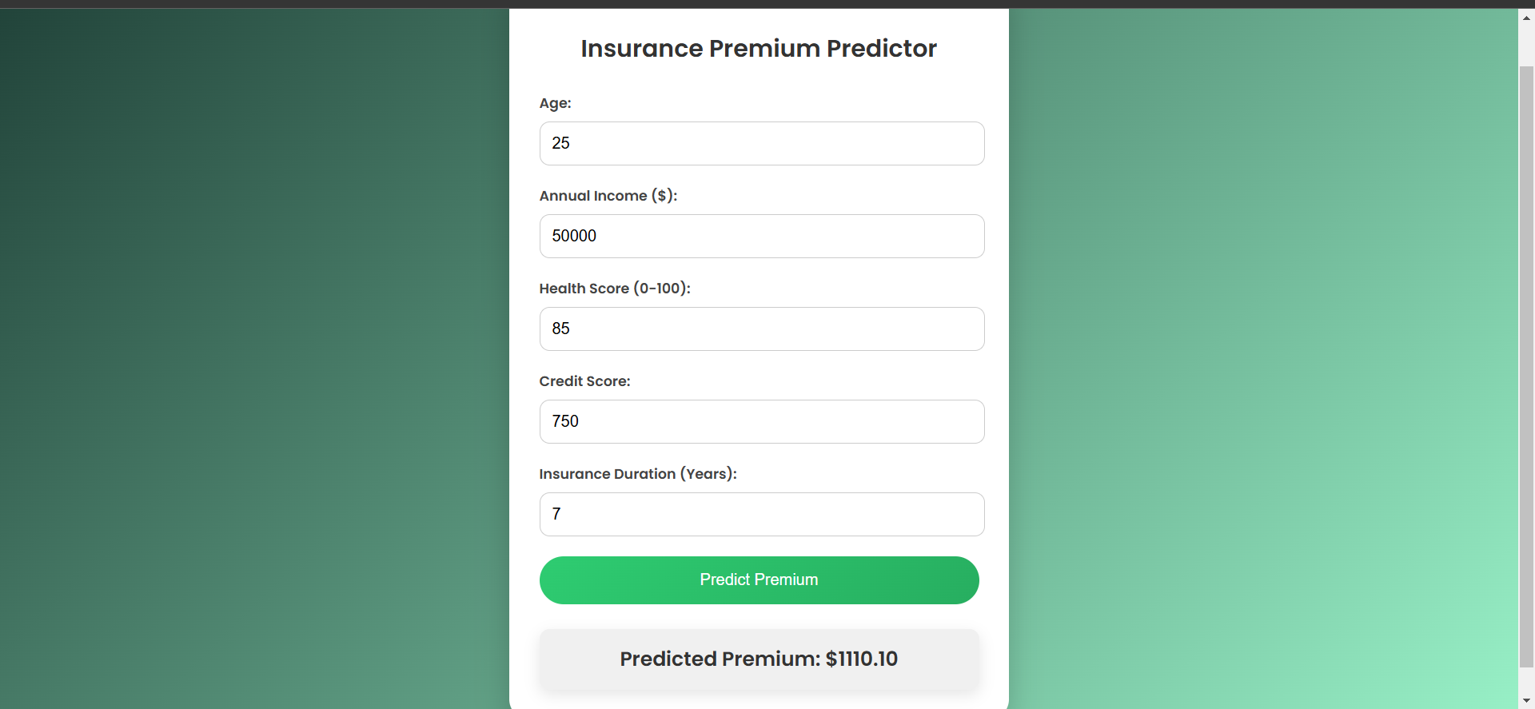
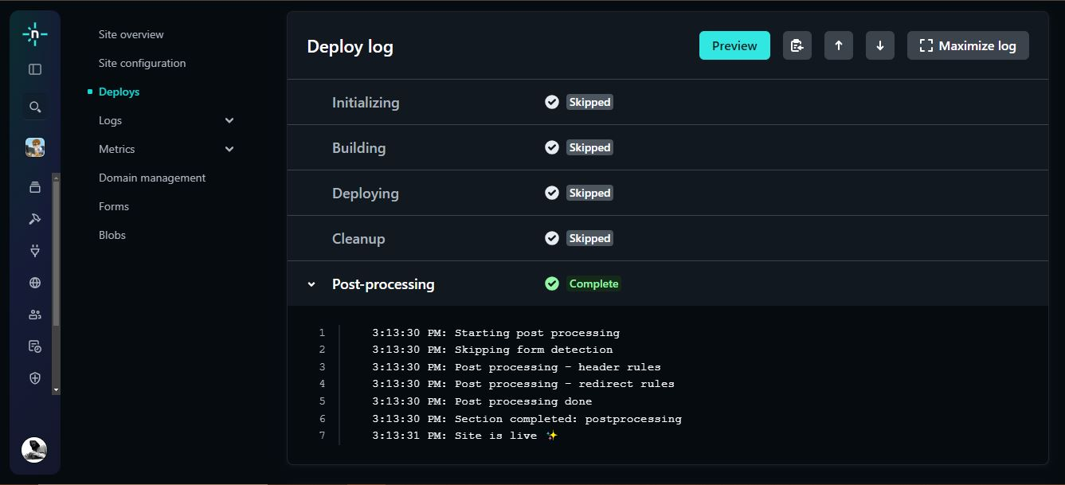
Frontend :

Slide 26
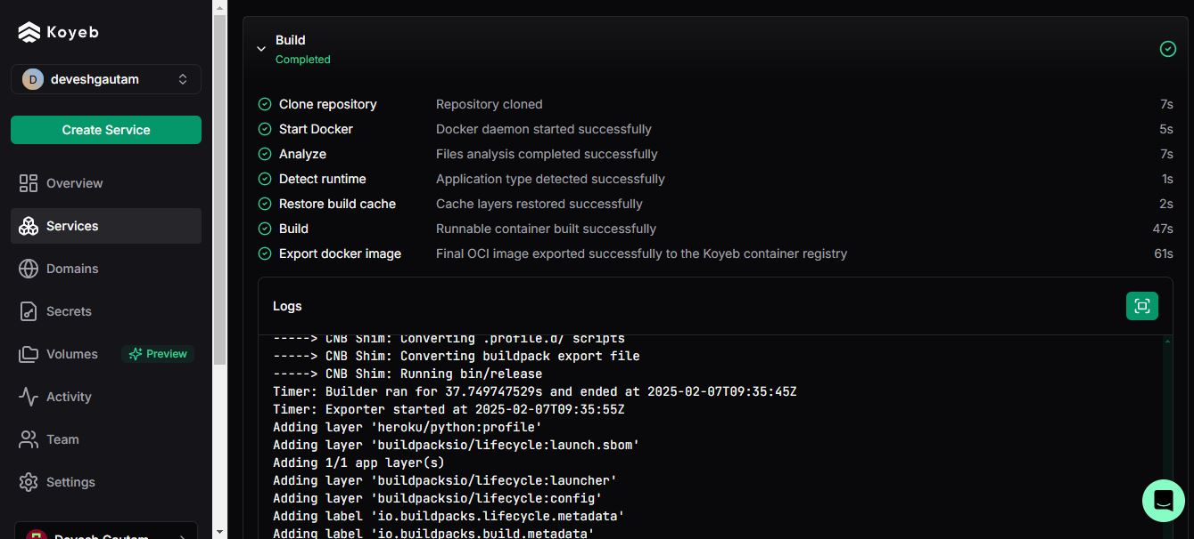
Backend :

Slide 27
Conclusion :
We developed a machine learning model to predict insurance premiums using Lasso Regression, Gradient Boosting, and Support Vector Regression (SVR).
Extensive data preprocessing, feature selection, and model evaluation were performed to ensure accuracy.
Gradient Boosting performed the best, capturing complex relationships while balancing bias and variance.
Lasso Regression was useful for feature selection, but its linear nature limited its predictive power.
SVR handled nonlinear patterns well, but it was computationally expensive and slower.

Slide 28
Future Scope :
Improve Model Accuracy: Fine-tune hyperparameters to get better predictions.
Add More Features: Include real-world factors like claim history, policyholder behavior, or economic trends.
Try Deep Learning: Use neural networks to capture more complex patterns in the data.
Make Real-Time Predictions: Deploy the model for instant premium calculations.
Improve Explainability: Use methods to understand how the model makes decisions.
Deploy in Production: Integrate the model into a cloud-based system for real-world use.

Slide 29
THANK YOU

