Slide 1
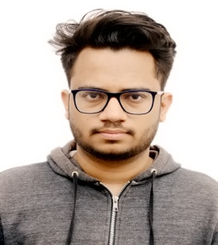
Abhuday Pandey
E-mail: Abhuday.Pandey@cognizant.com
Objective:
I want to put to use my skills , technologies that I am familiar with, innovative thoughts that will benefit the Organization in the long run and also help me in building my professional career.
Technical Skills:
Programming Languages: Java, C
Technologies: Micro-service, REST, Java8, JPA, Hibernate, Junit, Mockito.
Web Technology: HTML, CSS, JavaScript, Angular
Frameworks: Springboot, SpringCloud
Web/Application Server: Tomcat, Firebase
Operating System: Windows, Linux
Database: MySQL
Tools: Eclipse/STS, VSCode, Git, Docker, Maven, Postman, MySQLWorkBench
Project Experience / Key Highlights:
Worked on Bank Transaction Statistics followed by spring-boot based micro-service architecture.
Worked on a Stock-Market based project enhancing all full-stack technologies(Spring-Boot +MySQL + Angular).
Have Worked in test driven development using Junit, Mockito and documentation also.
Achievements & Participation:
Participated in college technical event in which we made Hand-Gesture controlled wheelchair.
Participated in technical event VERSION at NIT Trichy.
Completed course in core java from Ducat Noida.
Education:
MCA (2016-19) Lal Bahadur Shastri Institute of Management, New Delhi.

