Slide 1
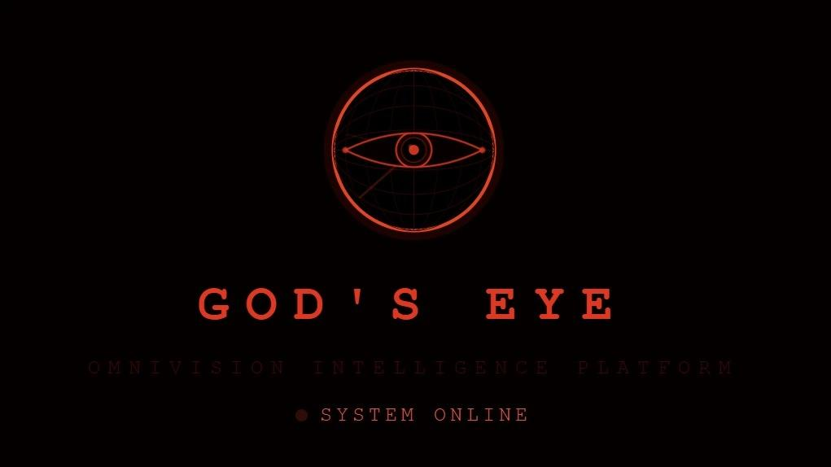
OMNIVISION INTELLIGENCE PLATFORM
Presenter: ABHYAS KATHURIA
Roll No: 20241BCI0063 | Course: BCA-AIML
DEPARTMENT OF COMPUTER SCIENCE & ENGINEERING | PRESIDENCY UNIVERSITY BANGALORE

Slide 2
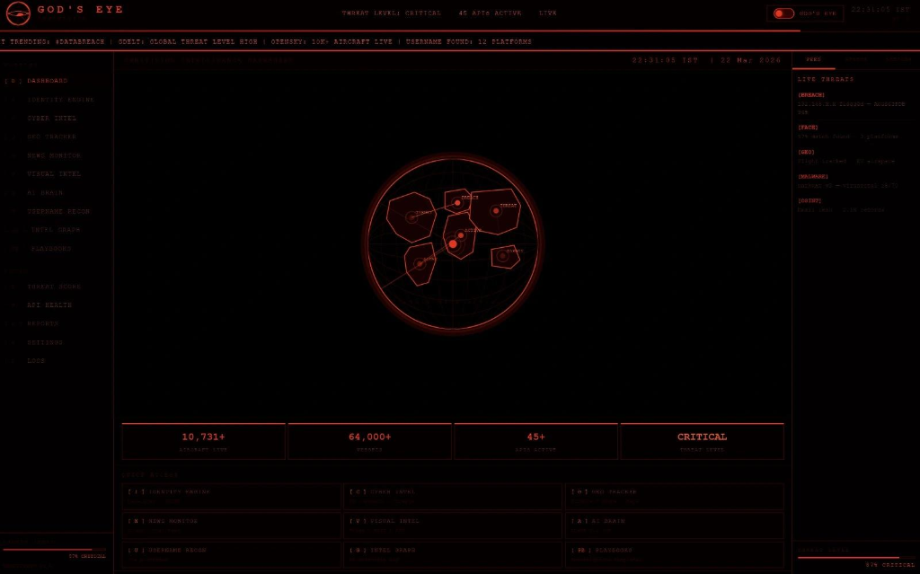
THE CORE PROBLEM STATEMENT
Operational Inefficiencies in CTI & OSINT:
Fragmented Tooling: Investigators waste time context-switching across 45+ separate command-line scripts and websites (Shodan, VirusTotal, AbuseIPDB, LeakCheck).
Data Correlation Silos: Information like IP reputation, WHOIS data, email leaks, and face images are processed separately, leaving correlation maps to manual spreadsheets.
Generative AI Integration Gap: Raw logs are complex to interpret, but traditional workflows lack a dynamic context-aware summarization layer.
Prohibitive Licensing Fees: Enterprise threat analysis software is too expensive for academic labs, SOC centers, and students.

Slide 3
TARGET USERS & OPERATIONAL PROFILES
CTI ANALYSTS
Discover and monitor malicious Command-and-Control (C2) servers and threat actor infrastructure. Use Module: Cyber Intelligence, News GDELT Tracker, and Intel Graph.
SOC & IR TEAMS
Triage network intrusion alerts, verify IP reputation score triggers, and audit breached credentials. Use Module: Threat Score, Domain Investigator, Breach Check.
FORENSICS & DFIR
Examine suspect digital evidence, parse camera model stamps, and extract geographical capture targets. Use Module: Visual EXIF analysis, Identity Engine reverse image search.
OSINT RESEARCHERS
Track global flight vectors, naval assets, search user handles across social channels, and print briefings. Use Module: Username Recon, Geo Tracker, PDF reports.

Slide 4
FULL-STACK SYSTEM ARCHITECTURE
FRONTEND CAPABILITIES (React 18 + Vite)
* Single Page Application (SPA) compiled with Vite for ultra-low loading latencies.
* Interactive mapping layers built on Leaflet.js and OpenStreetMap.
* Dynamic relation modeling using HTML5 canvas and animated custom SVGs.
* Stealth Theme Toggle: Switches UI context from Red to Analyst Blue instantly.
BACKEND DISPATCHER (FastAPI + Uvicorn)
* Asynchronous ASGI backend engine handling concurrent client searches via Uvicorn.
* JWT Session Protection: 8-hour token expiry with embedded user access role checks.
* Forensic Image Processing: Python Pillow parser extracting hidden metadata frames.
* Activity Audit Log: Writes user query metrics to logs to ensure tracking accountability.
API AGGREGATION (45+ External Feeds)
* Groq AI Engine: Runs LLaMA 3.3 70B inference to generate intelligence summaries.
* Cyber Threat Feeds: VirusTotal malware scans, Shodan networks, AbuseIPDB alerts.
* Identity & Breaches: Luxand, Face++, LeakCheck credentials repositories.
* Geo tracking: OpenSky flight feeds, AIS vessel overlays, Sentinel imagery maps.

Slide 5
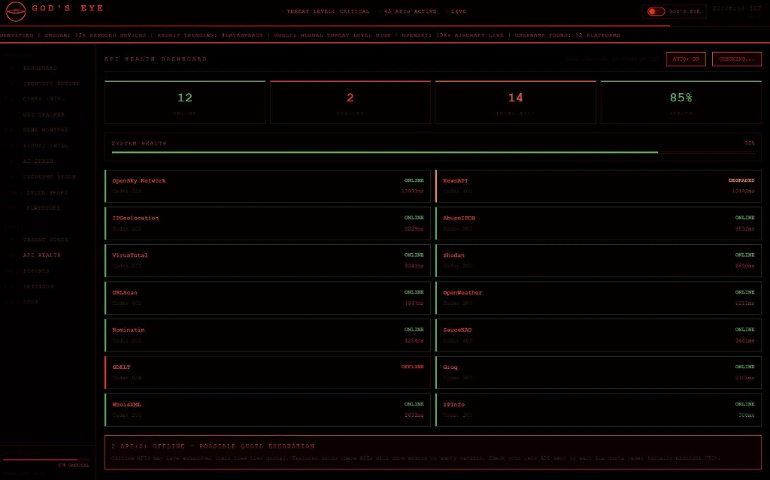
ASYNC-PARALLEL PROCESSING ENGINE
Overcoming API Latencies via Concurrency
Sequential Bottleneck: Standard tools query APIs one after another, hanging up to 20 seconds for multi-source scans.
Async Dispatcher: God's Eye uses Python's 'asyncio.gather()' to dispatch all API requests in parallel, cutting time to under 5 seconds.
Rate-Limiting Protection: Handles API response timeouts gracefully, preserving free-tier quotas.
Error Isolation: Wraps each endpoint query in insulated try-except blocks so individual API outages never crash active searches.

Slide 6
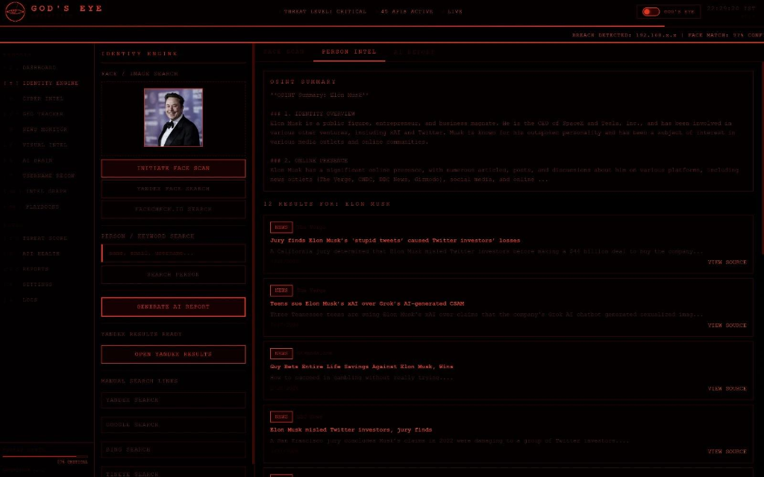
BIOMETRIC & KEYWORD PROFILING (IDENTITY ENGINE)
BIOMETRIC PORTRAIT SCANNING
Luxand AI Integration: Extracts approximate age, gender, active emotions, smile rates, and glasses markings.
Face++ Processing: Deep facial parameter extraction, including complex emotion vectors and cosmetic beauty ratings.
SauceNAO Reverse Indexing: Compares face layouts against database models to identify direct platform matches.
Parallel Search Links: Auto-generates links to query Google Lens, Yandex Visual Search, and Bing images in one click.
Keyword OSINT: Aggregates News API & Reddit public posts to build a summarized profile via LLaMA 3.3.

Slide 7
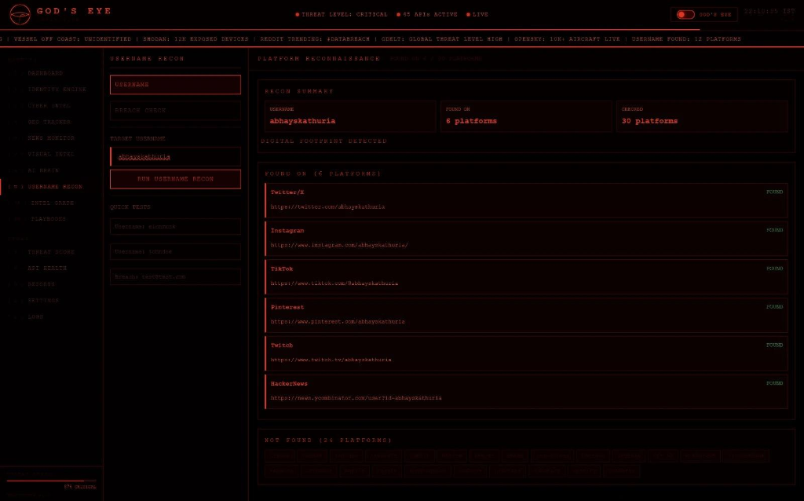
CYBER THREAT INTEL & USERNAME RECON
Cyber Investigation & Footprint Mapping
IP Tracker: Resolves exact coordinates, ISP maps, AbuseIPDB confidence score, and VirusTotal engines.
Domain Investigator: Pulls WHOIS registration records, DNS routing maps, and live landing page captures via URLScan.io.
Shodan Explorer: Queries globally exposed databases (MongoDB), remote servers (SSH), and webcams.
Username Recon: Scans 30+ major networks in parallel (GitHub, Twitter, Reddit, TikTok, LinkedIn, etc.) to list direct profile links.
Breach Check: Queries LeakCheck.io to check compromised employee credentials.

Slide 8
LIVE GEOSPATIAL TRACKING & SATELLITE HUB
Interactive Asset Mapping & Satellite Passes
* Live Flight Tracker: Connects to the OpenSky Network via OAuth2 to pull and map 10,000+ real-time aircraft locations globally. Renders flights on an interactive Leaflet map.
* Dynamic Flight Details: Click on plane icons to trace callsigns, ICAO registrations, altitude, velocity, and vector headings.
* Marine Vessel Tracking: Integrates coastal ship WebSocket overlays for maritime surveillance.
* Satellite Image Hub: Generates coordinates to pull passes from NASA Worldview and Sentinel Hub.
GEOGRAPHIC DATA FUSION
1. Nominatim Geocoder: Resolves decimal coordinates (e.g. from target photo EXIF) to exact addresses. 2. OpenWeatherMap Link: Fetches real-time weather logs (temperature, humidity, wind conditions) for the target location to confirm operational visibility. 3. OSINT Playbook Integration: Integrates geographical queries with standard investigation SOP checklists to support physical target tracking.

Slide 9
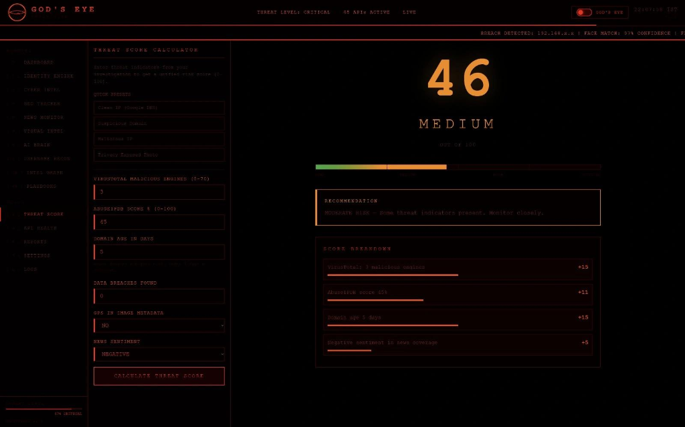
MULTI-SIGNAL THREAT SCORING MODEL
THE THREAT SCORE EQUATION
Score (0-100) = VirusTotal Detections [30] + AbuseIPDB Reputation [25] + Domain Registration Age [15] + Compromised Breaches [15] + GPS Metadata Presence [10] + Negative News Sentiment [5]
Mathematical Parameter Rationale
VT Consensus (30pts): 70+ AV engines consensus is the strongest malicious signal.
AbuseIPDB (25pts): Active abuse logs (port scans, bruteforce, proxy gateway alerts).
Domain Age (15pts): Penalizes new domains under 7 days (standard phishing tactics).
GPS (10pts): Instant 10-point addition if geotags are found in image metadata.

Slide 10
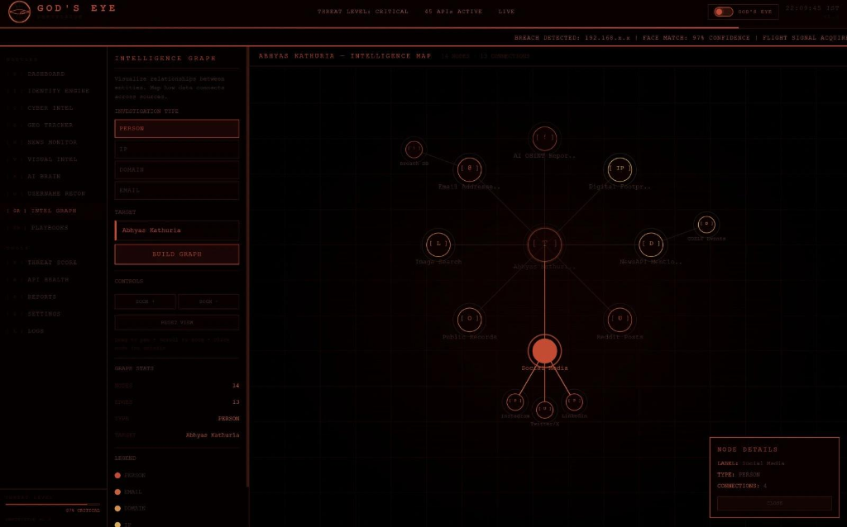
INTELLIGENCE GRAPH & PLAYBOOKS
Visual Correlation Maps & Guided SOPs
Intelligence Graph: Renders Maltego-style relationship maps dynamically (IPs, Domains, Emails, Names) using animated SVGs.
Click Node details: Interactive node inspection displays reputation metadata instantly.
Guided Playbooks: 6 pre-built incident templates (Cyber Threat Hunt, Image Forensics, Domain Recon). Checklists animate as steps are executed.
Jump Module Shortcuts: Click on a playbook step to jump directly to that module, auto-filling target inputs.

Slide 11
SIGINT & BLOCKCHAIN LEDGER INTEL
Wireless Recon & Cryptographic Ledger Tracking
Wireless Airspace Recon: Integrates with the Wigle.net database to locate nearby Wi-Fi network coordinates on an interactive dark Leaflet map.
Wi-Fi Audit Details: Extracts SSID, BSSID (MAC Address), signal strength (QoS), encryption standards, and channels dynamically.
Crypto Ledger Tracker: Communicates with Etherscan (ETH) and Blockcypher (BTC) explorers to query address balances and transaction tables.
Ledger Route Mapping: Graphs visual transaction hops (Target Wallet -> Current Balance -> Transfer Relays) for financial forensics.
Threat Intelligence: Real-time threat pulse metadata via AlienVault OTX (Open Threat Exchange) for indicators (IPs/domains).

Slide 12
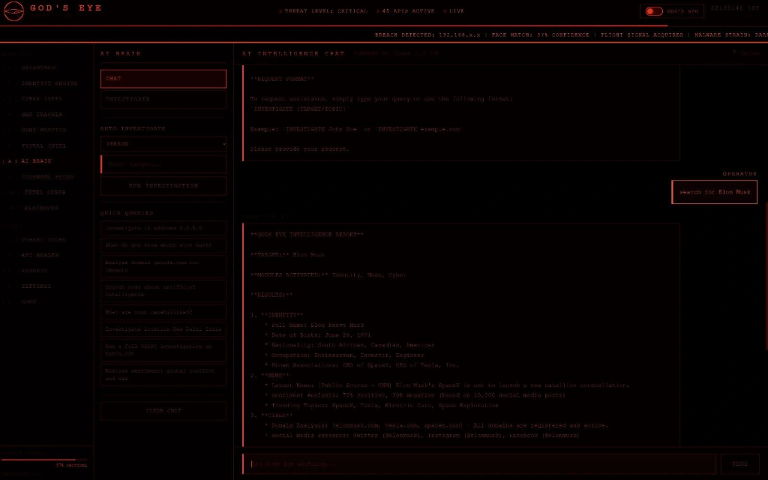
UNIQUE VALUE PROPOSITION
Why God's Eye is Different:
45+ Free-Tier APIs: Zero subscription or setup cost, rendering enterprise-grade CTI accessible.
AI Summaries (LLaMA 3.3 70B): Automatic text fusion reduces synthesis delays by over 90%.
JWT Session Protection: Session limits and secure local environment prevent raw key exposures.
Log Accountability: Mandatory Ethics Agreements and detailed search logs prevent tool misuse.

Slide 13
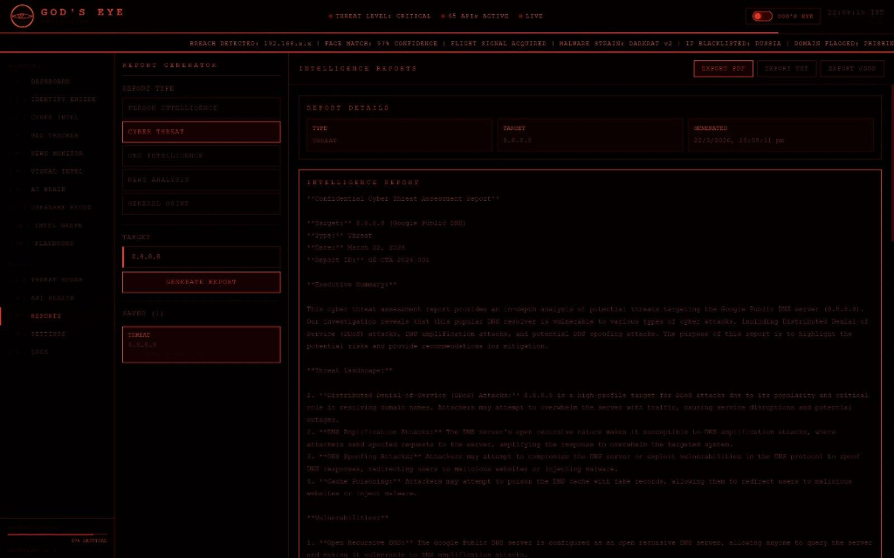
FUTURE ROADMAP & PROJECT CONCLUSION
Development Roadmap (v2.0)
* Docker Containerization: Support cross-platform deployments (Mac, Linux) via docker-compose.
* Deepfake GAN Detection: Integrate deep learning models to identify AI-generated synthetic media in visual scans.
* Advanced Forensics: Machine learning models for voice cloning detection.
* Mobile-Responsive Layout: Optimize Tailwind parameters for field mobile devices.

