Slide 1
BCA Mini Project (Review I) GOD'S EYE (OMNIVISION)
Submitted to the Presidency University, Bengaluru in partial fulfillment for the award of the degree of Bachelor of Computer Applications(BCA)
Project Number :
Under the supervision of
Ms.Gazala Zameer Assistant Professor, BCA School Of Information Science
Name | Roll Number
Abhyas Kathuria | 20241BCI0063
Tejas Singh Sisodia | 20241BCI0055
Sumana Biswas | 20241BCI0089
Dominic Melwin | 20241BCI0097

Slide 2
Content
Problem Statement
Literature Survey
Tools and Technologies to be used
Timeline of the Project
Github Link
References

Slide 3
Problem Statement
1. Clear definition of the problem Open-source intelligence (OSINT) work today is fragmented across dozens of disconnected, single-purpose tools — one for face recognition, another for breach lookups, another for IP/domain reputation, another for geolocation, another for social media recon. There is no unified platform that consolidates these capabilities into a single, coherent investigative workflow while enforcing responsible-use boundaries.
2. Relevance and significance in real-world scenarios Cybersecurity analysts, digital forensics teams, journalists, and researchers routinely need to correlate identity, cyber, and geospatial signals to assess threats or verify information — but doing so manually across 10+ disparate tools is slow, error-prone, and hard to audit. As misinformation, deepfakes, and cyber threats grow more sophisticated (2026 context), the need for consolidated, AI-assisted intelligence tooling — used responsibly and legally — is increasingly critical for both professional practice and cybersecurity education.
3. Gaps or limitations in existing solutions
Existing tools (Maltego, SpiderFoot, theHarvester, etc.) each specialize in one domain and require manual stitching-together of results.
Most lack built-in audit logging, legal-basis capture, or DPDP/GDPR-style compliance safeguards before processing biometric or personal data.
Few integrate a genuine AI reasoning layer that can correlate findings across modules automatically rather than presenting siloed raw output.
Educational/training environments for OSINT are scarce — most tools assume professional deployment, not safe, scoped learning.
4. Concise, specific, research-oriented statement "There exists no unified, AI-assisted, compliance-aware OSINT platform that consolidates identity, cyber, and geospatial intelligence gathering into a single research and educational environment — this project addresses that gap through God's Eye (OMNIVISION), a full-stack, multi-module intelligence platform built with responsible-use safeguards."

Slide 4
SAMPLE LITERATURE REVIEW
Reference Area | Key Insight | Gap Addressed by God's Eye
Existing OSINT frameworks (Maltego, SpiderFoot, theHarvester) | Powerful but fragmented — each tool covers one domain (recon, breach, graph) | Consolidates identity, cyber, geo, news, and graph intel into one platform
Facial recognition & reverse image search research | High accuracy but raises consent/privacy concerns | Ships with responsible-use statement, generic fixtures, no real-portrait datasets
Threat intelligence scoring models (VirusTotal, AbuseIPDB methodologies) | Individual signals scored in isolation | Unified 0–100 weighted threat score combining 6 independent signals
Data protection literature (India's DPDP Act, 2023) | Growing need for legal-basis capture before biometric processing | Planned DPDP compliance gateway before any face scan in Identity Engine
AI-assisted investigation tools (LLM-based analyst copilots) | Emerging trend of LLMs summarizing/correlating OSINT findings | AI Brain module uses LLaMA 3.3 70B with live map/telemetry grounding

Slide 5
Module Design
Brief Overview of the Project's Modular Architecture
God's Eye (OMNIVISION) is built as a full-stack, service-oriented system: a React 18/Vite frontend communicates over REST with a FastAPI backend, where each intelligence capability is isolated into its own router and service file (/auth, /identity, /cyber, /geo, /news, /visual, /ai, /recon). Each backend router pairs with a dedicated frontend page, and all external API calls run in parallel via asyncio.gather() so one module's failure never blocks another. This gives the platform 14 functionally distinct intelligence modules operating under one unified authentication, logging, and theming layer.
Purpose of Dividing the Project into Modules
Separation of concerns: Each OSINT domain (identity, cyber, geo, news, visual, AI) has its own service logic, so changes to one module (e.g., swapping a breach-check API) don't risk breaking others.
Graceful degradation: Since modules call independent third-party APIs, if one API goes down (e.g., Shodan quota exhausted), the rest of the platform keeps functioning — critical for a system built on 50+ free-tier external dependencies.
Scalability & maintainability: New intelligence capabilities (e.g., the planned deepfake detection module) can be added as new routers/pages without touching existing modules.
Role-based access control: Modular boundaries make it straightforward to gate access by role (ADMIN / RESEARCHER / STUDENT) at the module level.
Testability: Each service can be unit-tested in isolation (test_auth.py, test_services.py) rather than requiring end-to-end tests for every change.

Slide 6
Module Design
Modular Breakdown
Module 1: Identity & Access Management (Auth) Handles user authentication and session security — JWT token issuance (8-hour expiry), bcrypt-salted password hashing, role-based access (admin/researcher/student), and mandatory first-run credential reset. This module is foundational: every other module's API calls are gated behind a valid JWT, ensuring the platform can't be used anonymously.
Module 2: Identity & Visual Intelligence Engine Covers facial analysis (Luxand.cloud, Face++), reverse image search (Yandex, Google, Bing, SauceNAO, FaceCheck.id), and EXIF/GPS metadata extraction from uploaded images. Its role is converting a photo or username into a structured identity profile — this is the module with the highest privacy sensitivity, so it's the one earmarked for the DPDP-compliance gateway (mandatory legal-basis capture before any face scan).
Module 3: Cyber & Threat Intelligence Engine Aggregates IP/domain reputation (AbuseIPDB, WhoisXML), malware/URL scanning (VirusTotal, URLhaus), device exposure scanning (Shodan), and breach checking (LeakCheck.io). It feeds into the unified 0–100 Threat Score Calculator, which weights six signals (VT engines, AbuseIPDB confidence, domain age, breach count, GPS-in-metadata, news sentiment) into a single risk rating — this is the module that turns raw signals into an actionable verdict.
Module 4: Geospatial & Real-Time Tracking Engine Powers the Geo Tracker — live flight tracking (OpenSky, ADS-B), earthquake feeds (USGS), satellite orbits (CelesTrak), marine traffic, and Wi-Fi network mapping (Wigle.net) — rendered on a Leaflet map with tactical visual reskins (NVG/FLIR/Noir). Its role is real-time situational awareness, geolocating a target or event using live public telemetry feeds.
Module 5: News & Sentiment Monitor Pulls headlines and social discussion (NewsAPI, GDELT, Reddit, MediaStack) and runs sentiment analysis to correlate a target's real-world media footprint with the intelligence gathered elsewhere.

Slide 7
Module Design
Modular Breakdown
Module 6: AI Correlation Engine (AI Brain) The reasoning layer — LLaMA 3.3 70B via Groq, grounded with live telemetry context (map coordinates, active layer, zoom) from the Geo module. Its importance is architectural: rather than presenting siloed module outputs, this engine cross-references identity, cyber, and geo signals into a single natural-language intelligence report, which is the platform's core differentiator versus single-purpose OSINT tools.
Module 7: Reporting & Export Engine Consolidates findings from any module into PDF/JSON/TXT reports with platform branding and educational watermarking — the output layer that turns raw module data into a deliverable investigative artifact.

Slide 8
Tools And Technologies To Be Used
Development Tools
Visual Studio Code (primary IDE)
Docker Desktop + Docker Compose (containerized builds/deployment)
Postman / Thunder Client (API testing)
Programming Languages
Python 3.10+ (backend)
JavaScript (ES6+) (frontend)

Slide 9
Tools And Technologies To Be Used
Frameworks/Libraries
Frontend: React 18, Vite, Tailwind CSS, Leaflet.js (maps), Axios (HTTP), React Router DOM
Backend: FastAPI, Uvicorn (ASGI server), httpx (async HTTP client), Pydantic Settings
Auth/Security: PyJWT, bcrypt
AI/Image Processing: Groq SDK (LLaMA 3.3 70B), Pillow (PIL)
Testing: pytest, pytest-asyncio
Database
Lightweight JSON-based local data store (database/users.json, auto-seeded on startup) for user accounts and activity logs
(If your supervisor expects a formal RDBMS/NoSQL entry, this is a good place to note a planned migration to PostgreSQL — flag if you want me to word it that way)

Slide 10
Tools And Technologies To Be Used
Version Control
Git + GitHub (public repo: AbhyasKathuria/Gods-Eye-OMNIVISION)
GitHub Actions (CI pipeline — automated test/build on push and PR)
Additional Tools / Cloud Services / APIs
AI: Groq API (LLaMA 3.3 70B), Google Gemini (backup)
Cyber Intel APIs: Shodan, VirusTotal, AbuseIPDB, WhoisXML, URLScan.io, URLhaus, LeakCheck.io
Geo/Tracking APIs: OpenSky Network, USGS Earthquakes, CelesTrak, adsb.lol, Wigle.net, OpenWeatherMap, Nominatim/OSM
News/Social APIs: NewsAPI, GDELT, MediaStack, Reddit (public JSON)
Identity APIs: Luxand.cloud, Face++, SauceNAO, FaceCheck.id
Blockchain: Etherscan (ETH), Blockcypher (BTC)
Deployment: Docker containerization for cross-platform launch

Slide 11
Github Link
GitHub Repository:
https://github.com/AbhyasKathuria/Gods-Eye-OMNIVISION
✅ Public access confirmed — repository is publicly visible (no login required to view code, docs, or structure).
What the repository showcases:
Full source code — frontend/ (React 18 + Vite) and backend/ (FastAPI + Python)
Documentation: README.md, SECURITY.md, Gods_Eye_Documentation.docx
Supporting deliverables: Gods_Eye_Presentation_Final.pptx, Gods_Eye_Research_Paper.pdf
CI pipeline: .github/workflows/ci.yml (automated tests/builds on every push)
Test suite: backend/tests/ (test_auth.py, test_services.py)
Deployment configs: docker-compose.yml, one-click launch scripts for Windows/macOS/Linux
53 commits, MIT licensed, actively maintained

Slide 12
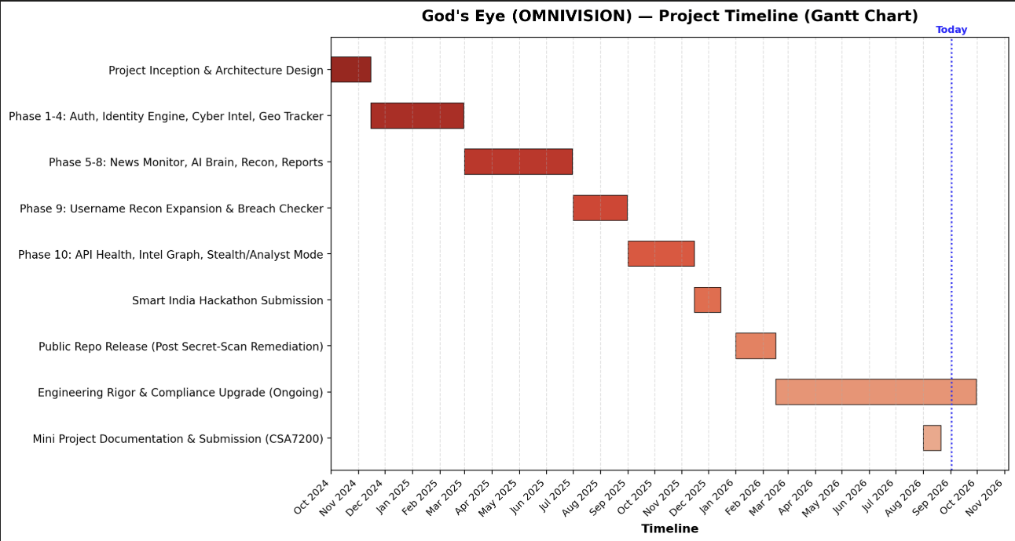
Timeline of the Project (Gantt Chart)

Slide 13
References (IEEE Paper format)
References — IEEE Format
[1] FastAPI, "FastAPI Documentation," 2026. [Online]. Available: https://fastapi.tiangolo.com
[2] Meta Platforms, Inc., "React Documentation," 2026. [Online]. Available: https://react.dev
[3] Google LLC, "VirusTotal API Documentation," 2026. [Online]. Available: https://developers.virustotal.com
[4] Shodan, "Shodan API Documentation," 2026. [Online]. Available: https://developer.shodan.io
[5] OpenSky Network, "OpenSky Network API," 2026. [Online]. Available: https://openskynetwork.github.io/opensky-api
[6] Ministry of Electronics and Information Technology, Government of India, Digital Personal Data Protection Act, 2023. New Delhi, India: MeitY, 2023.
[7] Groq, Inc., "LLaMA 3.3 70B Model Card," 2026. [Online]. Available: https://groq.com
[8] M. M. Yamin, M. Ullah, H. Ullah, B. Katt, M. Hijji, and K. Muhammad, "Mapping Tools for Open Source Intelligence with Cyber Kill Chain for Adversarial Aware Security," Mathematics, vol. 10, no. 12, p. 2054, 2022.
[9] I. Böhm and S. Lolagar, "Open Source Intelligence: Introduction, Legal, and Ethical Considerations," 2021.
[10] Y. Al Mahmeed, W. Elmedany, and M. S. Sharif, "Eagle-Eye: Open-Source Intelligence Tool for IoT Devices Detection," in Proc. 2022 Int. Conf. on Innovation and Intelligence for Informatics, Computing, and Technologies (3ICT), IEEE, 2022, pp. 526–530.
[11] J. Niu, M. Stillman, and A. Kruspe, "OSINT or BULLSHINT? Exploring Open-Source Intelligence Tweets about the Russo-Ukrainian War," arXiv preprint arXiv:2508.03599, 2023.
[12] AbhyasKathuria, "Gods-Eye-OMNIVISION," GitHub repository, 2026. [Online]. Available: https://github.com/AbhyasKathuria/Gods-Eye-OMNIVISION

Slide 14
References (IEEE Paper format)
References — APA Format
FastAPI. (2026). FastAPI documentation. https://fastapi.tiangolo.com
Meta Platforms, Inc. (2026). React documentation. https://react.dev
Google LLC. (2026). VirusTotal API documentation. https://developers.virustotal.com
Shodan. (2026). Shodan API documentation. https://developer.shodan.io
OpenSky Network. (2026). OpenSky network API. https://openskynetwork.github.io/opensky-api
Ministry of Electronics and Information Technology, Government of India. (2023). Digital Personal Data Protection Act, 2023. MeitY.
Groq, Inc. (2026). LLaMA 3.3 70B model card. https://groq.com
Yamin, M. M., Ullah, M., Ullah, H., Katt, B., Hijji, M., & Muhammad, K. (2022). Mapping tools for open source intelligence with cyber kill chain for adversarial aware security. Mathematics, 10(12), 2054. https://doi.org/10.3390/math10122054
Böhm, I., & Lolagar, S. (2021). Open source intelligence: Introduction, legal, and ethical considerations.
Al Mahmeed, Y., Elmedany, W., & Sharif, M. S. (2022). Eagle-Eye: Open-source intelligence tool for IoT devices detection. In Proceedings of the 2022 International Conference on Innovation and Intelligence for Informatics, Computing, and Technologies (3ICT) (pp. 526–530). IEEE.
Niu, J., Stillman, M., & Kruspe, A. (2023). OSINT or BULLSHINT? Exploring open-source intelligence tweets about the Russo-Ukrainian War (arXiv:2508.03599). arXiv. https://arxiv.org/abs/2508.03599
Kathuria, A. (2026). Gods-Eye-OMNIVISION [Source code]. GitHub. https://github.com/AbhyasKathuria/Gods-Eye-OMNIVISION

Slide 15


