Slide 1

Basic Details of the Team and Problem Statement
Ministry/Organization Name/Student Innovation: Government of Jharkhand
PS Code: 1369
Problem Statement Title: To develop an online integrated platform for projects taken up by the students of various universities/colleges.
Team Name: Mitnick Minds
Team Leader Name: Abhyuday Patel Institute Code (AISHE):
Institute Name: IIIT RANCHI
Theme Name: Smart Education

Slide 2
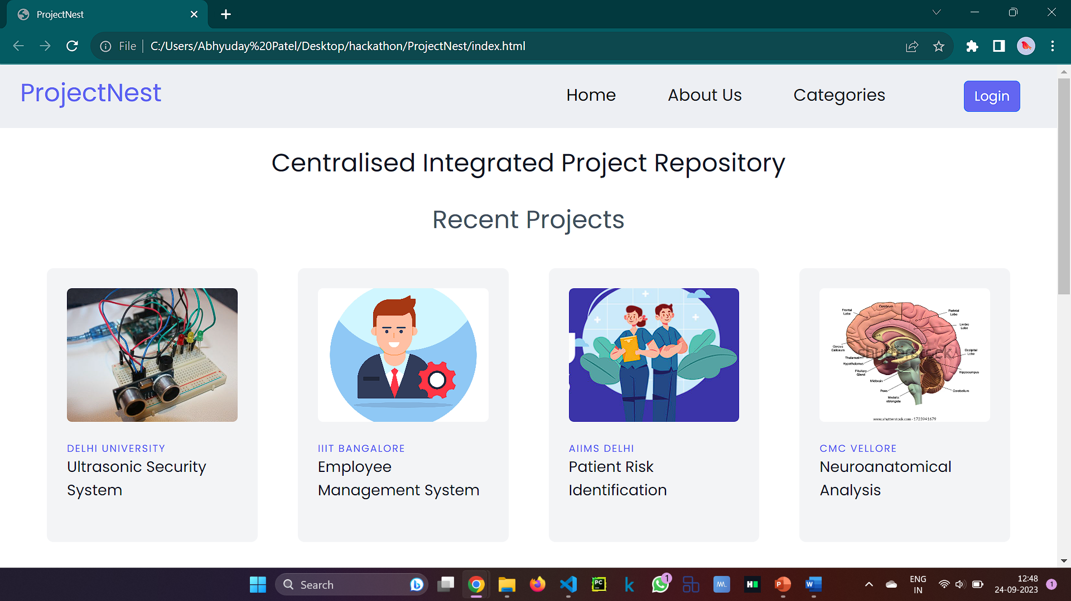
Idea/Approach Details
Describe your idea/Solution/Prototype here:
Our platform provides a centralized integrated repository, making this knowledge readily available to students, educators, and researchers. On our platform colleges will login and list the projects of their students and we will first check that the project is original through plagiarism software . we have different sections for what code used , components used , technology used , who have contributed and procedures , etc . on this basis we will generate a summary using chatgpt API and display each section with proper images . Anyone can access these projects ,they can read and download the data if needed and it will help in peer learning .
Describe your Technology stack here:
HTML
Tailwind Css
Bootstrap
Javascript
Django
SQLite
ChatGPT API
Plagarism Checker X

Slide 3
Idea/Approach Details
Describe your Use Cases here
Describe your Dependencies / Show stopper here
Resource can be tapped by industries, policymakers , and institutions for research and development purposes.
Helping in cross pollination of ideas among students and researchers.
Reducing duplication of ideas.
Helping in peer learning and research.
National level knowledge repository.
Plagarism Checker X
ChatGpt API

Slide 4
Team Member Details
Team Leader Name: Abhyuday Patel
Branch (Btech/Mtech/PhD etc): B.Tech Stream (ECE, CSE etc): ECE Year (I,II,III,IV): I
Team Member 1 Name: Suraj Bhan Rana
Branch (Btech/Mtech/PhD etc): B.Tech Stream (ECE, CSE etc): ECE Year (I,II,III,IV): I
Team Member 2 Name: Govind Mehta
Branch (Btech/Mtech/PhD etc): B.Tech Stream (ECE, CSE etc): ECE Year (I,II,III,IV): I
Team Member 3 Name: Pratik Chourasia
Branch (Btech/Mtech/PhD etc): B.Tech Stream (ECE, CSE etc): ECE Year (I,II,III,IV): I
Team Member 4 Name: Rituraj Singh
Branch (Btech/Mtech/PhD etc): B.Tech Stream (ECE, CSE etc): ECE Year (I,II,III,IV): I
Team Member 5 Name: Type Your Name Here
Branch (Btech/Mtech/PhD etc): B.Tech Stream (ECE, CSE etc): ECE Year (I,II,III,IV): I
Team Mentor 1 Name: Type Your Name Here
Category (Academic/Industry): Expertise (AI/ML/Blockchain etc): Domain Experience (in years):
Team Mentor 2 Name: Type Your Name Here
Category (Academic/Industry): Expertise (AI/ML/Blockchain etc): Domain Experience (in years):

Slide 5
Important Pointers
Please ensure below pointers are met while
Kindly keep the maximum slides limit to 4 pages
All the topics should be utilized for description of your idea
Try to avoid paragraphs and post your idea in points
Keep your explanation precisely and easy to understand
Idea should be unique and novel. If it has a business potential more weightage will be given.
Apart from this PPT abstract of your idea will be asked separately while submitting
You need to save the file in PDF and upload the same on portal. No PPT, Word Doc or any other format will be supported
You can delete this slide (Important Pointers) when you upload the details of your idea on SIH portal.

