Slide 1
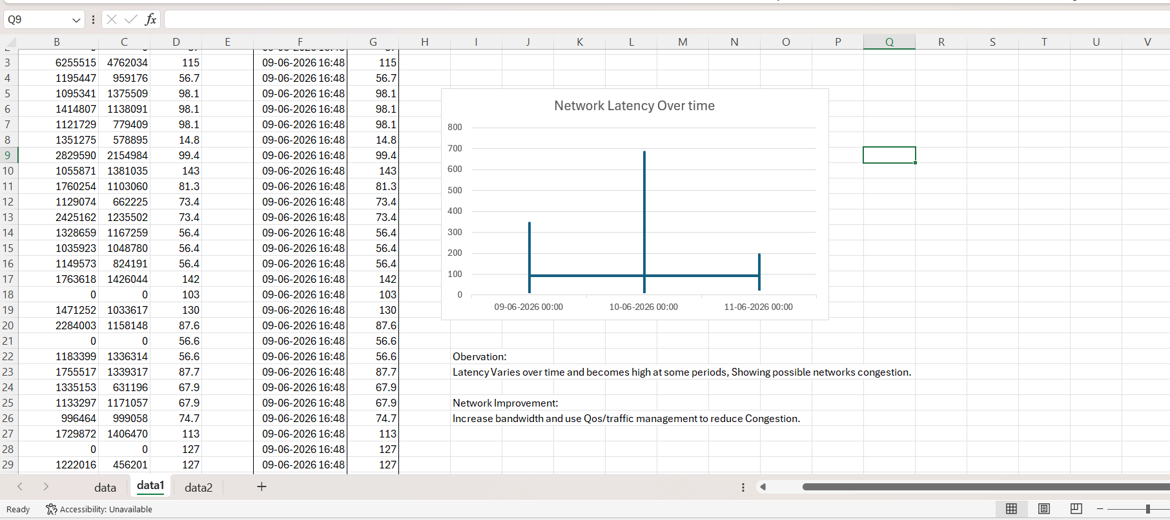
NETWORK TRAFFIC ANALYSIS
Industry Problem Solving Task
1. Network Quality Dataset

Slide 2
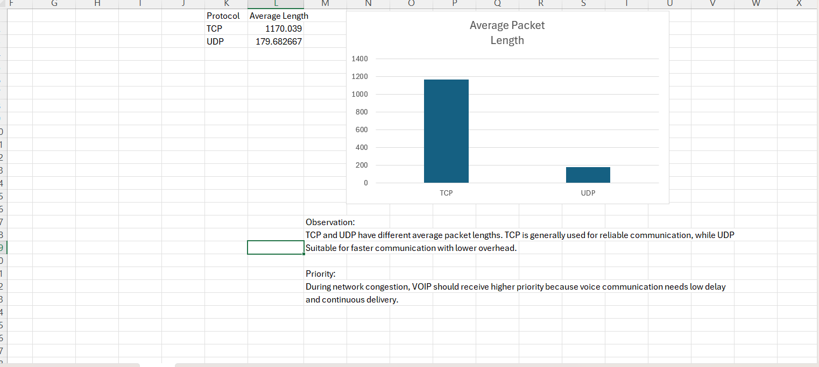
2. Network Traffic Dataset – Video Streaming vs VoIP

Slide 3
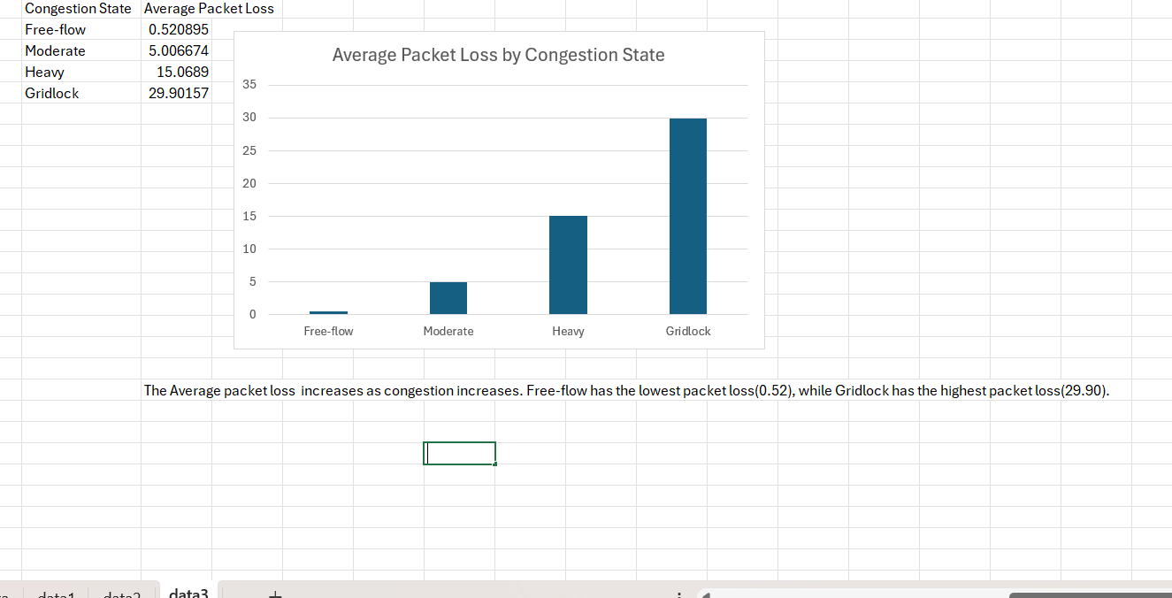
3. VANET Traffic Congestion Dataset

